Slide 1
Genome Evaluation and Annotation
JunLong Jiang
LMSE
Shanghai Ocean University
Jan 13 2022

Slide 2
Main content
1.Introduction of BUSCO and MAKER
2.Principle of BUSCO and MAKER
3.Data needed by BUSCO and MAKER
4.Pipeline of BUSCO and MAKER
5.Analysis Result

Slide 3
Two Evaluation indicators for Genome
Length
N50
Genome Structure
BUSCO Analysis

Slide 4
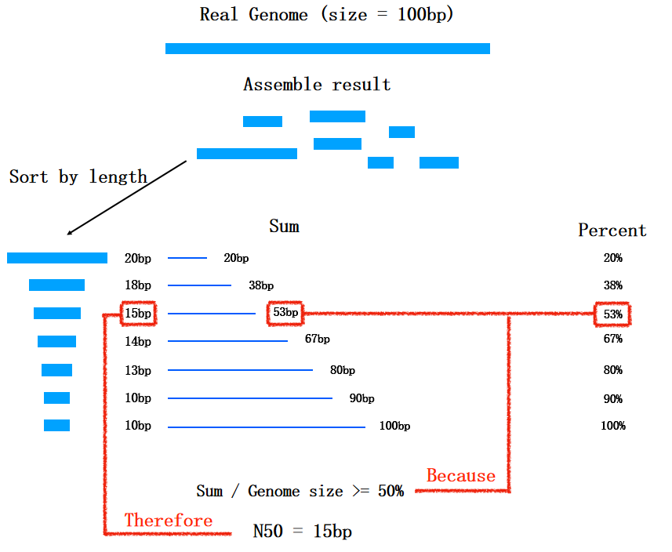
N50
1.Sort genomic sequences by length, from long to short
2.Start with the longest one and add the sequence lengths in order
3.When the sum of the lengths increases to 50% of the genome length, the length of the last sequence added is N50

Slide 5
1. Introduction of BUSCO and MAKER
1.1 BUSCO
Benchmarking Universal Single-Copy Orthologs, a tool used to assess the completeness of genomes, gene sets, and transcriptomes
1.2 MAKER
A portable and easily configurable genome annotation pipeline
Notes:
BUSCO 单拷贝直系同源校准

Slide 6
2.Principle of BUSCO and MAKER
HMM--Hidden Markov Model
Notes:
In this part, l wanna introduce you a concept at first -- what’s Hidden Markov Model ? This picture is a very simple example for us to understand what’s HMM. From the right , we can know S refers to Sunny; R means Rainy; H is happy; G means grumpy. And there is a Markov chain from start to H/G. In this process, a probaility will be generated. Just like first chain, Sunny is twenty percent and H is eighty percent; we can calculate that there is sixteen precent if the Sunny and Happy occurs together. So even if we don’t know what weather is today. From the mood of one person, we still can infer the weather of today. That’s all. This is an easy example and next let us see the HMM in DNA sequence.

Slide 7
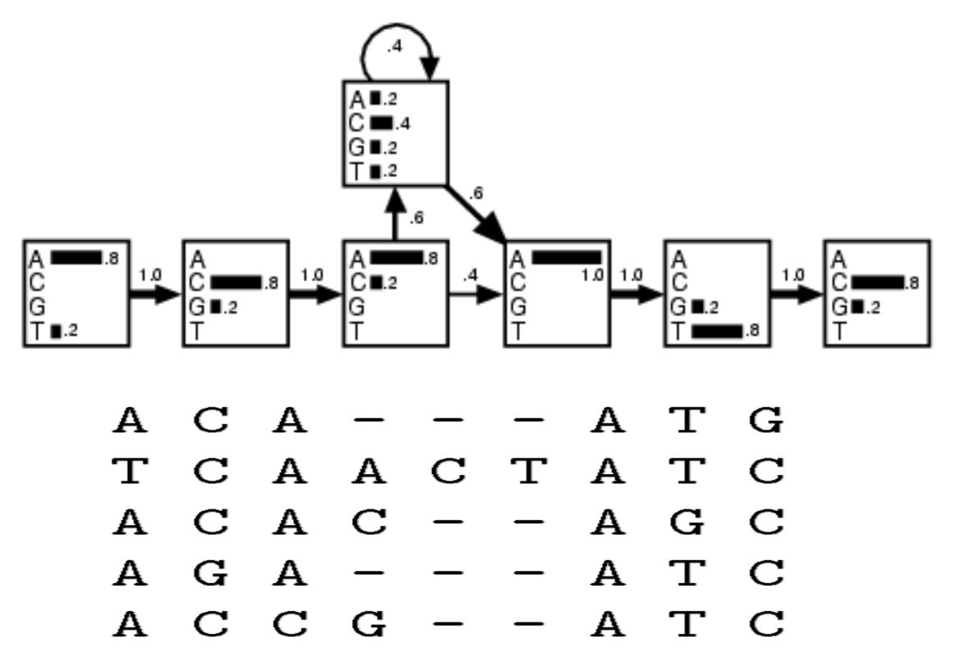
HMM of DNA sequence
Notes:
This picture shows the HMM of DNA sequence. Much probability build a model and from this model we can get one most reasonable sequence. With this sequence, we can match the location of one gene in the whole genome., thus help us know the genome structure.

Slide 8
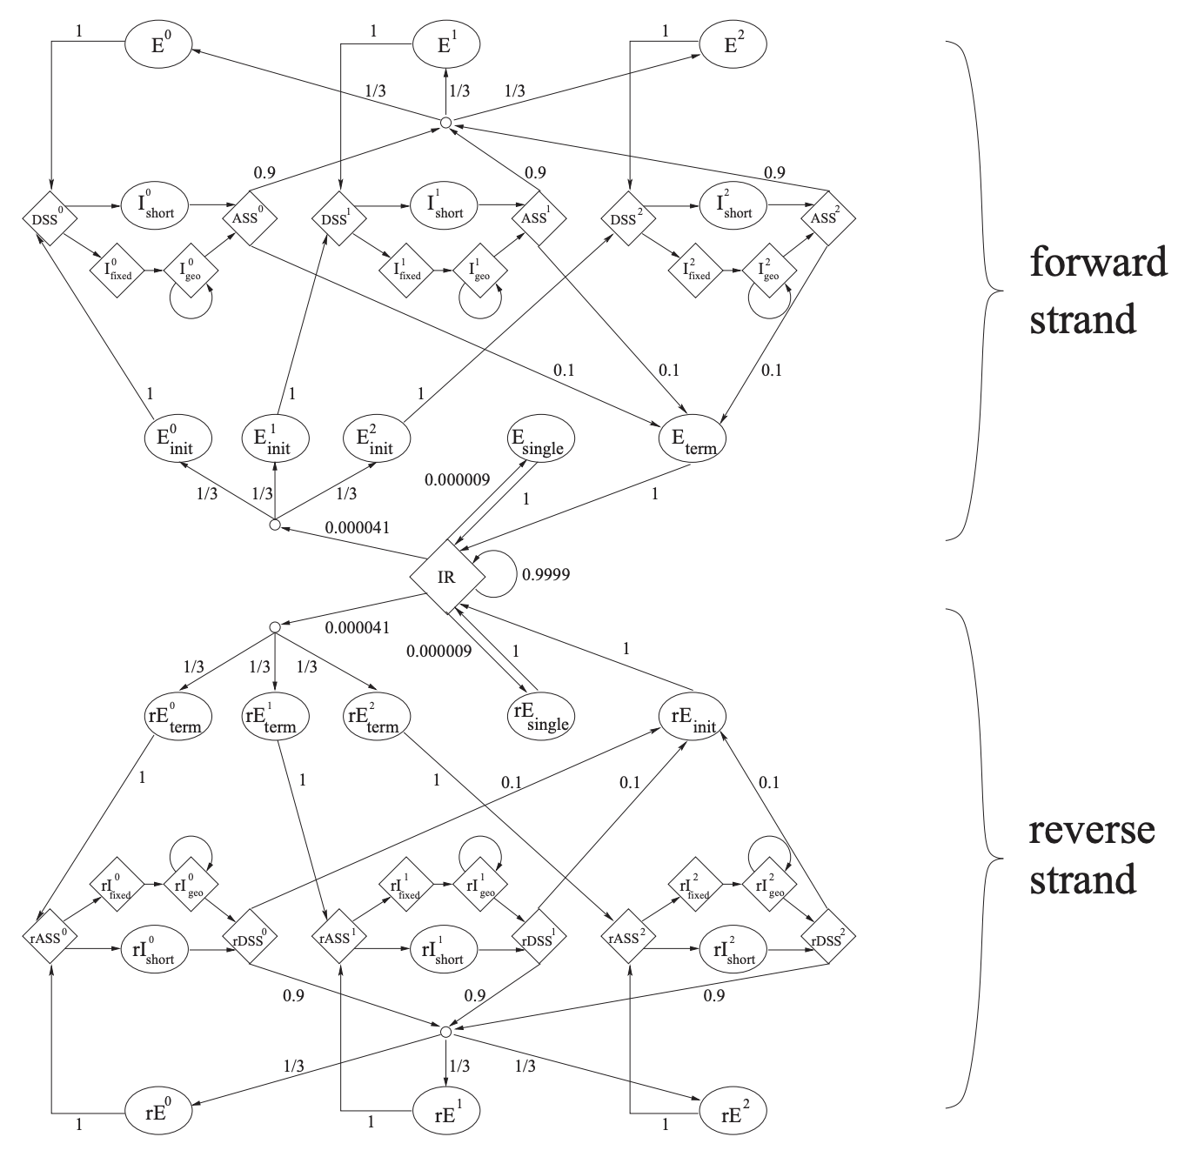
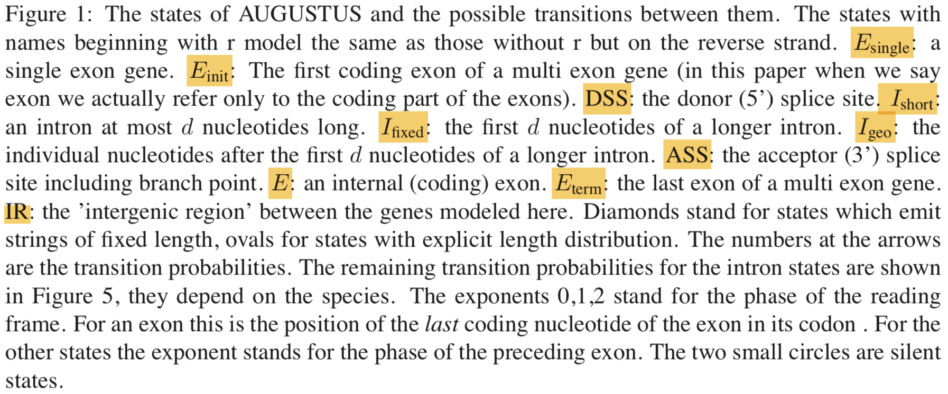
Hidden Markov Model of Gene Structure
Training Database
Homology genes
Gene from Transcriptome
Results of the last run
Notes:
The picture shows the Hidden Markov Model of gene structure. Augustus and Snap Model are both based on this logic. And it involves two layers. The Model first will cnstruct a reasonable sequence. And then the model will help us find the location of one gene in genome.

Slide 9
2.1 Principle of BUSCO
Notes:
Next is about the principle of BUSCO. In here, l will mainly tell you the criteria of the database OthoDB used by BUSCO. There are two indicators-- high universality and low duplicability. This ensure that they are enough conserved for our analysis.

Slide 11
2.2 Principle of MAKER

Slide 12
3.Data we need for BUSCO and MAKER
3.1 BUSCO
Assembled genome data
Related species' dataset from OrthoDB (https://www.orthodb.org/)
3.2 MAKER
Adjacent species' protein dataset from NCBI or Ensembl database (www.ensembl.org/)
Repeat sequence dataset from Repeat Modeler
Transcriptome data from Trinity and CD-Hit

Slide 13
4.1 Pipeline of BUSCO
$ BUSCO -i /path/to/sequence.fasta\
-o /path/to/output\
-l /path/to/OrthoDB_database\
-m genome\
-c 10\
-sp zebrafish

Slide 14
4.2 Pipeline of MAKER
4.2.1 Construction of repeat sequence database
# Build index
$ BuildDatabase -name db_name -engine ncbi genomic.fa
# Run RepeatModeler
$ RepeatModeler -pa 4 -database db_name -engine ncbi
# Filter repeat sequence database
$ makeblastdb -dbtype prot -in protein.fasta -out protein_db
$ blastx -query consensi.fa.classified -db protein_db -outfmt 6 -evalue 1e-5 -num_threads 20 -out\ prot.blast
$ python /mnt/genome1/Lab_Users/LL/tools/genome/annotools/Del_seq_in_blast.py -q consensi.fa.classified\ -blast prot.blast -l 30 -o denovo_repDB

Slide 15
4.2.2 Construction of transcriptome database
# Build index and run Blast
$ bwa index genome.fa
$ bwa mem -t 15 genome.fa sample1_R1.fq sample1_R2.fq | samtools sort -@ 10 -m 4G -O bam -o\
sample1.sorted.bam
# Assemble the transcriptome with Trinity
$ Trinity --genome_guided_bam sample1.sorted.bam --max_memory 50G --genome_guided_max_intron\ 10000 --CPU 6
# Remove the redundancy with CD-Hit
$ cd-hit-est -i all_trinity.fasta -o all_trinity_95.fasta -c 0.95 -n 10 -d 0 -M 32000 -T 20

Slide 16
4.2.3 MAKER RUN 1
(1). Create and Edit Configuration File
# Activate environment
$ conda activate MAKER_env
$ mkdir maker_run1 && cd maker_run1
# Create configuration file
$ /home/software/maker/maker-3/bin/maker -CTL
# Open and edit configuration file with Notepad++

Slide 17
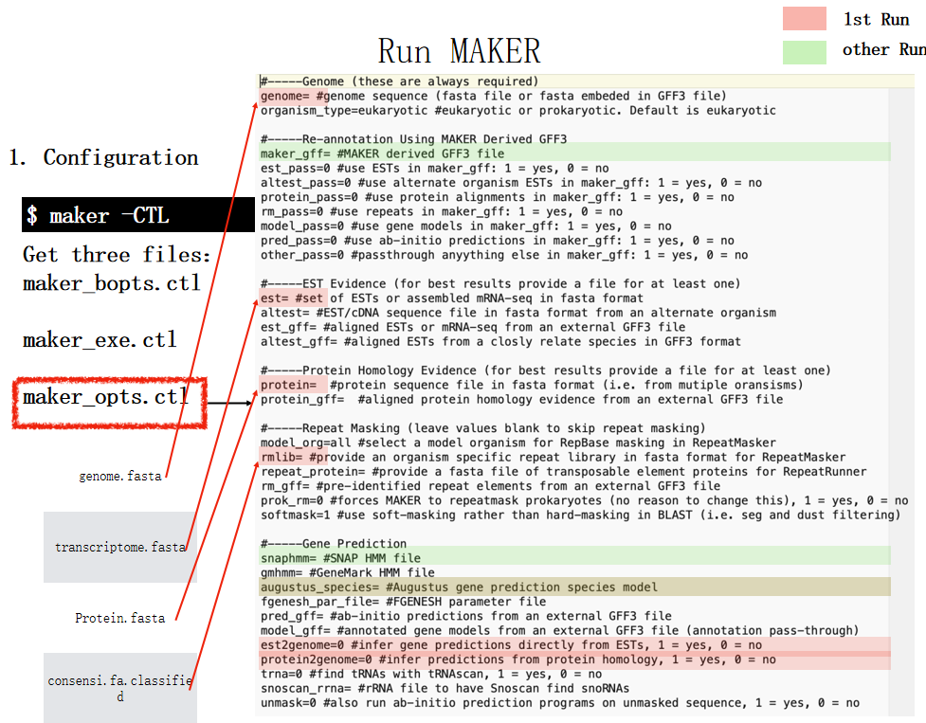
Edit Configuration File

Slide 18
(2). Run First Round MAKER
$ nohup mpiexec -n 20 /home/software/maker/maker-3/bin/maker > maker.log 2>&1 &
(3). Result Integration
$ cd maker_run1/*.maker.output
$ fasta_merge -d *_master_datastore_index.log
$ gff3_merge -d *_master_datastore_index.log
# There will be much .gff/.fasta file in your folder. They are the final result of your first round Maker.

Slide 19
4.2.4 MAKER RUN 2
(1). Training Augustus Model
$ mkdir maker_run2 && cd maker_run2
$ mkdir augustus && cd augustus
$ samtools faidx genome.fa
$ awk -v OFS="\t" '{ if ($3 == "mRNA") print $1, $4, $5 }' *.all.gff | awk -v OFS="\t" '{ if ($2 < \
1000) print $1, "0", $3+1000; else print $1, $2-1000, $3+1000 }' | bedtools getfasta -fi genome.fa -bed -\ -fo *_augustus_trainingData.fa
$ export BUSCO_CONFIG_FILE=/home/room/users/zhoutao/busco4.1.4/config/myconfig.ini
$ export AUGUSTUS_CONFIG_PATH=/home/room/users/zhoutao/conda/envs/busco_env/config
$ nohup busco -i *_augustus_trainingData.fa -o * -l /home/software/vertebrata_odb10/ -m genome -c\
20 --long --augustus_species zebrafish --augustus_parameters='--progress=true' &>\ busco.ctl &
$ cp -r */run_/augustus_output/retraining_parameters/BUSCO_*$AUGUSTUS_CONFIG_PATH/species

Slide 20
(2). Training SNAP Model
$ mkdir snap && cd snap
$ maker2zff -c 0.8 -e 0.8 -o 0.8 -x 0.2 *.all.gff
$ *.all.gff is the result of first round MAKER
$ fathom -categorize 1000 genome.ann genome.dna
$ fathom -export 1000 -plus uni.ann uni.dna
$ mkdir params && cd params
$ forge ../export.ann ../export.dna
$ cd ../
$ hmm-assembler.pl genome params > genome.hmm

Slide 21
(3). Edit Configuration File
$ cp maker_run1/*.ctl maker_run2
# Edit configuration file
(4). Run Second Round MAKER
$ nohup mpiexec -n 20 /home/software/maker/maker-3/bin/maker > maker.log 2>&1
(5). Result Integration
$ cd maker_run2/*.maker.output
$ fasta_merge -d *_master_datastore_index.log
$ gff3_merge -d *_master_datastore_index.log

Slide 22
4.2.5 MAKER RUN 3
(1). Edit Configuration File
$ mkdir maker_run3 && cd maker_run3
$ cp maker_run2/*.ctl maker_run3
# Edit configuration file
(2). Run Third Round MAKER
$ nohup mpiexec -n 20 /home/software/maker/maker-3/bin/maker > maker.log 2>&1 &
(3). Result Integration
$ cd maker_run3/*.maker.output
$ fasta_merge -d *_master_datastore_index.log
$ gff3_merge -d *_master_datastore_index.log

Slide 23
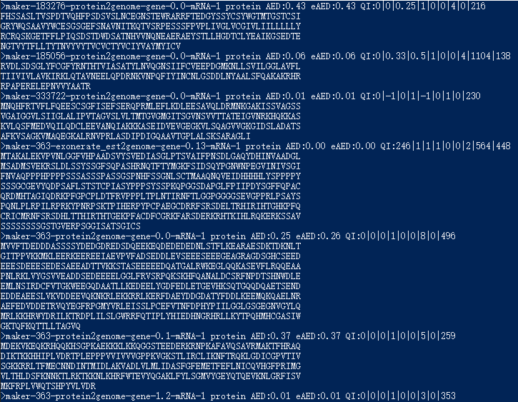
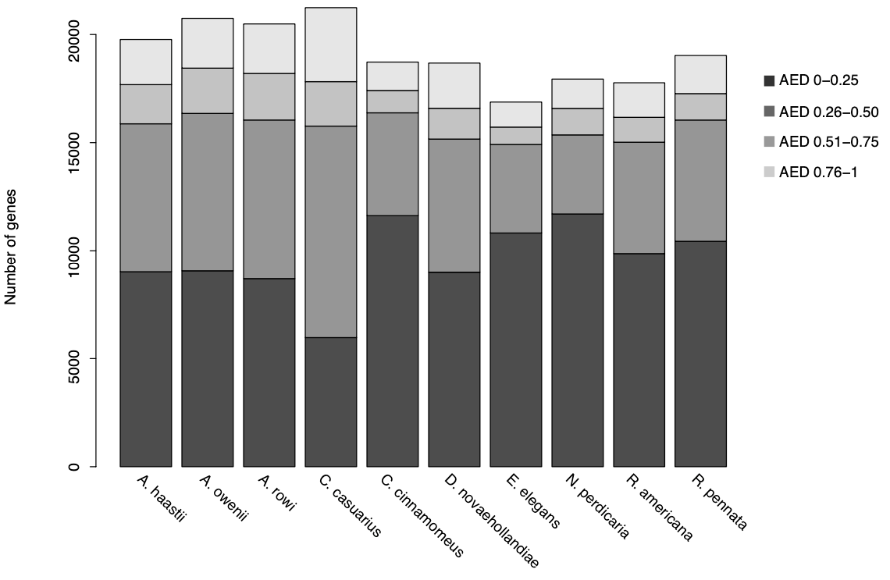
4.2.6 Result Filtration
Select genes with AED<0.5
Notes:
This is the interface of fasta files.

Slide 24
4.2.7 InterProScan
$ interproscan.sh -i seq_proteins.fa -iprlookup -goterms -cpu 20 -t p -f tsv

Slide 25
5.1 Analysis result of BUSCO

Slide 26
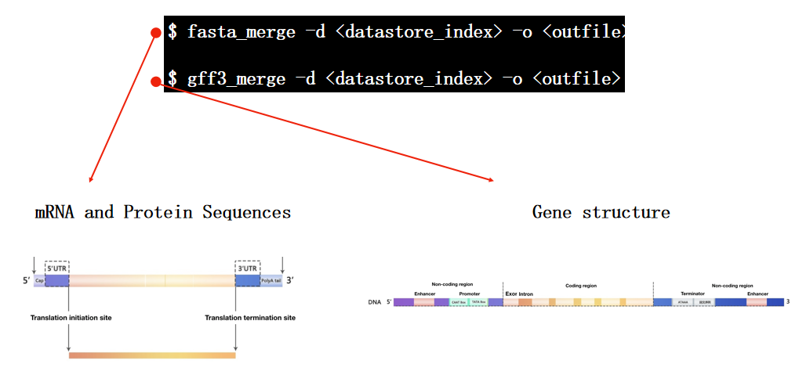
5.2 Analysis result of MAKER

Slide 27
SOURCE
TYPE
START
END
POSITIVE/NEGATIVE STRAND

Slide 28
Thanks.

