Slide 1
Assembly of NGS
Jiantao Hu

Slide 2
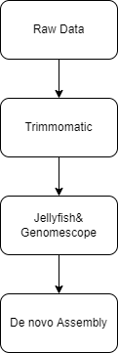
Data Filtration
(or mapping)

Slide 3
Data Filtration

Slide 4
Trimmomatic
A flexible read trimming tool for Illumina NGS data
To remove the adaptor or control the quality of reads
works with either uncompressed or gzipp'ed FASTQ. Use of gzip format is determined based on the .gz extension.
single-ended data, one input and one output file are specified, plus the processing steps.
Paired-end data, two input files are specified, and 4 output files, 2 for the 'paired' output where both reads survived the processing, and 2 for corresponding 'unpaired' output where a read survived, but the partner read did not.

Slide 5
The current trimming steps are:
ILLUMINACLIP: Cut adapter and other illumina-specific sequences from the read.
SLIDINGWINDOW: Perform a sliding window trimming, cutting once the average quality within the window falls below a threshold.
LEADING: Cut bases off the start of a read, if below a threshold quality
TRAILING: Cut bases off the end of a read, if below a threshold quality
CROP: Cut the read to a specified length
HEADCROP: Cut the specified number of bases from the start of the read
MINLEN: Drop the read if it is below a specified length
TOPHRED33: Convert quality scores to Phred-33
TOPHRED64: Convert quality scores to Phred-64
#trimmomatic SE -phred33 input.fq.gz output.fq.gz ILLUMINACLIP:TruSeq3-SE:2:30:10 LEADING:3 TRAILING:3 SLIDINGWINDOW:4:15 MINLEN:36
#trimmomatic PE input_forward.fq input_reverse.fq
output_forward_paired.fq.gz output_forward_unpaired.fq.gz output_reverse_paired.fq.gz output_reverse_unpaired.fq.gz ILLUMINACLIP:TruSeq3 -PE.fa:2:30:10 LEADING:3 TRAILING:3 SLIDINGWINDOW:4:15 MINLEN:36

Slide 6
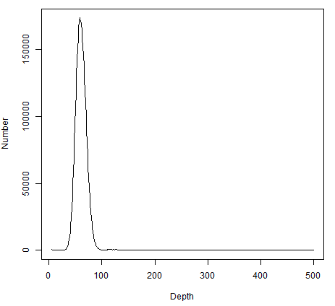
Jellyfish & Genomescope
A tool for fast, memory-efficient counting of k-mers in DNA.
A k-mer is a substring of length k, and counting the occurrences of all such substrings is a central step in many analyses of DNA sequence.
FASTA and multi-FASTA files containing DNA sequences
GenomeScope can infer the global properties of a genome from unassembled sequenced data. GenomeScope uses the k-mer count distribution from Jellyfish.

Slide 7
Why?
One of the first goals when sequencing a new species is determining the overall characteristics of the genome structure, including the genome size, abundance of repetitive elements, and the rate of heterozygosity. These features are needed to study trends in genome evolution, and can inform the parameters that should be used for the individual assembly steps. They can also serve as an independent quality control during any analysis, such as quantifying the quality of an assembly, or measuring the expected number of heterozygous bases in the genome before mapping any variants.

Slide 8
#jellyfish count -m 21 -s 20G -t 20 -o 21mer_out -C <(filename_1.fq.gz) <(filename_2.fq.gz)
#jellyfish histo -o 21mer_out.histo 21mer_out
#genomescope.R –i filename.hist -o output_p3 -k 21 -p 3 -n 21.p3

Slide 9
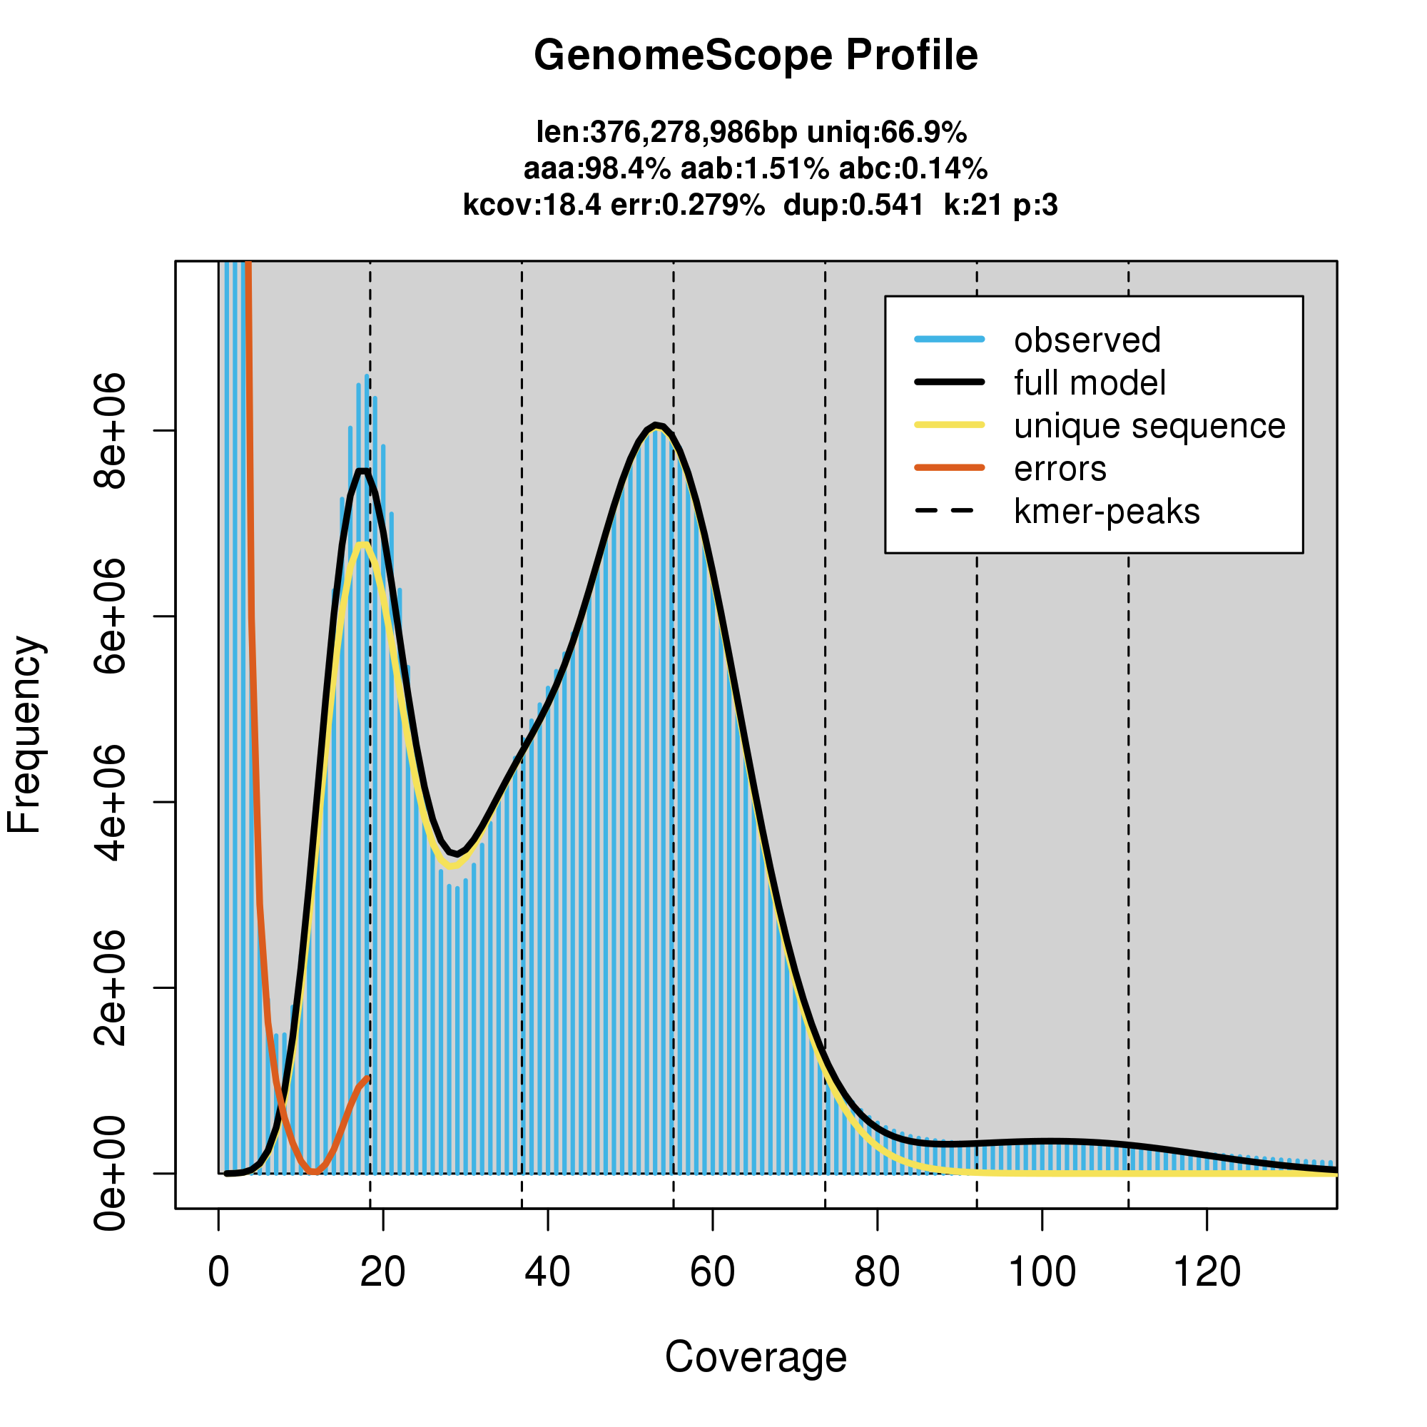
Notes:
蓝色柱子是实际观测值； 黑色拟合线是除去被认为是错误的部分（橙红色拟合线部分）之后剩下的所有k-mer，这些被认为是可靠的kmer数据，只拿这部分数据来评估基因组的大小； 黄色拟合线被认为来自基因组非重复区域的K-mer分布； 橙红色拟合线部分对应着深度过低的kmer，这些kmer被认为是测序错误引入的； 垂直的黑色虚线为预测最低深度峰的整倍数覆盖度；
杂合度

Slide 10
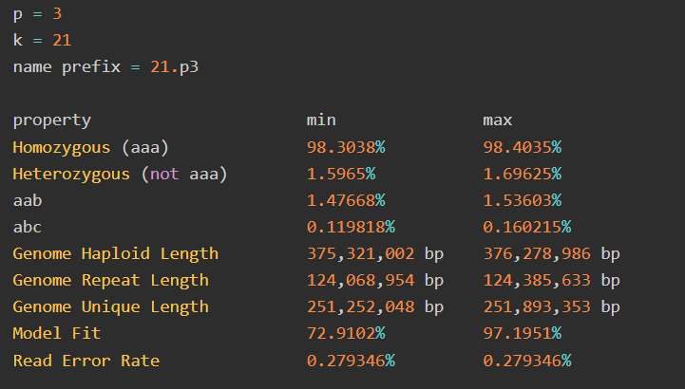

Slide 11
Assembly of NGS sequencing data
De novo assembly

Slide 12
de Bruijn graph (Basic method)
First step, the sequence reads are fragmented into smaller pieces called k-mers.
Sequence read
AGCTGTAAGACTGTC
AGCTGTA
GCTGTAA
CTGTAAG
TGTAAGA
GTAAGAC
TAAGACT
AAGACTG
AGACTGT
GACTGTC
k-mers
k=7

Slide 13
De Bruijn Graph
>seq1
TTCTAAGT
>seq2
CGATTCTA
CGA
GAT
ATT
TTC
TCT
CTA
TAA
AAG
AGT
Notes:
each node is a K-mer. Two nodes that overlap K - 1 bp and appeared in a neighboring read sequence were connected as an edge. Small K-mers make the graph very complex with a lot of edges created by repeat sequences; while large K-mers can have poor overlap in regions with low sequencing depth.

Slide 14
De Bruijn Graph
>seq1
TTCTAAGT
>seq2
CGATTCTA
>seq3
CGATTGTAAGT
CGA
GAT
ATT
TTC
TCT
CTA
TAA
AAG
AGT
CGA
GAT
ATT
AAG
AGT
TTG
TGT
GTA

Slide 15
>seq1
TTCTAAGT
>seq2
CGATTCTA
De Bruijn Graph
>seq3
CGATTGTAAGT
CGA
GAT
ATT
TTC
TCT
CTA
TAA
AAG
AGT
TTG
TGT
GTA

Slide 16
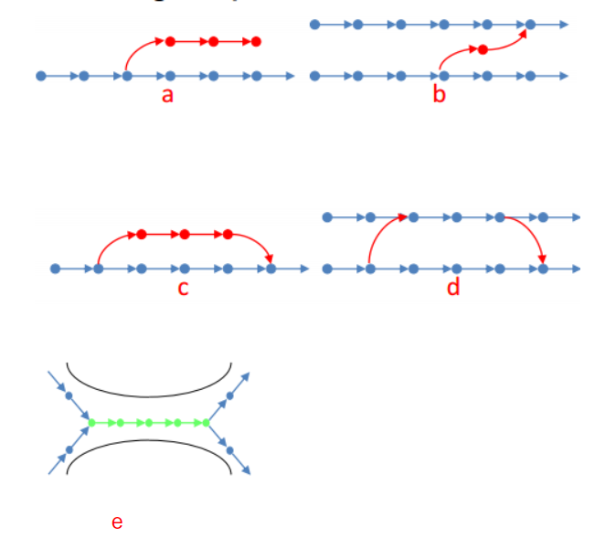
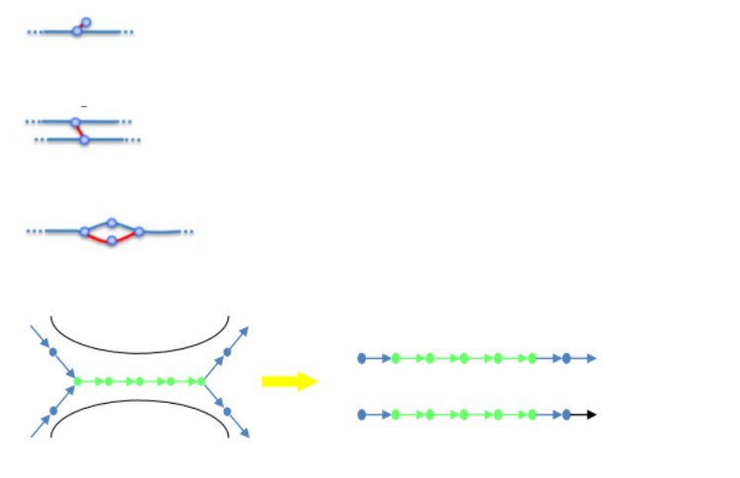
tip
low coverage links
bubble
error/delete
tiny repeat
bubble/merge

Slide 17
In Real Case

Slide 18
SOAP(Short Oligonucleotide Alignment Program)denovo
SOAPdenovo-SOAPdenovo is a novel short-read assembly method that can build a de novo draft assembly for human-sized genomes. The program is specially designed to assemble illumina short reads. It creates new opportunities for building reference sequences and carrying out accurate analyses of unexplored genomes in a cost effective way.
Download Link: http://soap.genomics.org.cn/soapdenovo.html

Slide 19
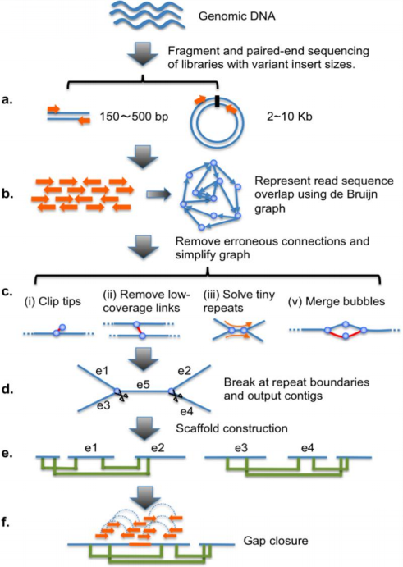
De Bruijn graph construction
the 25-mer provided the best tradeoff
Tip removal
Solving tiny repeats
Merging bubbles
Notes:
Schematic overview of the assembly algorithm. (A) Genomic DNA was fragmented randomly and sequenced using paired-end technology. Short clones with sizes between 150 and 500 bp were amplified and sequenced directly; while long range (2–10 kb) paired-end libraries were constructed by circularizing DNA, fragmentation, and then purifying fragments with sizes in the range of 400–600 bp for cluster formation. (B) The raw or precorrected reads were then loaded into computer memory and de Bruijn graph data structure was used to represent the overlap among the reads. (C ) The graph was simplified by removing erroneous connections (in red color on the graph) and solving tiny repeats by read path: (i) Clipping the short tips, (ii) removing low-coverage links, (iii) solving tiny repeats by read path, and (iv) merging the bubbles that were caused by repeats or heterozygotes of diploid chromosomes. (D) On the simplified graph, we broke the connections at repeat boundaries and output the unambiguous sequence fragments as contigs. (E ) We realigned the reads onto the contigs and used the paired-end information to join the unique contigs into scaffolds. (F ) Finally, we filled in the intrascaffold gaps, which were most likely comprised by repeats, using the paired-end extracted reads.

Slide 20
Contig linkage graph
Used the number of read pairs between two contigs to weight the linkage, and used the read paired-end insert sizes to estimate the gap size between the two contigs.
Scaffolding
1.subgraph linearization: The compatible transitive lineages among a group of contigs were removed and the contigs were merged into one node with carefully estimated internal gap sizes.
2.repeat masking: If a contig has multiple incoming and outgoing linkages to the other contigs, but the linkages are not compatible, this contig is a repeat. The repeat contigs, together with their linkages, were masked during scaffolding.
Notes:
Since we have multiple paired-end read sets with different insert sizes, and clone physical coverage for each insert-sized read set is very deep and sufficient for reliable scaffold construction, constructed scaffolds starting with short paired-ends and then iterated the scaffolding process, step by step, using longer insert size paired-ends.

Slide 21
how to use it
Once the configuration file is available, a typical way to run the assembler is:
User can also choose to run the assembly process step by step as:
#./soapdenovo all -s config_file -K 25 -R -o graph_prefix
#./soapdenovo pregraph -s config_file -K 25 [-R -d -p] -o graph_prefix #./soapdenovo contig -g graph_prefix [-R -M 1 -D] #./soapdenovo map -s config_file -g graph_prefix [-p] #./soapdenovo scaff -g graph_prefix [-F -u -G -p]

Slide 22
Supernova
Supernova is a software package for de novo assembly from Chromium Linked-Reads that are made from a single whole-genome library from an individual DNA source. A key feature of Supernova is that it creates diploid assemblies, thus separately representing maternal and paternal chromosomes over very long distances. Almost all other methods instead merge homologous chromosomes into single incorrect 'consensus' sequences. Supernova is the only practical method for creating diploid assemblies of large genomes.
Use 10X genomics sequence
Information Link: https://omictools.com/supernova-tool
https://support.10xgenomics.com/de-novo-assembly/software/overview

Slide 23
supernova run
takes FASTQ files containing barcoded reads from supernova mkfastq and builds a graph-based assembly. The approach is to first build an assembly using read kmers (K = 48), then resolve this assembly using read pairs (to K = 200), then use barcodes to effectively resolve this assembly to K ≈ 100,000. The final step pulls apart homologous chromosomes into phase blocks, which are often several megabases in length.
supernova mkoutput
takes Supernova's graph-based assemblies and produces several styles of FASTA suitable for downstream processing and analysis.

Slide 24
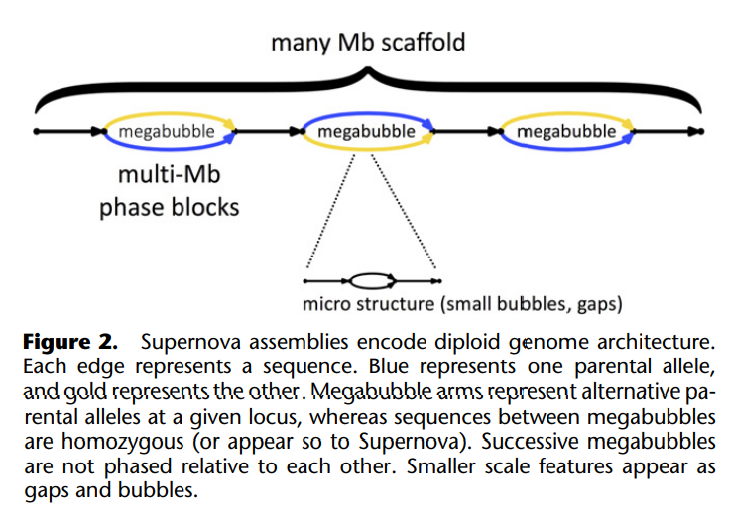
A Supernova assembly can separate homologous chromosomes over long distances, in this sense capturing the true biology of a diploid genome
Notes:
These separated alleles (or phase blocks) are represented as “megabubbles” in the assembly, with each branch representing one parental allele. Sequences between megabubbles are nominally homozygous. Successive megabubbles are not phased relative to each other (if they were, they would have been combined). A chain of megabubbles as shown comprise a scaffold. In addition to large-scale features, the Supernova graph encodes smaller features such as gaps and bubbles at long homopolymers, whose lengths are not fully determined by the data

Slide 25
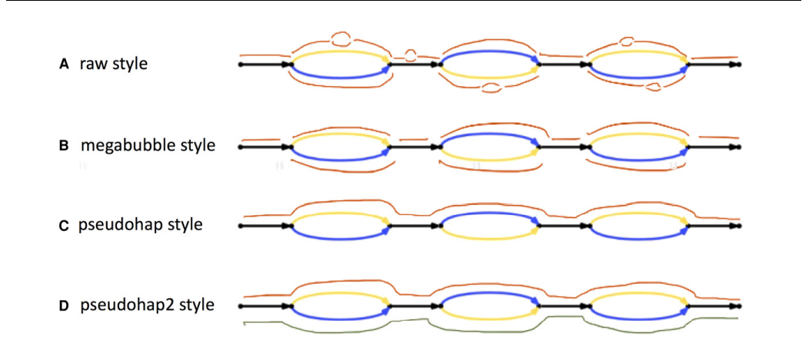
Representation of Supernova assemblies as FASTA. Several styles are depicted.
Notes:
A Supernova assembly can be translated into FASTA in several distinct ways that might prove useful for different applications (Fig. 3). These allow representation of the full (or “raw”) graph (Fig. 3A), or erase microfeatures (choosing the most likely branch at small bubbles and replacing gap edges by Ns). There is more than one way to package the result, depending on how megabubble branch points are handled (Fig. 3B–D). We note that erasing microfeatures entails some loss of information, as in some cases the wrong branch of a bubble is chosen.

Slide 26
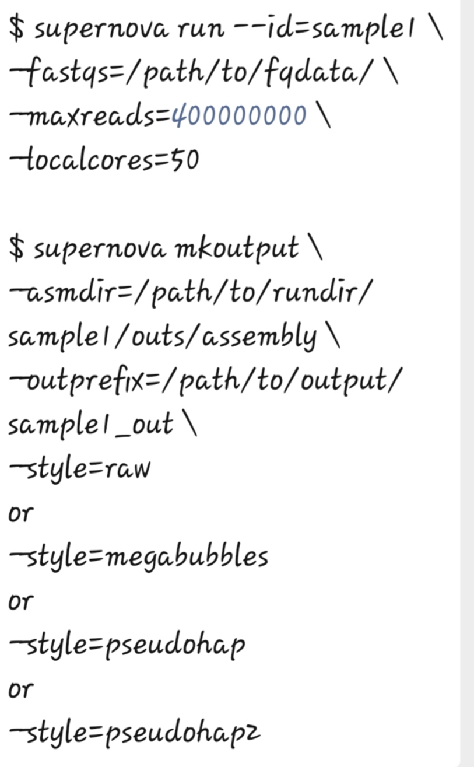
Basic Command Line
#supernova run –filename.fastq -maxreaads=40000000 -localcores=50
#supernova mkoutput -asmdir=assembly -outprefix= sample_out
-style=raw
or
-style=megabubble
or
-style=pesudohap
or
-style=pesudohap2

Slide 27
THANKS

