Slide 1
Detection of Structural Variation
Syri
delly
Workshop2026
Lab of Molecular Systematics and Ecology
College of Fisheries and Life Science
Dipak Rajbanshi

Slide 2
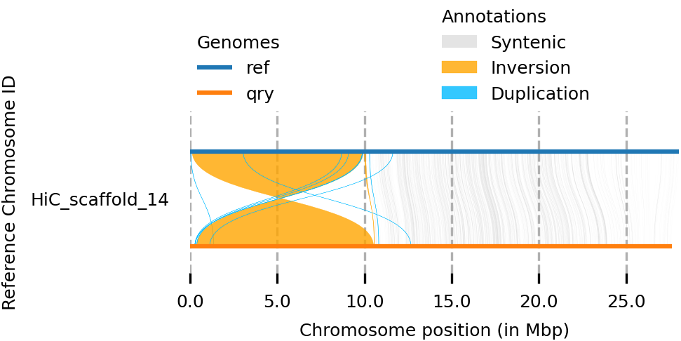
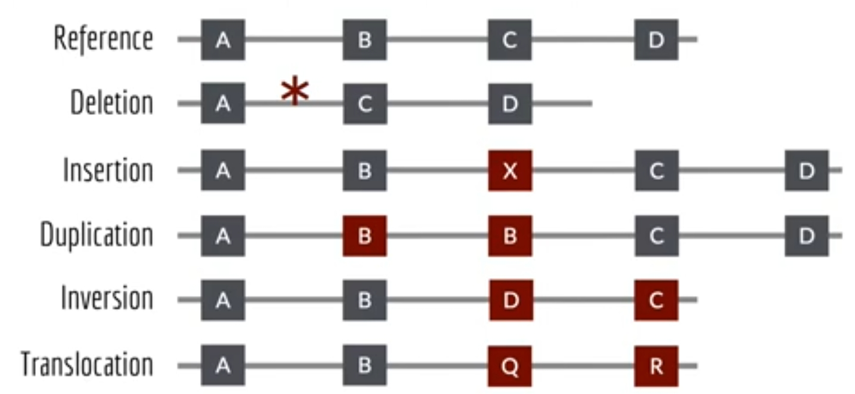
Structural variants (SVs) are large rearrangements (>50 bp) within the genome that impact gene function and the content and structure of chromosomes.

Slide 3
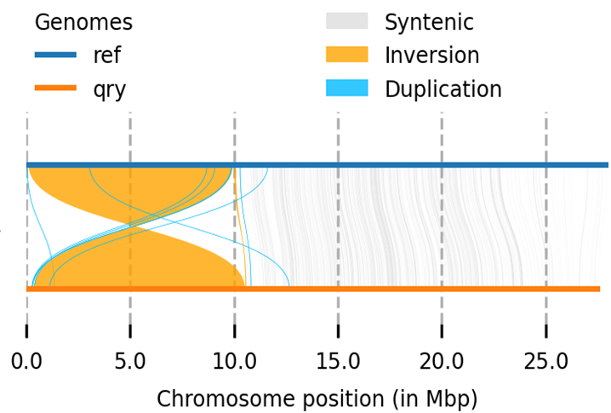
Using Syri to detect SV
Using minimap2 for generating alignment
minimap2 -ax asm5 --eqx refgenome qrygenome -o out.sam
Using MUMmer for generating alignment
nucmer --maxmatch -c 100 -b 500 -l 50 refgenome qrygenome
delta-filter -m -i 90 -l 100 out.delta > out.filtered.delta
show-coords -THrd out.filtered.delta > out.filtered.coords
out.delta
Run Syri
Syri -c out.sam -r refgenome -q qrygenome -k -F S
Syri -c out.filtered.coords -d out.filtered.delta -r refgenome -q qrygenome
Syri.out
Generate plot
plotsr --sr syri.out --genomes genome.tsv -o plot.png

Slide 4
Using delly for detecting SV
Index the Genome
bwa index genome.fasta
Now run delly
delly call -g genome.fasta -o out.bcf sorted.bam
Reads Alignment
Bwa mem -t 25 genome.fasta r1.fq r2.fq -o aling.sam
Convert bcf to vcf
bcftools view out.vcf > out.vcf
Remove duplicates
Samblaster -r -i aling.sam -o dup.sam
Visualize using IGV
Convert sort and index the bam file
samtools view -bS -o dup.bam dup.sam
samtools sort dup.bam -o sorted.bam
samtools index sorted.bam

Slide 5
Thank you

