Slide 1
Detection of Selective Signal in Populations
LMSE
Workshop2026
Lu liang
2026.1.16

Slide 2
Core Signal Types
Abnormal Population Differentiation (High Fst):
  A beneficial mutation rises rapidly in frequency in a specific population, increasing genetic divergence (Fst) between populations.
  Detecting local adaptation.
Distorted Allele Frequency Spectrum (Low Tajima's D):
  A beneficial mutation "drags" linked regions to fixation, removing local variants and reducing diversity.
  Detecting recent, strong positive selection.
Abnormal Haplotype Length (High iHS or REHH):
  Selected regions harbor unusually long, high-frequency haplotypes not yet broken by recombination.
  Detecting ongoing or recently completed selection.

Slide 3
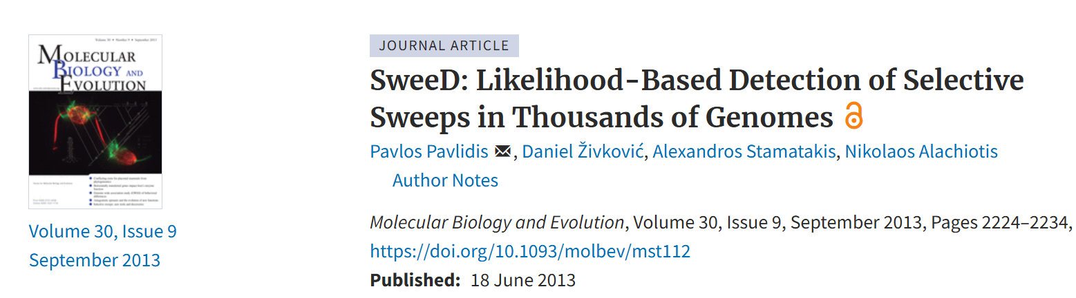
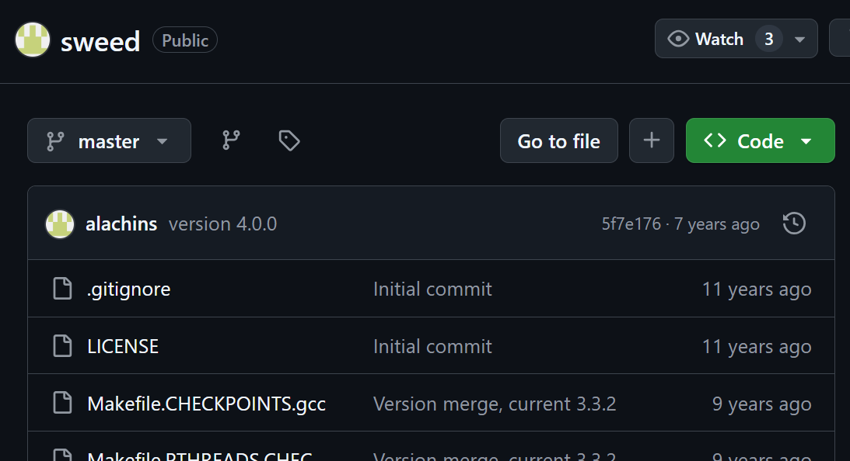

Slide 4
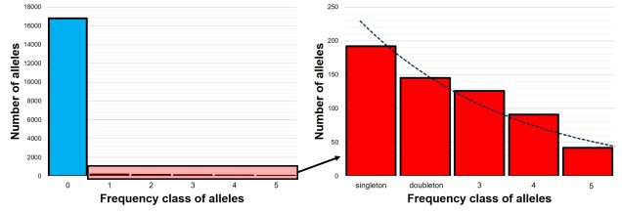
CLR base on SFS(Site/Allel Frequency Spectrum)

Slide 5
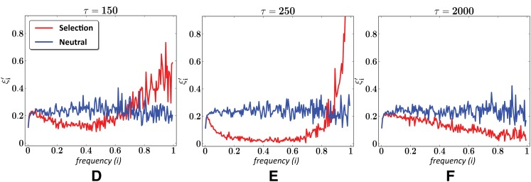
SFS and Generations(τ)
Not surprisingly, selective sweeps have a dramatic effect on the scaled SFS. Near the point of fixation, the scaled SFS is characterized by an abundance of very high-frequency alleles and a near absence of intermediate frequency alleles (Figure E). Importantly, the scaled SFS of regions evolving under selective sweeps differs even in the prefixation and postfixation regimes from that of regions evolving neutrally (Figure D and F). (Roy Ronen et. al. 2013)

Slide 6
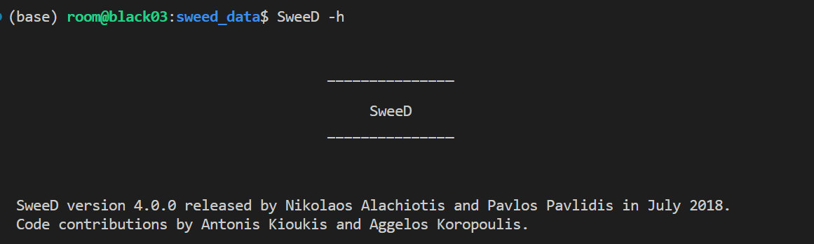
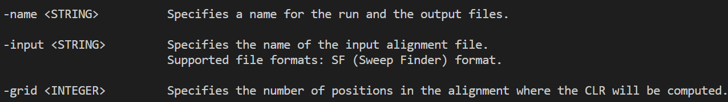
Usage

Slide 7
Usage
Input data -> .vcf file
Extract single chromosome vcf file
$ vcftools --vcf test.vcf --recode --recode-INFO-all --stdout --chr chr1 > chr1.vcf
Calculate SweeD windows (10kb)
$ grep chr1 chr1.vcf
##contig=<ID=chr1,length=31077448>
-grid = 31077448 / 10000 = 3107

Slide 8
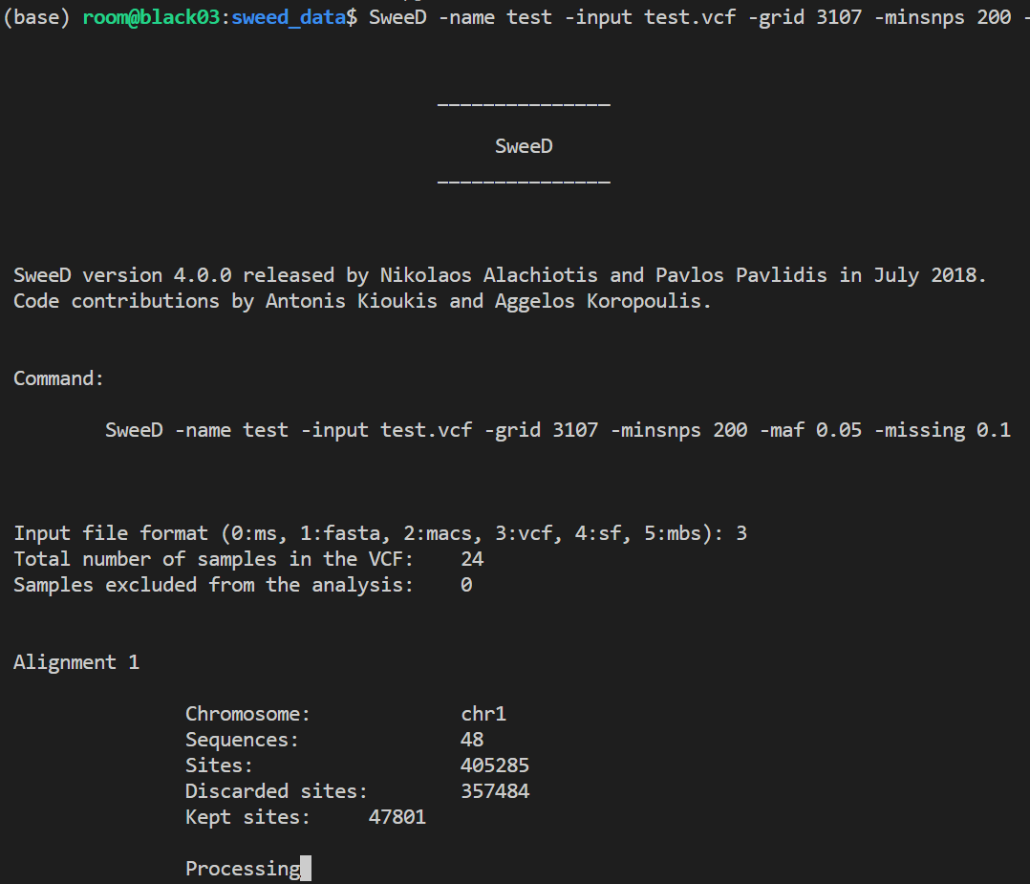
Usage
Run SweeD
$ SweeD -name pop1.chr1.10kb \
-input test_old.vcf \
-grid 3107 \
-minsnps 200 \
-maf 0.05 \
-missing 0.1

Slide 9
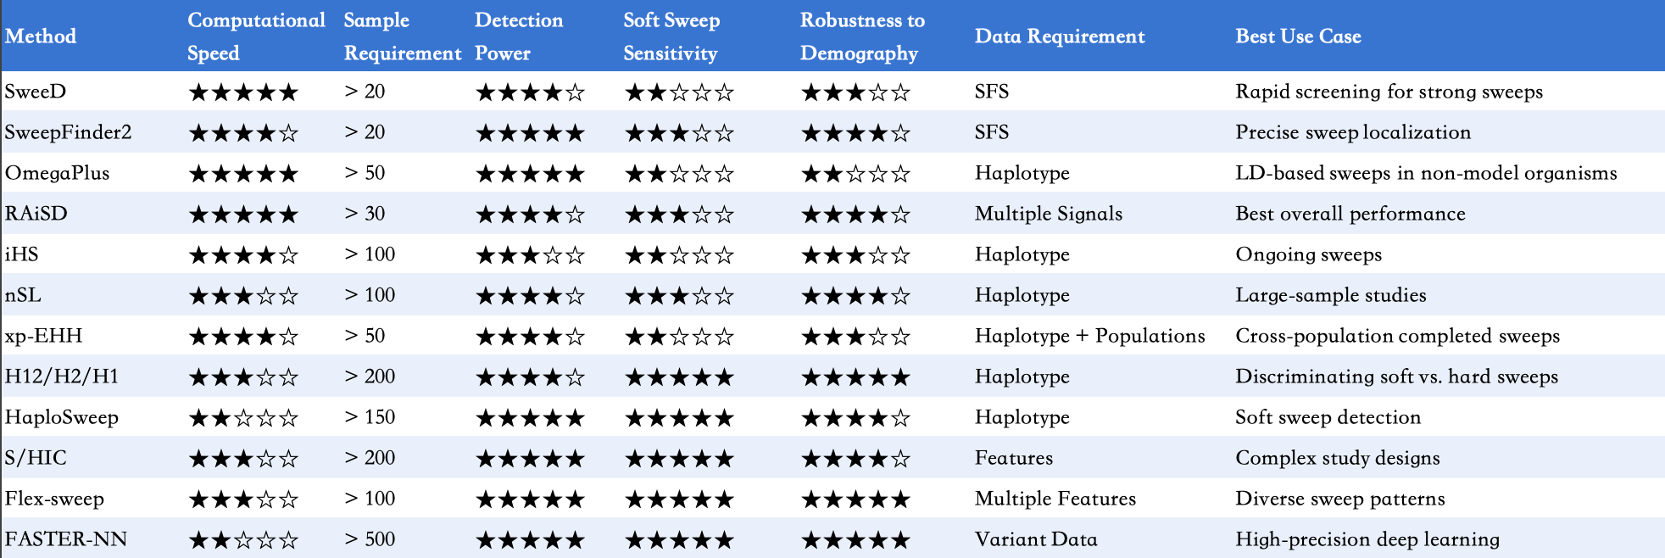
Software/Tools for Detecting Selective Sweeps (in Populations)

Slide 10
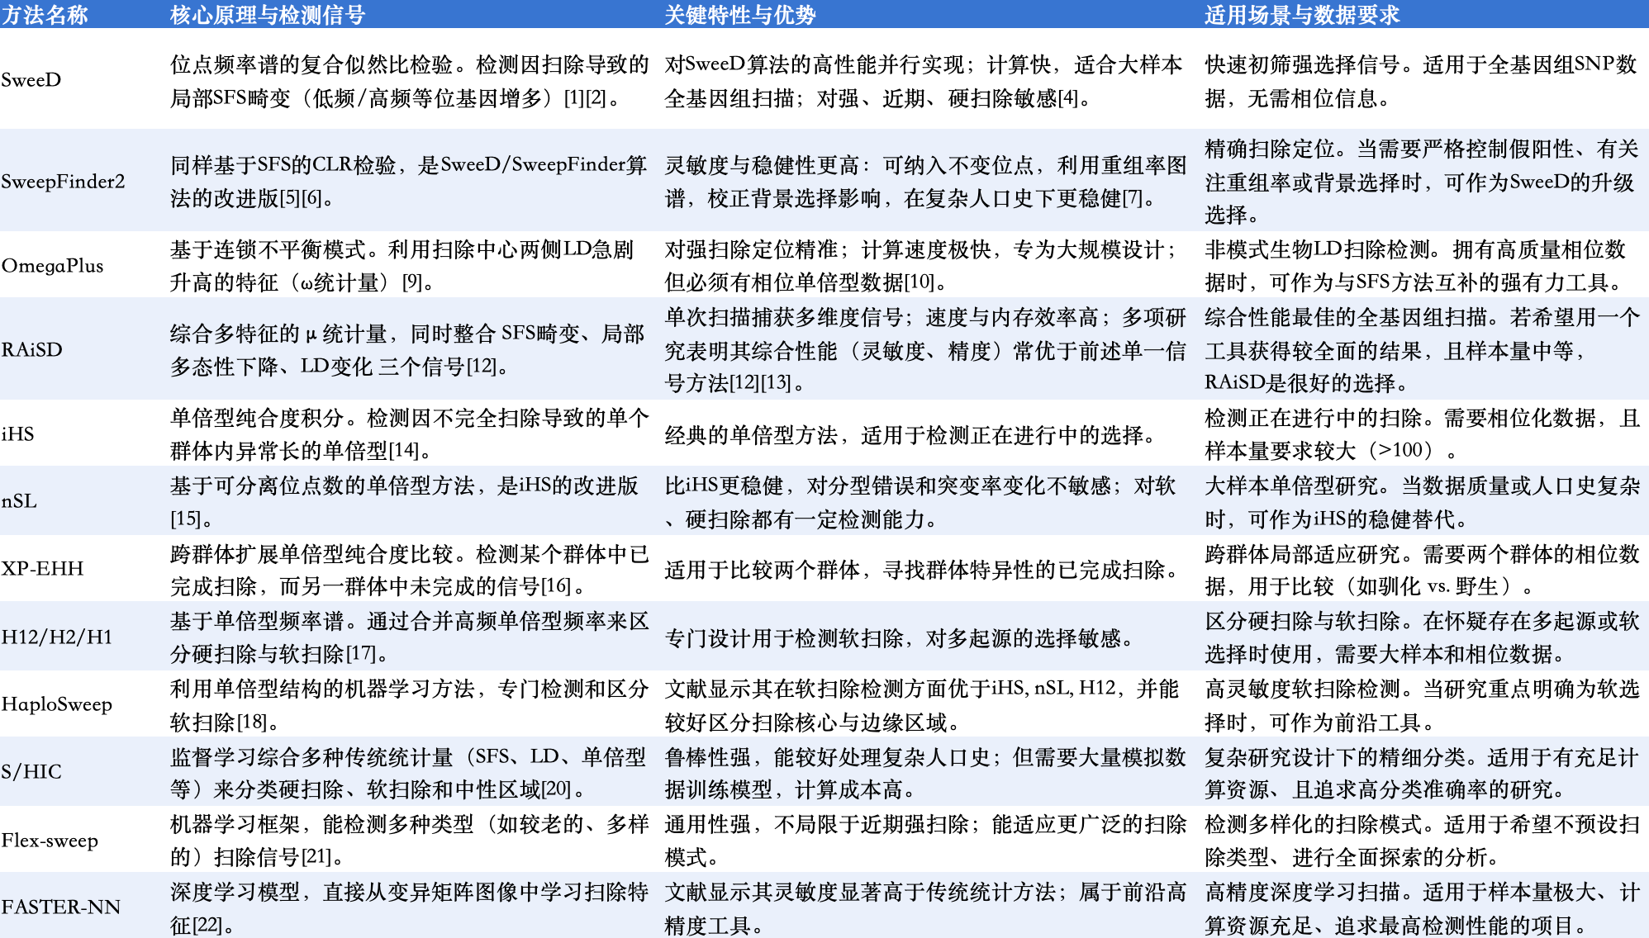

Slide 11
Practice

Slide 12
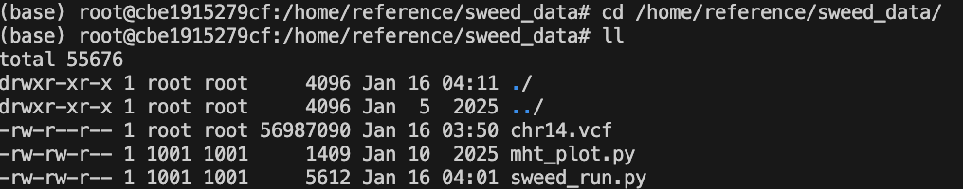
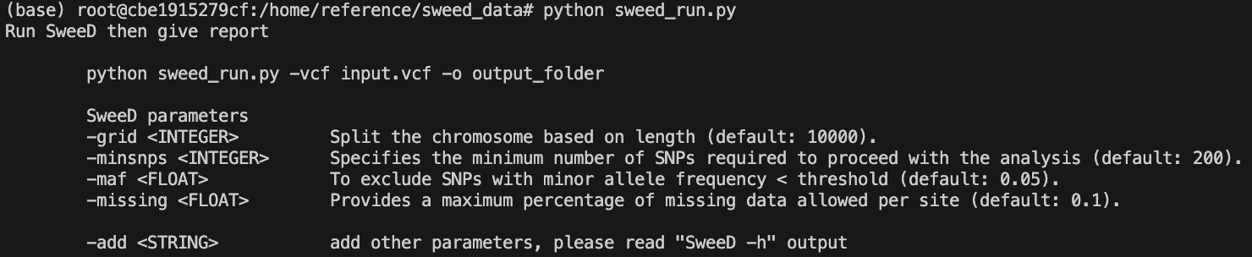

Slide 13
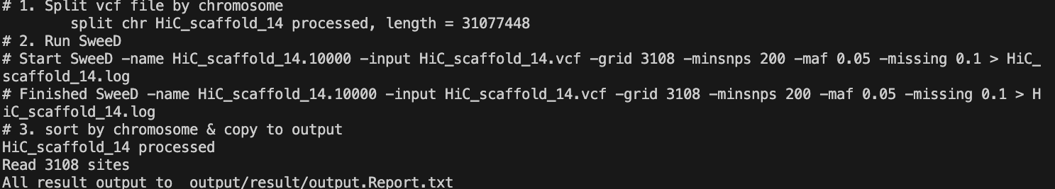
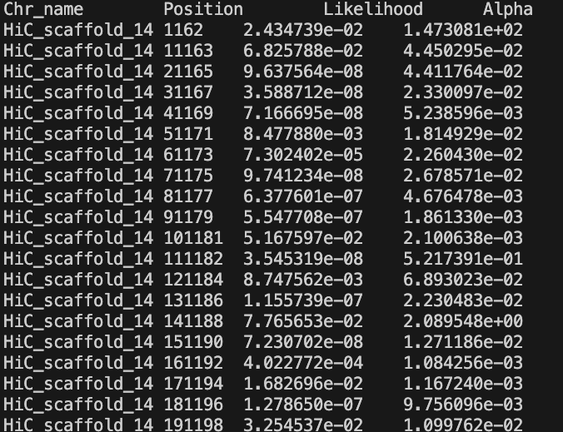

Slide 14
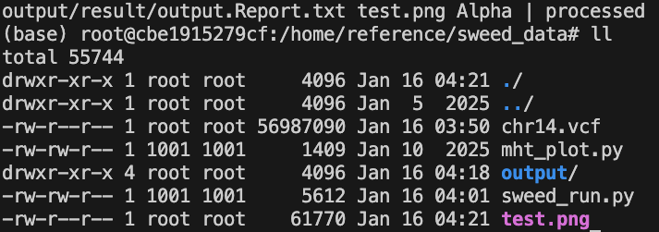

Slide 15
