Slide 1
Annotation and Quality assessment of Genome
Workshop2026
Lab of Molecular Systematics and Ecology
College of Fisheries and Life Science
Dipak Rajbanshi

Slide 2
Genome (genome.fasta)
BuildDatabase -name db_name -engine ncbi genome.fa
BuildDatabase
db_name
Recon: de-novo repeat discovery
RepeatScout: consensus building
RepeatModeler
RepeatModeler -pa 10 -database db_name -engine ncbi -LTRStruct
TRF: tandem repeat finder
Custom Library: consensi.fa.classified
LTR_retriever: Ltr detection
RepeatMasker
RepeatMasker -e ncbi -pa 30 -lib consensi.fa.classified -dir outpath -xsmall genome.fa
Masked genome:
genome.fasta.masked

Slide 3
Genome Annotation
Braker
Maker
Helixer

Slide 4
Annotation using Braker
braker.pl --threads=25 --gff3 --augustus_args="--species=zebrafish“ --genome=genome.fasta.masked --species=species_name --prot_seq=all_protein.fa --rnaseq_sets_dir=rna_rawdata --rnaseq_sets_ids=sample1,sample2,
--gff3- Outputs annotation results in GFF3 format
--augustus_args- Augustus annotation database name
--genome- Your masked genome
-- species- Name of your species
--prot_seq- proteins from closely related species
--rnaseq_sets_dir- Directory containing the raw rna seq data in fastq format
--rnaseq_sets_ids- Rnaseq ids name (e.g. sample1,sample2,sample3………)
Your RNAseq directory
sample1_R1.fastq
sample1_R2.fastq
sample2_R1.fastq
sample2_R2.fastq
Expected output:
braker.gff3
braker.gtf
braker.aa
braker.codingseq

Slide 5
Annotation using Maker
Input files
Your genome in fasta format (genome.fasta)
Proteins from closely related species (proteins.fasta)
Transcriptomes sequence (transpriptome.fasta)
Custom Library if you have one (consensi.fa.classified) from RepeatModeler

Slide 6
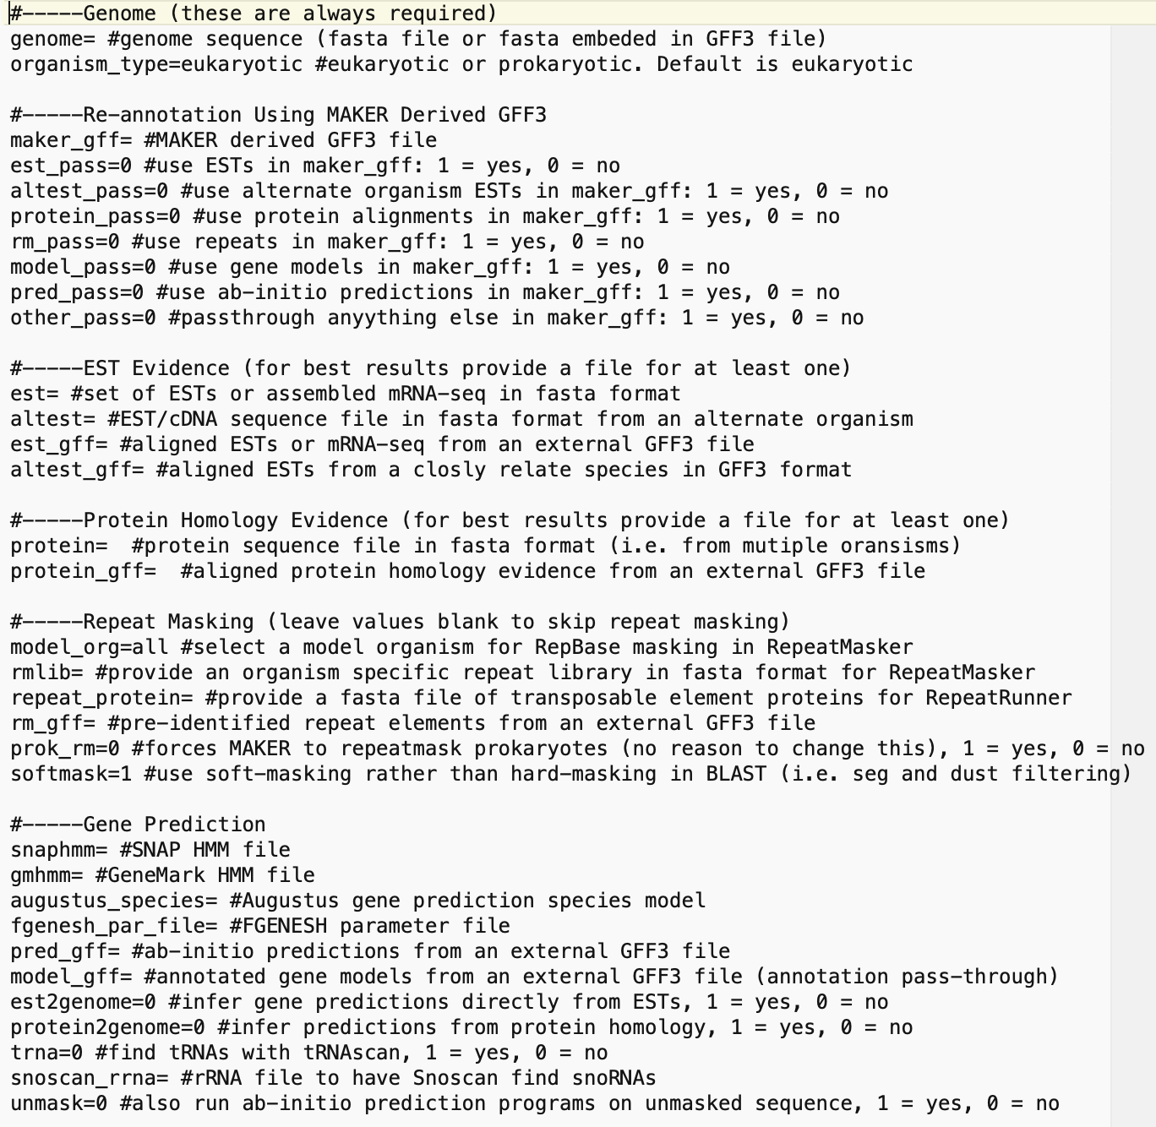

Run MAKER
1. Configuration
maker -CTL
Get three files：
maker_bopts.ctl
maker_exe.ctl
maker_opts.ctl
genome.fasta.masked
Transcriptome.fasta
Protein.fasta
2. Running
Consensi.fa.classified
maker

Slide 7
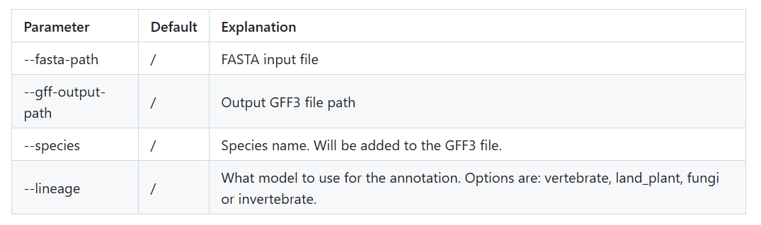
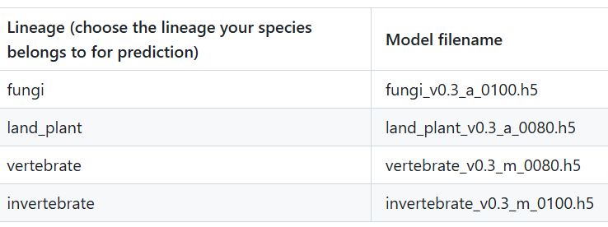
Annotation using Helixer
Helixer.py --lineage vertebrate --fasta-path your_genome --species your_species --gff-output--path /path/output/.gff3

Slide 8
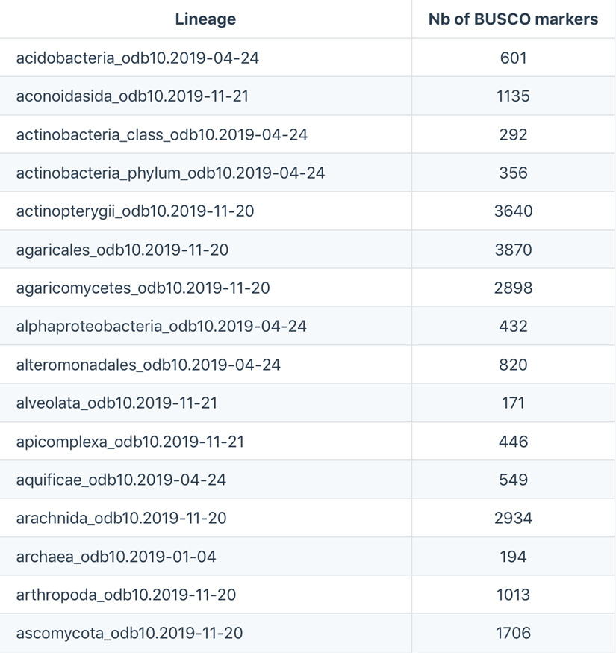
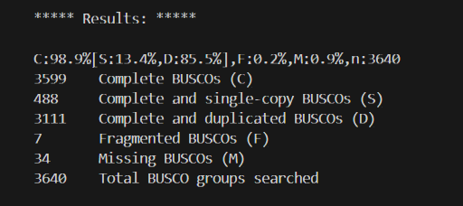
Genome completeness using Busco
busco -i genome.fasta -l /path/to/database/actinopterygii_odb10/ -m geno -o output
busco -i protein.fasta -l /path/to/database/actinopterygii_odb10/ -m prot -o output

Slide 9
THANK YOU

