Slide 1
DE analysis for non-model species: Trinity
KISHOR KUMAR SARKER
LMSE, Shanghai Ocean University
China
Date:15012026

Slide 2

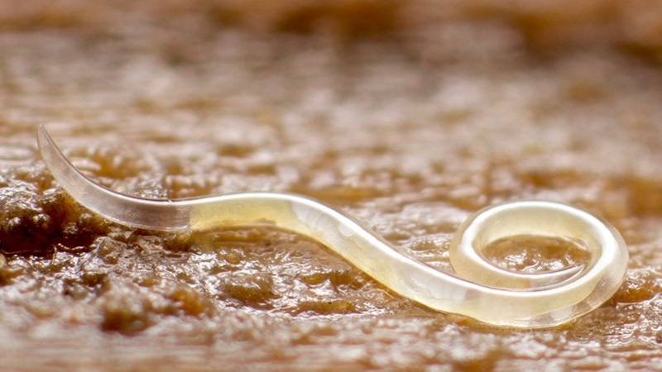
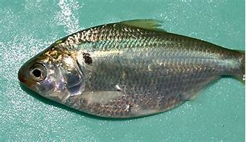
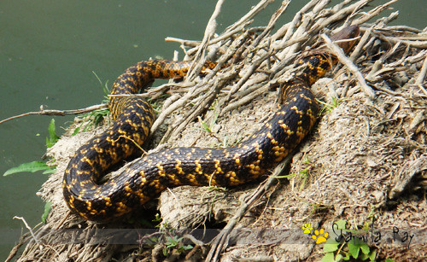
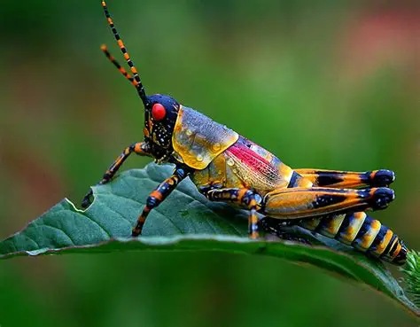
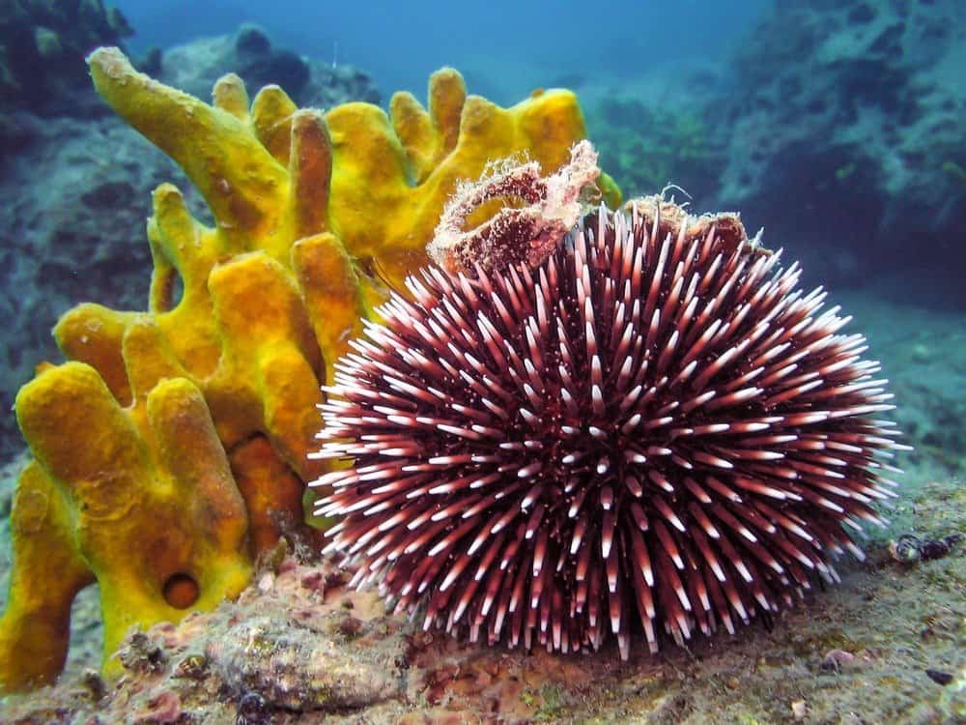
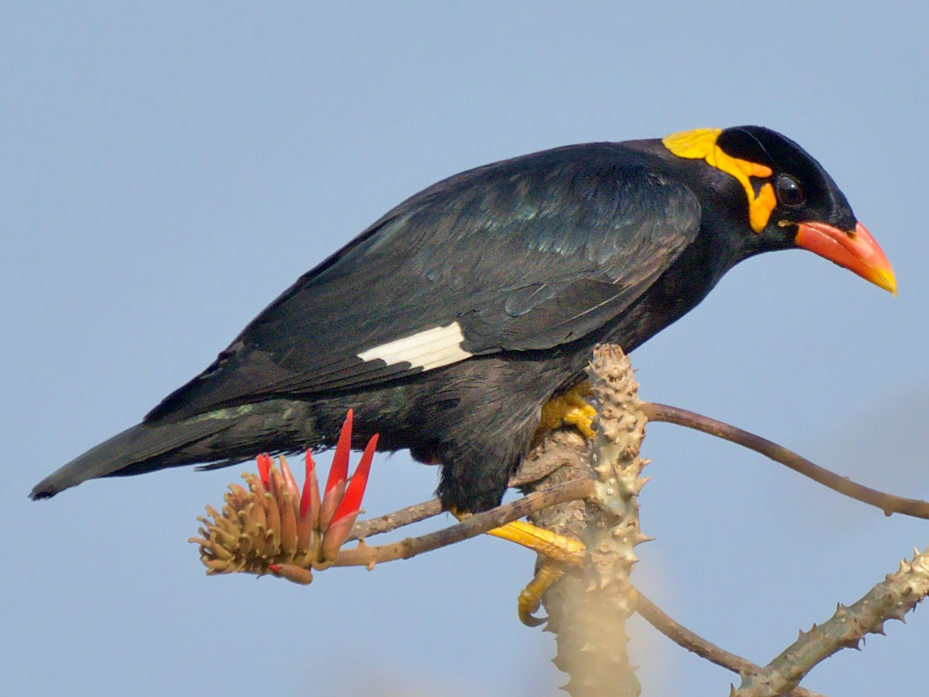
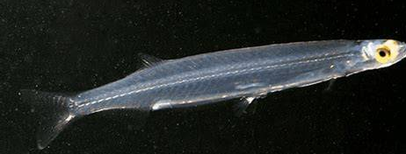
Species With less focus/sound annotation

Slide 3
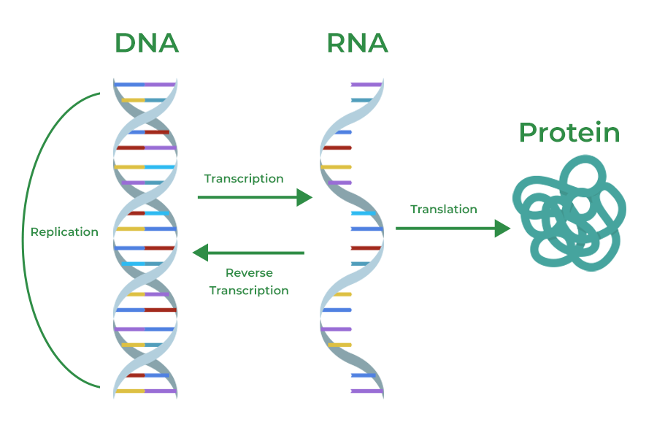
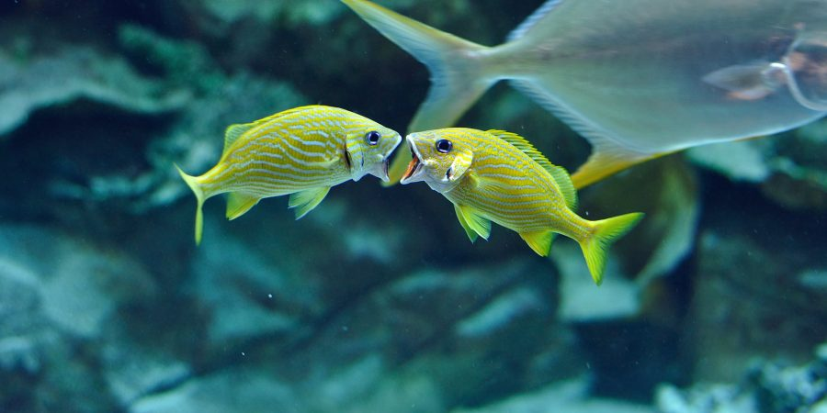
Differential Expression (DE)
The intensity difference in gene expression

Slide 4
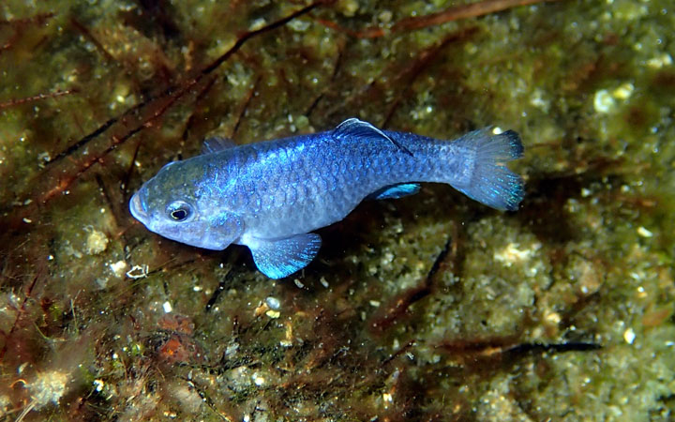
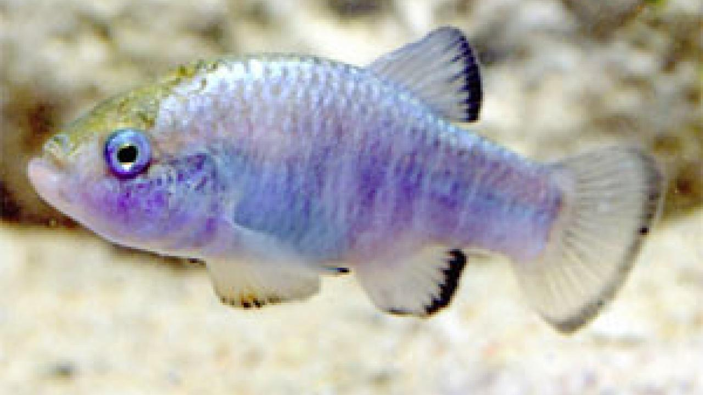
Why DE analysis is fundamental?
1. Biological factors driving phenotypic differences
2. Evaluation of treatments
3. Biomarkers or therapeutic targets

Slide 5
Ways of DE analysis
For model organism; Ex Zebra fish; Alignment based
For non-model organisms, Ex Hilsha shad; De-novo construction

Slide 6
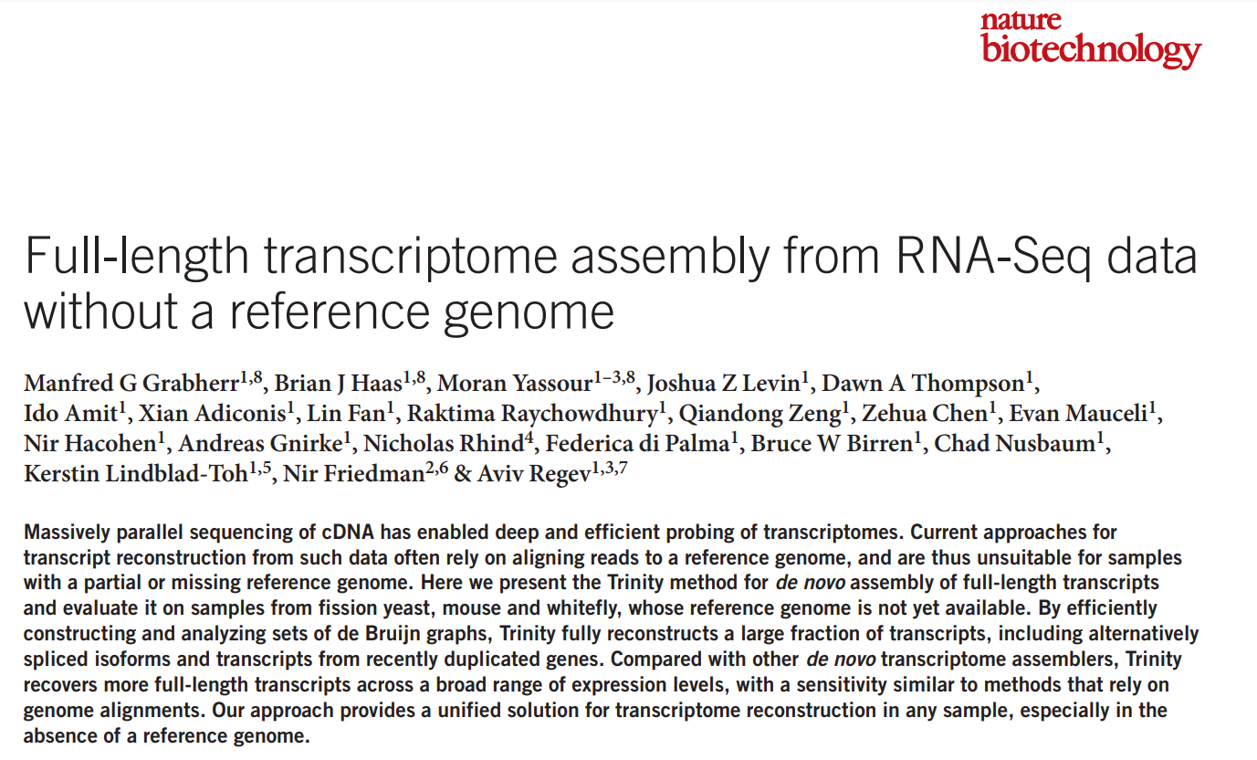
For non-model organism Trinity at its best

Slide 7
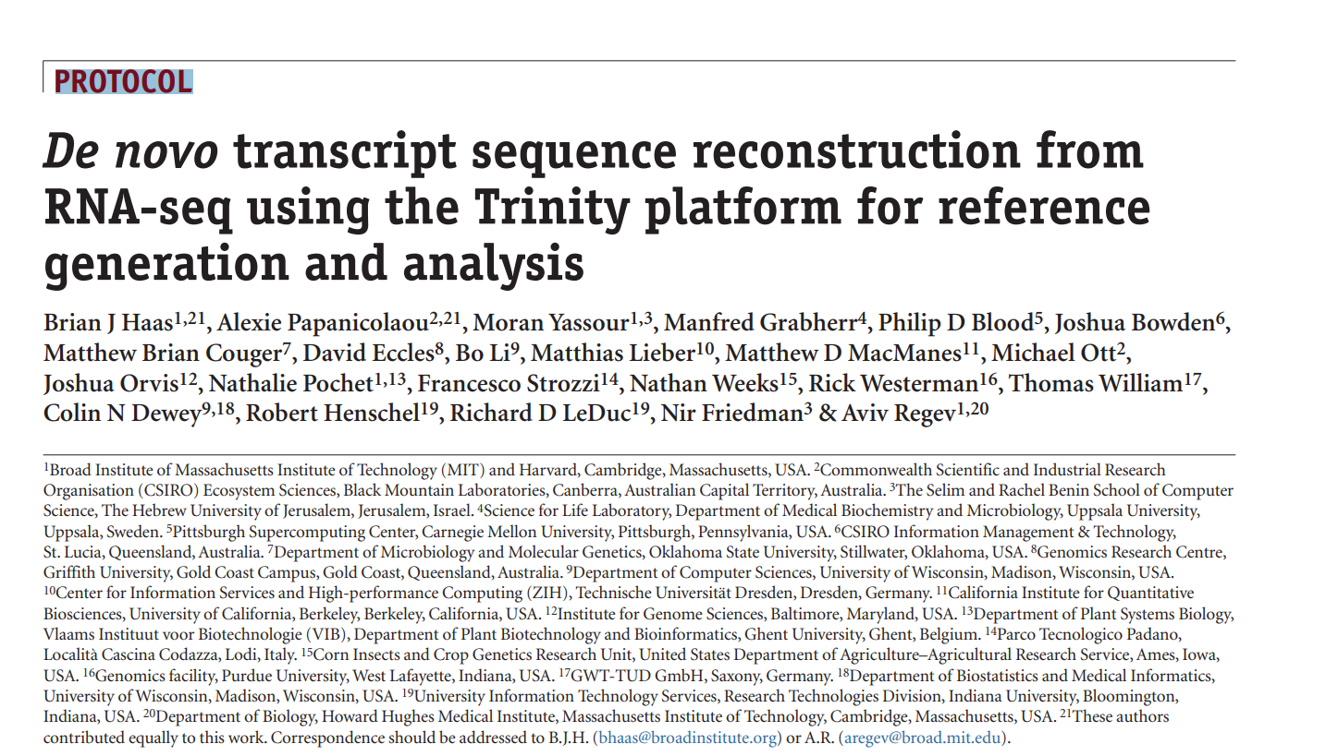

Slide 8
Trinity:A wrapped package including all needed for DE analysis

Slide 9
How does Trinity reconstruct transcripts?
Inchworm
Chrysails
Butterfly

Slide 10
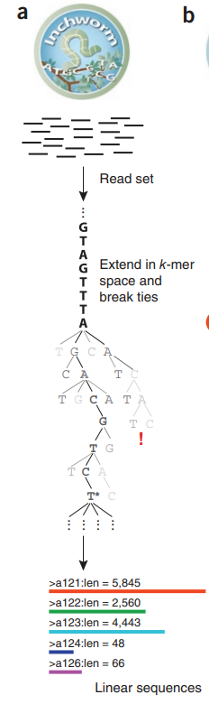
Inchworm: Assembles initial contigs from the RNA-Seq reads

Slide 11
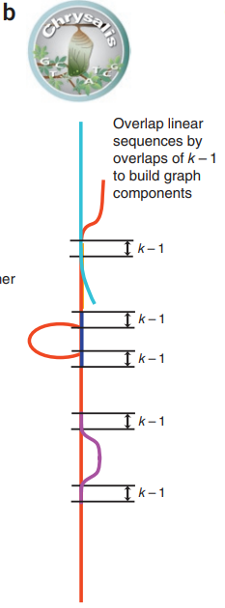
Chrysalis: Groups related contigs into clusters.

Slide 12
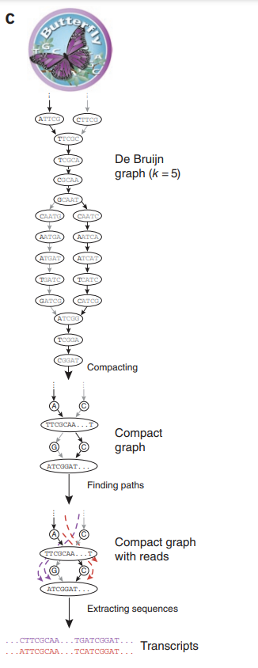
Butterfly: Refines the clusters into final, complete transcript models, resolving ambiguities and alternative splicing.

Slide 13
Let’s have some quick practice

Slide 14
Sample Design
Condition | Replicate | Forward strand | Reverse strand
FW | conA_1 | conA_1.left.fq | conA_1.right.fq
FW | conA_2 | conA_2.left.fq | conA_2.right.fq
FW | conA_3 | conA_3.left.fq | conA_3.right.fq
MW | conB_1 | conB_1.left.fq | conB_1.right.fq
MW | conB_1 | conB_2.left.fq | conB_2.right.fq
MW | conB_1 | conB_3.left.fq | conB_3.right.fq

Slide 15
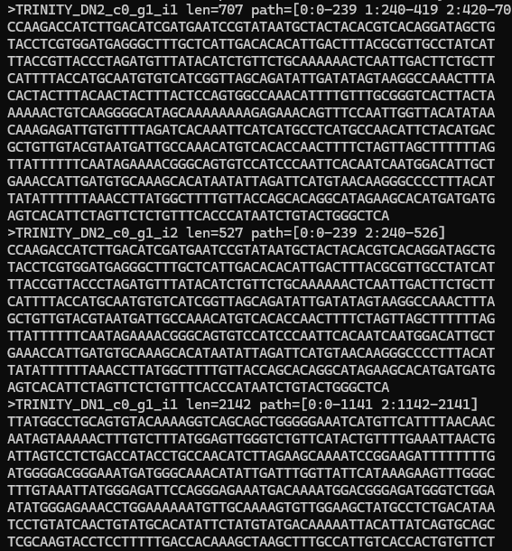
Make a combine assembly
Trinity --seqType fq --max_memory 50G --samples_file samples.txt --CPU 6 --min_contig_length 151
The transcripts are ready….

Slide 16
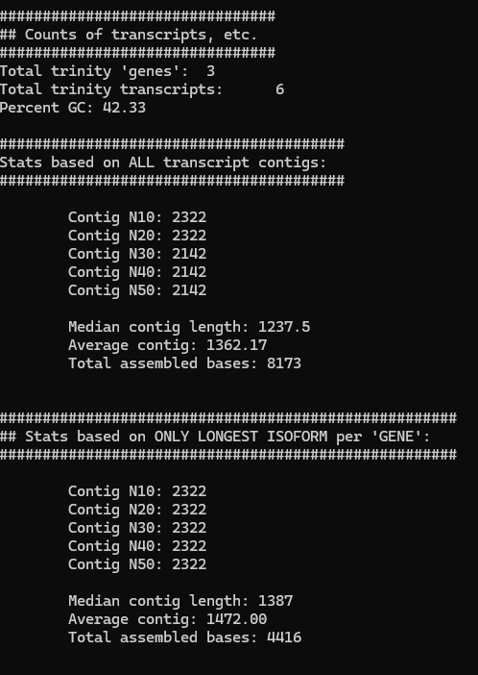
Assembly statistics
/usr/local/bin/util/TrinityStats.pl trinity_out_dir.Trinity.fasta
Align the reads against the assembly is the best way to check assembly quality (>80%)

Slide 17
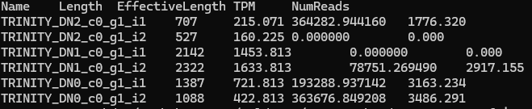
Expression quantitation using Salmon
/usr/local/bin/util/align_and_estimate_abundance.pl --seqType fq --samples_file samples.txt --transcripts trinity_out_dir.Trinity.fasta --est_method salmon --trinity_mode --prep_reference

Slide 18
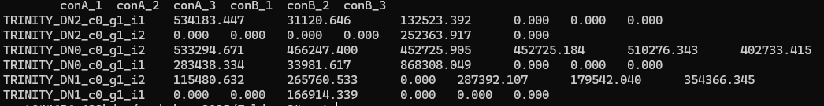
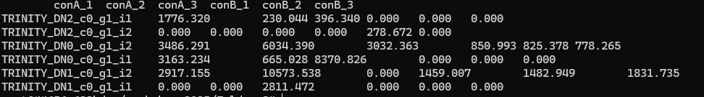
Cross-sample normalization
/usr/local/bin/util/abundance_estimates_to_matrix.pl --est_method salmon --out_prefix Trinity --name_sample_by_basedir --quant_files quant_file.list --gene_trans_map trinity_out_dir.Trinity.fasta.gene_trans_map
TMM value
Raw seq count

Slide 19
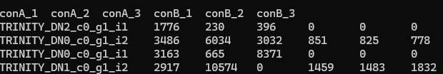
DE expression using edgeR/DESeq2
/usr/local/bin/Analysis/DifferentialExpression/run_DE_analysis.pl --matrix Trinity.isoform.counts.matrix --samples_file samples.txt --method edgeR --output edgeR_trans

Slide 20
Significantly DE transcripts and producing heatmap
/usr/local/bin/Analysis/DifferentialExpression/analyze_diff_expr.pl --matrix ../Trinity.isoform.TMM.EXPR.matrix --samples ../samples.txt -P 1e-3 -C 2

Slide 21
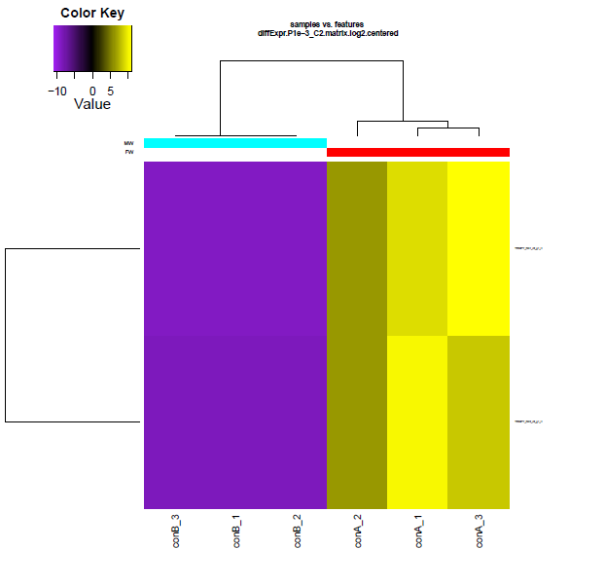
Here is your result…..

Slide 22
Play with RNA seq using Trinity……
…………..Thanks for listening

