Slide 1
DE analysis for model species:Hisat2-StringTie-Ballgown
KISHOR KUMAR SARKER
LMSE, SHANGHAI OCEAN UNIVERSITY
CHINA
14.01.26

Slide 2
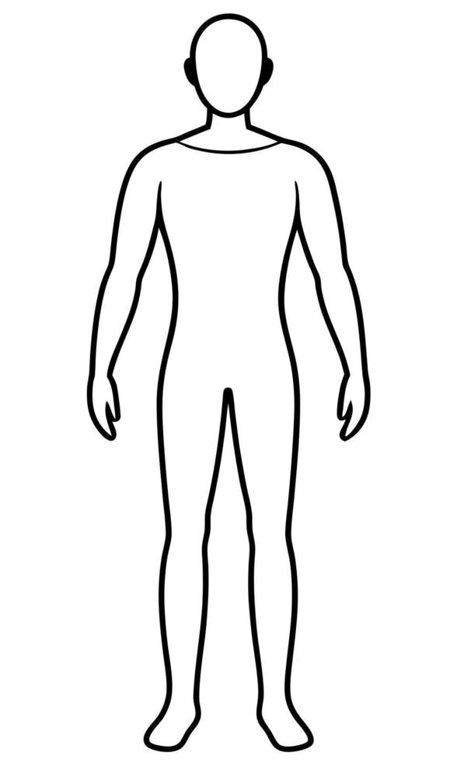
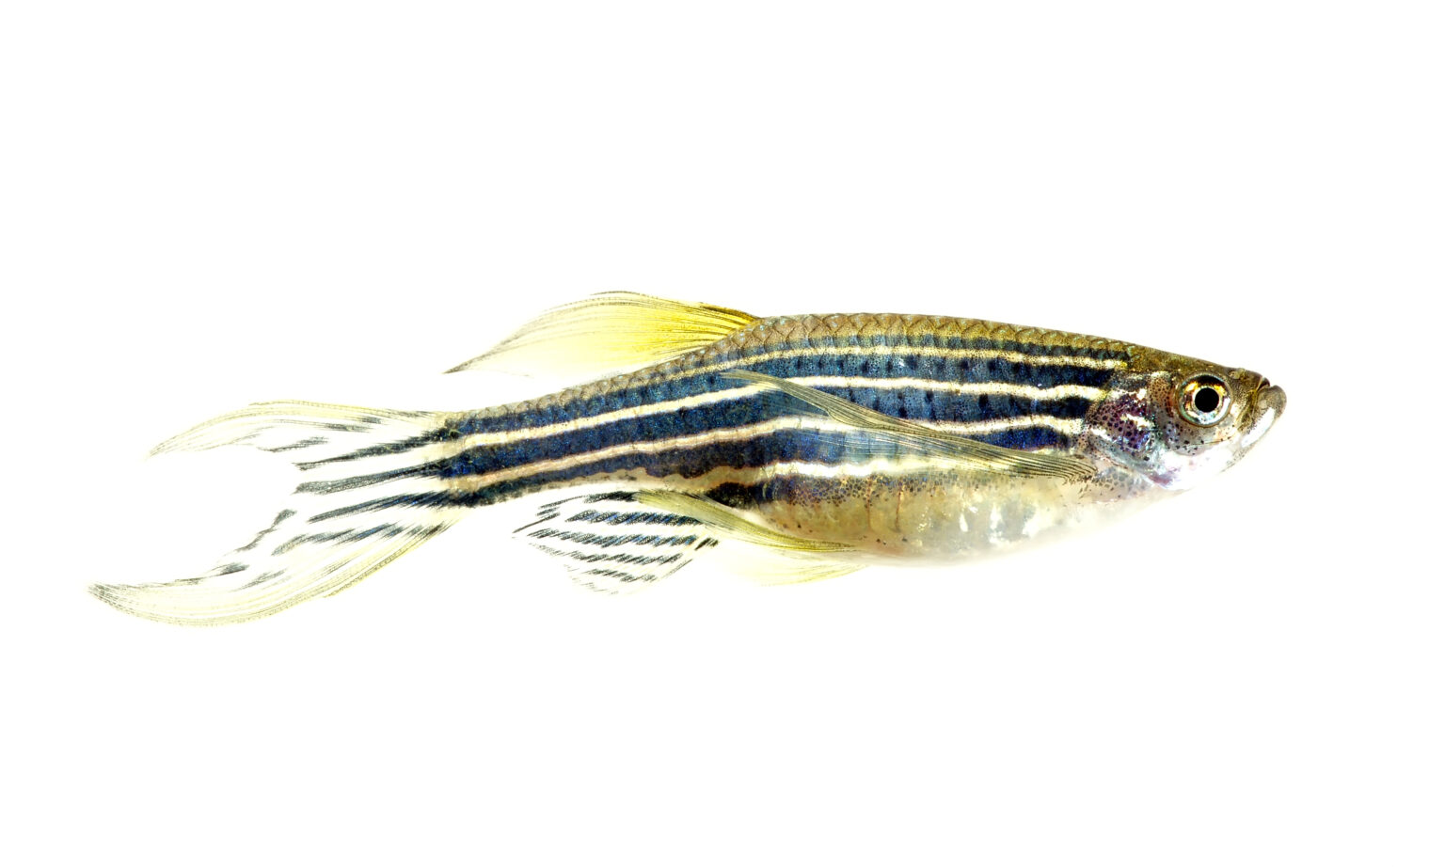
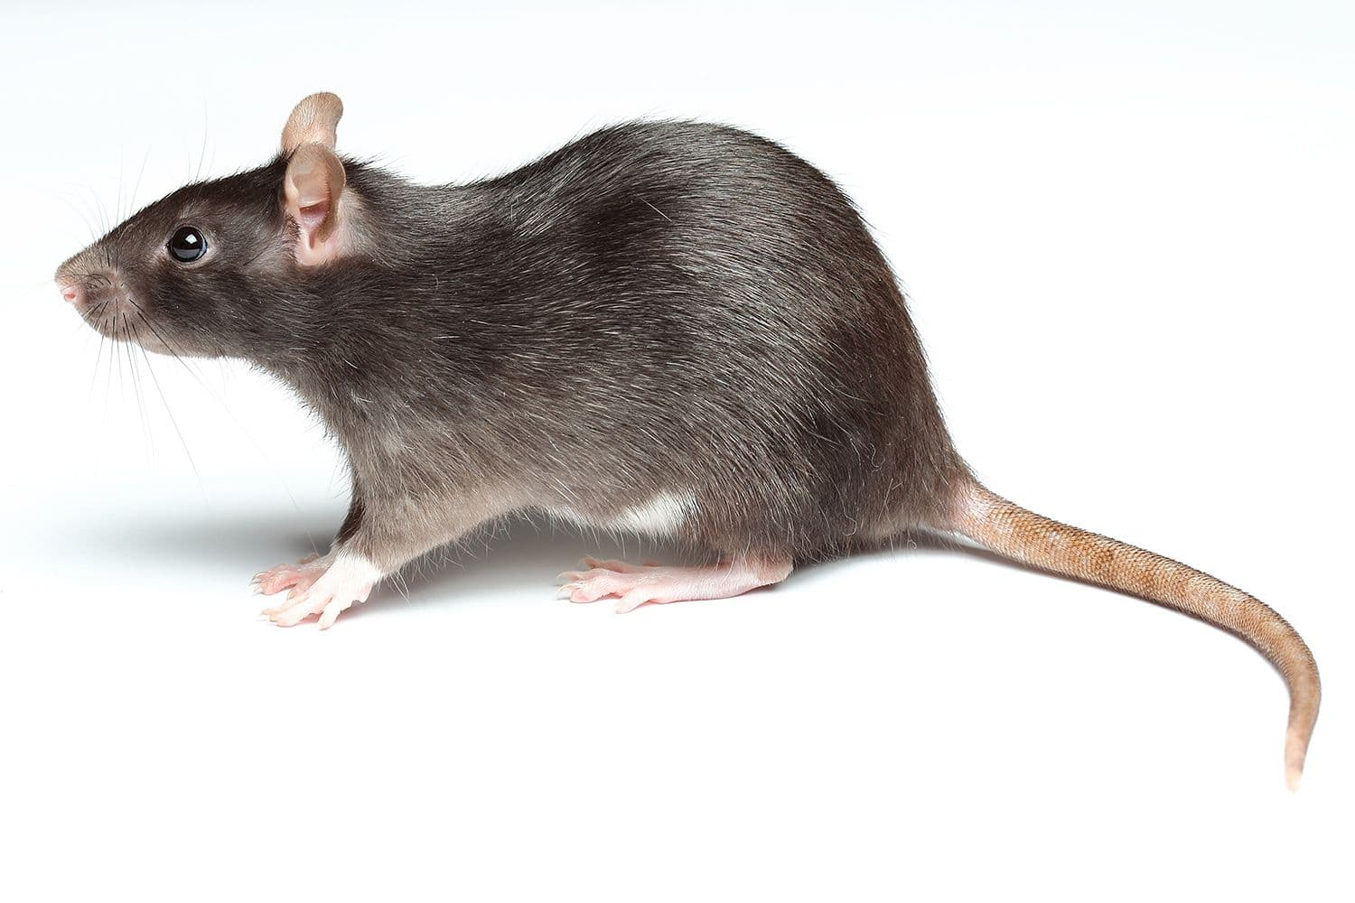
Model species: Species with sound annotation

Slide 3
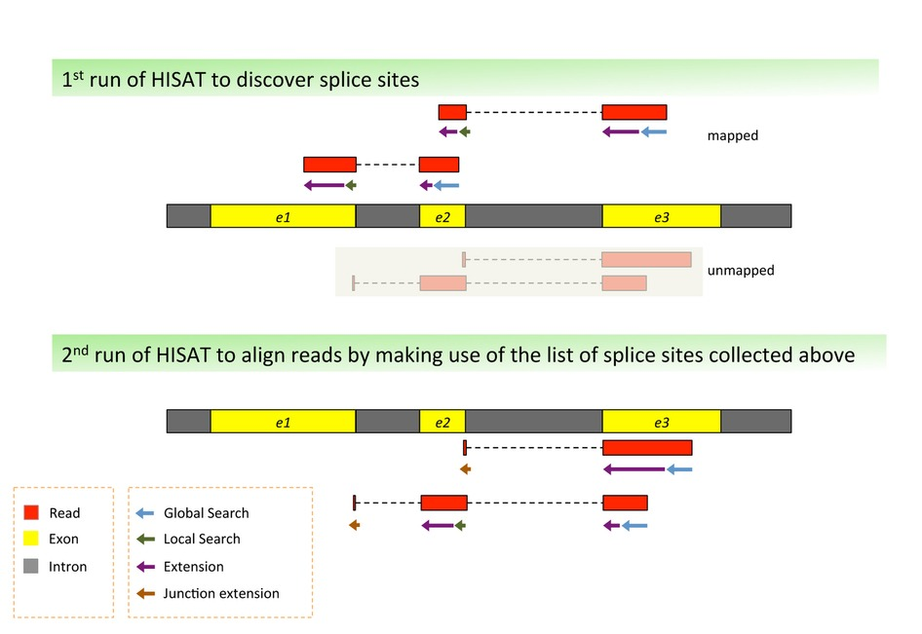
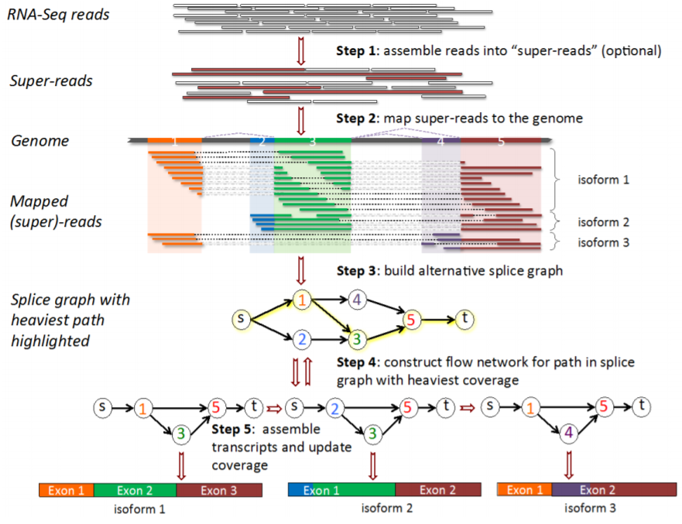
Three spare heads of a Bow...
Hisat2: Aligning the Reads; A splice-aware aligner, with less memory consumption compared to Tophat (Old, less accurate) or Star (Require high memory)
StringTie: Reconstructing and measuring the reads; Stiches exons (basically read support with junction info) and delivers the transcript
Ballgown: Statistics and Visualization; Perform statistical analysis of transcript-level expression

Slide 4
Let’s begin the practice….
#extract the transcript splicing info
hisat2_extract_splice_sites.py NC_055967.1.gtf > NC_055967.ss
#extract the exon ordinates
hisat2_extract_exons.py NC_055967.1.gtf > NC_055967.exon
#build a HISAT2 genome index incorporating splice sites and exon info
hisat2-build --ss NC_055967.ss --exon NC_055967.exon NC_055967.1.fa NC_055967_tran

Slide 5
Contd…
#Align the rna-seq reads to the genome
hisat2 -p 16 --dta -x NC_055967_tran -1 feeding_1_R1.fastq -2 feeding_1_R2.fastq -S NC_055967_feeding_1.sam
hisat2 -p 16 --dta -x NC_055967_tran -1 feeding_2_R1.fastq -2 feeding_2_R2.fastq -S NC_055967_feeding_2.sam
hisat2 -p 16 --dta -x NC_055967_tran -1 feeding_3_R1.fastq -2 feeding_3_R2.fastq -S NC_055967_feeding_3.sam
hisat2 -p 16 --dta -x NC_055967_tran -1 fasting_1_R1.fastq -2 fasting_1_R2.fastq -S NC_055967_fasting_1.sam
hisat2 -p 16 --dta -x NC_055967_tran -1 fasting_2_R1.fastq -2 fasting_2_R2.fastq -S NC_055967_fasting_2.sam
hisat2 -p 16 --dta -x NC_055967_tran -1 fasting_3_R1.fastq -2 fasting_3_R2.fastq -S NC_055967_fasting_3.sam

Slide 6
Contd…
#Sort and convert the SAM files to BAM
samtools sort -@ 16 -o NC_055967_feeding_1.bam NC_055967_feeding_1.sam
samtools sort -@ 16 -o NC_055967_feeding_2.bam NC_055967_feeding_2.sam
samtools sort -@ 16 -o NC_055967_feeding_3.bam NC_055967_feeding_3.sam
samtools sort -@ 16 -o NC_055967_fasting_1.bam NC_055967_fasting_1.sam
samtools sort -@ 16 -o NC_055967_fasting_2.bam NC_055967_fasting_2.sam
samtools sort -@ 16 -o NC_055967_fasting_3.bam NC_055967_fasting_3.sam

Slide 7
Contd..
#Assemble transcripts for each sample
stringtie -p 16 -G NC_055967.1.gtf -o NC_055967_feeding_1.gtf -l feeding_1 NC_055967_feeding_1.bam
stringtie -p 16 -G NC_055967.1.gtf -o NC_055967_feeding_2.gtf -l feeding_2 NC_055967_feeding_2.bam
stringtie -p 16 -G NC_055967.1.gtf -o NC_055967_feeding_3.gtf -l feeding_3 NC_055967_feeding_3.bam
stringtie -p 16 -G NC_055967.1.gtf -o NC_055967_fasting_1.gtf -l fasting_1 NC_055967_fasting_1.bam
stringtie -p 16 -G NC_055967.1.gtf -o NC_055967_fasting_2.gtf -l fasting_2 NC_055967_fasting_2.bam
stringtie -p 16 -G NC_055967.1.gtf -o NC_055967_fasting_3.gtf -l fasting_3 NC_055967_fasting_3.bam

Slide 8
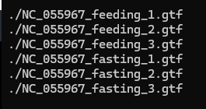
Contd..
#make a list with gtf location from each sample
vim mergelist.txt

Slide 9
Contd…
#Merge transcripts from all samples
stringtie --merge -p 16 -G genes/fAloSap1_fixed.gtf -o fAloSap1_11_12_merged.gtf genes/mergelist.txt
#Examine how the transcripts compare with the reference annotation (optional)
/home/software/gffcompare-0.12.10.Linux_x86_64/gffcompare -r genes/fAloSap1_fixed.gtf -G -o merged fAloSap1_11_12_merged.gtf

Slide 10
Contd…
#Estimate transcript abundances and create table counts for Ballgown
stringtie -e -B -p 32 -G NC_055967.1.gtf -o ballgown/fasting_1/NC_055967_fasting_1.gtf NC_055967_fasting_1.bam
stringtie -e -B -p 32 -G NC_055967.1.gtf -o ballgown/fasting_2/NC_055967_fasting_2.gtf NC_055967_fasting_2.bam
stringtie -e -B -p 32 -G NC_055967.1.gtf -o ballgown/fasting_3/NC_055967_fasting_3.gtf NC_055967_fasting_3.bam
stringtie -e -B -p 32 -G NC_055967.1.gtf -o ballgown/feeding_1/NC_055967_feeding_1.gtf NC_055967_feeding_1.bam
stringtie -e -B -p 32 -G NC_055967.1.gtf -o ballgown/feeding_2/NC_055967_feeding_2.gtf NC_055967_feeding_2.bam
stringtie -e -B -p 32 -G NC_055967.1.gtf -o ballgown/feeding_3/NC_055967_feeding_3.gtf NC_055967_feeding_3.bam

Slide 11


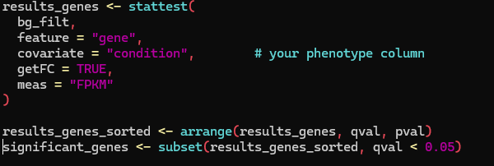
Finish it with a simple Ballgown script..
Rscript ballgown_run.R

Slide 12
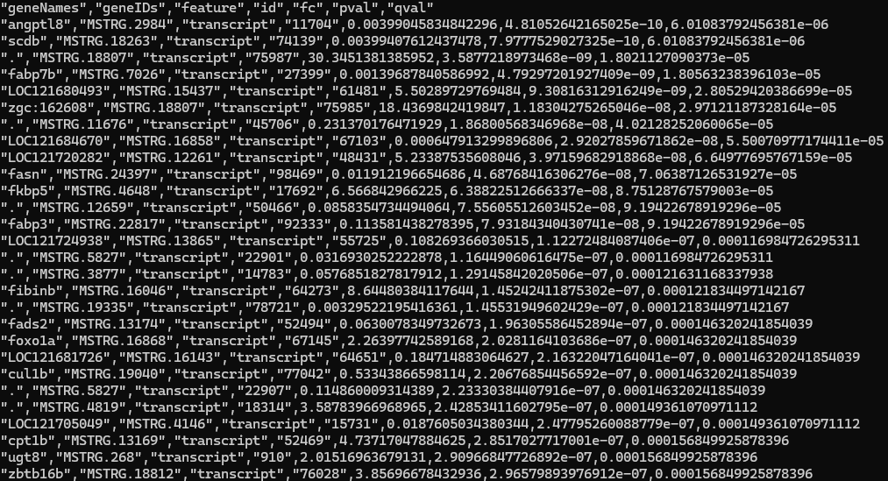
Save money for your lab….

Slide 13
Thanks…..

