Slide 1
Gene Family Evolution & CAFE
KISHOR KUMAR SARKER
LMSE Shanghai Ocean University
15.01.2026

Slide 2
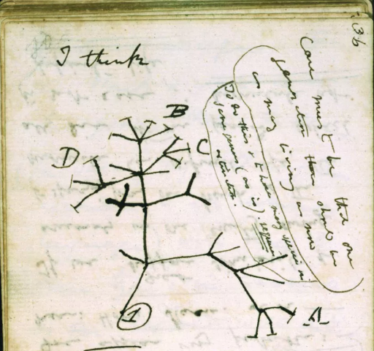
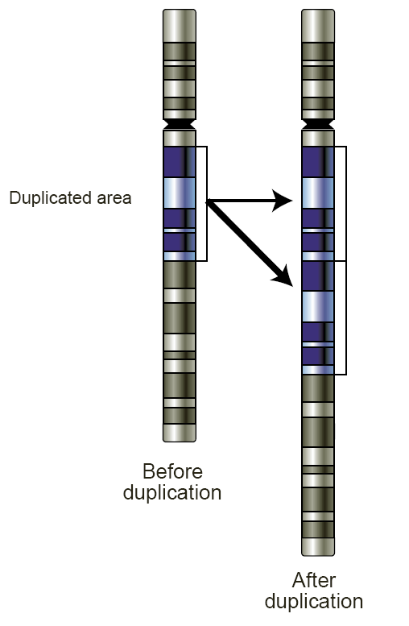
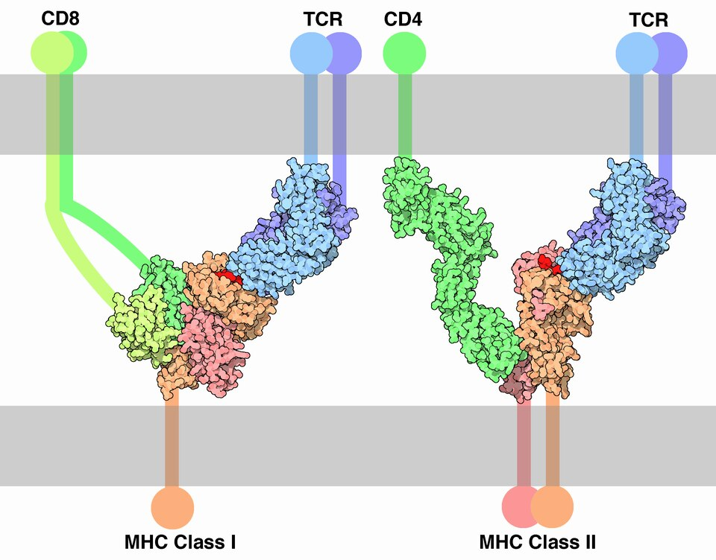
What is gene family
-several similar genes, either in the same chromosome or on different chromosomes inherited from a common ancestor
-originates from the result of gene duplication
- and finally having the similar function by those group of genes can be considered as a ‘gene family’.

Slide 3
A test case….
Sequence homology
ATGAATACTA..
ATGAATACTA..
ATGAATAATG..
ATGAATACCC..
Protein with a similar domain
Pep.1
LLLYFARVAGPLTQYKKRMKTLLVAGVAGLVGQAMERDPAPVLRNVKS
Pep.2
KSMKTLLVAGVGMERDPAPVLRLTDPVYQGQNVKSLYMKTLLVAGVAR
LLVAGVAGKSMKTMERDPAPVLRVYQGQNVKSLYFARVAGPLTQYKKR
Pep.3
Pep.4
MKTLLVAGVAGLVGGGGLKTLTDPVYQGQNVKSLYFARVAGPLTQYKK
Conserve Domain/EMP2AIP1 = MKTLLVAGVAGLV

Slide 4
Glucose
Cell Membrane
Glucose → Glucose-6-Phospahte ↔ Glycogen
Insoluble aggregates/Lafora
Less efficient Energy conversion
GlycogenP
Laforin (EMP2A), a gene/protein responsible for Lafora disease/prevents the hyperphosphorylation
MHPKEGAEQHVFSPVPGAPTPPPNRCGRLVLGPRLPAAGTPGPGIRAAAARHALPLWGGG

Slide 5
EMP2A
MHPKEGAEQHVFSPVPGAPTPPPNRCGRLVLGPRLPAAGTPGPGIRAAAARHALPLWGGG
LLLYFARVAGPLTQYKKRMKTLLVAGVAGLVGQAMERDPAPVLRNVKS
EMP2AIP1
Ͱ
GlycogenP
18 Copies of EMP2A1A
2 Copies of EMP2A1A
Who can use the energy more efficiently?

Slide 6
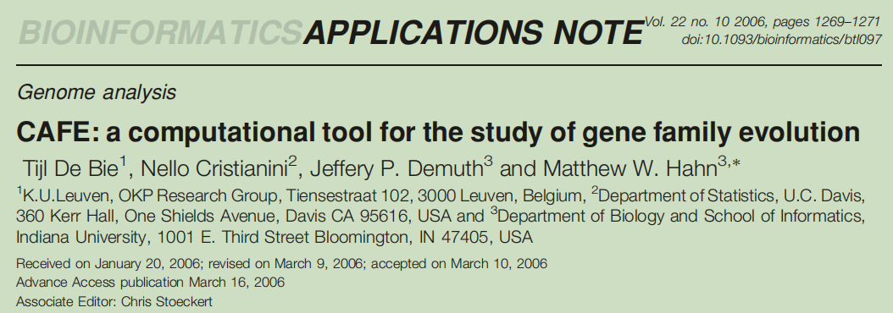
Let's meet with CAFE!

Slide 7
How CAFE works
CAFE (Computational Analysis of gene Family Evolution) inferences both the direction and size of evolutionarily significant changes in gene family size in a phylogenetic context.
The probabilistic model adopted in CAFE was introduced by Hahn et al. (2005)
It uses a random birth and death process to model gene gain and loss along each lineage of a phylogenetic tree.
Chr1
G1-1
G1
G1+1
t

Slide 8
Contd..
CAFE’s main inputs are a Newick description of a rooted and bifurcating phylogenetic tree (including branch lengths in units of time)
A data file containing the gene family sizes for the extant taxa
A third input is lamda(ɤ), which is the probability of both gene gain and loss per gene per unit time in the phylogeny

Slide 9
Running CAFE
1. Prepare Database
Prerequisite
- Select closely related 10 species or more
- Extract proteins using the genome and gff file using gffread software
gffread genomic.gff -g genome.fa -x cds.fa -y pep.fa

Slide 10
Contd..
-Pick the longest isoform from each species python /home/tools/genome/annotools/pick_longest_isoform_for_gff.py -gff species.gff -fa species.pep -o species.pep.longest.fa
-Convert all the file name according to the species name
-Concatenate all the *.pep file into a single file for blast.

Slide 11
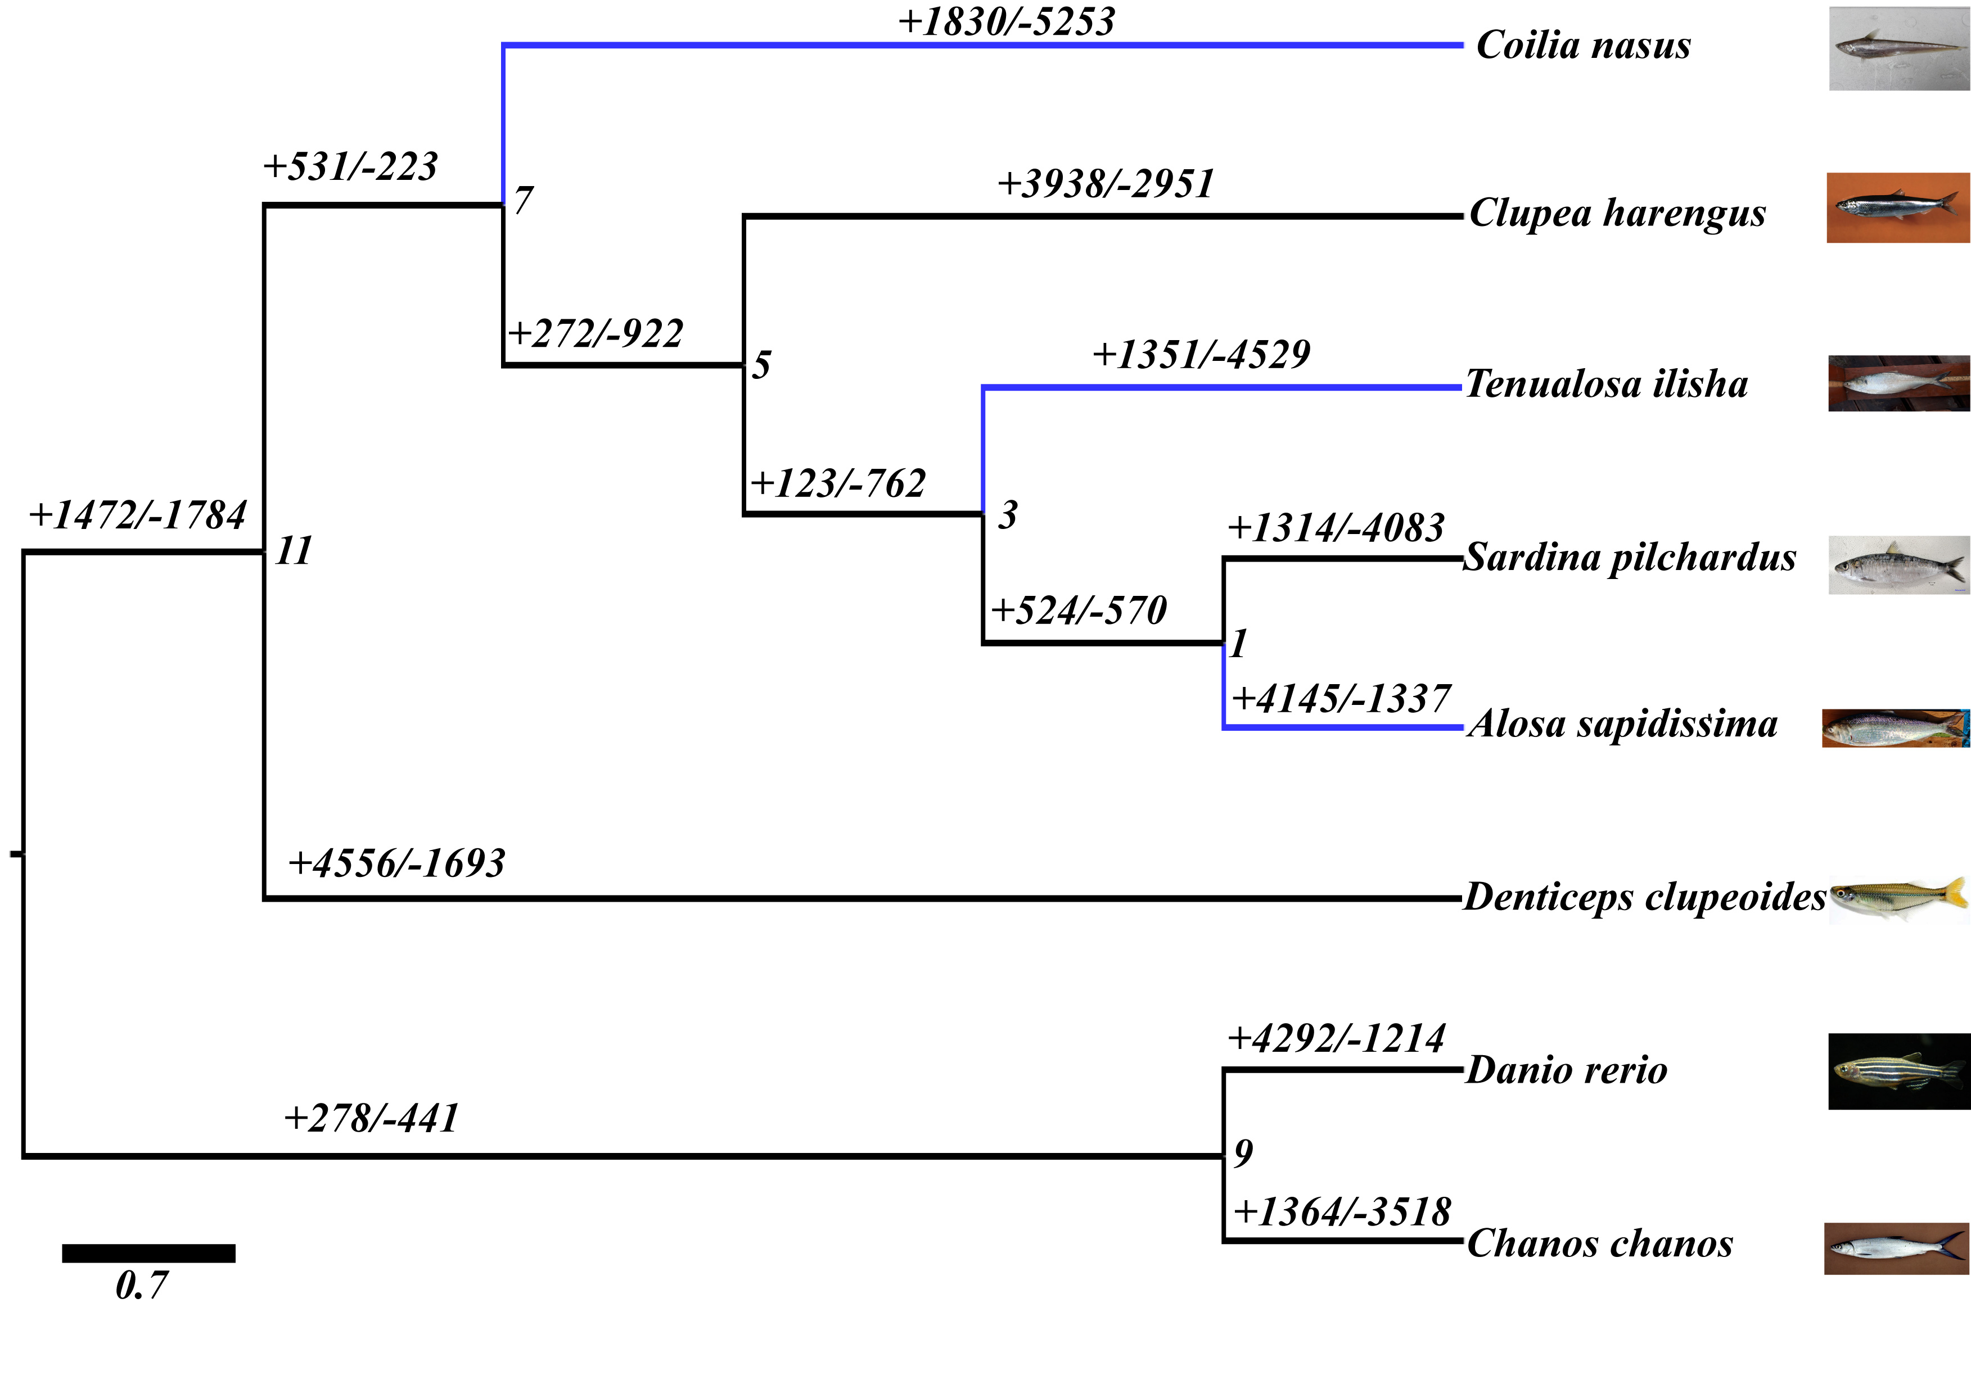
Contd..
What will happen you don’t pick longest isoforms?
ISO1
√
ISO2
×
ISO3
×

Slide 12
Contd..
2. All by all blast
2.1. Preparing the database
makeblastdb -in makeblastdb_input.fa -dbtype prot -out blastdb
2.2 Now blast it!
blastp -num_threads 20 -db blastdb -query makeblastdb_input.fa -outfmt 7 -seg yes > blast_output.txt &

Slide 13
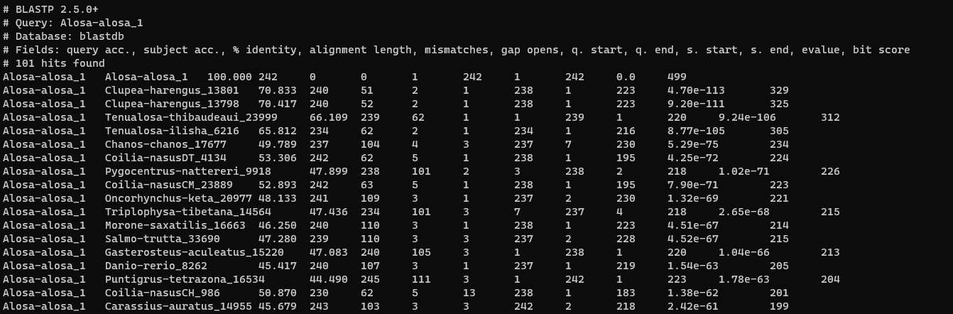
Contd...
Blast Output..
A1
B1
C1

Slide 14


Contd..
B3
Cluster 1
3. mcl clustering: a graph clustering algorithm that groups the items
A1,B1,B2,C1,C3
A1
A2
A3
C4
C3
B2
C2
A4
A5
Cluster 2
B1
C1
A3,A4,A5,B3,A5,C4

Slide 15
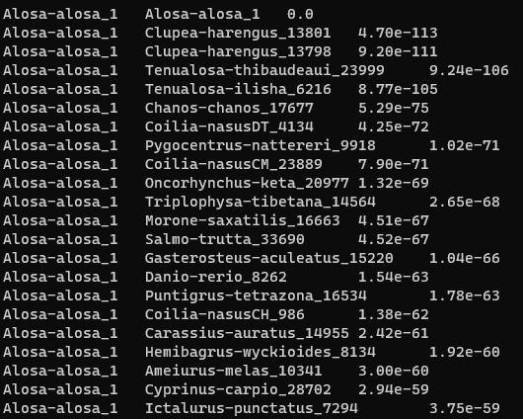
Contd..
3.1. Prepare the format for ‘mcl’
grep -v "#" blast_output.txt | cut -f 1,2,11 > blast_output.abc

Slide 16
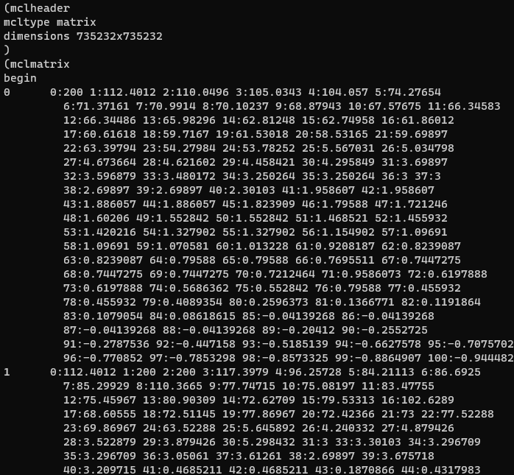
Contd..
3.2 Create network file in *.mci and dictionary file in *.tab format
mcxload -abc blast_output.abc --stream-mirror --stream-neg-log10 -stream-tf 'ceil(200)' -o blast_output.mci -write-tab blast_output.tab &

Slide 17
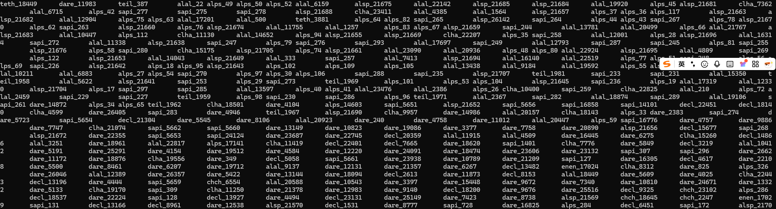
Contd..
3.3 Cluster and deduplicate
mcl blast_output.mci -I 3
mcxdump -icl out.blast_output.mci.I30 -tabr blast_output.tab -o dump.blast_output.mci.I30

Slide 18
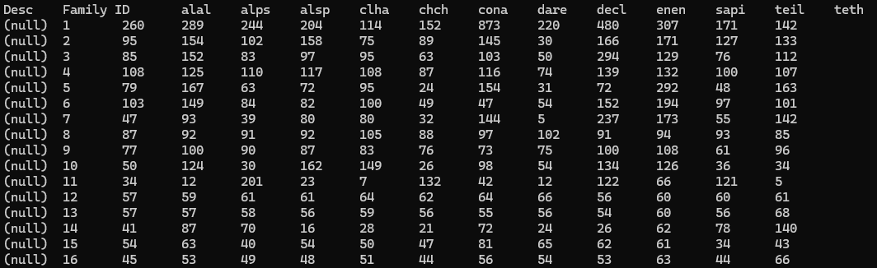
Contd..
3.4. Organize mcl results into a compatible format to cafe
python /mnt/genome1/Lab_Users/LL/tools/genome/cafe_script/python_scripts/cafetutorial_mcl2rawcafe.py -i dump.blast_output.mci.I30 -o unfiltered_cafe_input.txt -sp “alal alps alsp clha chch cona dare decl enen sapi teil teth"

Slide 19
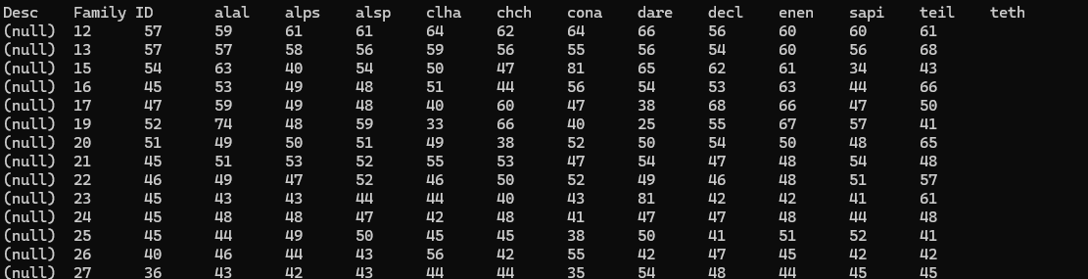
Contd..
3.5. Eliminate the category with particularly large copy variation
python /mnt/genome1/Lab_Users/LL/tools/genome/cafe_script/python_scripts/cafetutorial_clade_and_size_filter.py -i unfiltered_cafe_input.txt -o filtered_cafe_input.txt -s

Slide 20
Contd..
4. Species tree and time tree inference
4.1. Infer species tree using OrthoFinder
orthofinder -f /protein/in/path/ -S diamond -t 50 -a 50 -T iqtree -M msa
4.2. Use seqkit find out the total alignment length
seqkit stat SpeciesTreeAlignment.fa

Slide 21
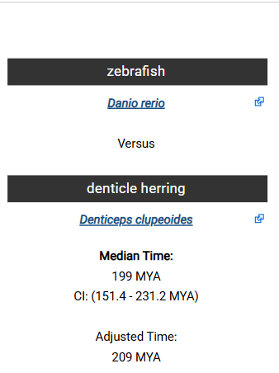
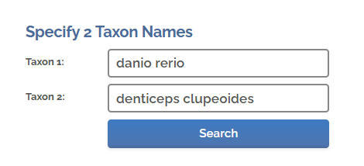
Contd..
4.3. Building Time Tree (Ultrametric Trees)
4.3.1. Preparing the *.ctl file for r8s
python2 cafetutorial_prep_r8s.py -i SpeciesTree_rooted.txt -o r8s_ctl_file.txt -s 31629122 -p dare,decl' -c ‘199'
The following two parameters are from timetree.org, use the two species in the tree, find the divergence time in the website
‘-p’ denotes for Species names, separated by commas, the same as the names in the tree
‘-c’ denotes for the differentiating time provided by timetree, only numbers

Slide 22
Contd..
4.3.2. Running r8s
r8s -b -f r8s_ctl_file.txt > r8s_tmp.txt
tail -n 1 r8s_tmp.txt | cut -c 16- > time_tree.txt

Slide 23
Contd..
Rooted_tree, (chch:0.1367,dare:0.187143)0.73145:0.0227625,(decl:0.174017,((enen:0.117821,cona:0.0678363)0.749314:0.0395608,(clha:0.0922453,((teil:0.0304623,teth:0.104812)0.776153:0.0528893,(sapi:0.047093,((alal:0.0171831,alsp:0.00615032)0.620191:0.0109729,alps:0.0135951)0.843457:0.0265235)0.80241:0.0330825)0.435563:0.0199042)0.414125:0.0196254)0.875197:0.0701133)0.73145:0.0227625);
Time_tree, ((chch:172.462890,dare:172.462890)0.73145:26.537110,(((enen:87.235927,cona:87.235927)0.749314:35.697286,(((teil:54.382839,teth:54.382839)0.776153:36.041532,(((alal:11.848337,alsp:11.848337)0.620191:11.558322,alps:23.406659)0.843457:27.938496,sapi:51.345155)0.80241:39.079215)0.435563:15.381756,clha:105.806126)0.414125:17.127087)0.875197:56.813066,decl:179.746279)0.73145:19.253721)areecl;
Time_tree_inputFormat
((chch:172.462890,dare:172.462890):26.537110,(((enen:87.235927,cona:87.235927):35.697286,(((teil:54.382839,teth:54.382839):36.041532,(((alal:11.848337,alsp:11.848337):11.558322,alps:23.406659):27.938496,sapi:51.345155):39.079215):15.381756,clha:105.806126):17.127087):56.813066,decl:179.746279):19.253721);

Slide 24
Contd..
5. Run CAFE
5.1. Create the control file (cafe_run_ctl.sh)
python3 cafe_run_sh_edit.py -i filtered_cafe_input.txt -o /path/to/report -tree "(sp1,(sp2,sp3))"
5.2. Running the program cafe cafe_run_ctl.sh

Slide 25
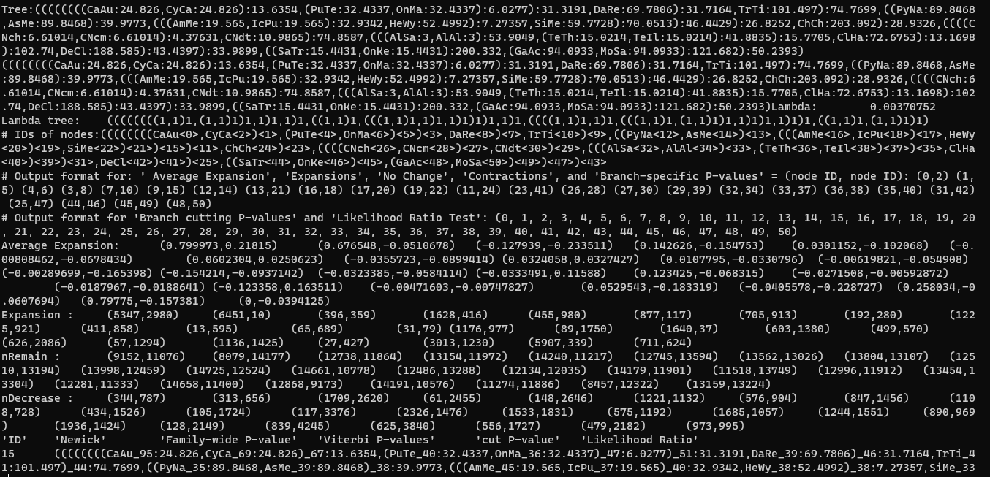
Raw output...

Slide 26
Contd..
5.3. Statistics
python cafetutorial_report_analysis.py -i reports/report_run1.cafe -o reports/summary_run1

Slide 27
Final tree output..

Slide 28
THANKS……

