Slide 1
STACKS & ARLEQUIN
Ruyi Huang 黄汝怡
Jan 15th, 2026

Slide 2
01
General Introduction
OVERVIEW
02
STACKS
http://catchenlab.life.illinois.edu/stacks/
03
ARLEQUIN
https://cmpg.unibe.ch/software/arlequin35/Arlequin35.html

Slide 3
01
General Introduction

Slide 4
F_{IS}（coefficient of inbreeding 近交系数 ）
FIS The inbreeding coefficient is defined as the probability that the two alleles at any locus in a diploid individual are derived from the same gene in a common ancestor, and it is expressed as a percentage that represents the degree of genetic homozygosity resulting from a given number of generations of consanguineous mating.
FIS = 0：杂合度符合 Hardy–Weinberg 预期，没有近交。
FIS > 0：杂合度比预期低 → 种群存在近交。
FIS < 0：杂合度比预期高 → 可能存在杂合优势或外来基因流入等。
Pi/π（nucleotide diversity 核苷酸多样性）
π measures the level of genetic diversity within a population, and it specifically represents the average proportion of nucleotide differences between any two randomly sampled sequences.
A higher π value indicates greater genetic variation within a population and thus higher genetic diversity.
F_{st} （Fixation index 遗传分化系数）
FST measures the degree of genetic differentiation between different populations and reflects the proportion of the total genetic variation that is due to differences among populations.

Slide 5
F_{st} is develop from F statistics, reflecting the level of heterozygosity of population alleles, and used to measure the degree of population differentiation.
Average heterozygosity among subpopulations
Average heterozygosity in composite population
Notes:
Fst：群体间遗传分化指数，是种群分化和遗传距离的一种衡量方法，分化指数越大，差异越大。适用于多个群体间多样性的比较。
用于衡量种群分化程度，取值从0到1，为0则认为两个种群间是随机交配的，基因型完全相似；为1则表示是完全隔离的，完全不相似。它往往从基因的多样性来估计，比如SNP或者microsatellites(串联重复序列一种，长度小于等于10bp)。是一种以哈温平衡为前提的种群遗传学统计方法。
两个种群之间遗传差异的基本测量是统计量FST。在遗传学中，F一词通常代表“近亲繁殖”，它倾向于减少群体中的遗传变异。遗传变异可以用杂合度来衡量，所以F一般表示群体中杂合性的减少。 FST是与它们所属的总群体相比，亚群体中杂合性的减少量。
具体可以下面的公式表示：

Slide 6
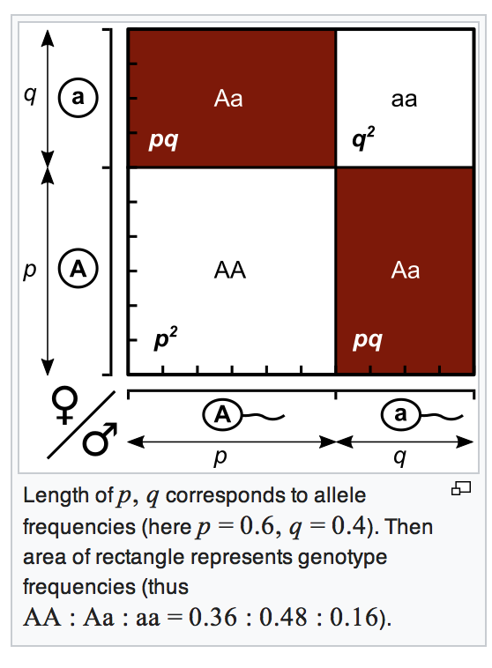
Hardy-Weinberg equilibrium
In an infinite mating population that mates with each other without mutation, migration and selection, gene frequency and genotype frequency will remain unchanged from generation to generation.
One locus with 2 alleles at HWE: p² + 2pq + q² = 1
Test of non-random association of alleles within diploid individuals.
Separate tests are carried out at each locus.

Slide 7
02
STACKS
http://catchenlab.life.illinois.edu/stacks/

Slide 8
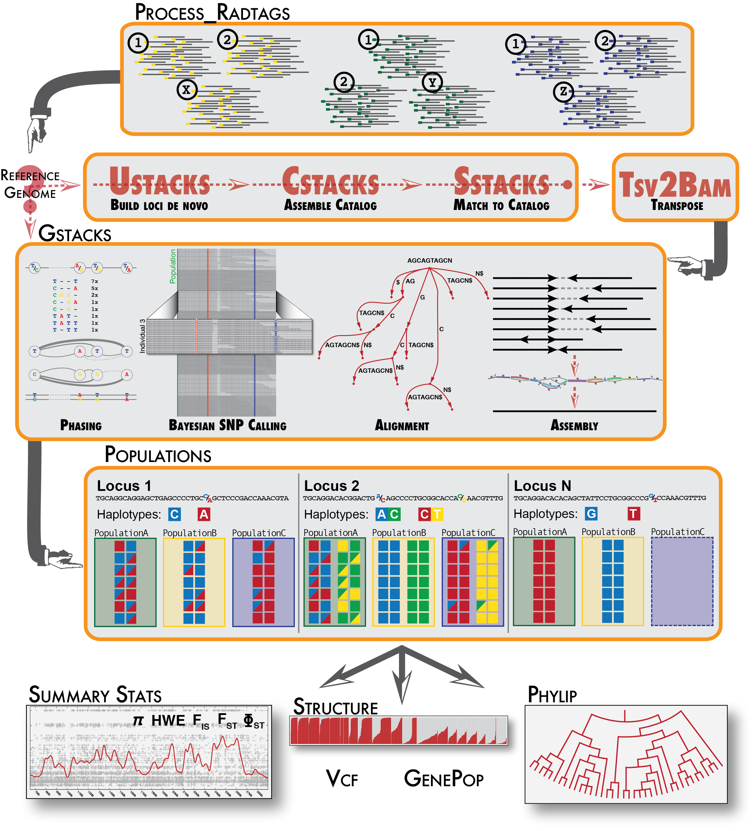
Stacks is designed as a modular pipeline to efficiently curate and assemble large numbers of short-read sequences from multiple samples.
Stacks employs a Catalog to record all loci identified in a population and matches individuals to that Catalog to determine which haplotype alleles are present at every locus in each individual.
The Stacks pipeline
Notes:
stacks的piplinge整体流程是这样的，但是我们只使用它其中生成汇总统计数据和计算种群遗传测量值的模块，解释一下为什么

Slide 9
populations - This program will be executed in place of the exisiting genotypes program when a population is being processed through the pipeline. The populations program will output site level SNP calls (in VCF format) and will compute summary statistics ( population genetic measures such as F_{IS} and π within populations and F_{ST} between populations).
1.building genetic maps
2.conducting population genomics
3.conducting phylogeography
The populations program will analyze a population of individual samples computing a number of population genetics statistics as well as exporting a variety of standard output formats. And compare all populations pairwise to compute F_{ST}.
Notes:
Stacks provides tools to generate summary statistics and to compute population genetic measures such as FIS and π within populations and FST between populations, allowing for genome scans.
Stacks 提供了生成汇总统计数据和计算种群遗传测量值的工具，例如种群内的 FIS 和 π 以及种群之间的 FST，从而允许进行基因组扫描。
种群程序将分析单个样本种群，计算一些种群遗传学统计数据，并导出各种标准输出格式。 并成对比较所有种群以计算 FST。

Slide 10
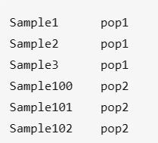
Working with STACKS--program options
Tab!!! Not Space
populations 1.44
Usage:
$ populations -V vcf -O dir [-M popmap] (filters) [--fstats] [-k [--sigma=150000] [--bootstrap [-N 100]]] (output formats)
-V,--in_vcf: path to an input VCF file.
-O,--out_path: path to a directory where to write the output files. (Required by -V; otherwise defaults to value of -P.)
-M,--popmap: path to a population map. (Format is 'SAMPLE1 POP1\SAMPLE2 POP1'.)
-t,--threads: number of threads to run in parallel sections of code.
--fstats: enable SNP and haplotype-based F statistics.
-k,--kernel_smoothed: enable kernel-smoothed Pi, Fis, Fst, Fst', and Phi_st calculations.
--sigma [int]: standard deviation of the kernel smoothing weight distribution. Default 150kb.
--bootstrap: turn on boostrap resampling for all smoothed statistics.

Slide 11
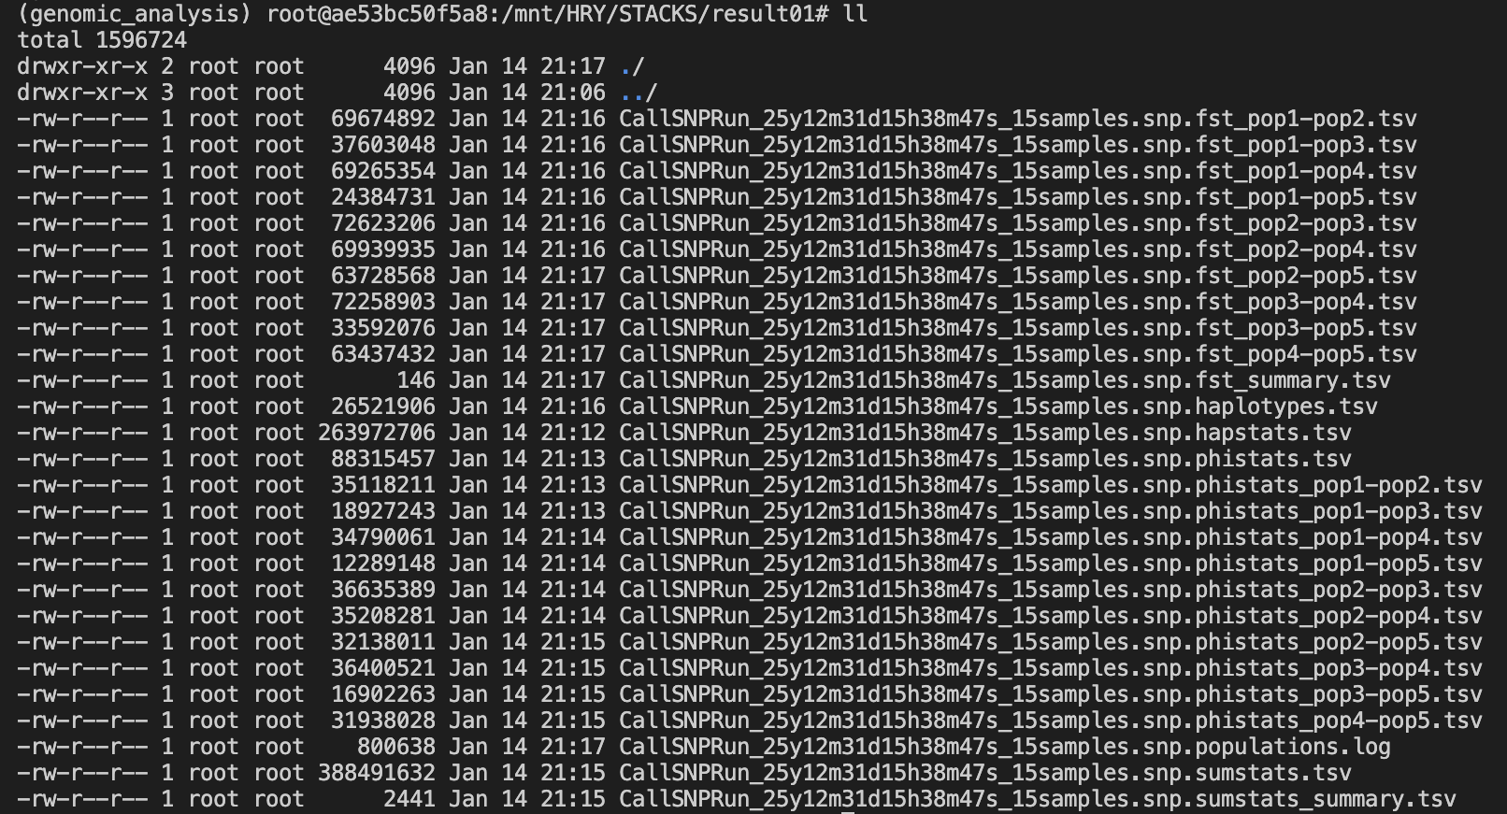
Working with STACKS--results
Notes:
1. populations.log：此文件包含了屏幕上显示的所有输出内容，包括 Stacks 的版本号以及运行时间。它还包含了许多描述应用过滤器后数据的有用信息，包括丢弃/保留的位点数量、位点的平均长度以及平均位点数。
2. populations.sumstats.tsv：此文件包含描述在群体分析图中定义的每个群体中发现的每个单核苷酸多态性（SNP）的汇总统计信息。这包括等位基因的频率、预期/观察到的杂合度、π、FIS 等等。
3. populations.hapstats.tsv：此文件包含了描述每个群体中所发现的每一个位点（已分型的单核苷酸多态性）的汇总统计信息。其中包括单倍型的频率、基因多样性和单倍型多样性。
4. populations.sumstats_summary.tsv：此文件包含了群体层面的平均汇总统计信息。
5.如果启用了 F 统计量功能，那么 populations.fst_X-Y.tsv 这个文件就包含了基于单核苷酸多态性（SNP）的 FST 指标数据。
6.如果启用了 F 统计量功能，那么 populations.phistats_X-Y.tsv 文件：此文件包含了基于单倍型的 FST 指标测量值。

Slide 12
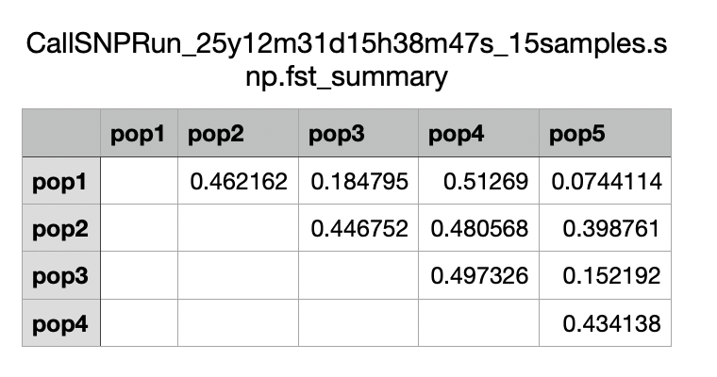
Working with STACKS--results
If F_{st} in 0 ~ 0.05, means that the genetic differentiation between populations is very small, which can be ignored.
If F_{st} in 0.05 ~ 0.15, means moderate genetic differentiation between populations.
If F_{st} in 0.15 ~ 0.25, means large genetic differentiation between populations.
If F_{st} > 0.25, means great genetic differentiation between populations.
Notes:
Display fst values between different species

Slide 13
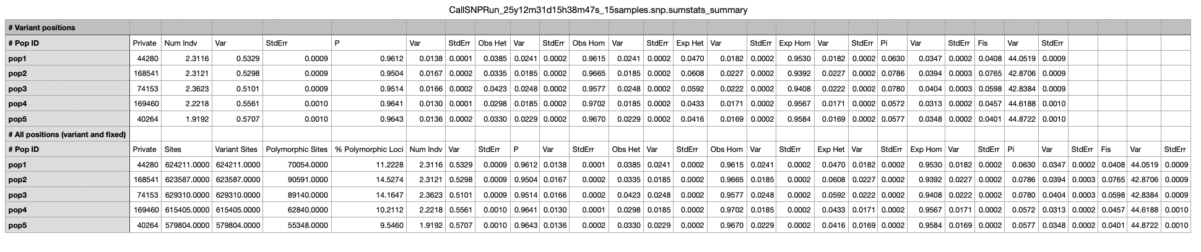

Slide 14
03
ARLEQUIN
https://cmpg.unibe.ch/software/arlequin35/Arlequin35.html

Slide 15
Arlxequin
An Integrated Software for Population Genetics Data Analysis（quite a large set of basic methods and statistical testsx）
Purpose ：analyze several times the same data set from different perspectives
data types are:
• DNA sequences （ arbitrary length ）
• RFLP data
• Microsatellite data
• Standard data
• Allele frequency data
Inter-population methods:
• AMOVA
• Hardy-Weinberg equilibrium

Slide 16
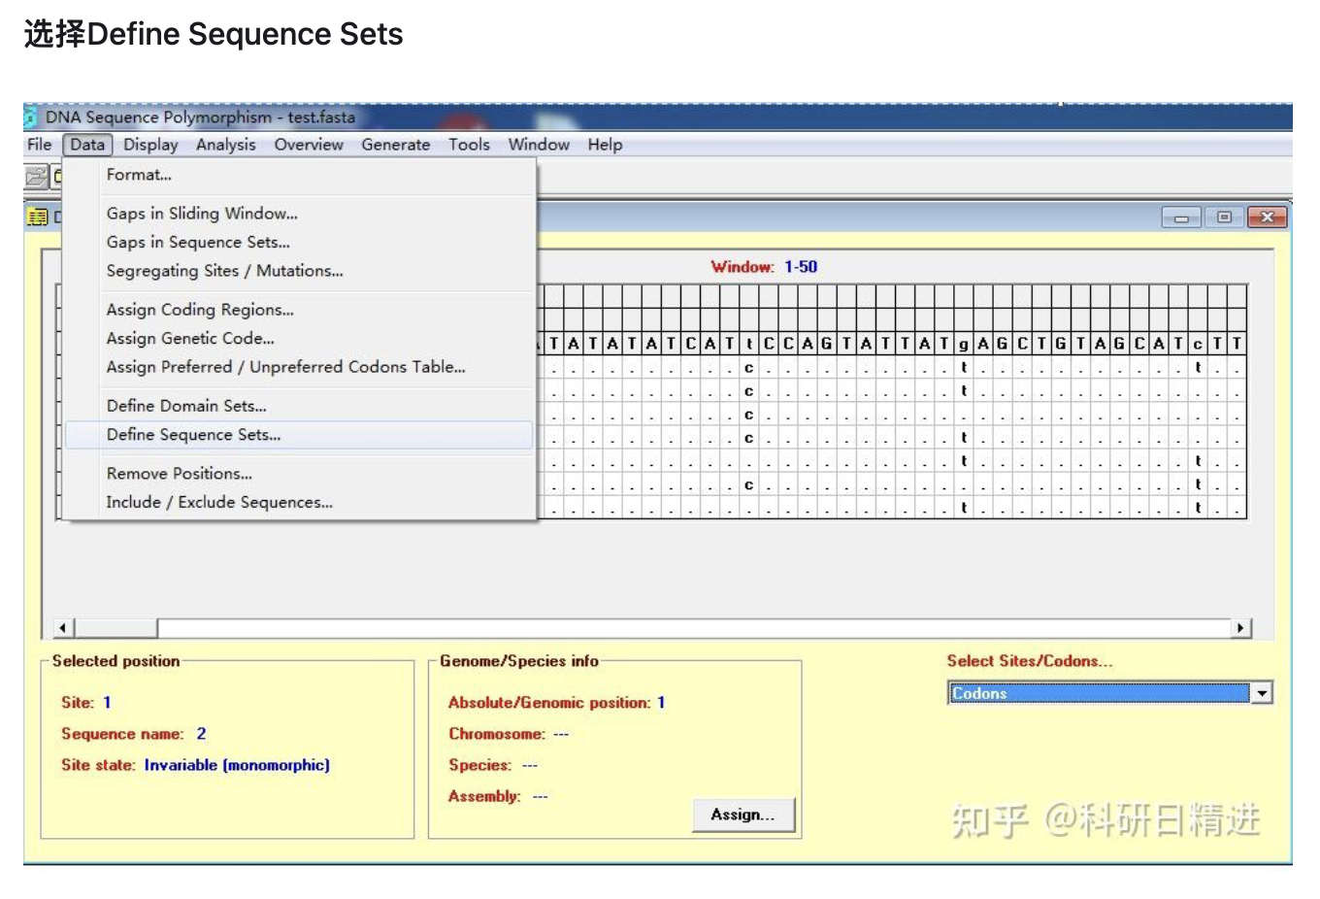
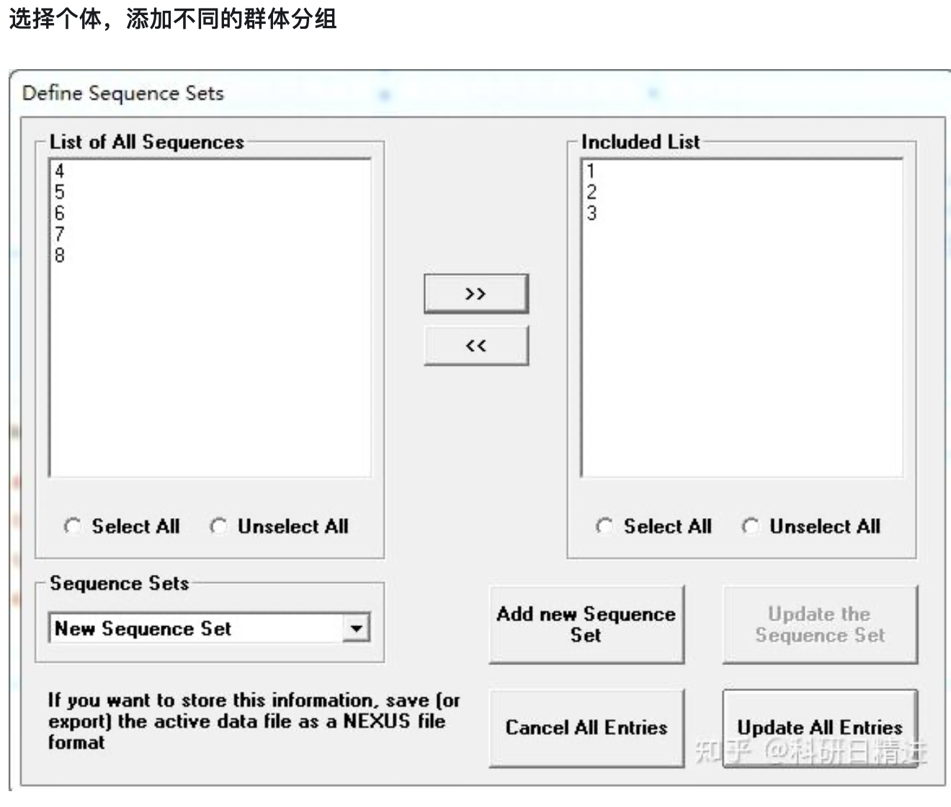
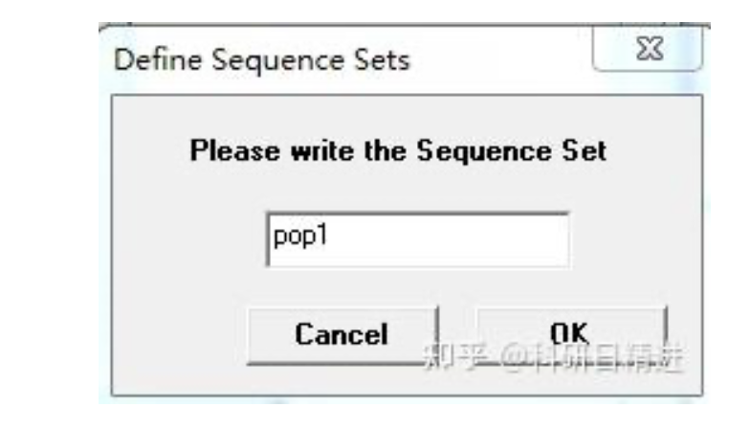
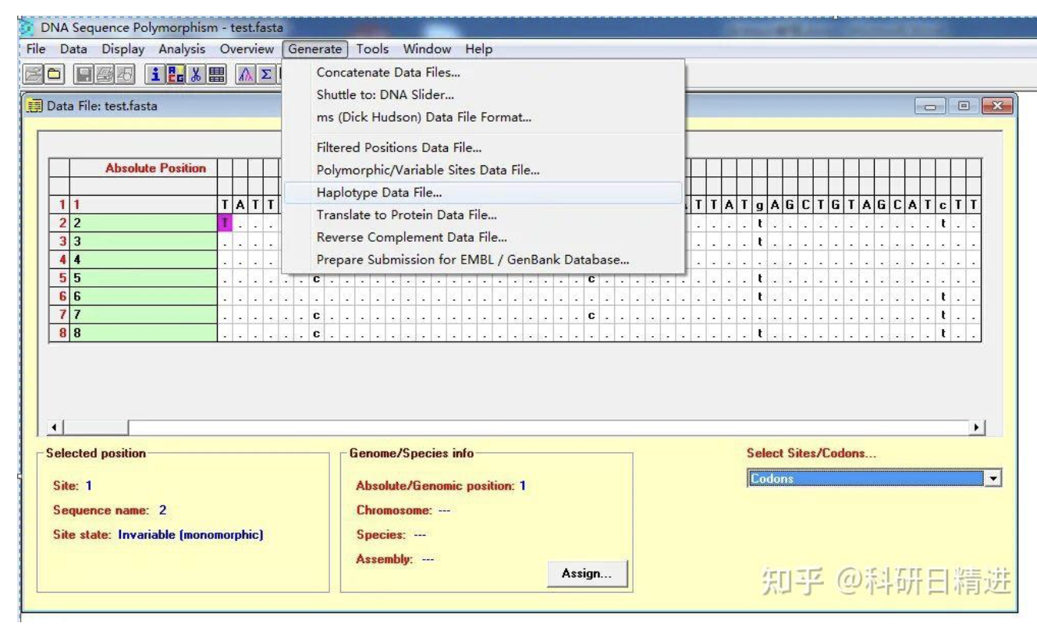
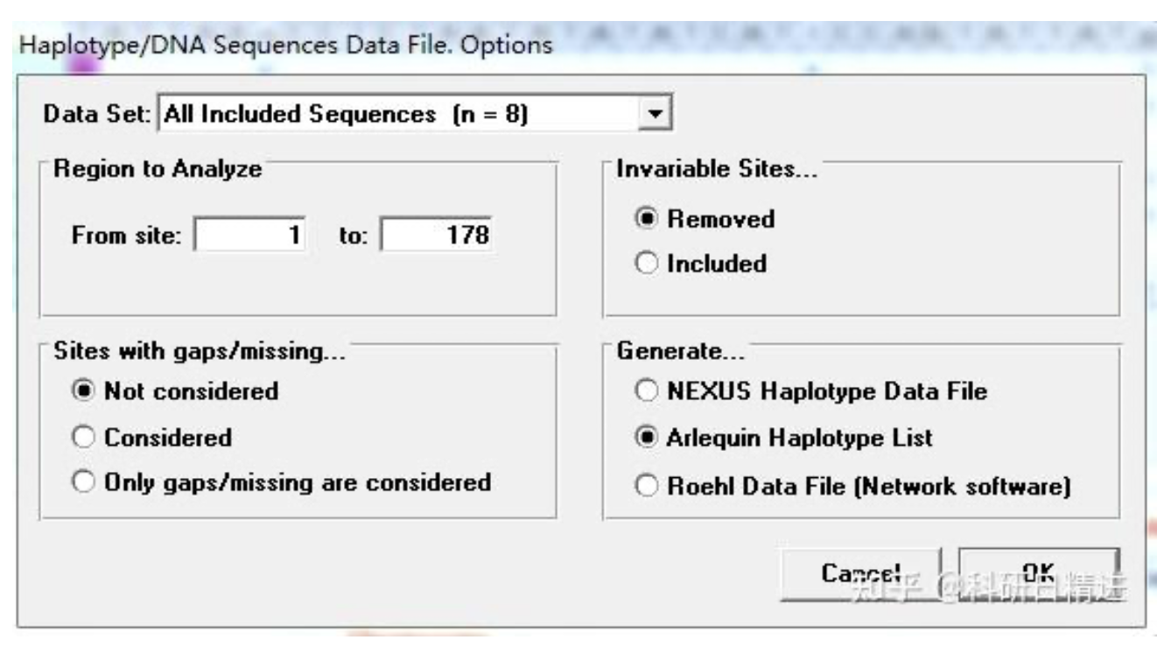
use DNASP to prepare haplotype (.arq) file
Notes:
1、Arlequin可以处理DNA序列数据，也可以处理微卫星数据。微卫星数据可以直接用Genalex导出为arp文件，导出时需要选择数据类型为微卫星。假如是DNA序列数据，则首先比对好序列，得到fasta格式的文件。用DNASP软件打开比对好的序列。
2、选择Define Sequence Sets
3、选择个体，添加不同的群体分组
4、给群体命名，直到所有群体定义好
5、点击update所有点击生成单倍型文件
6、选择Arlequin格式保存

Slide 17
AMOVA
Different hierarchical Analyses of Molecular Variance to evaluate the amount of population genetic structure.
This method can discuss whether there are corresponding genetic variations among different altitudes, different languages, and geographic groups.

Slide 18
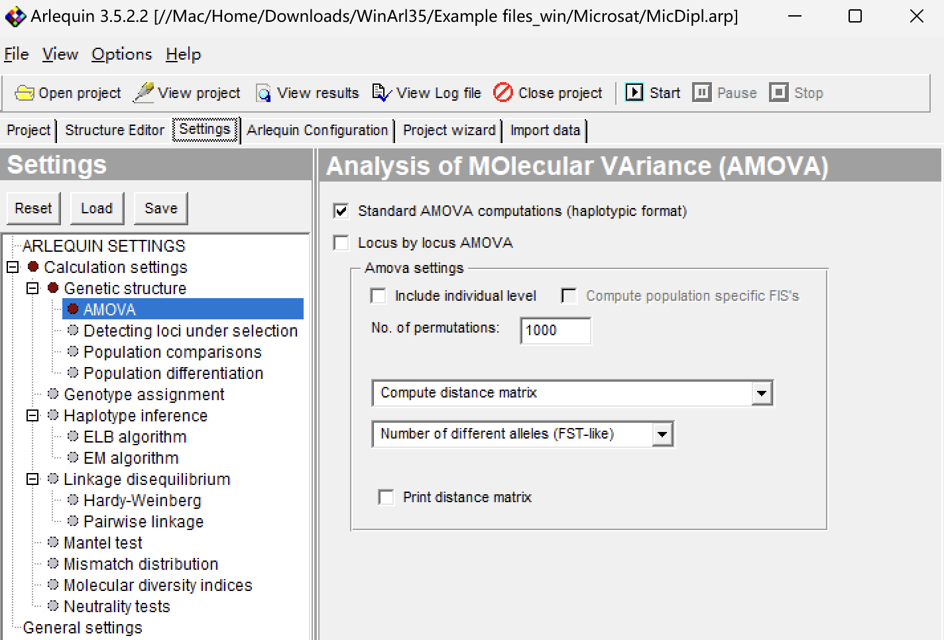
1.AMOVA with haplotypic data（a sister chromatid）
A separate AMOVA can be performed for each locus separately.
Population specific FST indices will be computed for all loci and for each locus separately.
Enter the number of permutations used to test the significance of covariance components and fixation indices.
project distance matrix
Compute distance matrix
Use conventional F-statistics

Slide 19
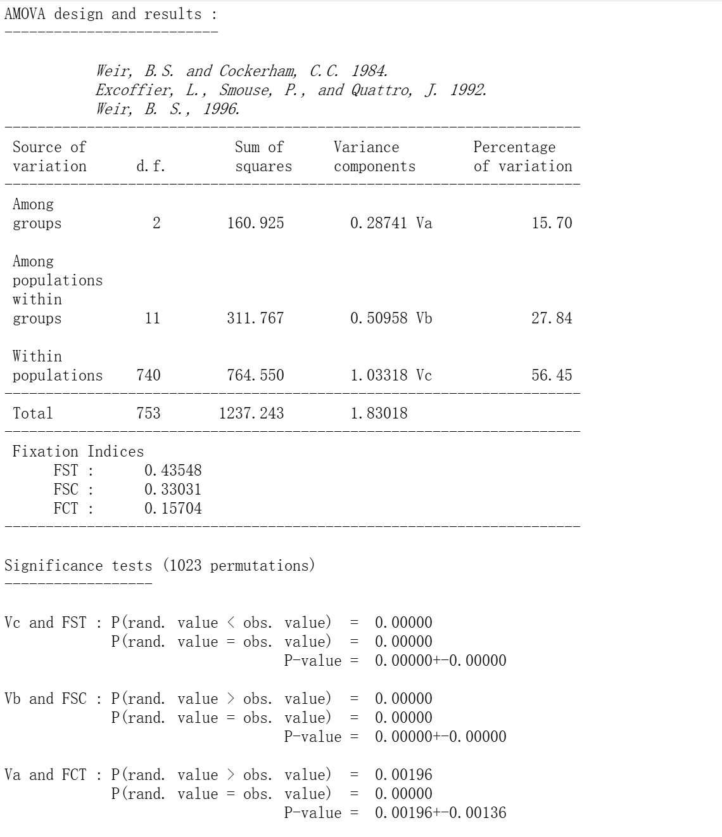
null hypothesis：
There are no differences among populations
P-value<=0.05(violate)

Slide 20
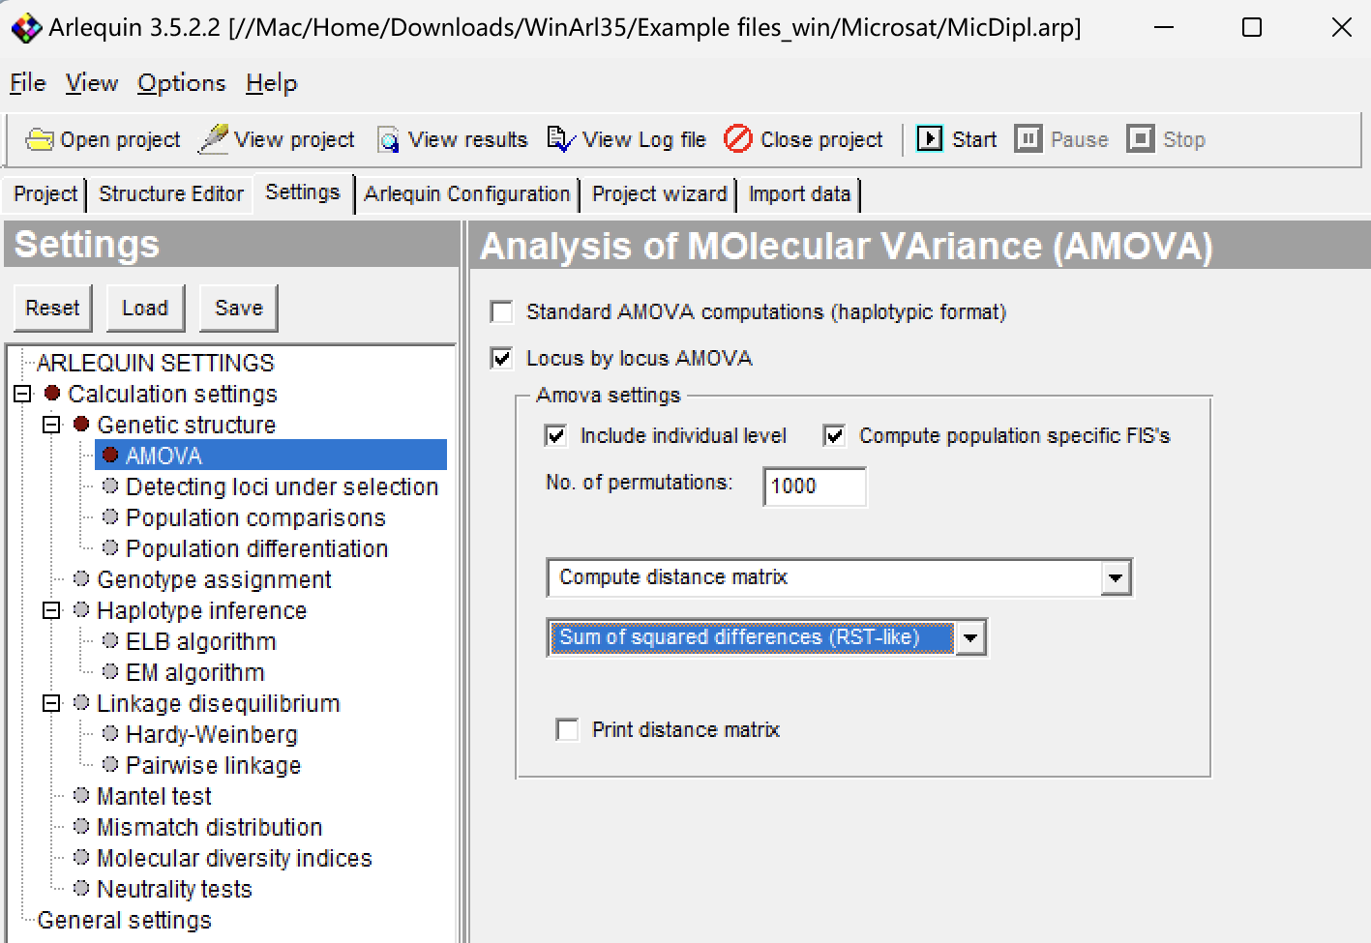
2.AMOVA with genotypic data（uncommonly used） Compared to haplotypic data, it becomes possible to compute the average inbreeding coefficient FIS with dipxloid genotypic data.
Include the intra-individual covariance component of genetic diversity, and its associated inbreeding coefficients (FIS and FIT)
Compute inbreeding coefficients (FIS) separately for each population and test it by permutation of gene copies between individuals within population. （Include individual level ）

Slide 21
Hardy-Weinberg equilibrium
In an infinite mating population that mates with each other without mutation, migration and selection, gene frequency and genotype frequency will remain unchanged from generation to generation.
One locus with 2 alleles at HWE: p² + 2pq + q² = 1
Test of non-random association of alleles within diploid individuals.
Separate tests are carried out at each locus.

Slide 22
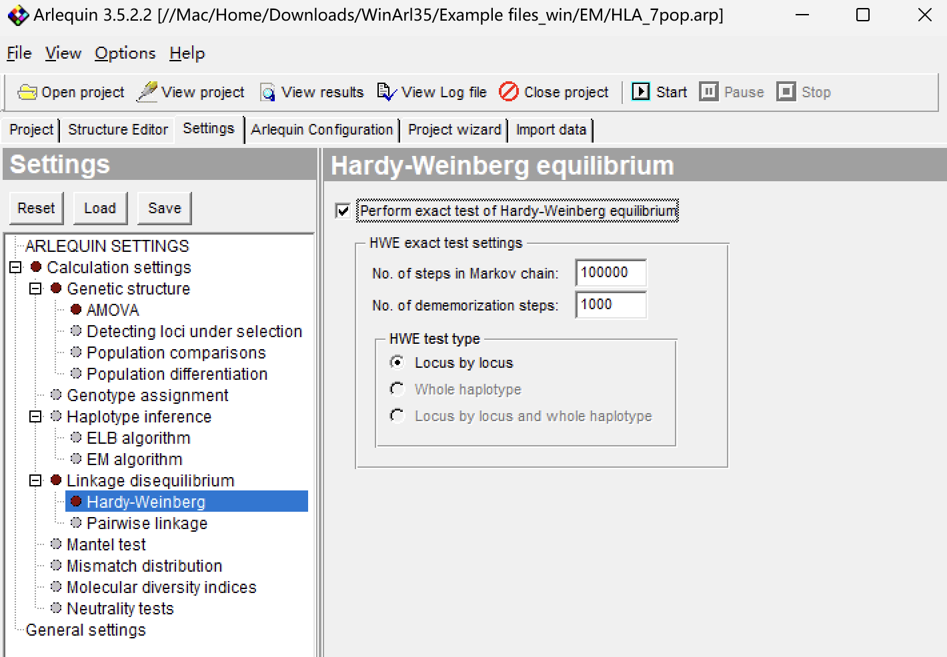
The maximum number of alternative tables to explore
The number of steps to perform before beginning to compare the alternative table probabilities to that of the observed table.
Perform separate HWE test for each locus.
Perform a HWE test at the haplotype level (if gametic phase is available).
Perform both kinds of tests (if gametic phase is available)

Slide 23
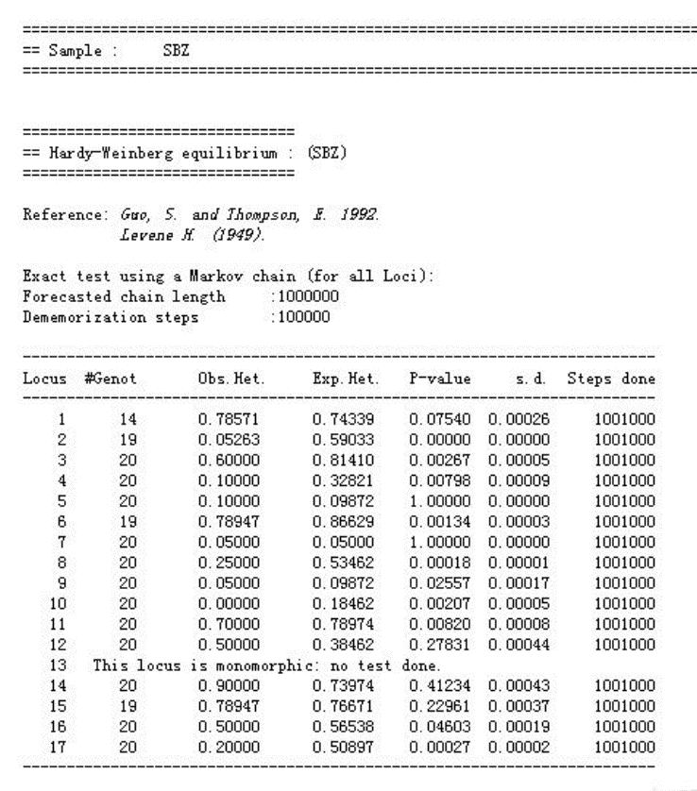
null hypothesis：
Conform Hardy-Weinberg equilibrium
P-value>0.05(Conform)

Slide 24

THANKS！

