Slide 1
Time tree & Divergence time estimating

Slide 2
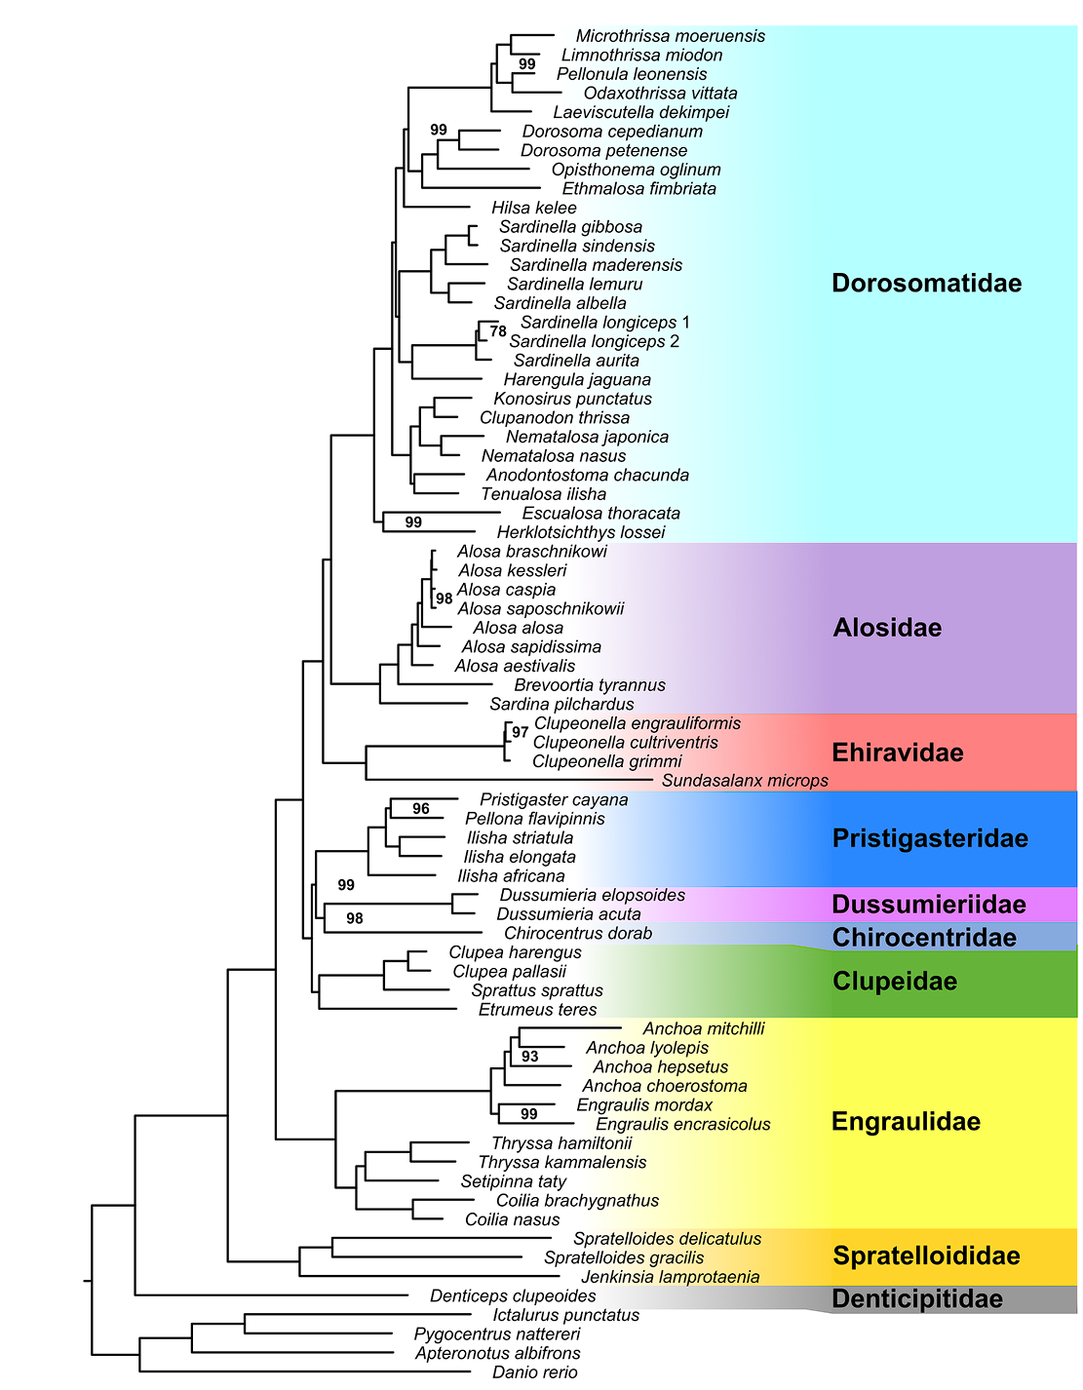
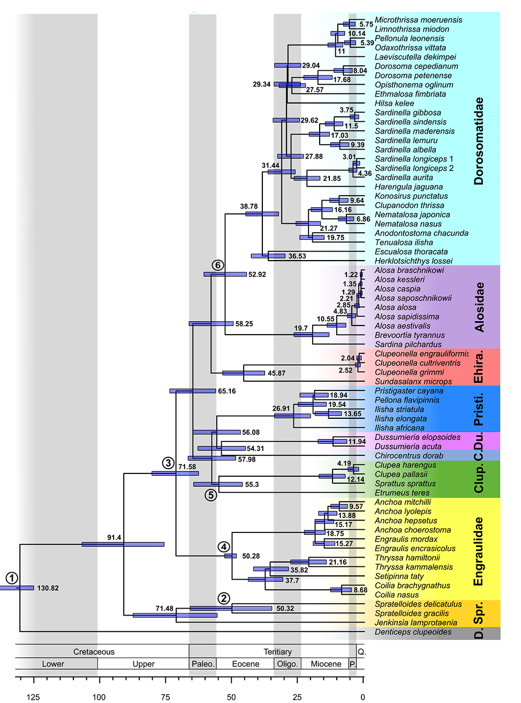

Slide 3
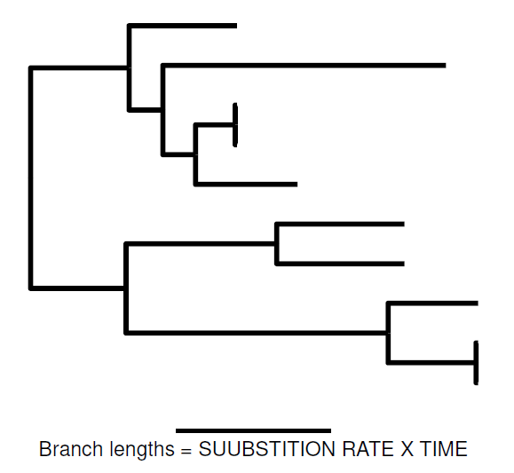

Slide 4
The Molecular Clock
DNA and protein sequences evolve at a rate that is relatively constant over time and among different organisms.
REALLY?
However, molecular evolution can vary significantly among organisms.
"relaxed" molecular clocks

Slide 5
STEP 0: Pick up clocklike loci
clocklikeness_test.pl in Assexon package
Input files:
(1) nf_aligned # File contains aligned sequences.
(2) besttree.tre # Concatenated ML tree
Output files:
(1) clocklike_dir # Loci following molecular clock hypothesis are written here.
(2) likelihood_list.txt
Align & Concatenate

Slide 6
Calibrating the Molecular Clock
Two DNA sequences that have a content difference of 5%.
Mutation rate 1% / million years * 5 million years ?
Mutation rate 5% / million years * 1 million years ?
Know the absolute age of some evolutionary divergence event !

Slide 7
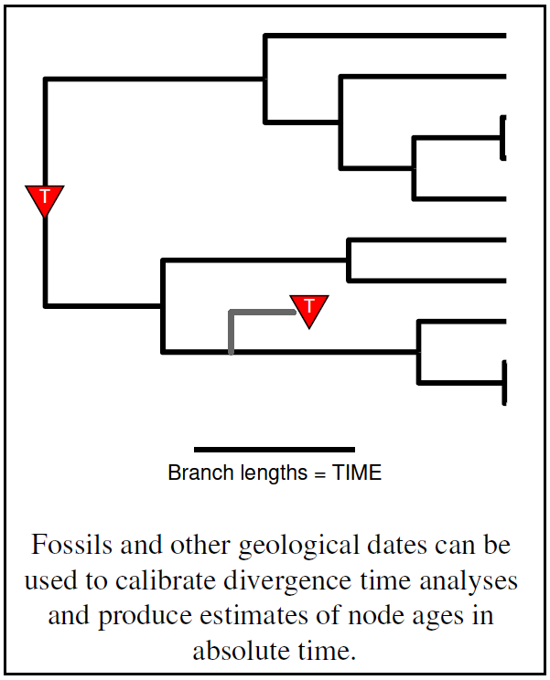

Slide 8
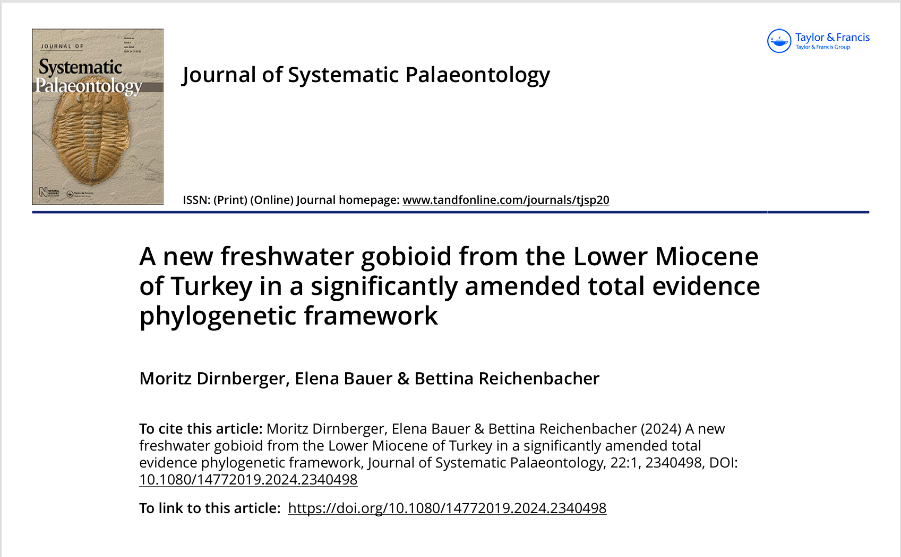
https://timetree.org/

Slide 9
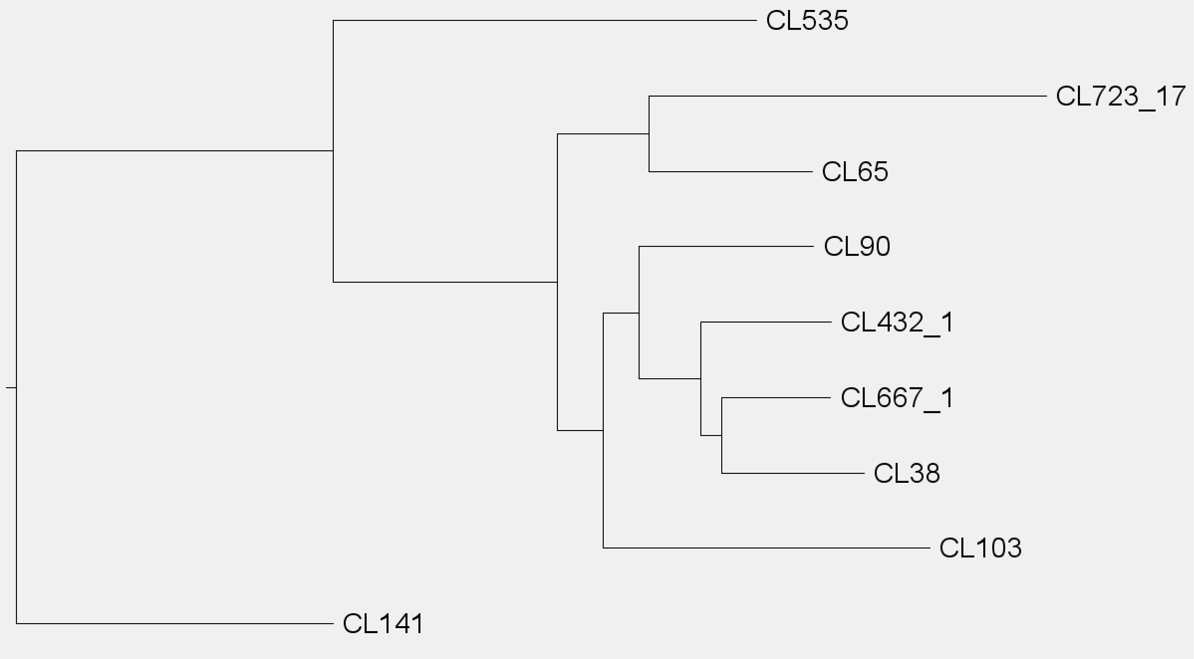
E.g.
F1: event (30-25 Ma)
F2: Fossil A (15-12 Ma)
F3: Fossil B (14-11 Ma)
F4: Fossil C (5-0.5 Ma)
So:
F2: max 30, min 12
F3: max 30, min 11
F4: max 14, min 0.5
F2
F1
F3
F4

Slide 10
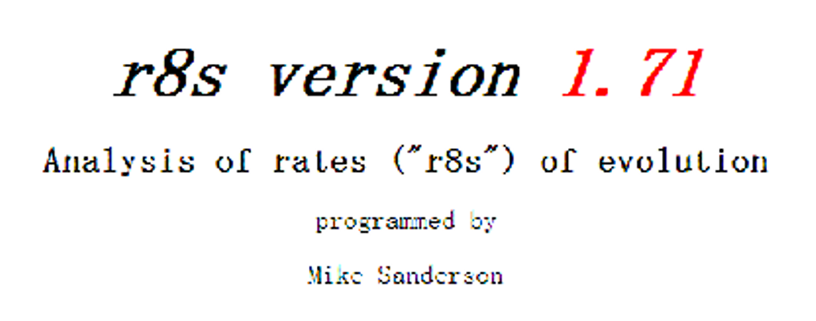
R8s (Calibration on tree)

Slide 11
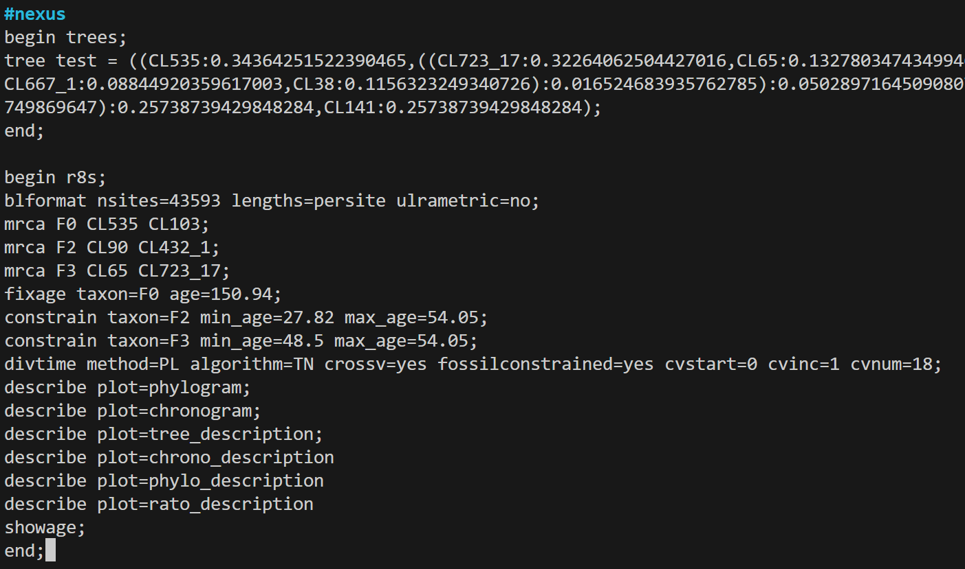
tree in .newick format
Calibration point setting
(>3 points, 1 fix, 2 constrain)
Result setting
nohup $PATH/r8s -b -f ./input_r8s.nex > r8s.out &

Slide 12
F2
F1 (fixed age)
F3

Slide 13
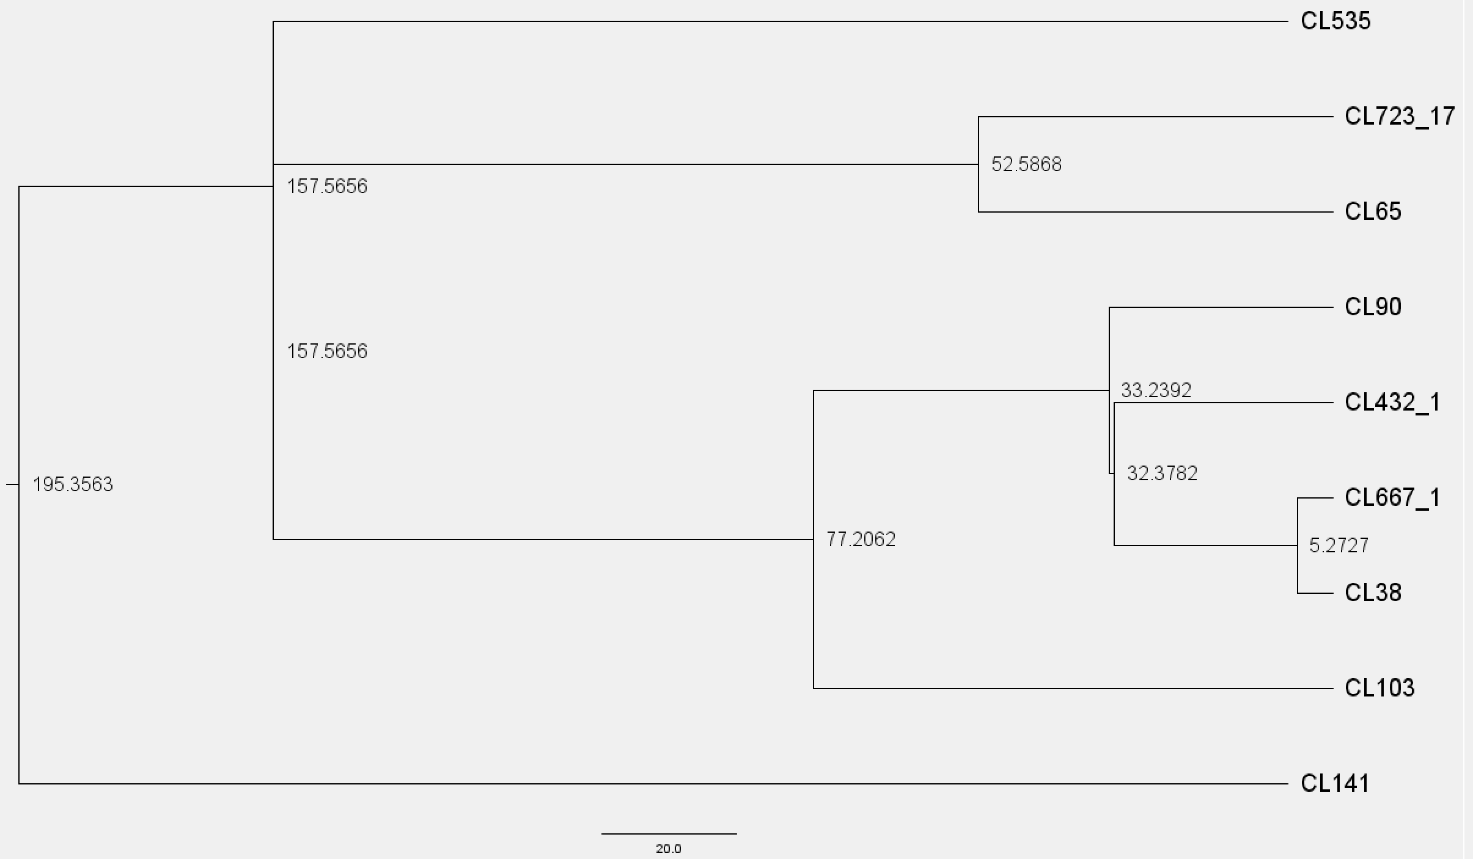
less r8s.out
If branch length < 0, change it to 0

Slide 14
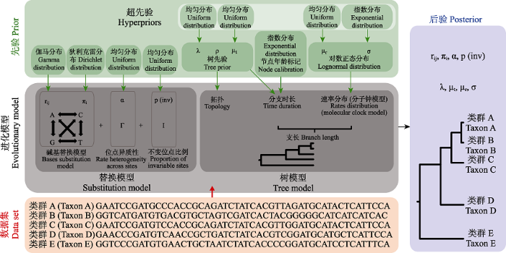
Bayesian time tree construction

Slide 15
Taming the Beast
Tutorials
https://taming-the-beast.org/
BEAUti
Generating input files
BEAST
Run analysis
Tracer
Estimate the result
TreeAnnotator
Output the result

Slide 16
Beast pipeline
Step 0:
Edit the input .nex file
(add partition infomation)

Slide 17
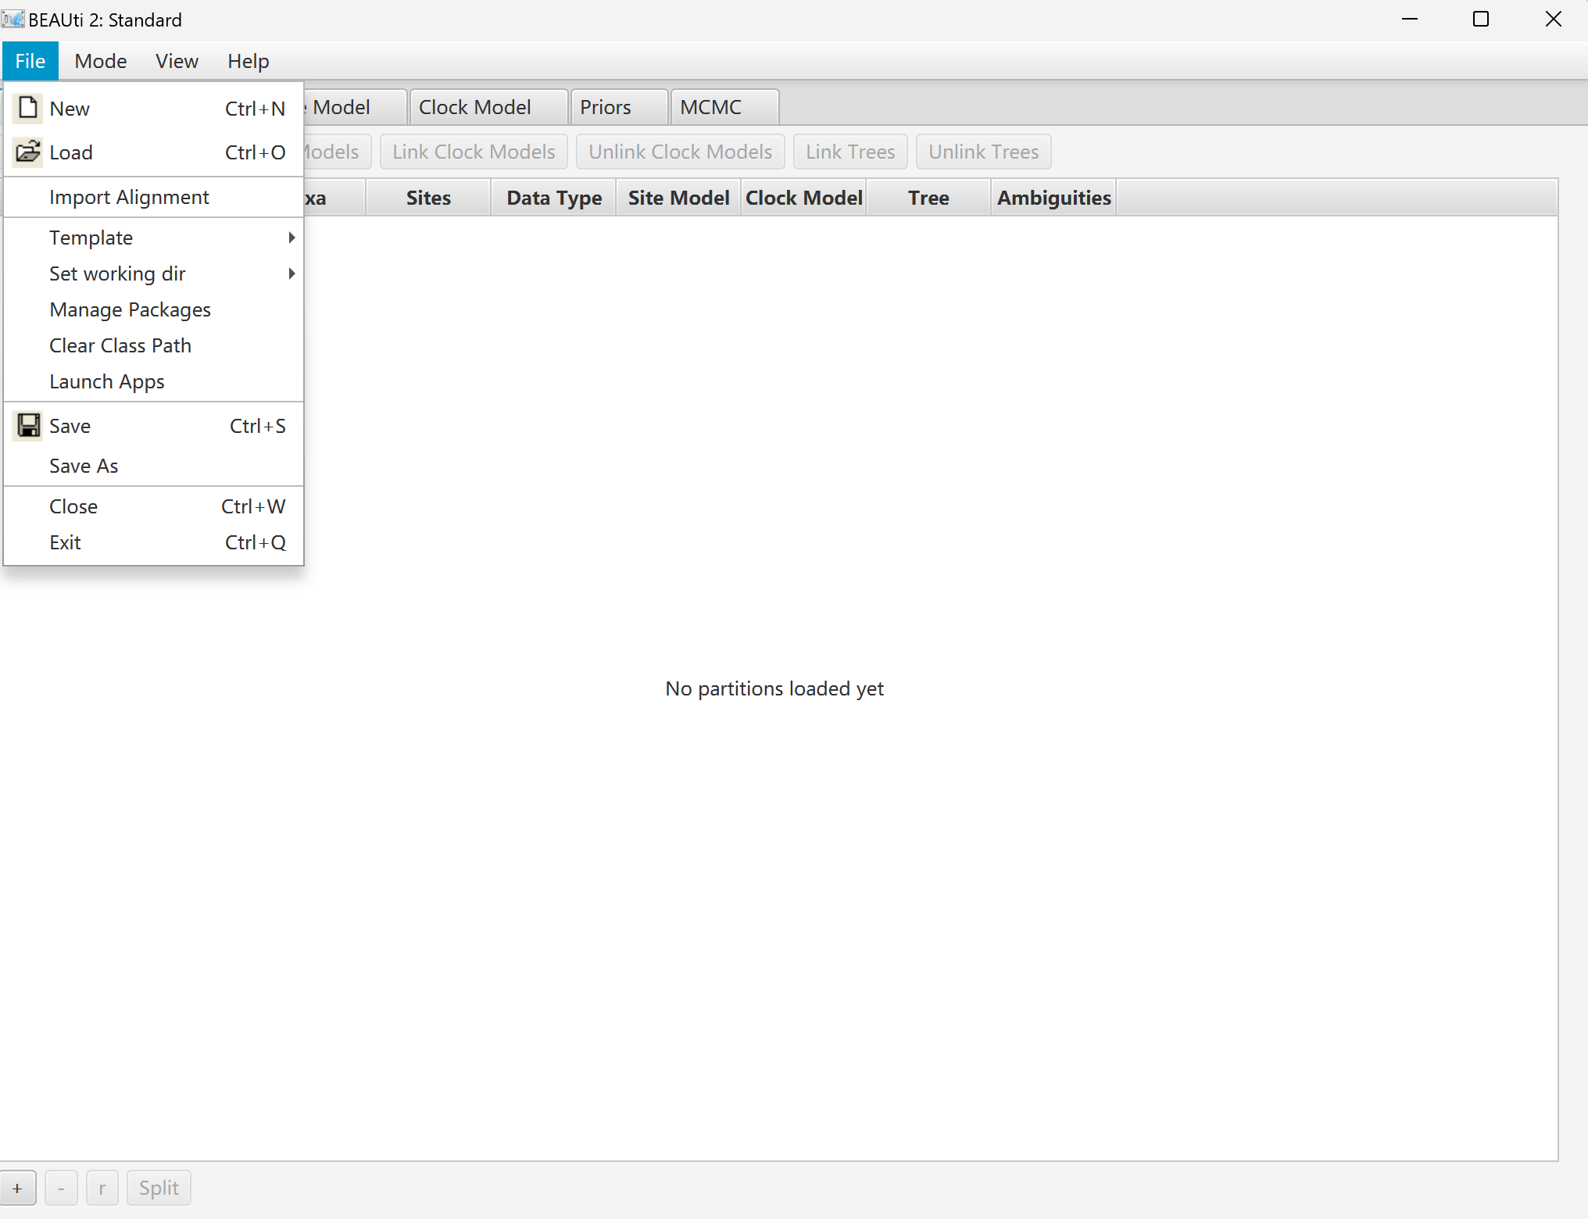
Step 1:
Import .nex file

Slide 18
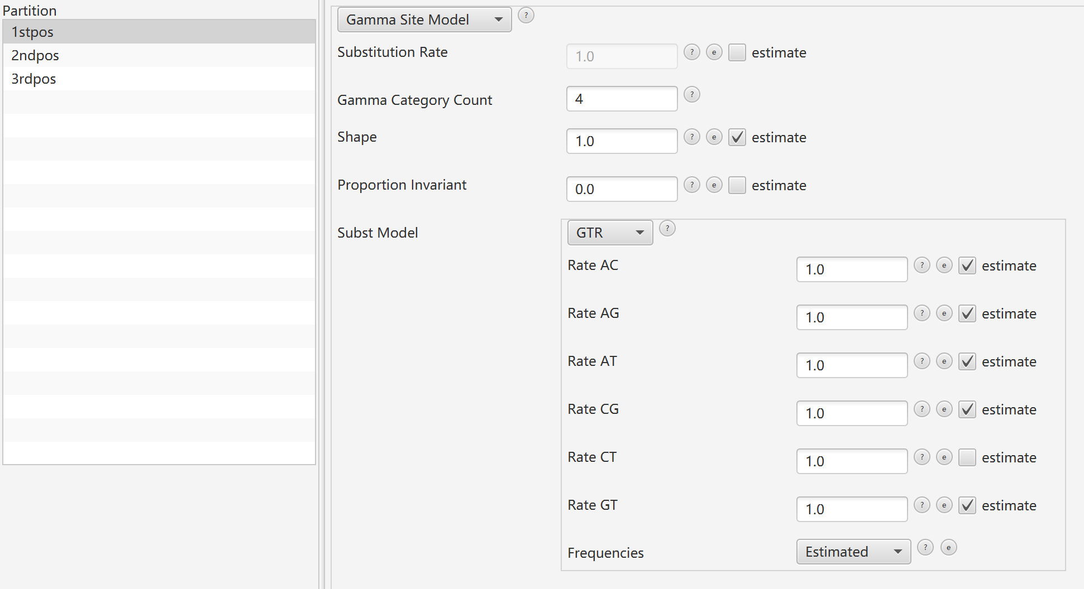
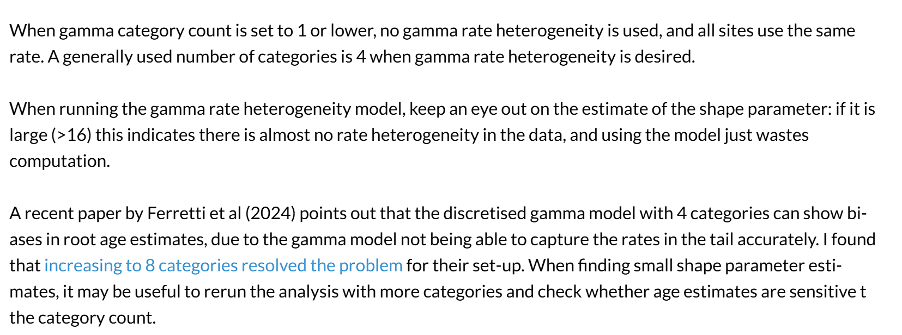
Step 2:
Set site model

Slide 19
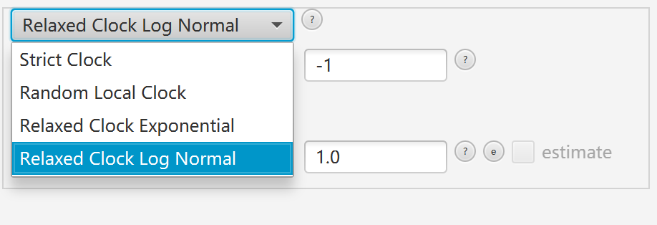
Step 3:
Set clock model

Slide 20
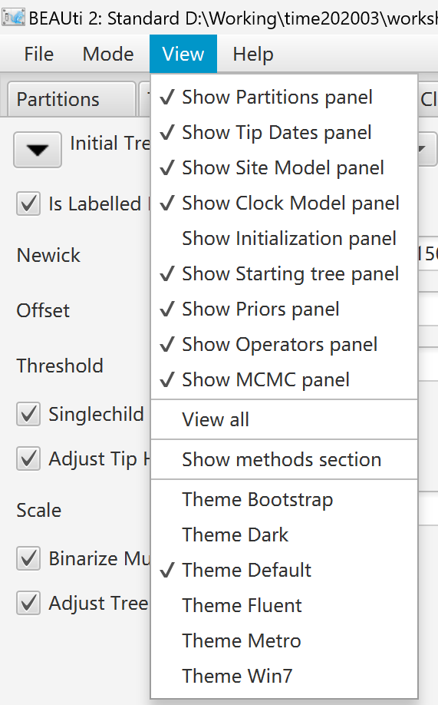
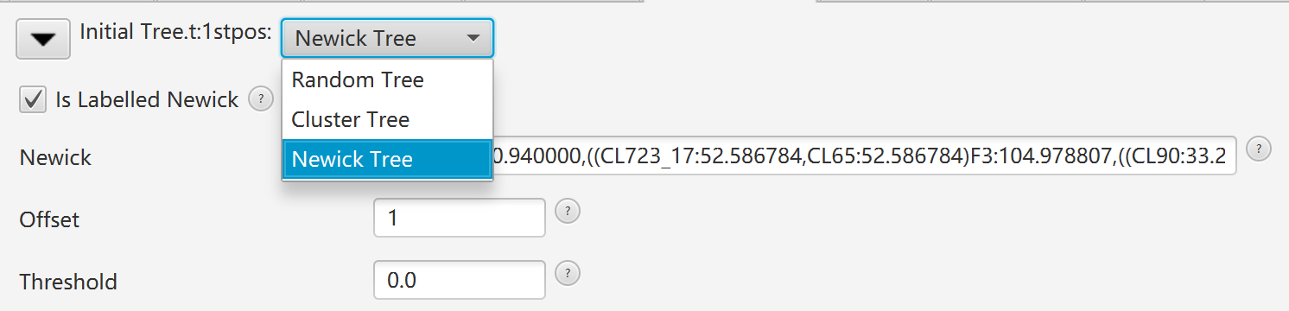
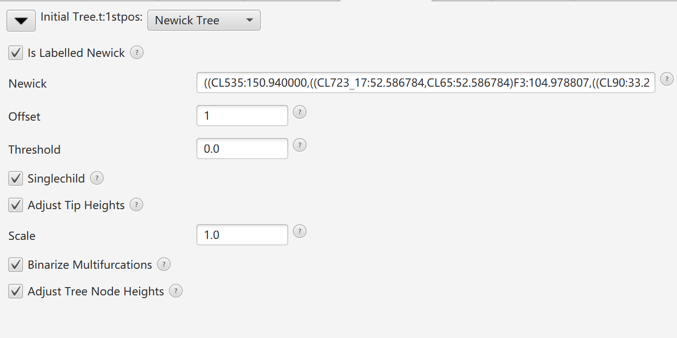
Step 4&4.5:
Set starting tree & tree parameter
Paste resulting newick tree from r8s

Slide 21
Step 4&4.5:
Set starting tree & tree parameter
Fix tree topology

Slide 22
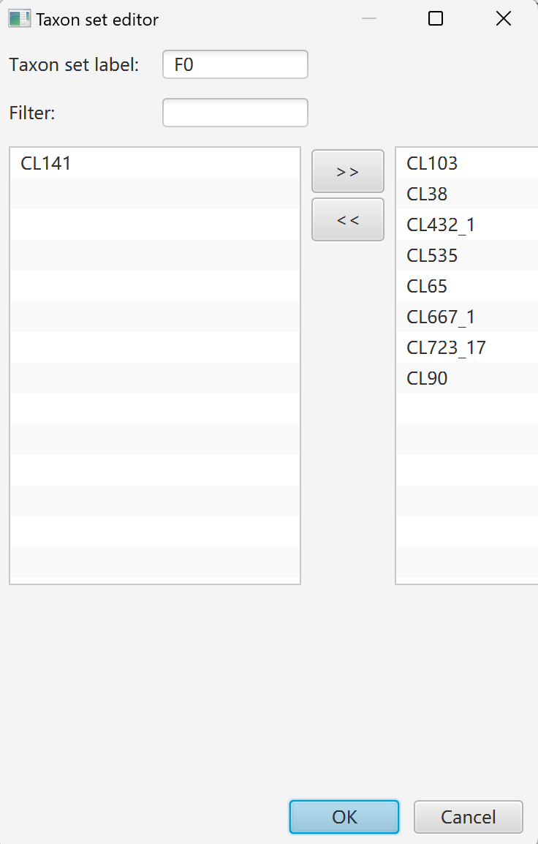
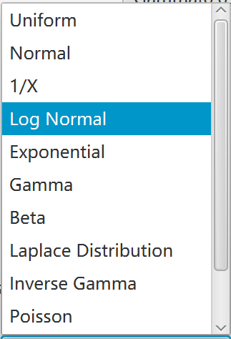
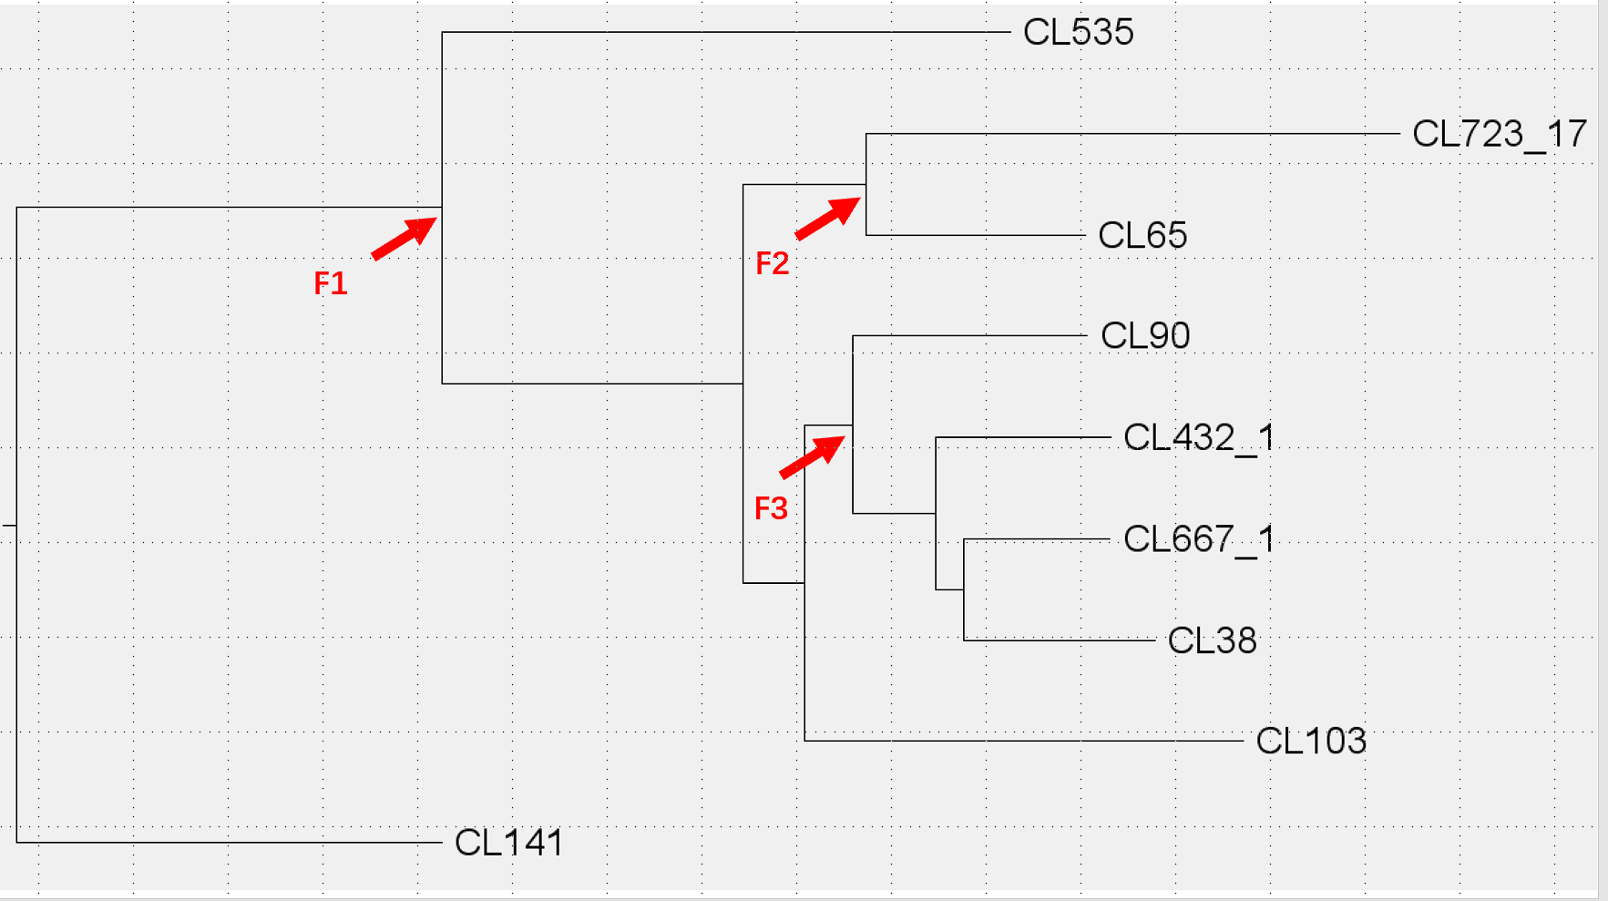
Step 5:
Set Priors
MRCA Priors

Slide 23
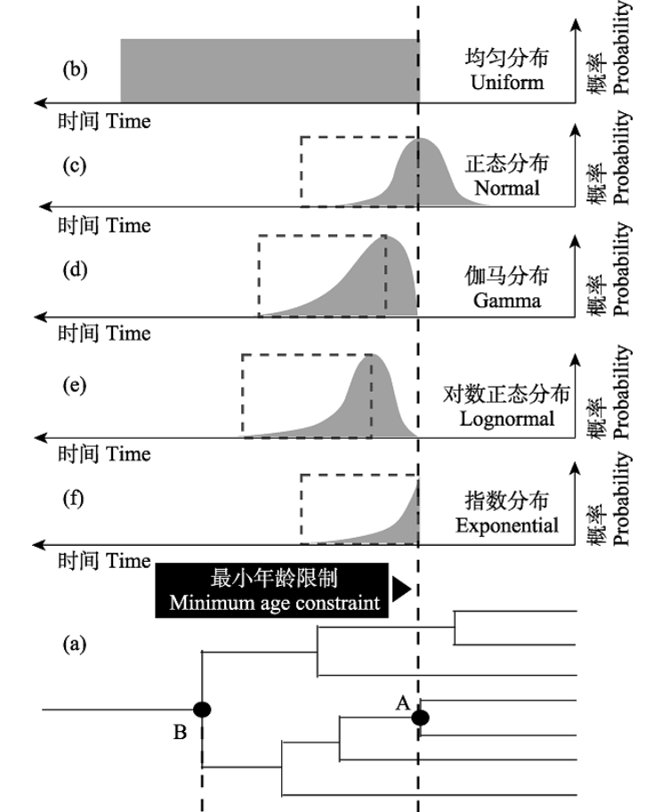
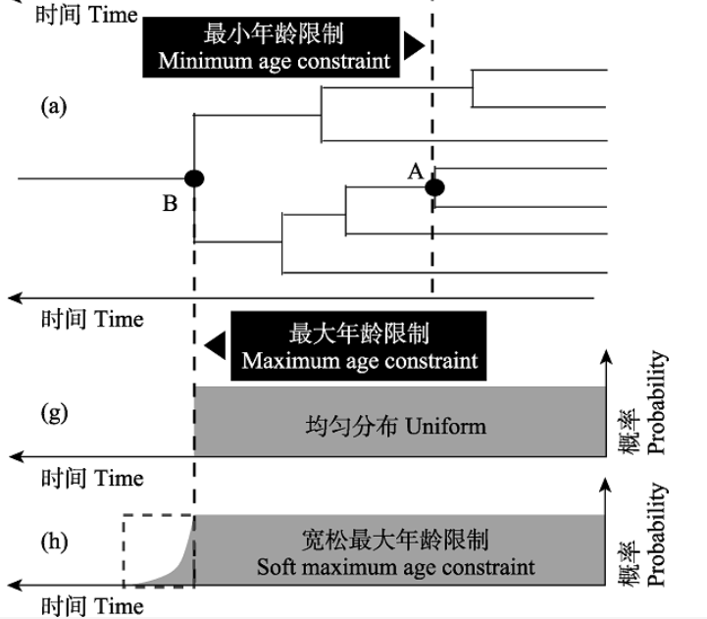

Slide 24
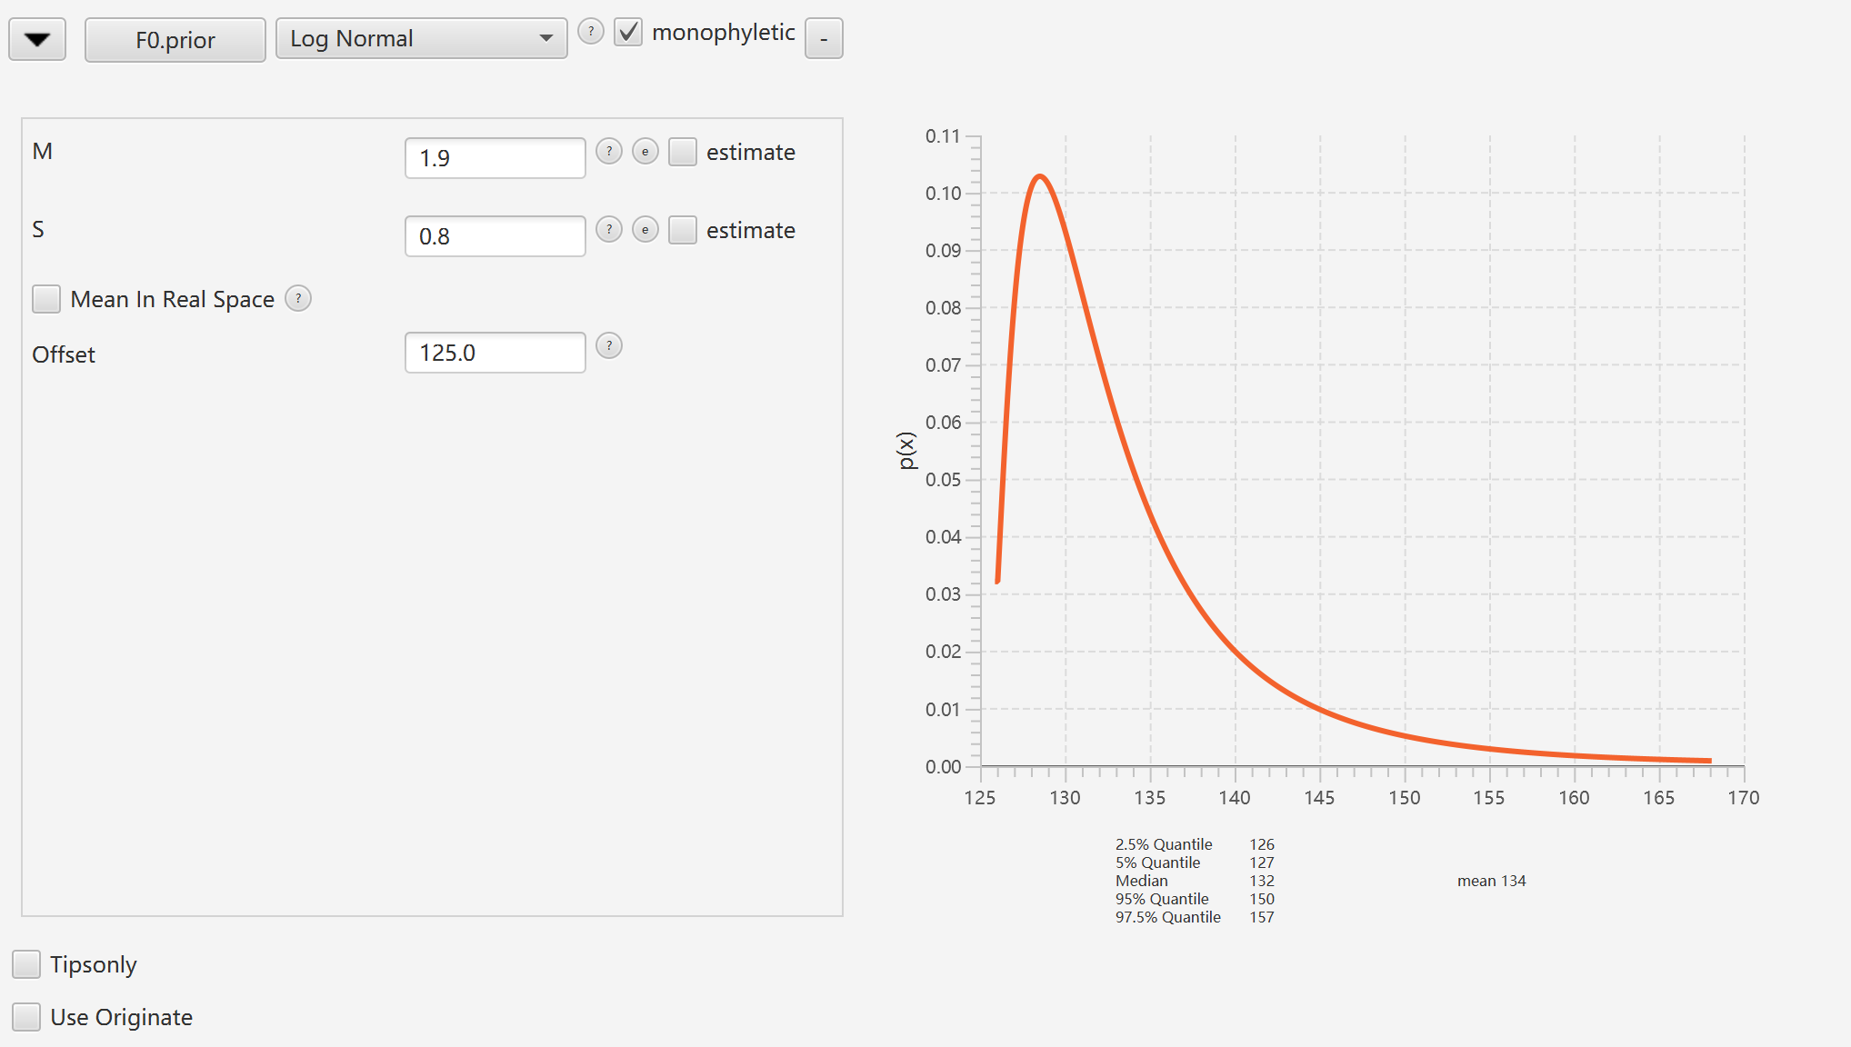
Hard min
Soft max

Slide 25
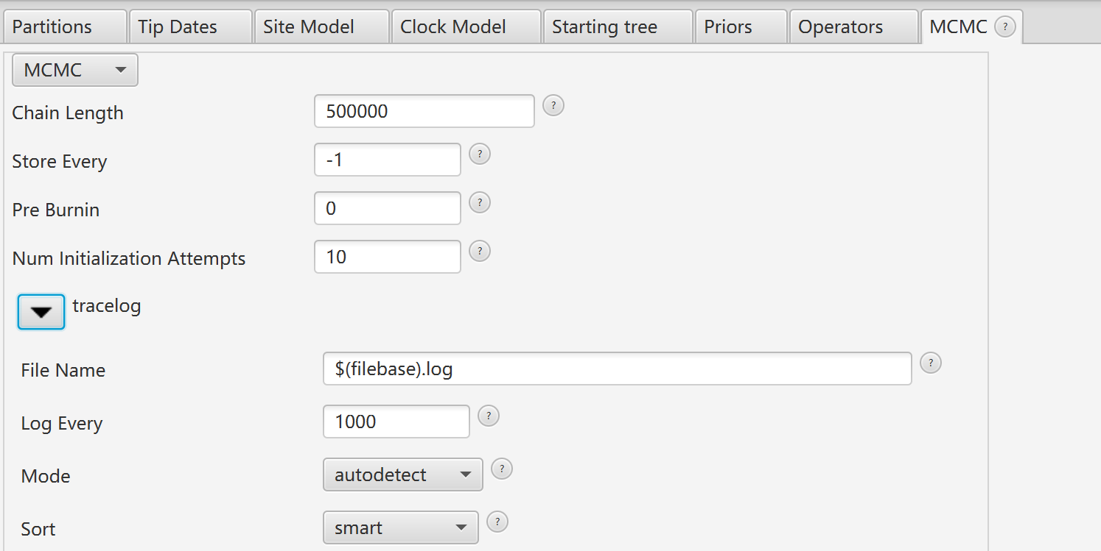
Step 6:
Set MCMC parameter

Slide 26
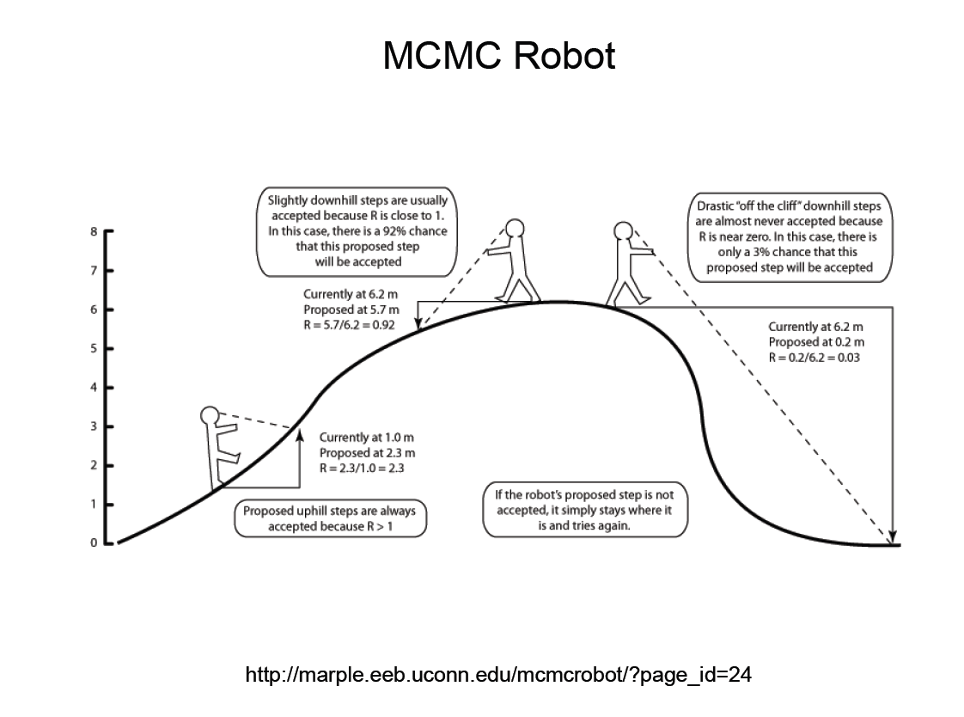

Slide 27
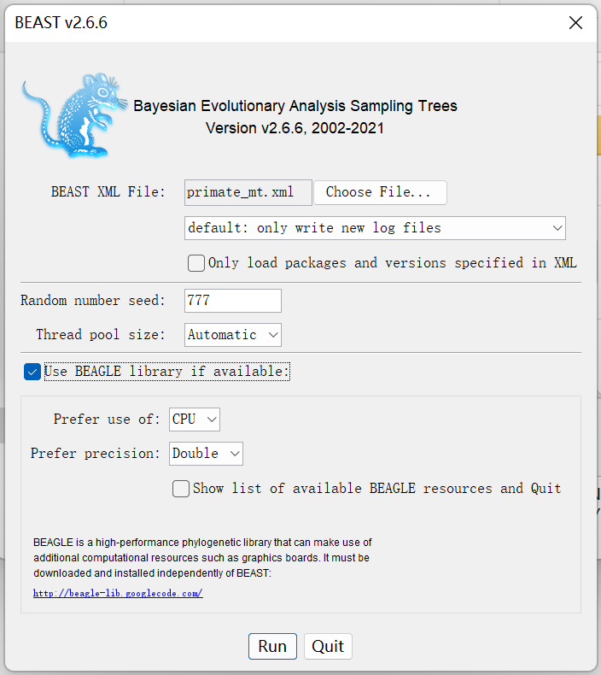
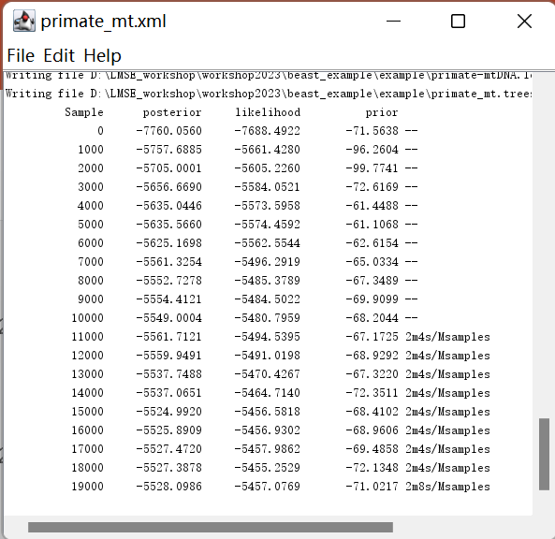

Slide 28
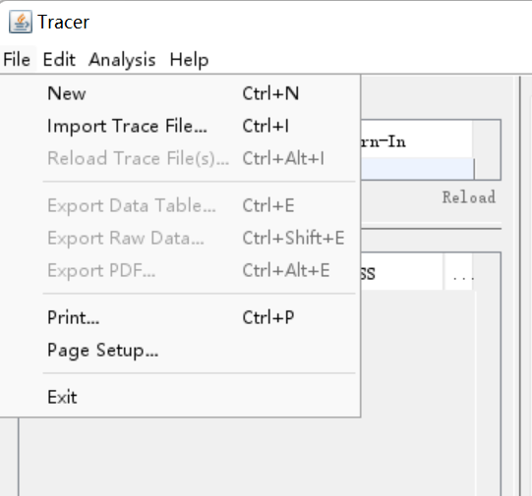
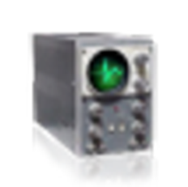

Slide 29
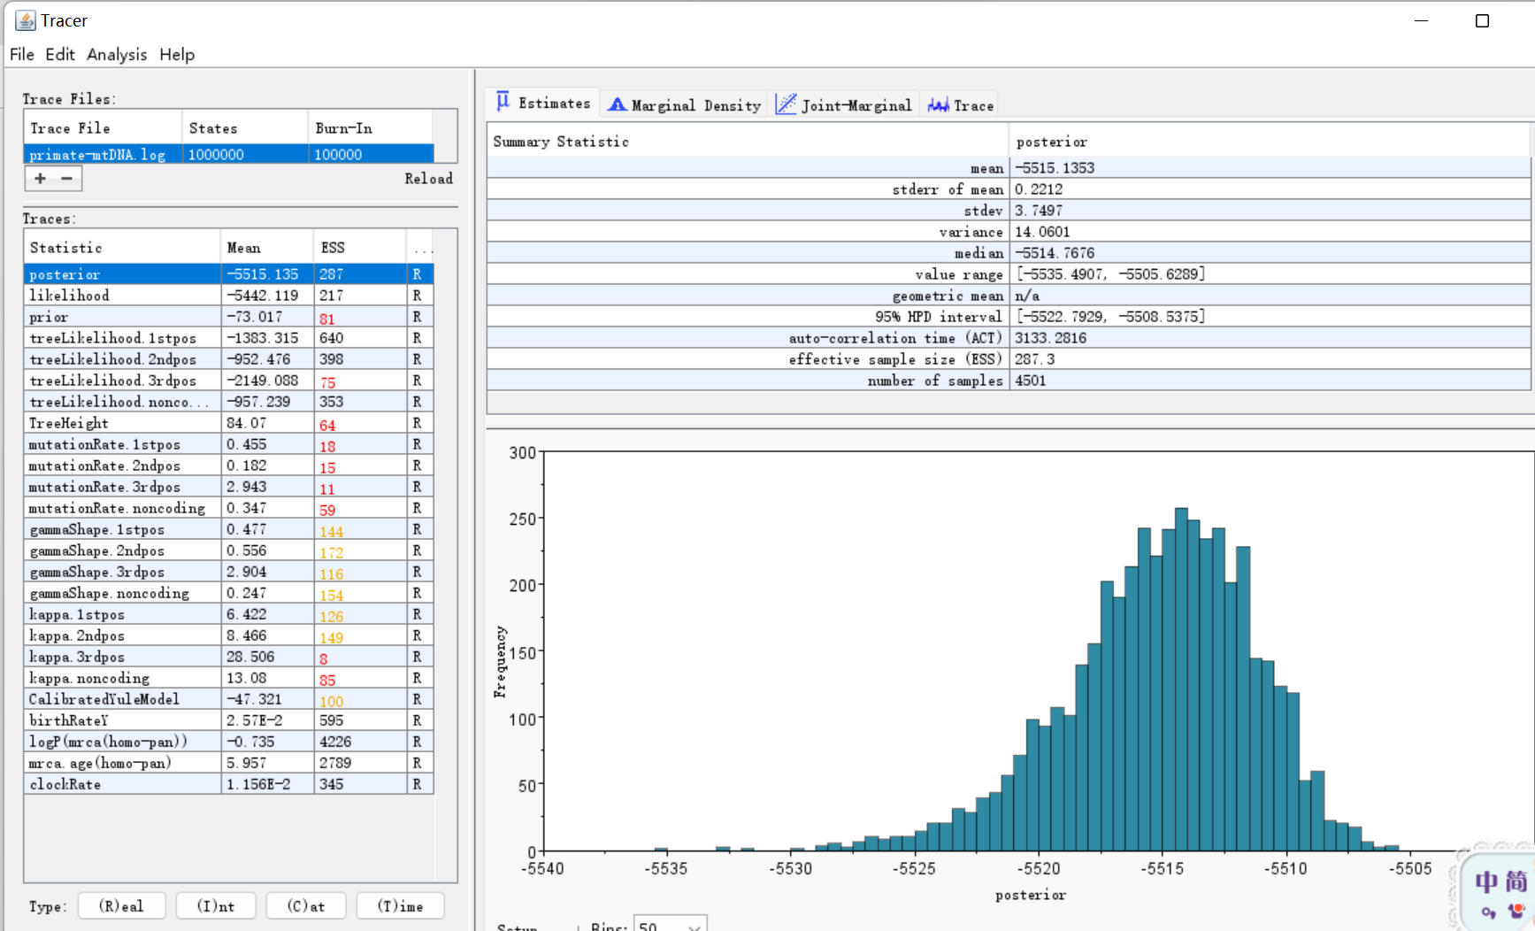
ESS> 200 (GOOD)

Slide 31
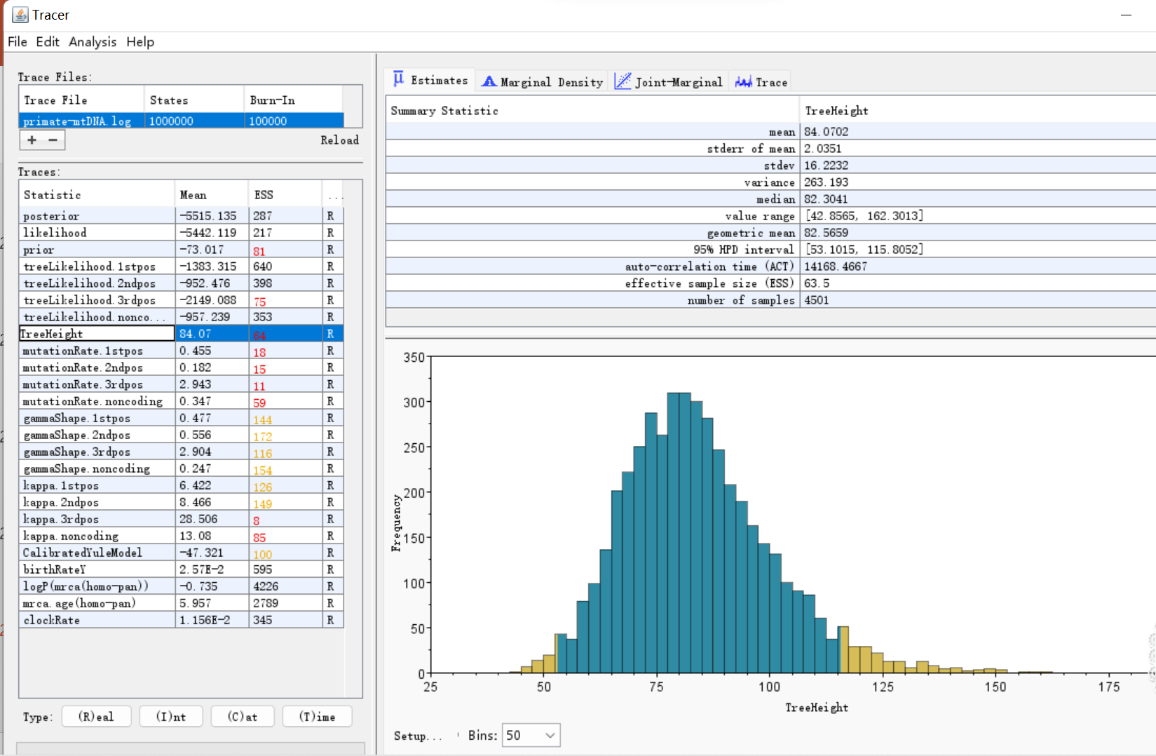

Slide 32
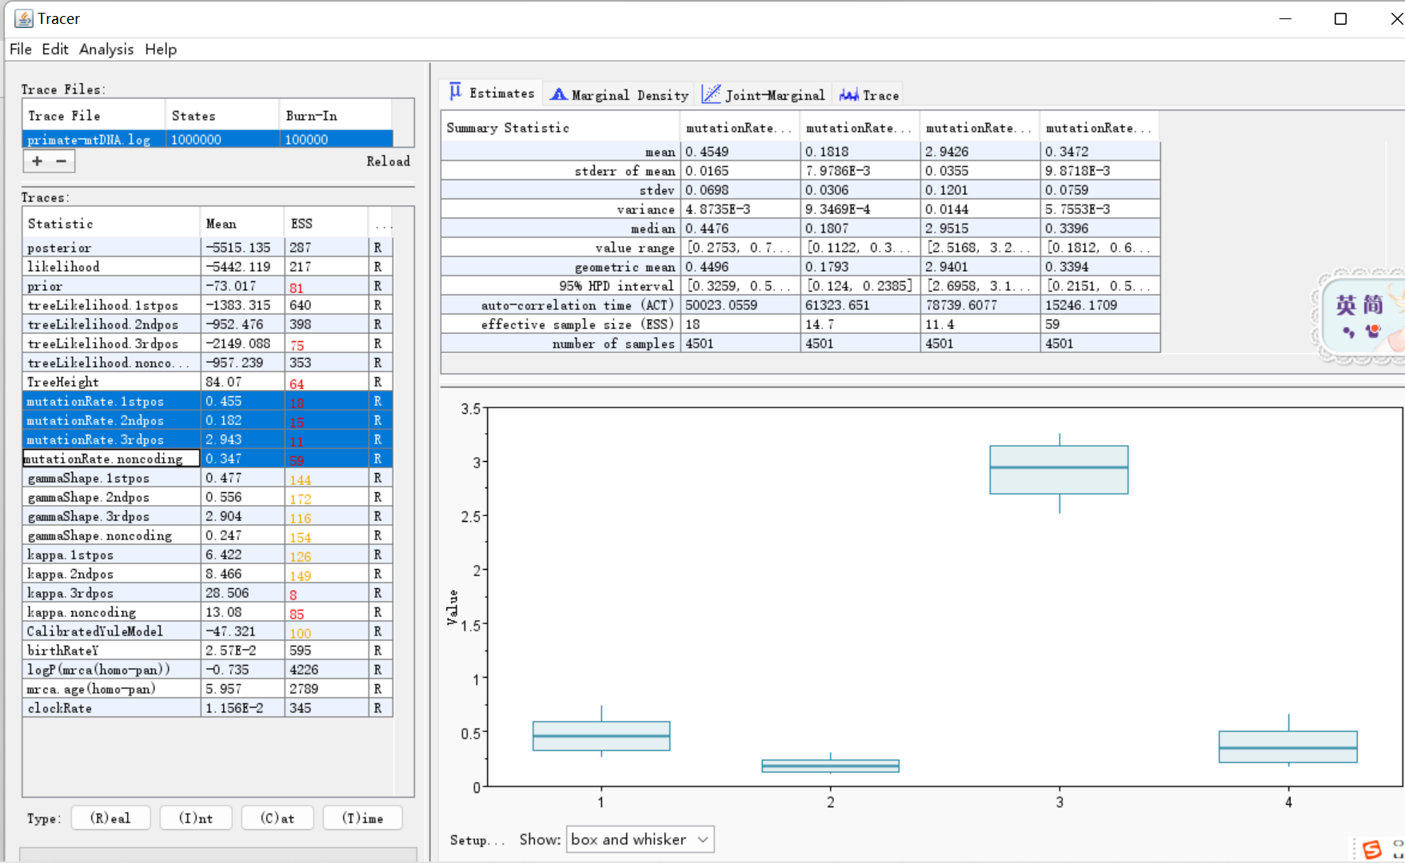

Slide 33
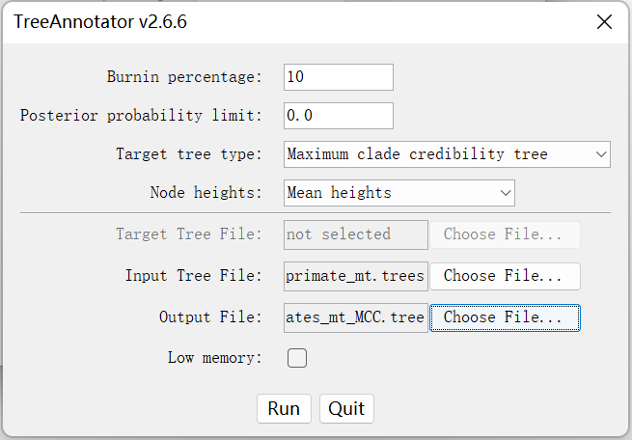

Slide 34
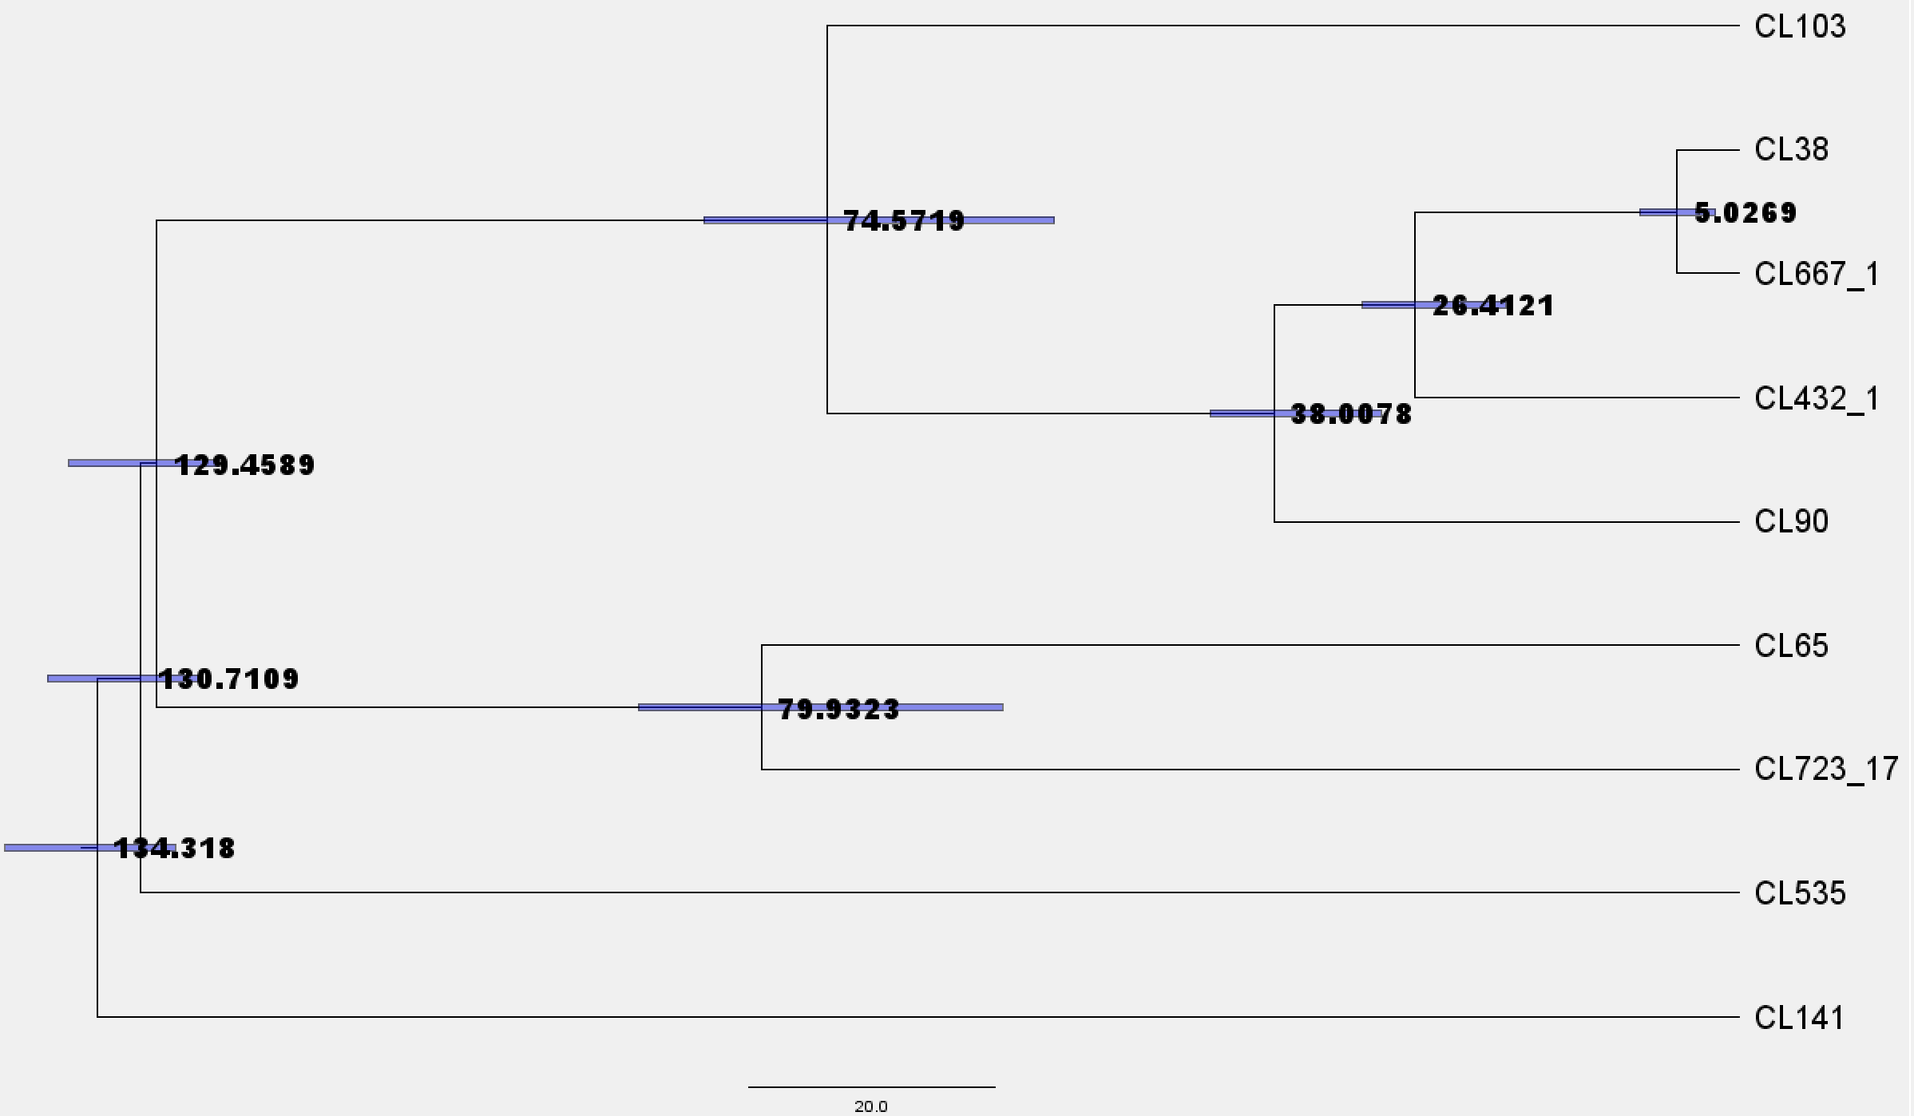

Slide 35
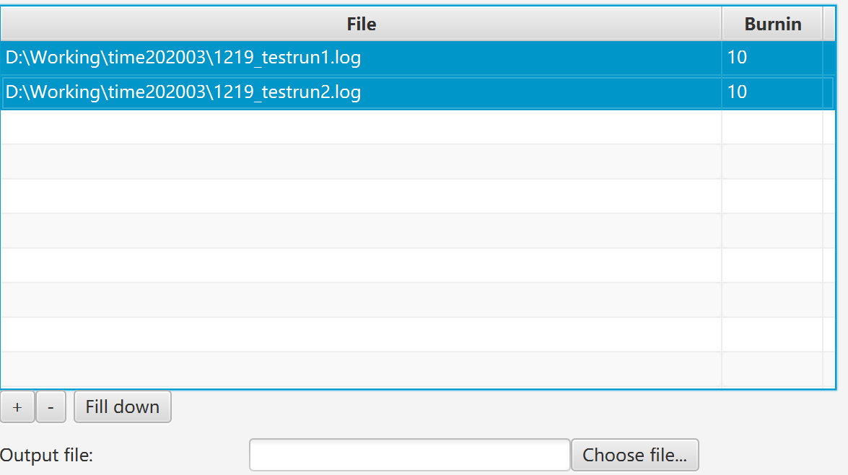
Step ? :
Combine multiple run results(.log & .trees)

Slide 36
Thank You

