Slide 1
Differential Expression Analysis Using the Trinity pipeline
KISHOR KUMAR SARKER
Postdoc, LMSE
SHOU, China Date:010825

Slide 2
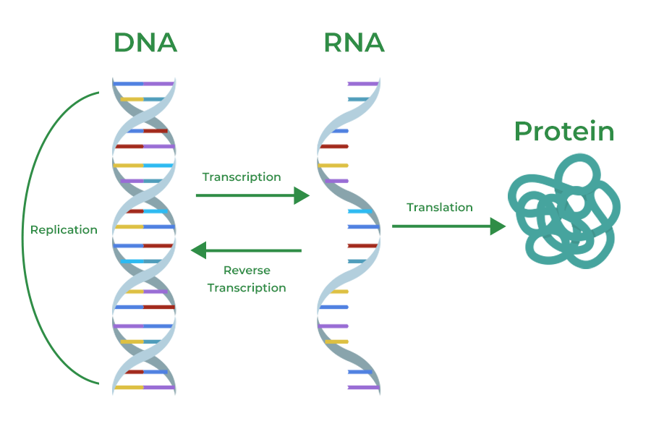
Differential Expression (DE)
The intensity difference in gene expression

Slide 3
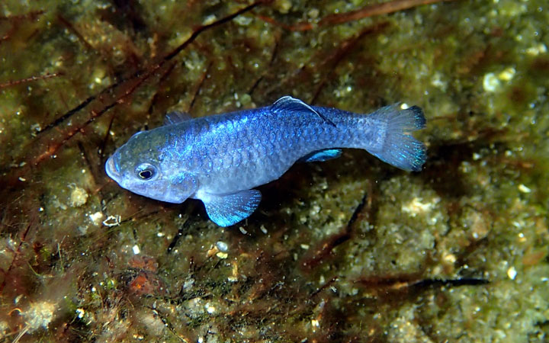
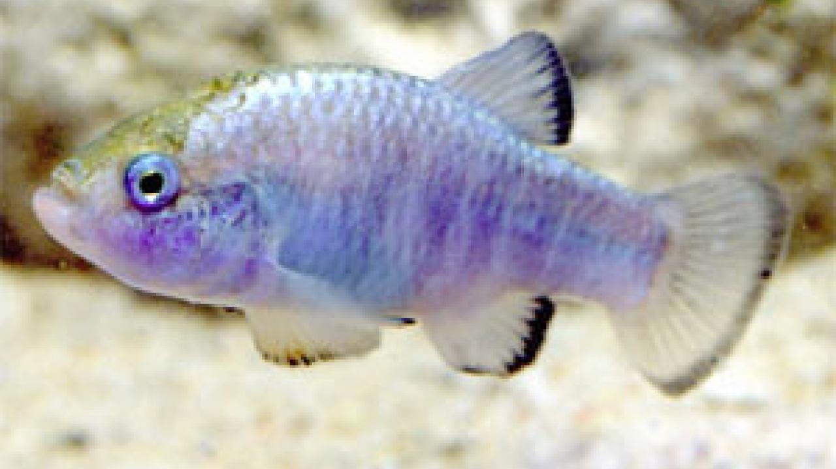
Why DE analysis is fundamental?
1. Biological factors driving phenotypic differences
2. Evaluation of treatments
3. Biomarkers or therapeutic targets

Slide 4
Ways of DE analysis
For model organism; Ex Zebra fish; Alignment based
For non-model organisms, Ex Hilsha shad; De-novo construction

Slide 5
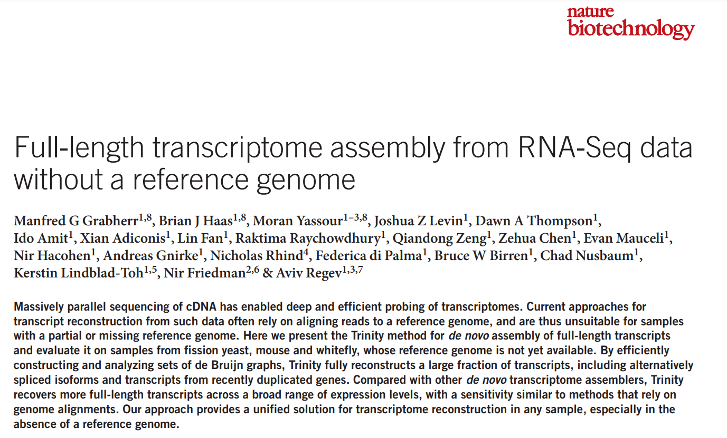
For non-model organism Trinity at its best

Slide 6
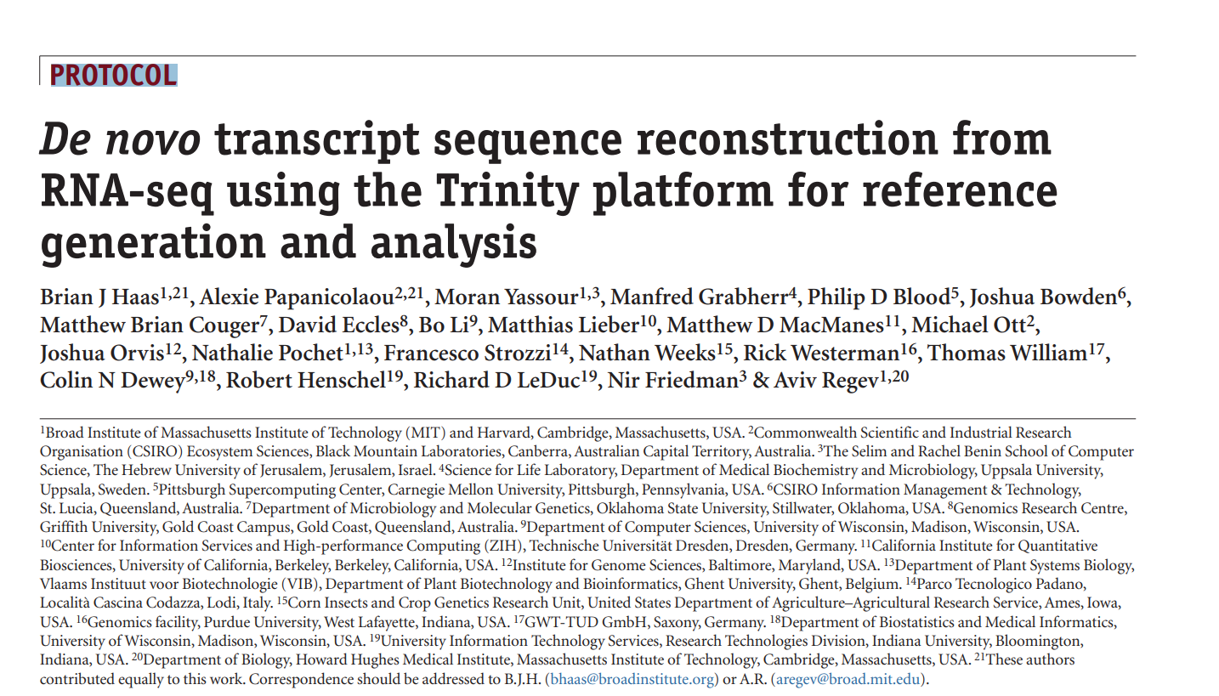

Slide 7
Trinity:A wrapped package including all needed for DE analysis

Slide 8
How does Trinity reconstruct transcripts?
Inchworm
Chrysails
Butterfly

Slide 9
Inchworm: Assembles initial contigs from the RNA-Seq reads

Slide 10
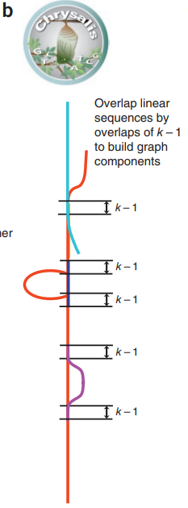
Chrysalis: Groups related contigs into clusters.

Slide 11
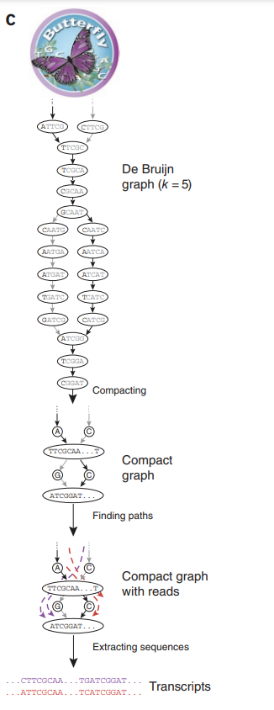
Butterfly: Refines the clusters into final, complete transcript models, resolving ambiguities and alternative splicing.

Slide 12
Let’s have some quick practice

Slide 13
Sample Design
Condition | Replicate | Forward strand | Reverse strand
FW | conA_1 | conA_1.left.fq | conA_1.right.fq
FW | conA_2 | conA_2.left.fq | conA_2.right.fq
FW | conA_3 | conA_3.left.fq | conA_3.right.fq
MW | conB_1 | conB_1.left.fq | conB_1.right.fq
MW | conB_1 | conB_2.left.fq | conB_2.right.fq
MW | conB_1 | conB_3.left.fq | conB_3.right.fq

Slide 14
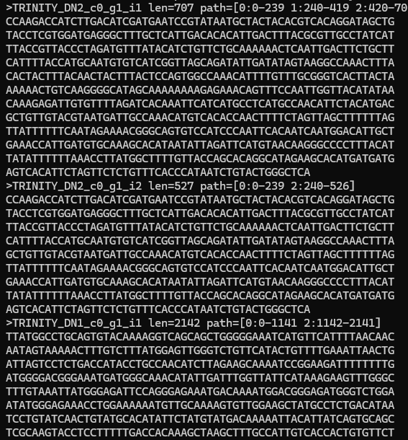
Make a combine assembly
Trinity --seqType fq --max_memory 50G --samples_file samples.txt --CPU 6--min_contig_length 150
The transcripts are ready….

Slide 15
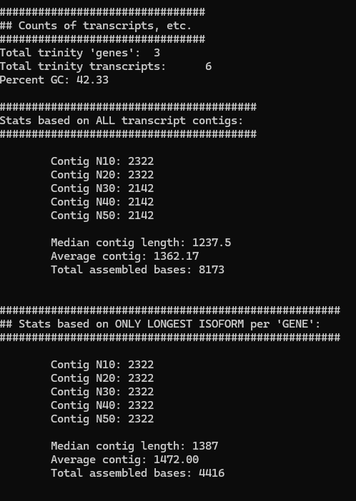
Assembly statistics
/usr/local/bin/util/TrinityStats.pl trinity_out_dir.Trinity.fasta
Align the reads against the assembly is the best way to check assembly quality (>80%)

Slide 16
Expression quantitation using Salmon
/usr/local/bin/util/align_and_estimate_abundance.pl --seqType fq --samples_file samples.txt --transcripts trinity_out_dir.Trinity.fasta --est_method salmon --trinity_mode --prep_reference

Slide 17
Cross-sample normalization
/usr/local/bin/util/abundance_estimates_to_matrix.pl --est_method salmon --out_prefix Trinity --name_sample_by_basedir --quant_files quant_file.list --gene_trans_map trinity_out_dir.Trinity.fasta.gene_trans_map
TMM value
Raw seq count

Slide 18
DE expression using edgeR/DESeq2
/usr/local/bin/Analysis/DifferentialExpression/run_DE_analysis.pl --matrix Trinity.isoform.counts.matrix --samples_file samples.txt --method edgeR --output edgeR_trans

Slide 19
Significantly DE transcripts and producing heatmap
/usr/local/bin/Analysis/DifferentialExpression/analyze_diff_expr.pl --matrix ../Trinity.isoform.TMM.EXPR.matrix --samples ../samples.txt -P 1e-3 -C 2

Slide 20
Here is your result…..

Slide 21
Play with RNA seq using Trinity…… …………..Thanks for listening

