Slide 1
Comparative genomics
Lu Liang
LMSE
Shanghai Ocean University
Jan 8 2025

Slide 2
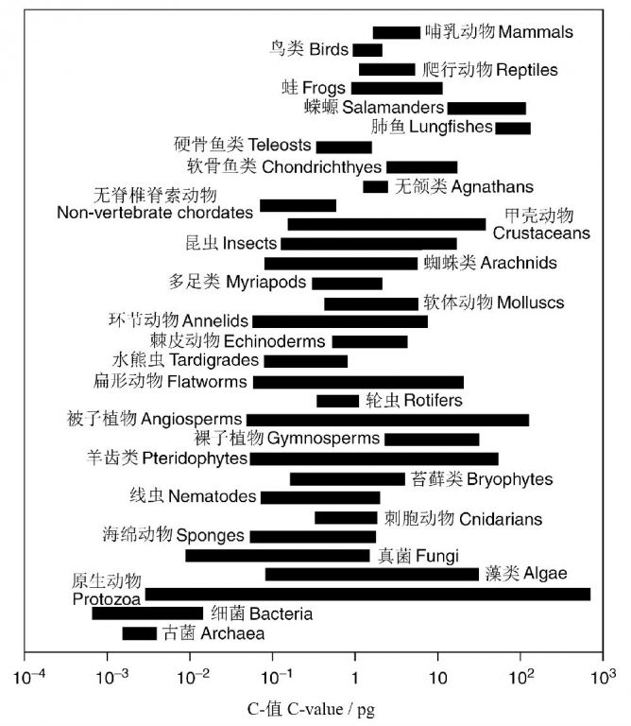
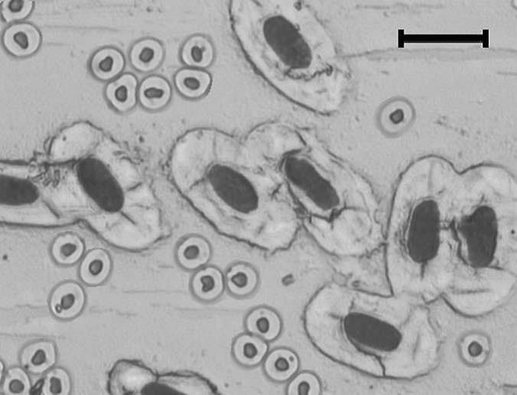
Betta splendens, 2C= 1.3 pg -> small cells
Neoceratodus forsteri, 2C≈105 pg -> big cells

Slide 4
genome
The relationship between
genome sequences and functions
The relationship between genome sequences and phylogenetic history.
Notes:
fin 鱼鳍

Slide 5
Search genes in similar species for different phenotypes
genome
Notes:
horns

Slide 6
Search genes in different species for same phenotypes
genome
Notes:
Oc to pus
dinosaur

Slide 7
Interesting questions of the species itself
The most important steps
Genes for different phenotype
All genes
Different genes
How to narrow the
scope of gene searches

Slide 8
Interesting Questions
Hypothesis
Mutation&Selection
Multiple genome alignment
GO / KEGG / OtherDB
Transcriptome
Stereo-seq
filter
Population genomics
(GWAS, SweeD)
Gene family
Single Cell Genomic
Non-coding element
CRISPR / ChIP / ...
Verify

Slide 9
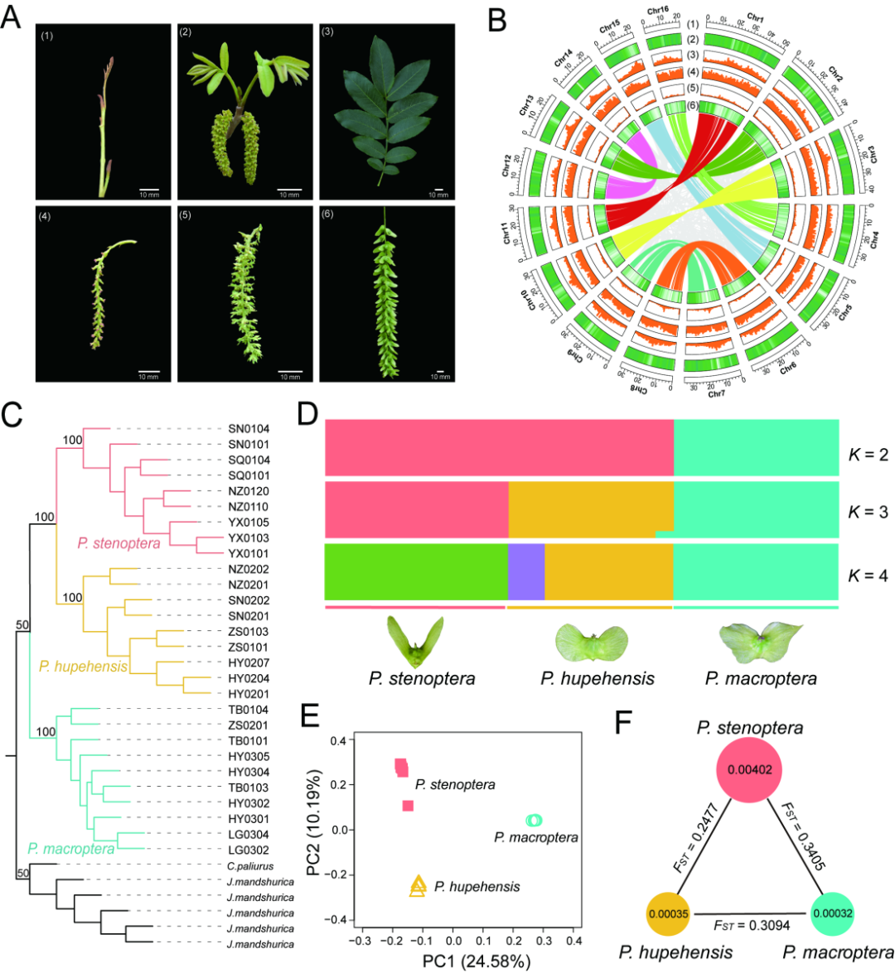
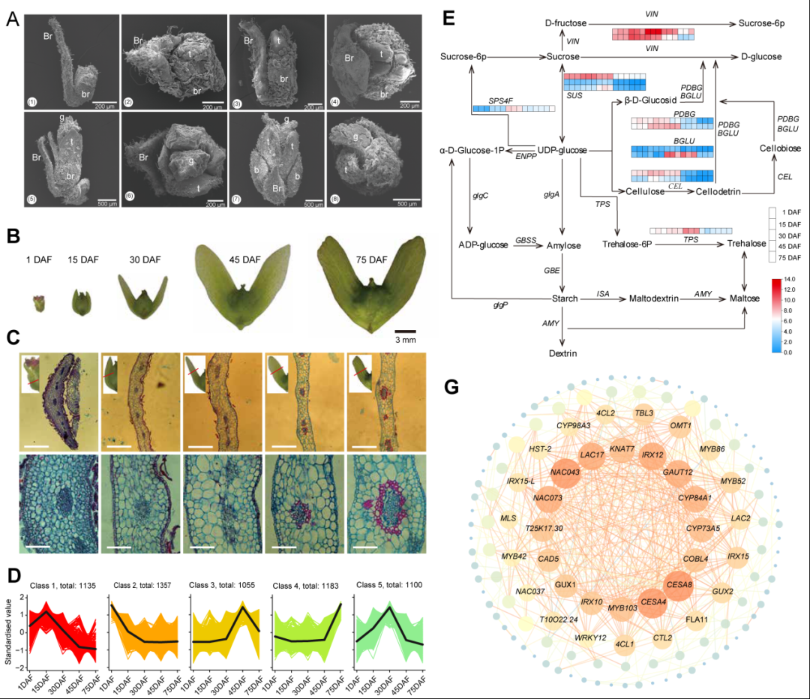
Search genes in similar species for different phenotypes

Slide 10
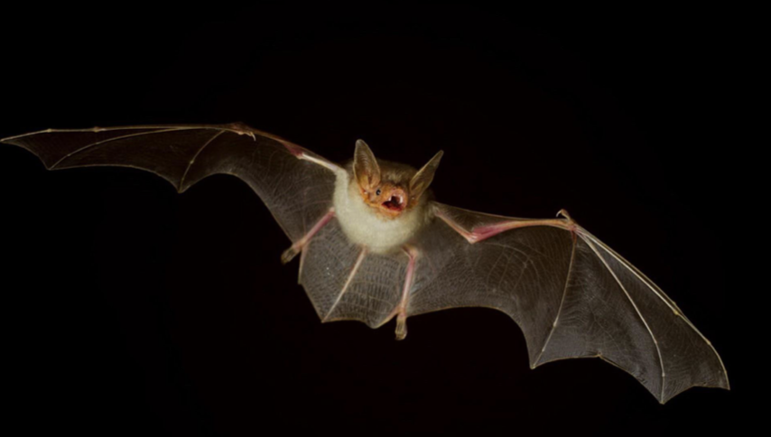
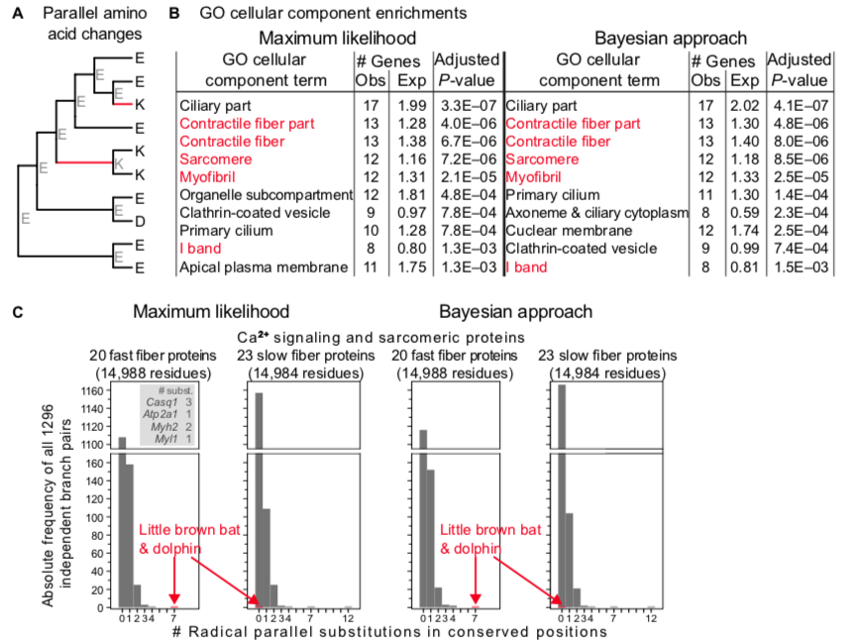
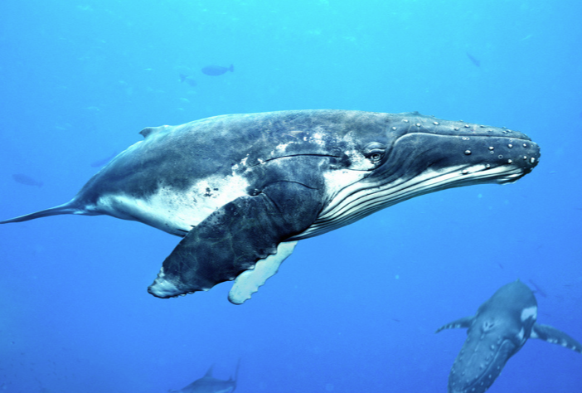
Search genes in different species for same phenotypes
Notes:
bat
Whale
supersonic
Ultrasound

Slide 11
Compare genomes in closer genetic distance
Different Species
Same Species
Population Genomics

Slide 12
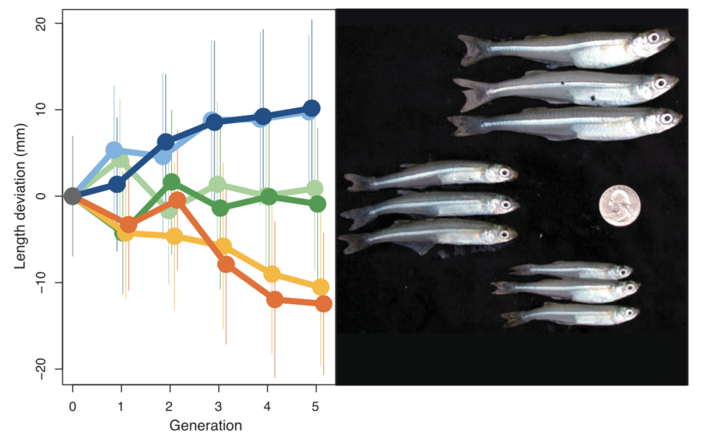
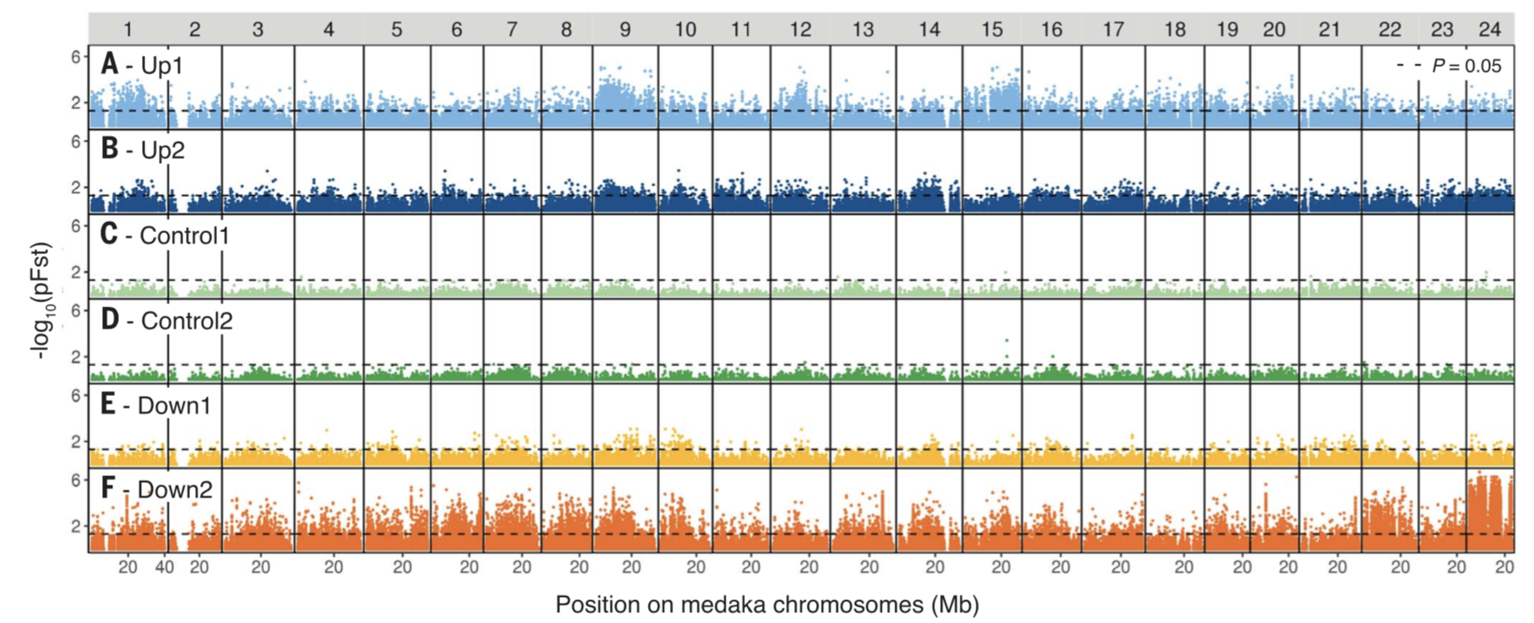
SNP-based population genome research

Slide 13
Can it be compared in more similar genomes？
Different Species
Same Species
Single Genome
Population History

Slide 14
Pairwise sequentially Markovian coalescent (PSMC)
the time since the most recent common ancestor (TMRCA)
Diploid genome
Gene 1
Gene 2
TMRCA 2
Time
TMRCA 1
Notes:
Homozygous
Heterozygosis

Slide 15
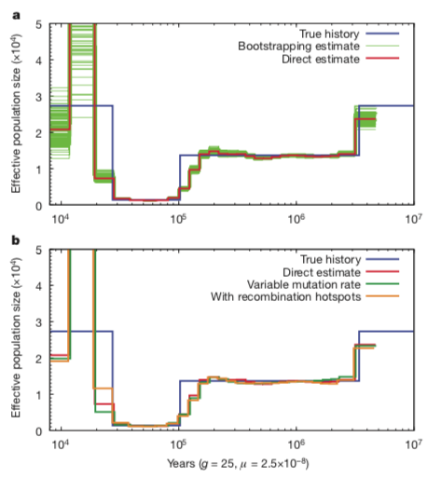
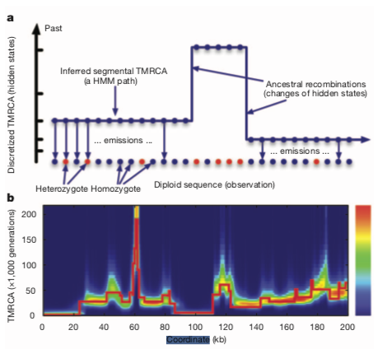

Slide 16
Another direction Compare the genomes of hundreds of different species

Slide 17
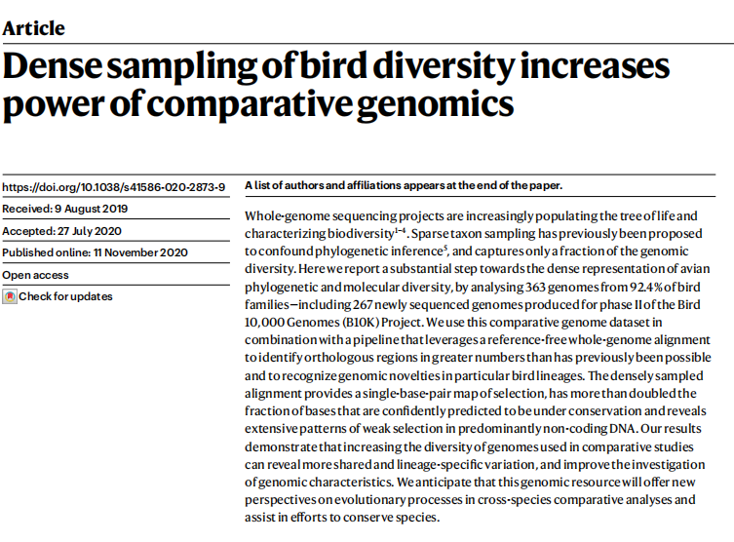

Slide 18
A pipeline for fixing orthologs
Notes:
Homologous
Paralogous
Orthologs

Slide 19
One interesting feture
I can sing!!!!!
CRNN is a cell proliferating gene

Slide 20
Cornulin is missing in Oscines!!!

Slide 21
Hope you have fun in the genomic

