Slide 1
Extracting mt-genome and annotation
Haifeng Xu
LMSE
Shanghai Ocean University
College of Fisheries and Life Science
January 6th ，2025

Slide 2
Extracting mt-genome and annotation
Chapter1 Extracting mt-genome
NOVOPlasty Introduction
NOVOPlasty extraction
IDBA extraction

Slide 3
一、NOVOPlasty Introduction
Programming language: Perl
Target Data: Mitochondrial and Chloroplast genomes
Algorithm Model: Seed extension algorithm
The seed extension algorithm is the core technology of NOVOPlasty, utilizing user-provided seed sequences (such as conserved gene fragments or complete genomes) to locate the target genome reads from sequencing data as a starting point.
Application Scenarios:
Phylogenetic Studies
Species Identification
Food Safety and Forensic Identification
Download Link：https://github.com/ndierckx/NOVOPlasty

Slide 4
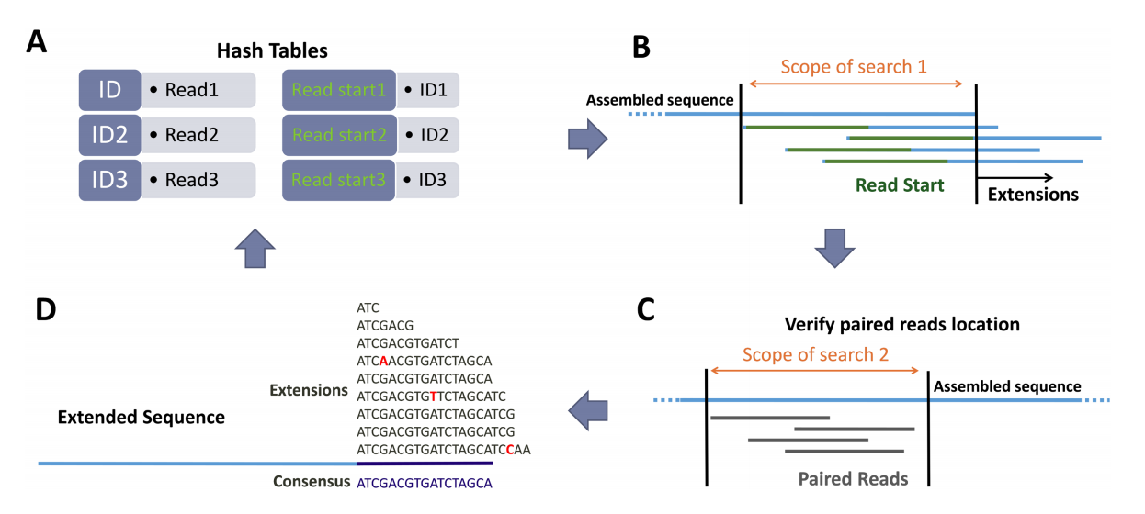
二、NOVOPlasty extraction
(A) All reads are stored in the first hash table, while the second hash table records the starting k-mer (default: 38 bases) of each read.
(B) Using the k-mer at the current extension sequence's end, matching reads from the hash table and stores all matched reads for further extension.
(C) Paired reads are validated to ensure they align with expected positions.
(D) A consensus sequence is generated by integrating consistency among matched reads.
（一）Work flow
A. Data Storage
B. Initial Search for Matched Reads
C. Validation of
Paired Reads
D. Consensus Sequence Generation

Slide 5
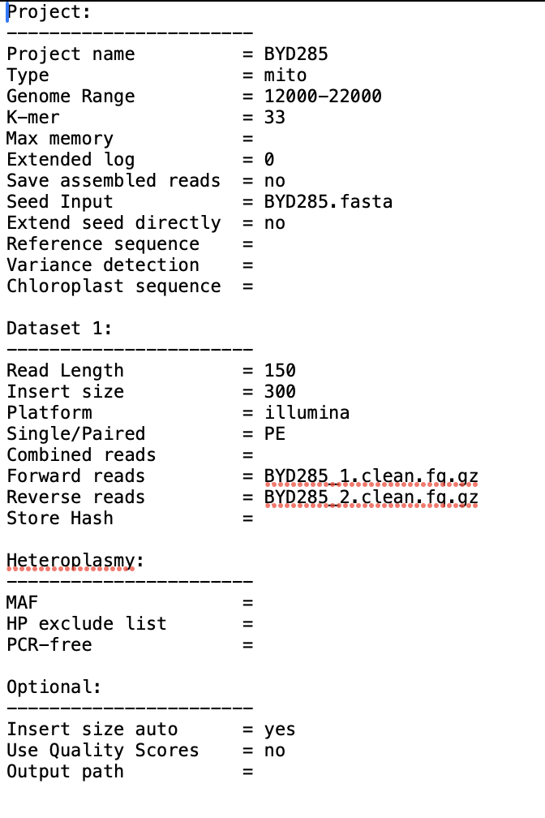
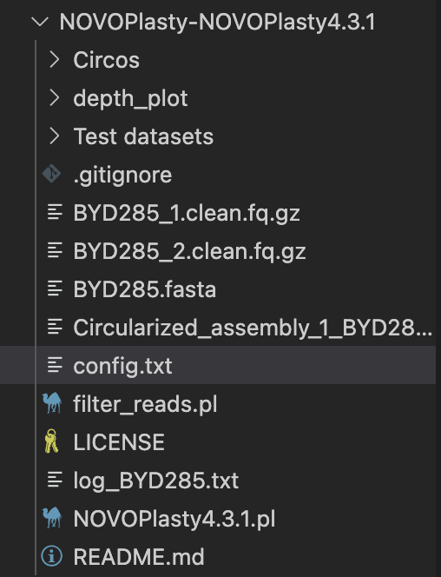
二、NOVOPlasty extraction
（二）File preparation
Required File 1: Configuration File
Purpose:
Defines the parameters for NOVOPlasty, including project name, genome type, size range, insert size, and other settings.
Source:
Custom-written or modified from a template file based on experimental requirements.
config.txt file parameters

Slide 6
二、NOVOPlasty extraction
（二）File preparation
Required File 2: Seed Input
File Type: FASTA format (.fasta)
Purpose:Used to initiate the assembly process
by providing a seed sequence related to the target genome.
Source:
Complete or partial genome fragments
of the target species(e.g., cox1, rbcL, etc.)
Genome fragments from closely or distantly related species (high compatibility with NOVOPlasty)
Notes:
Ensure the seed sequence is of sufficient length (recommended > 100 bp).
If the seed comes from the same sample and there is no risk of mismatches, you can set Extend seed directly=yes.

Slide 7
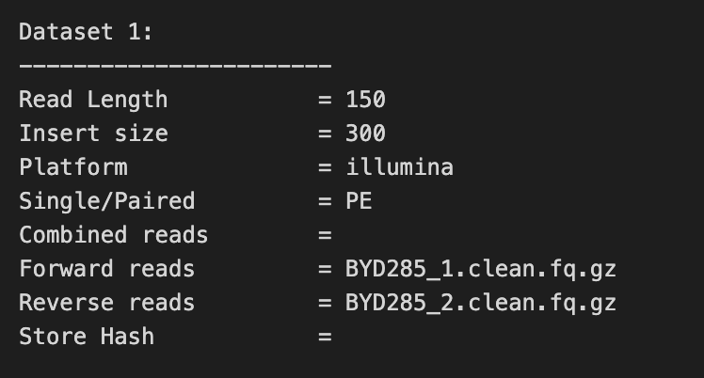
二、NOVOPlasty extraction
（二）File preparation
Required File 3: Sequencing Data File
File Type: FASTQ format
(compressed or uncompressed, e.g., .fq.gz or .fq)
Purpose:Provides raw sequencing reads for the assembly process.
Source:
Raw paired-end sequencing data generated by sequencing platforms (e.g., Illumina).
File Requirements:
Forward reads: e.g., *_1.clean.fq.gz
Reverse reads: e.g., *_2.clean.fq.gz
If forward and reverse reads are merged into a single file, use the Combined reads parameter to specify the file path.
Data format must comply with Illumina standards. Single-end reads are currently not supported.

Slide 8
（二）File preparation
Optional File 1: Reference Sequence
File Type: FASTA format
Purpose:
Assists in assembling complex regions, such as repeats or chloroplast inverted repeats.
Does not alter the de novo nature of the assembly, only provides guidance.
Source:
Genome sequences from closely related species (e.g., mitochondrial or chloroplast reference genomes).
Notes:
It is recommended to use reference genomes from species within the same genus.
Reference genomes from different genera may not be suitable and could reduce assembly accuracy.
Optional File 2: Chloroplast Genome (for mito_plant mode only)
File Type: FASTA format
Purpose:
When assembling plant mitochondrial genomes, a pre-assembled chloroplast genome must be provided as input.
Source:
A pre-assembled chloroplast genome.

Slide 9
（二）File preparation
Summary
File Type | File Format | Required | Example
Seed Sequence | .fasta | Required | seed.fasta
Forward Reads | .fq.fz or .fq | Required | reads_1.clean.fq.gz
Reverse Reads | .fq.fz or .fq | Required | reads_2.clean.fq.gz
Reference Genome | .fasta | Optional | reference.fasta
Chloroplast Genome | .fasta | Optional | chloroplast.fasta (only mito_plant)
Configuration File | Text File | Required | config.txt

Slide 10
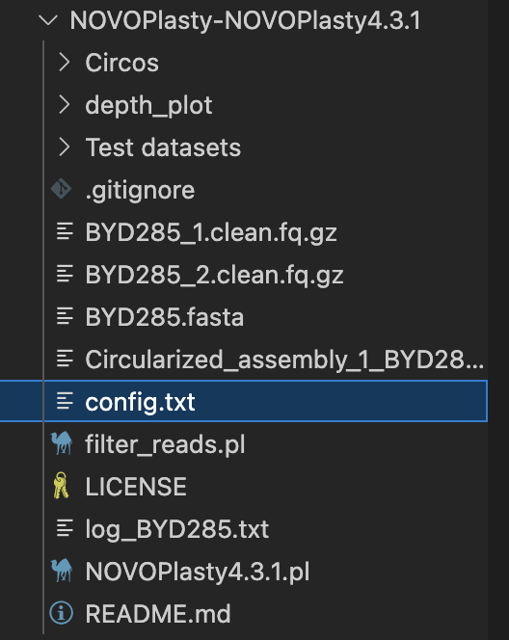
（三）Running
Command：
perl NOVOPlasty4.3.1.pl -c config.txt
Time using：5-10mins

Slide 11
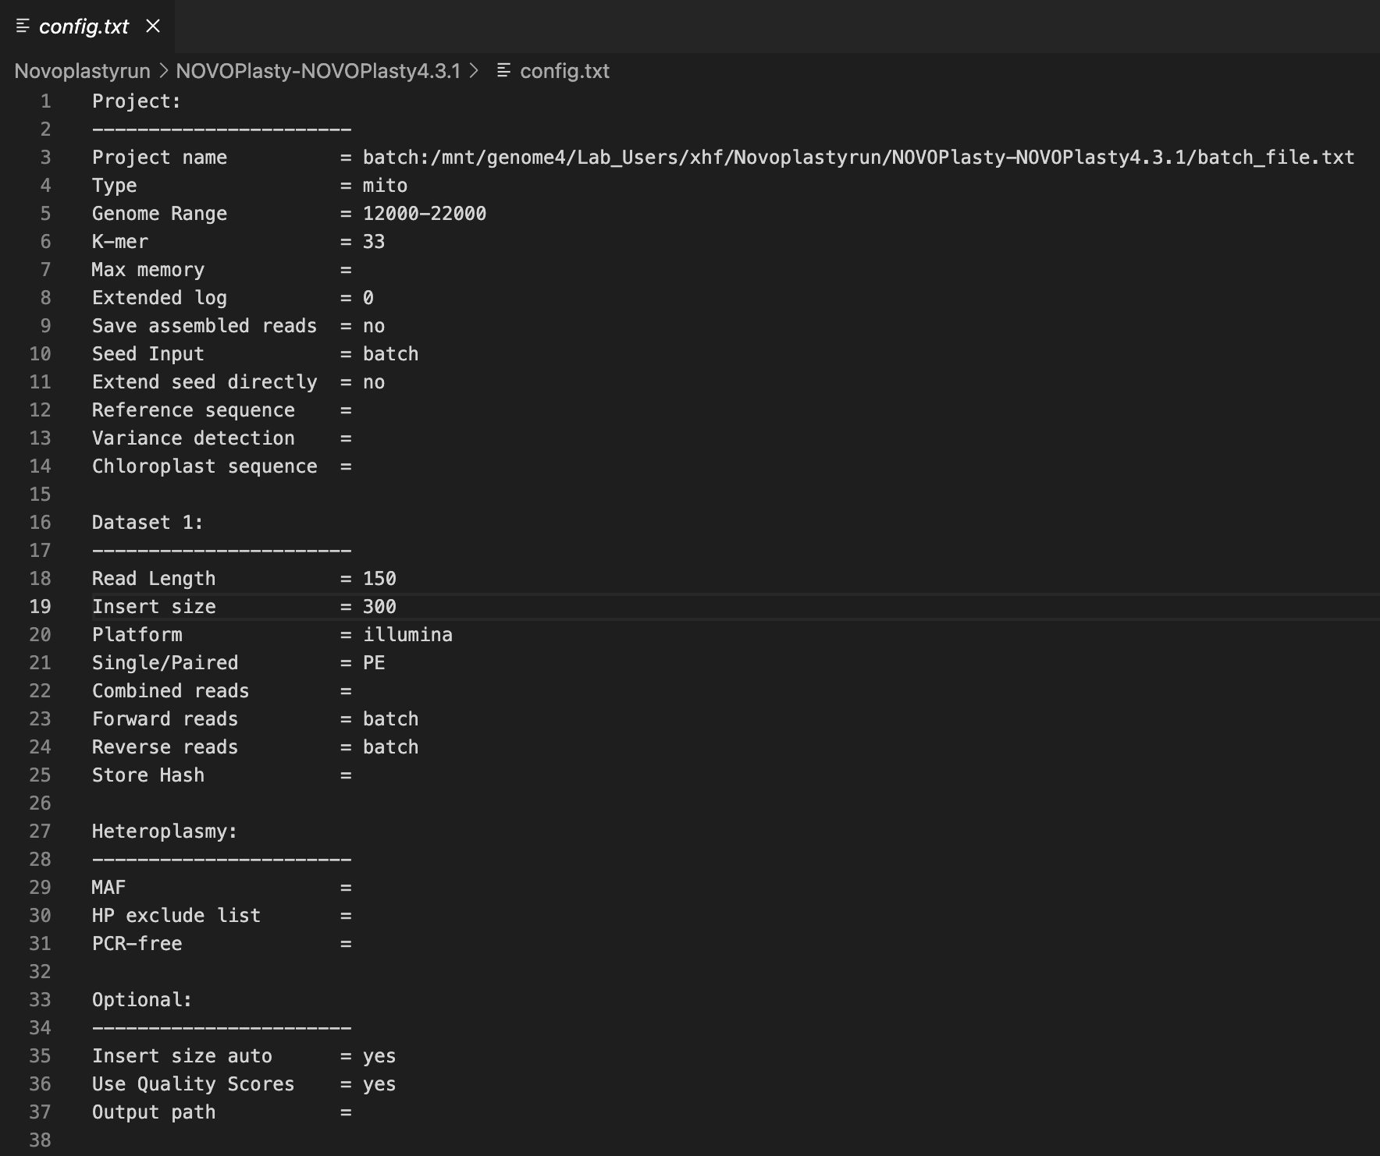
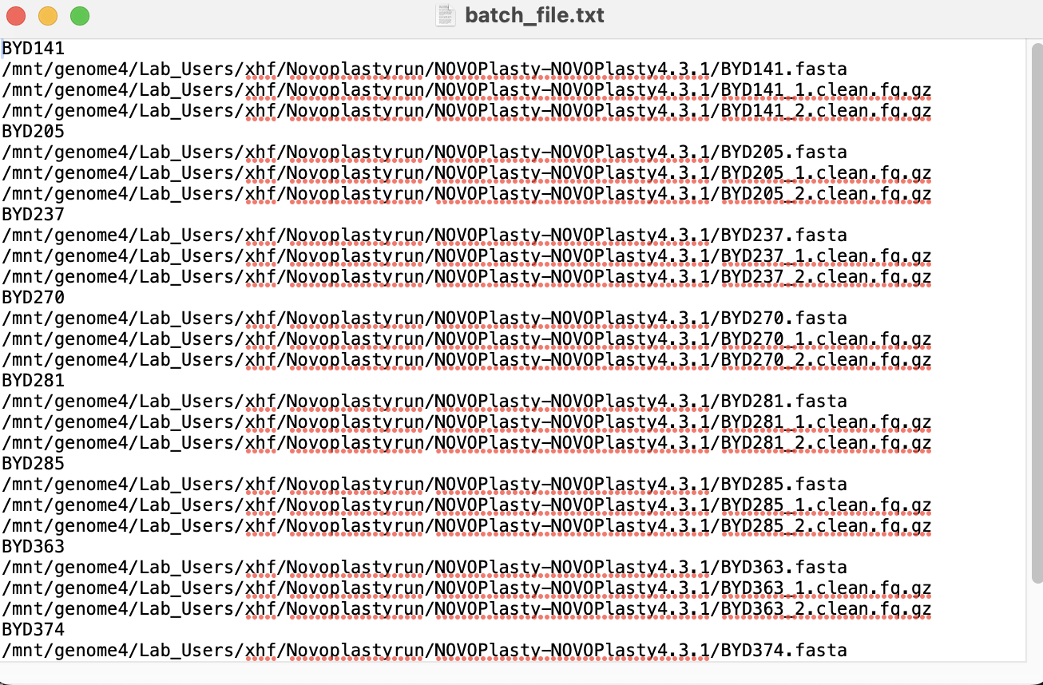
（四）Cycling running
Command：
nohup perl NOVOPlasty4.3.1.pl -c config.txt &
Running Mode: Background Execution

Slide 12
（五）Results
Assembled Files: Circularized / Contigs

Slide 13
三、IDBA extraction
File preparation
Required File：Sequencing Data File
File Type: FASTQ format (compressed: .fq.gz)
Purpose: Provides raw sequencing reads for the assembly process.
Source: Raw paired-end sequencing data generated by sequencing platforms (e.g., Illumina).
File Requirements:
Forward Reads: e.g., *_1.clean.fq.gz
Reverse Reads: e.g., *_2.clean.fq.gz

Slide 14
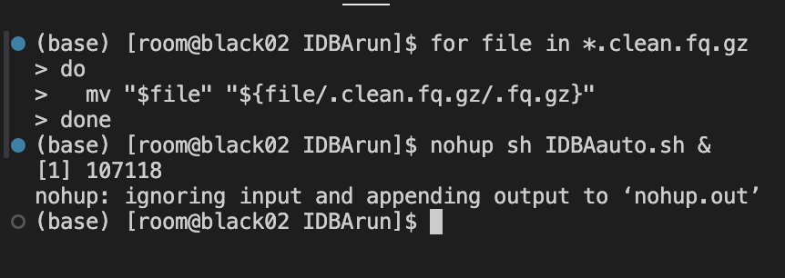
三、IDBA extraction
for file in *.clean.fq.gz
do
mv "$file" "${file/.clean.fq.gz/.fq.gz}"
done
1.Import Sequencing Data Files
3.Renamed Files
2.Batch Rename Files
4.Run IDBA in Background：
nohup sh IDBAauto.sh &
5. Assembly Results

Slide 15
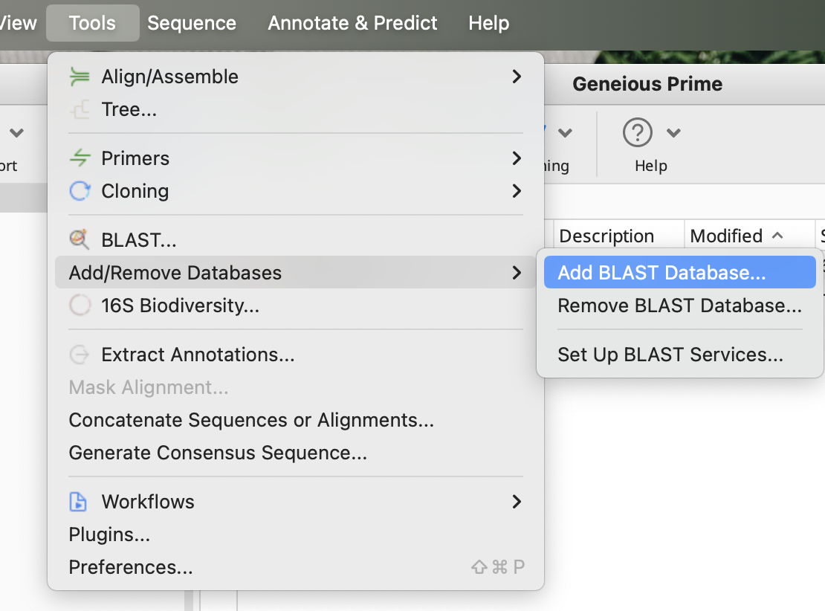
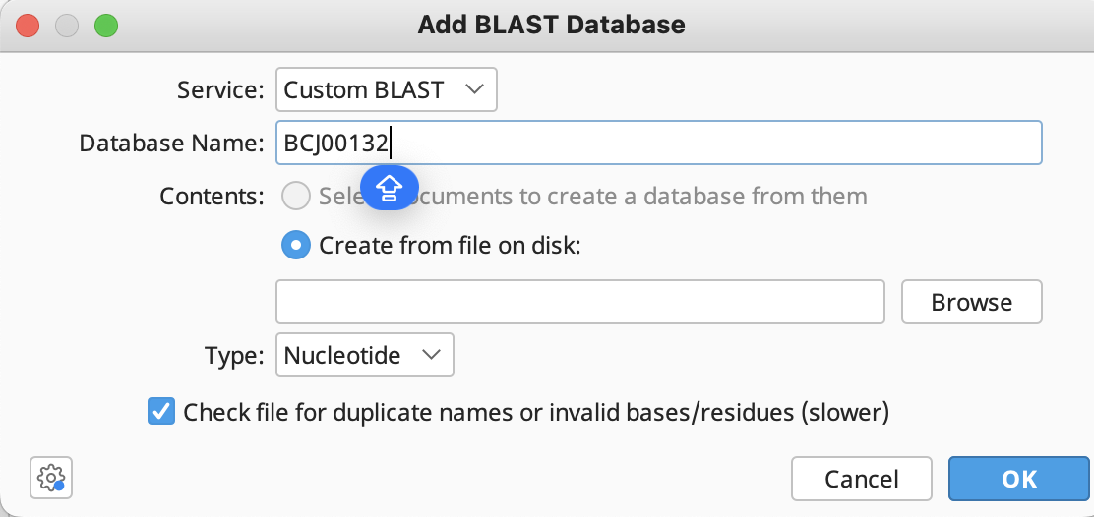
三、IDBA extraction
6. Mitochondrial Genome Extraction
Extracting Mitochondrial Genome Using CO1

Slide 16
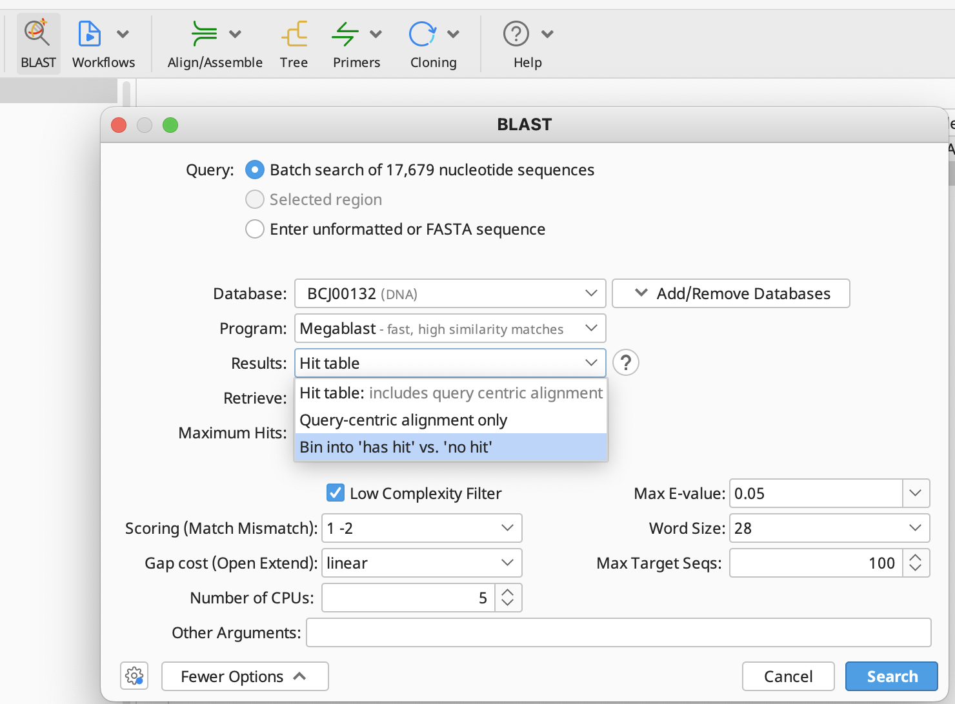
三、IDBA extraction

Slide 17
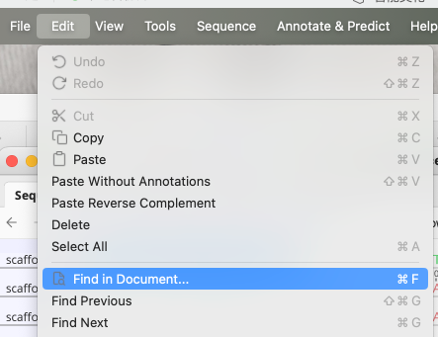
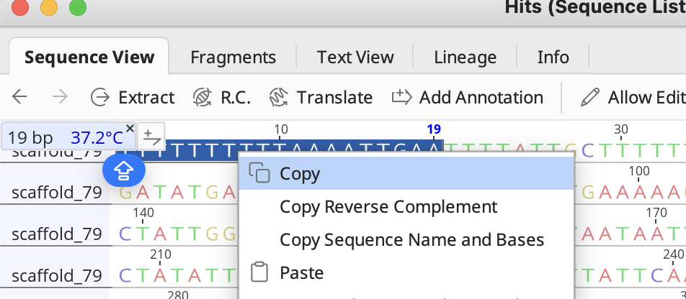
三、IDBA extraction
7. Mitochondrial Genome Processing
Removing Terminal Repeats from the Mitochondrial Genome

Slide 18
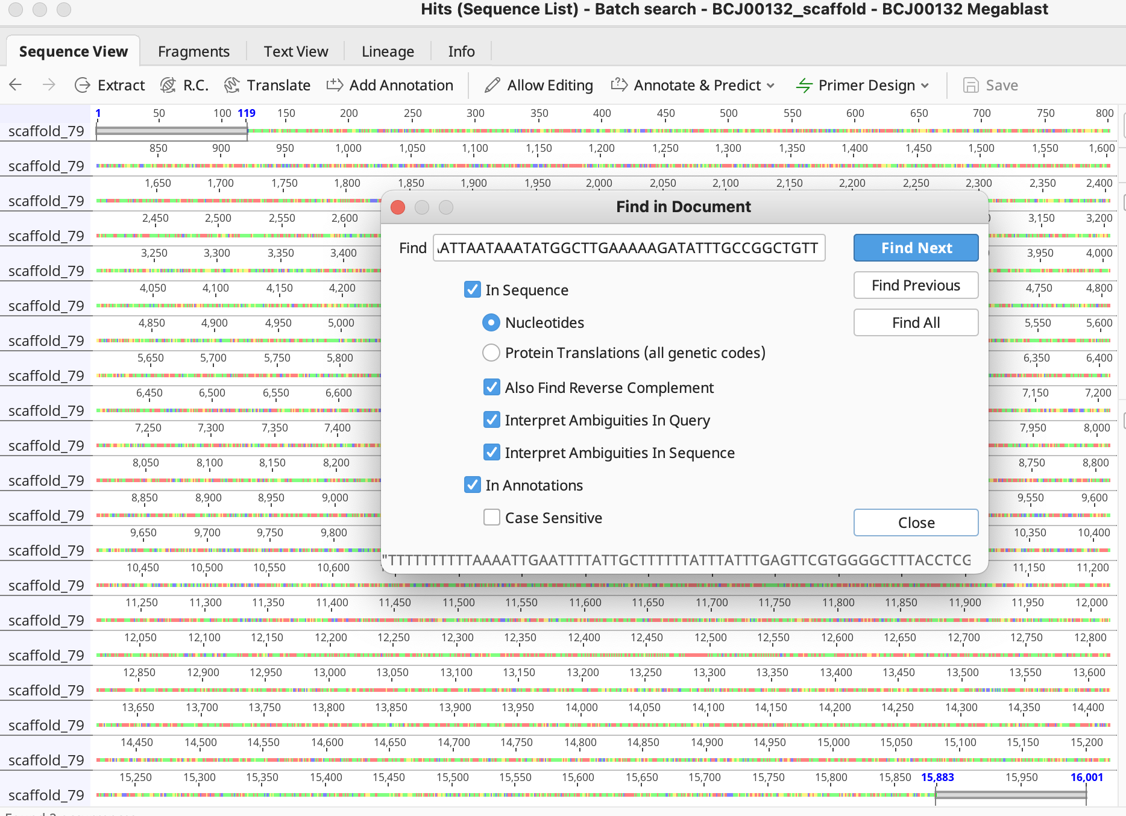
三、IDBA extraction
7. Mitochondrial Genome Processing

Slide 19
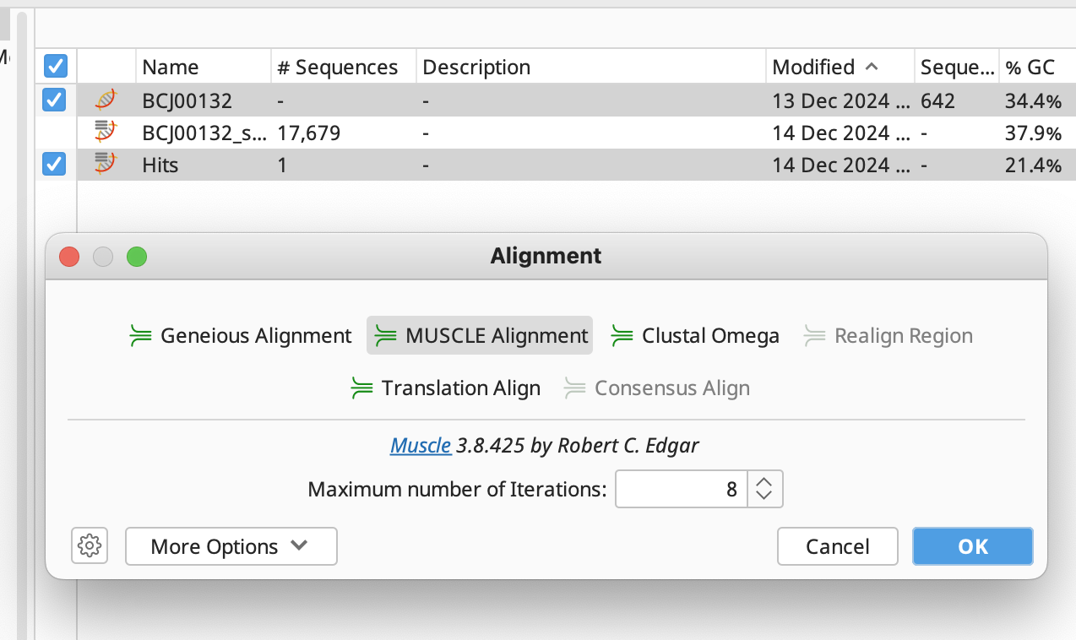
三、IDBA extraction
8. Mitochondrial Genome Confirmation

Slide 20
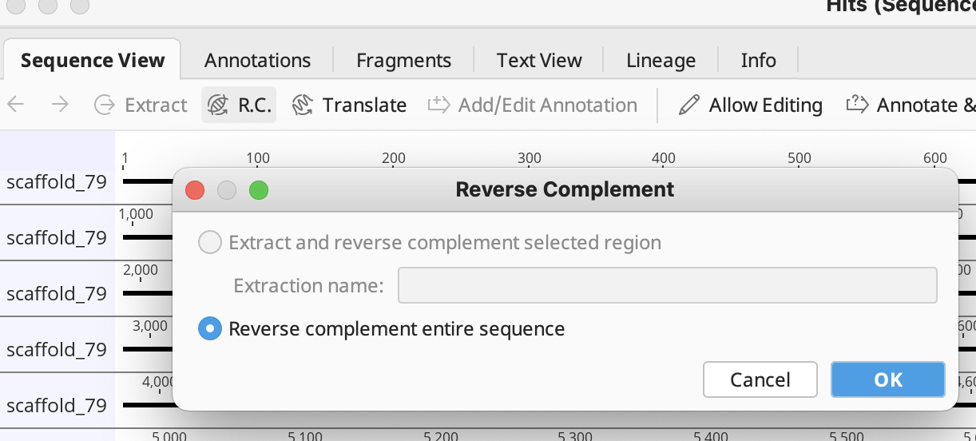
三、IDBA extraction
8. Mitochondrial Genome Confirmation
Reverse Mitochondrial Genome
alignment again

Slide 21
Extracting mt-genome and annotation
Chapter2 Annotation
MitoFinder
De novo annotation

Slide 22
一、MitoFinder
MitoFinder Introduction
File preparation
Input Files.fasta
The assembled mitochondrial genome file is required for running MitoFinder
Reference Sequence.gb
A reference mitochondrial genome file, typically in GenBank format (.gb), is required.
Suitable reference genomes can be downloaded from NCBI or other databases
MitoFinder's annotation function integrates MITOS2, a tool designed for annotating mitochondrial genomes.
MITOS2 automatically identifies protein-coding genes, rRNAs, tRNAs, and other structural elements.
MitoFinder submits the assembled mitochondrial genome to MITOS2 for detailed annotation and outputs the functional annotation results.
Command：mitofinder -j 项目名 -a 输入文件.fasta -r 参考序列.gb -o 2 -m mitochondrion

Slide 23
一、MitoFinder

Slide 24
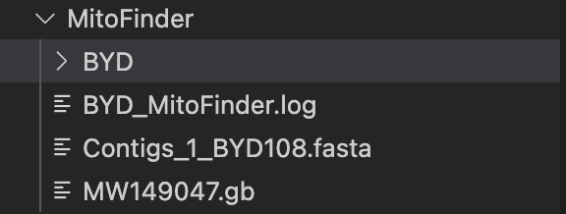
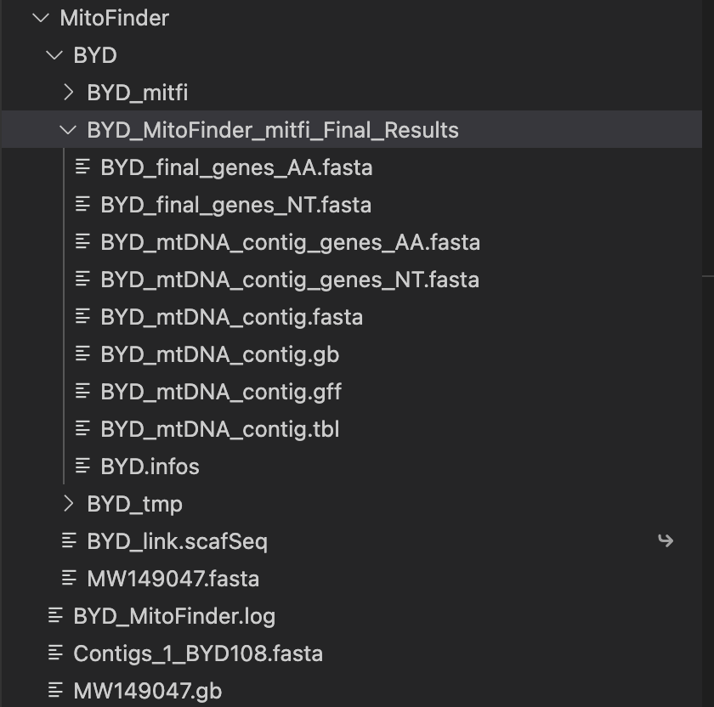
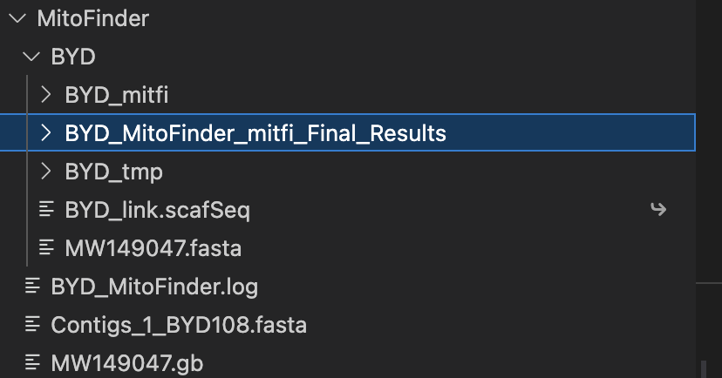
一、MitoFinder

Slide 25
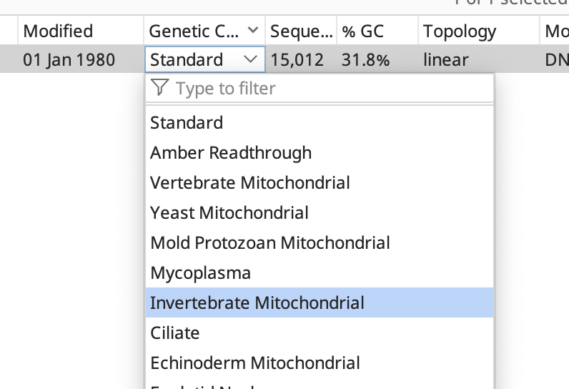
一、MitoFinder
Geneious Prime Software

Slide 26
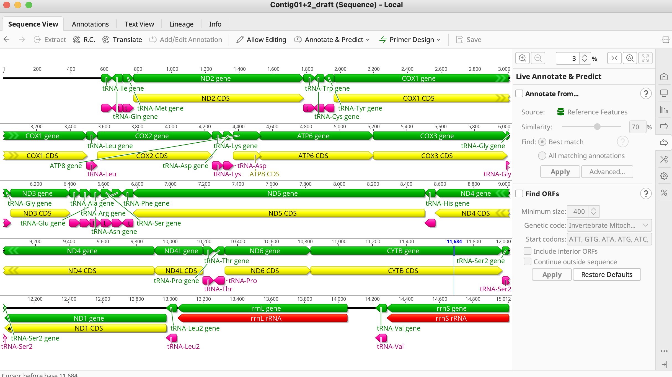
一、MitoFinder

Slide 27
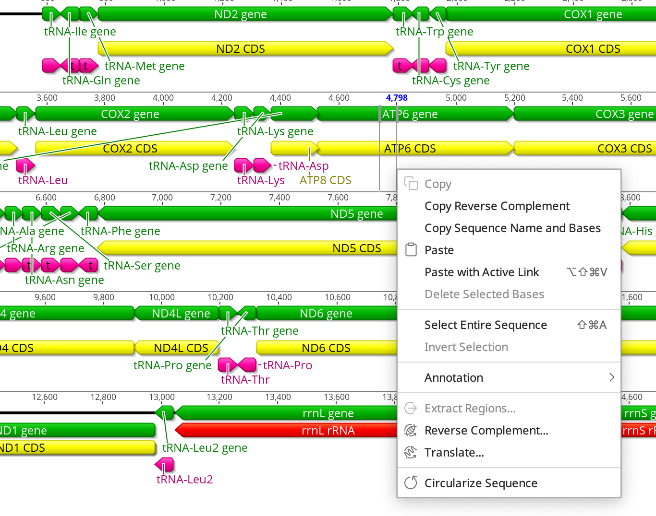
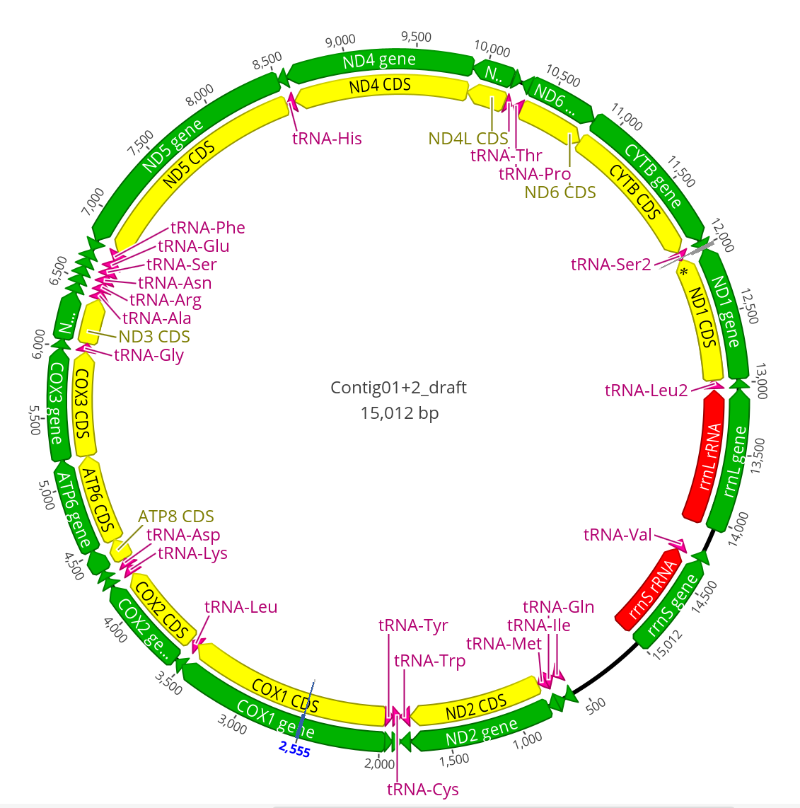
一、MitoFinder

Slide 28
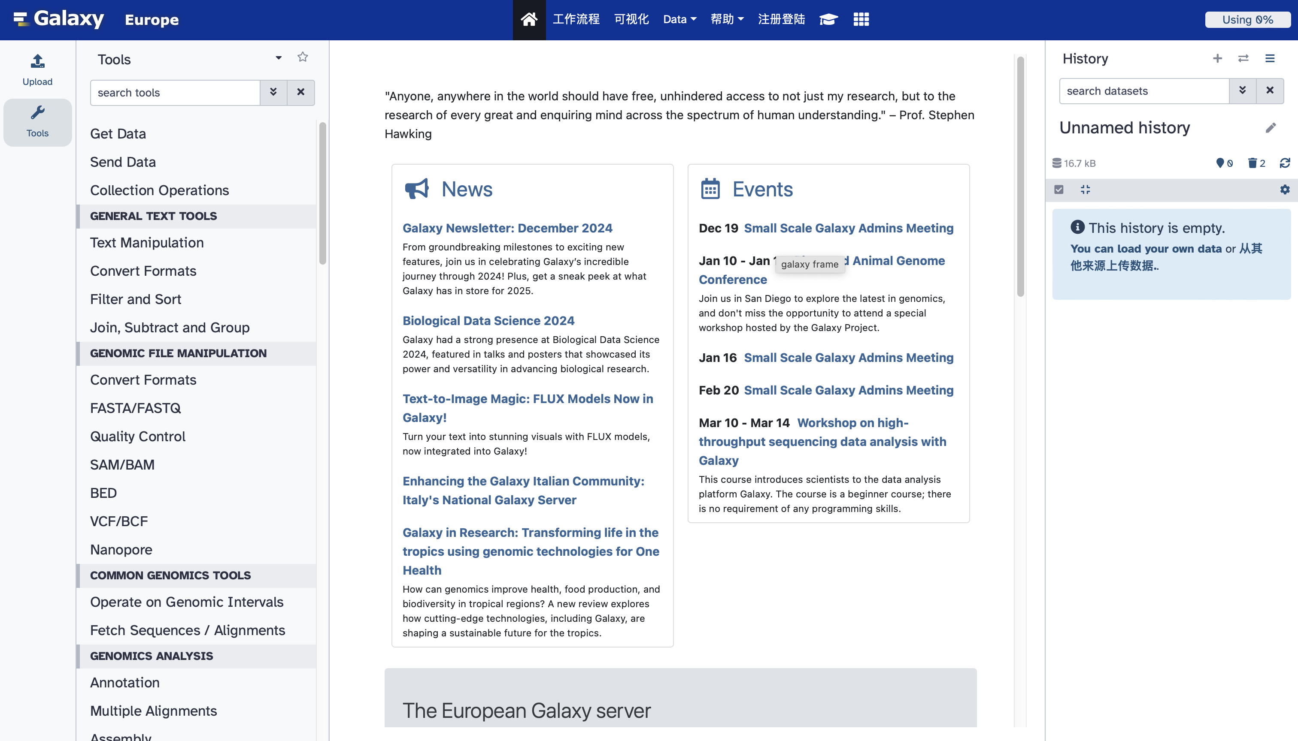
二、De novo annotation
平台：Galaxy
软件工具：mitos2
网站：https://usegalaxy.eu/

Slide 29
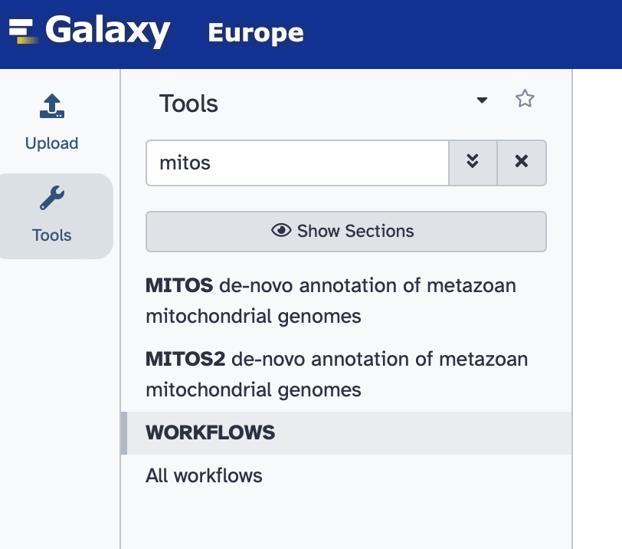
二、De novo annotation
Step1: Search and Select the Latest Version of MITOS2

Slide 30
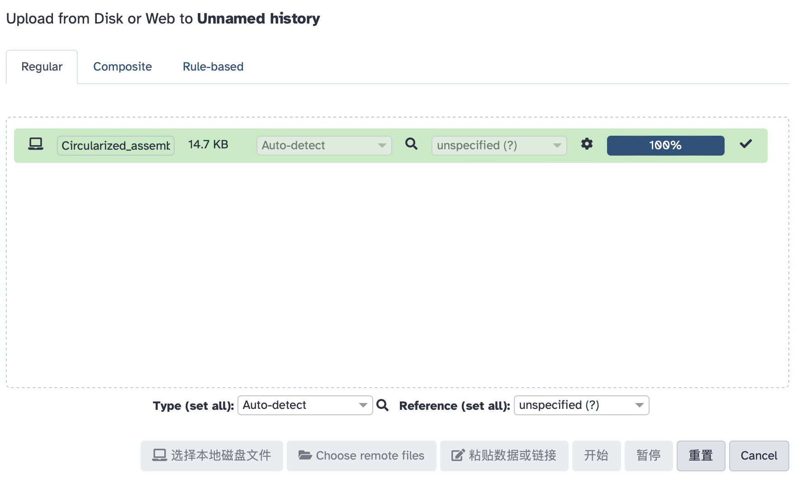
二、De novo annotation
Step2: Importing Mitochondrial Genome Data for Prediction

Slide 31
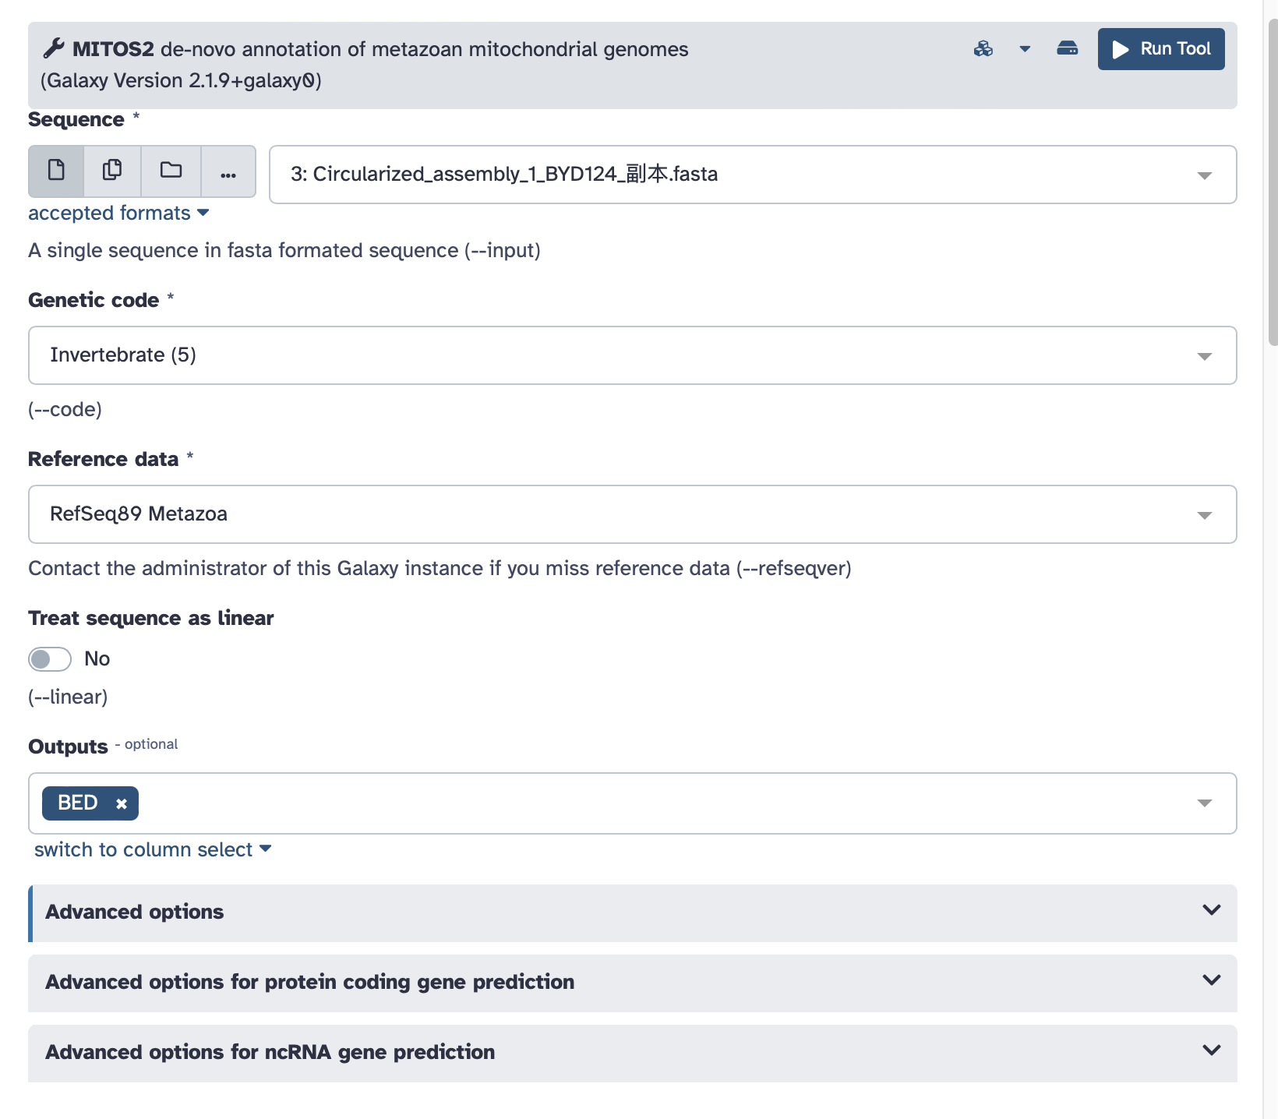
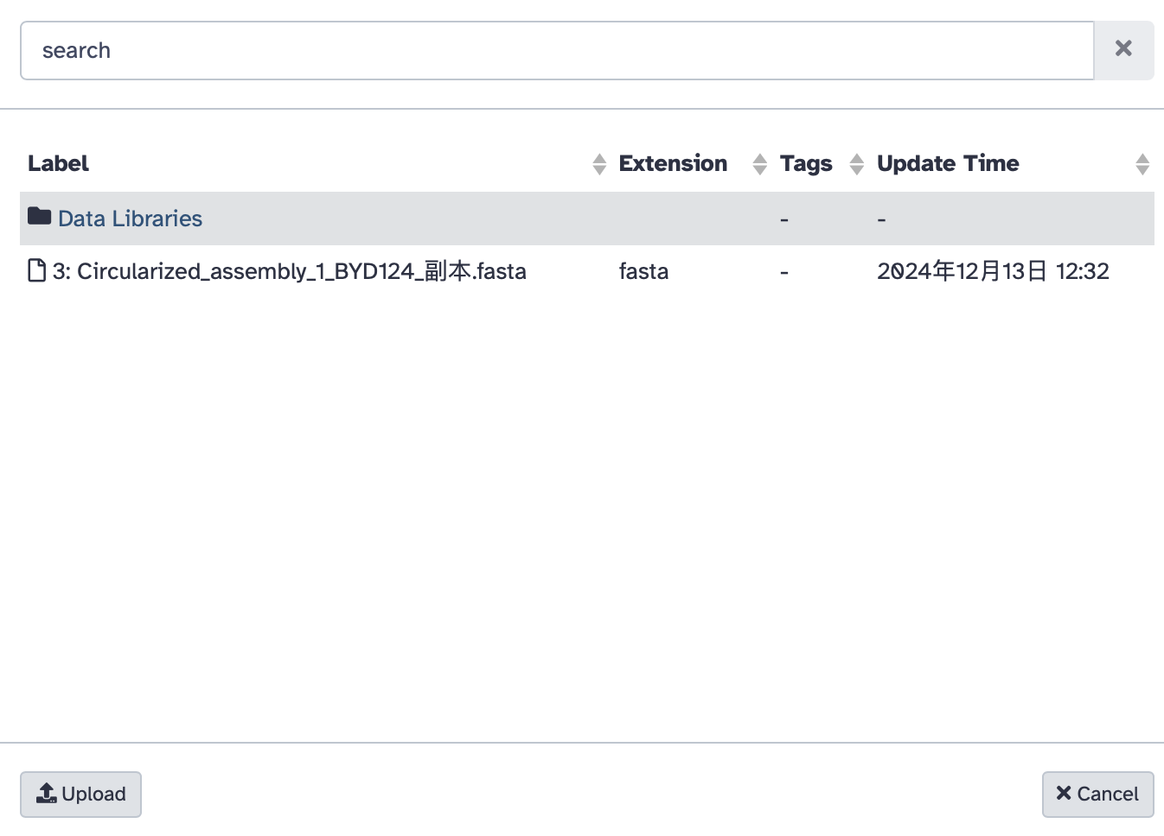
二、De novo annotation
Step3: Parameters setting

Slide 32
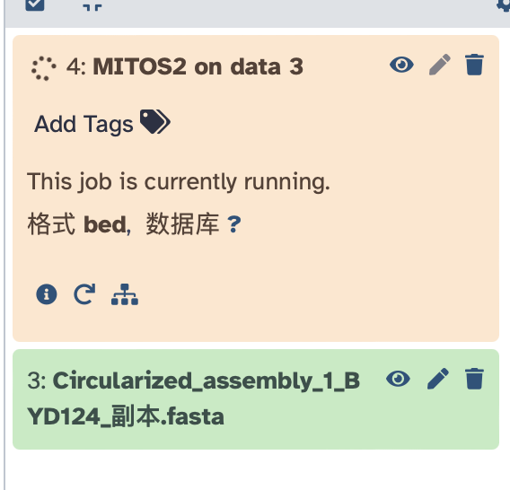
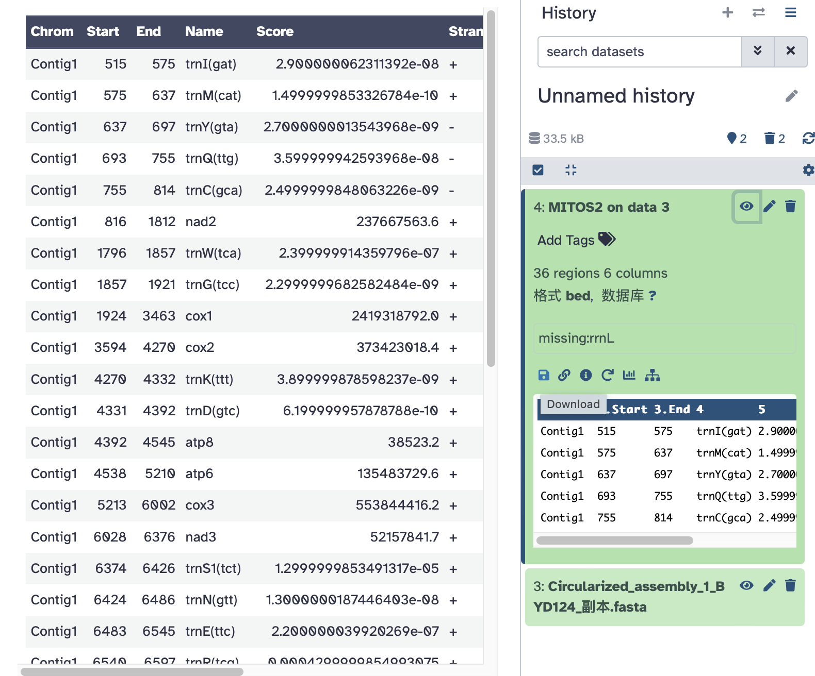
二、De novo annotation
Step4: Export results

Slide 33
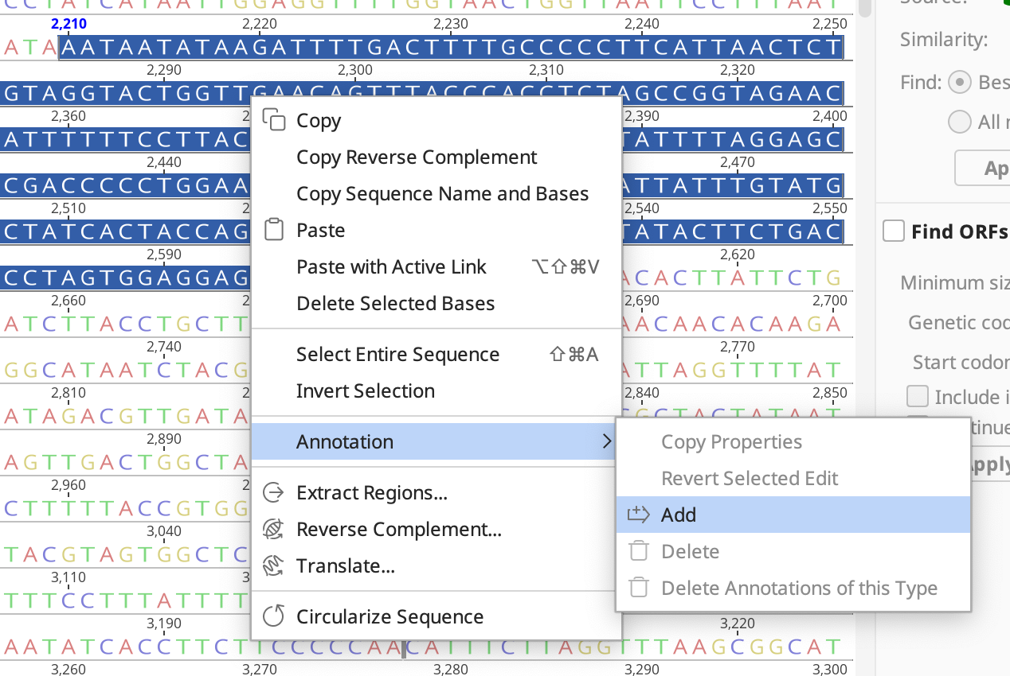
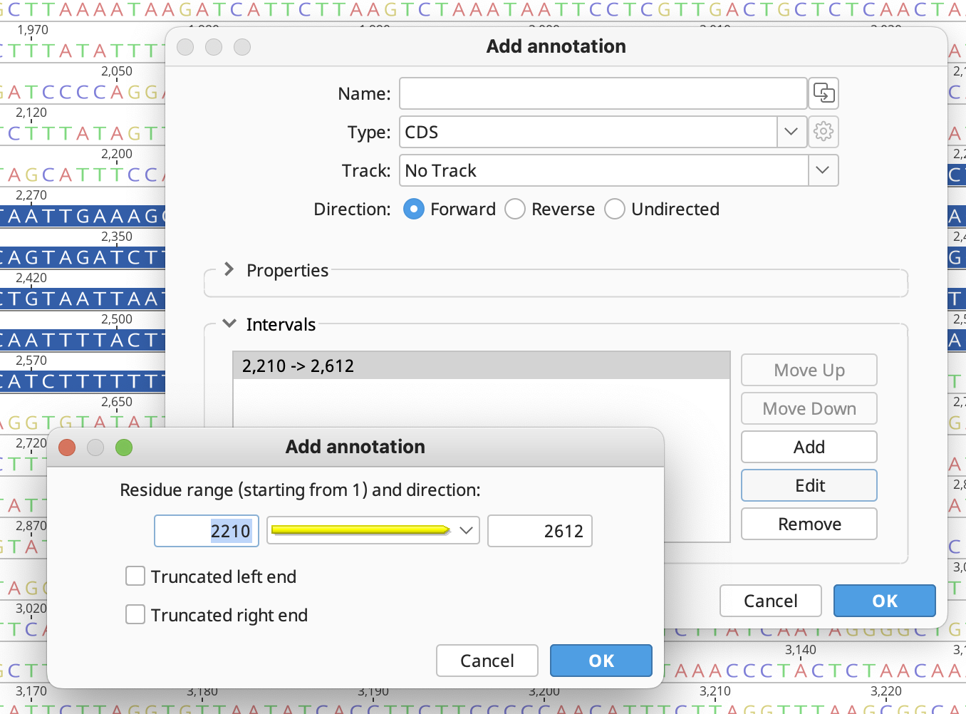
二、De novo annotation

Slide 34
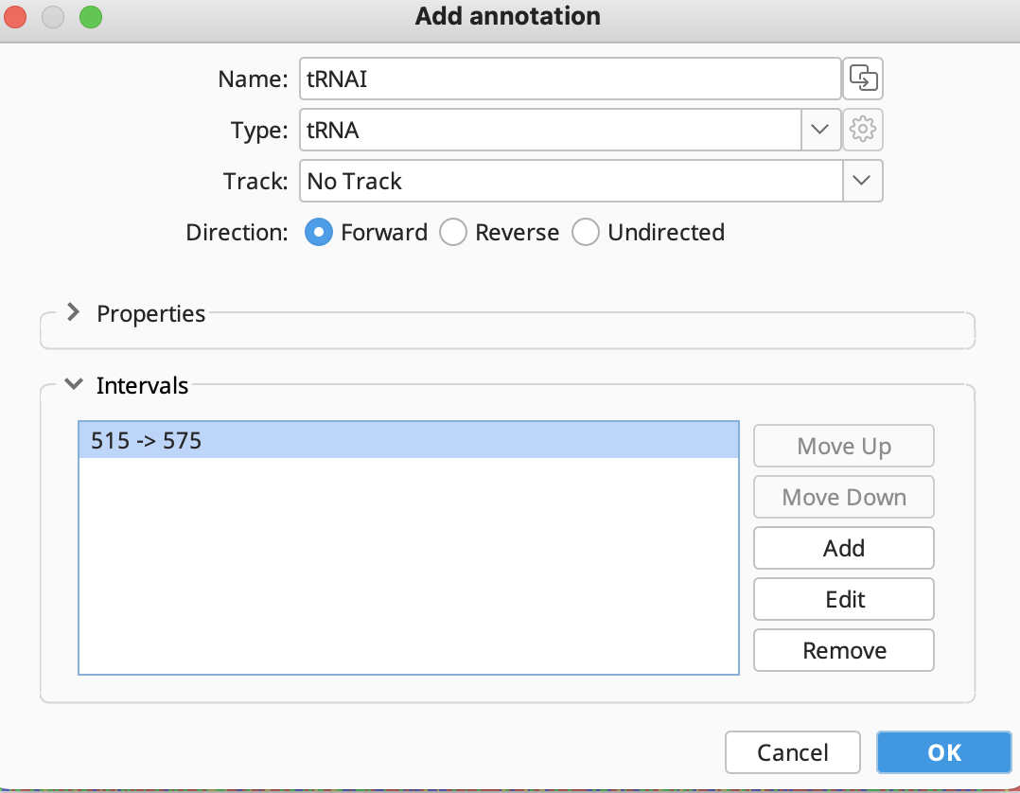
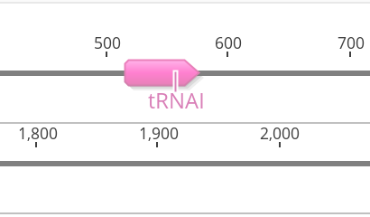
二、De novo annotation

Slide 35
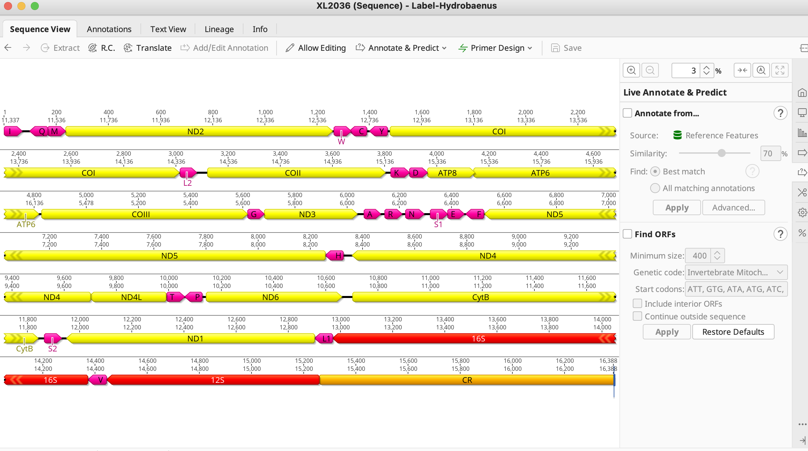
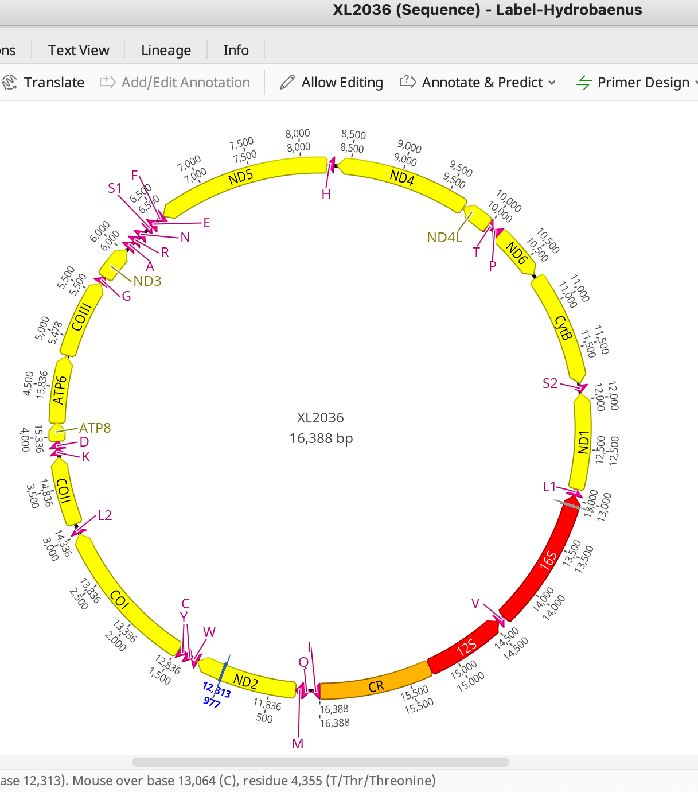
二、De novo annotation
Final chart

Slide 36
THANKS

