Slide 1
Haplotype
Haplotype ： Several closely linked genotypes that determine the same trait 。
Distinguish between variations in common haplotype sequences (SNPs)。
Notes:
单倍型：Several closely linked genotypes that determine the same trait（若干个决定同一性状的紧密连锁的基因构成的基因型）。不同的单倍型常用SNP数据进行区分。

Slide 2
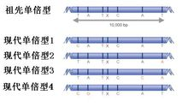
Notes:
The chromosomes are from both parents, and the original arrangement of ancestral chromosome fragments has been disrupted among non-close relatives. Certain ancestral chromosomal fragments appear in the DNA sequences of many offspring individuals. These are segments that have not been broken by reorganization, separated from each other by those regions that have undergone reorganization. These sections are haplotypes,（染色体是来自父母双方的，祖先染色体的片段的原有排布在非近亲结婚的人群中已被打乱。某些祖先染色体片段会在许多后代个体的DNA序列中出现。这些是没有被重组打破的区段，相互间被那些发生了重组的区域隔开。这些区段就是单倍型，）

Slide 3
What is the haplotype network
A haplotype network graph is a two-dimensional graph created by the relationships between haplotypes, which can reflect the relationships between haplotypes.
An important tool for geographic research. Through the haplotype network, we can infer the origin and diffusion history of the group.
Notes:
All the trees we build reflect the relationship between species or genes in the tree。单倍型网络图就是通过单倍型之间的关系建立出来的二维图，它可以反映单倍型之间的关系。An important tool for geographic research. Through the haplotype network, we can infer the origin and diffusion history of the group.
（谱系地理研究的重要手段。通过单体型网络，我们可以推断群体的起源、扩散历史。）

Slide 4
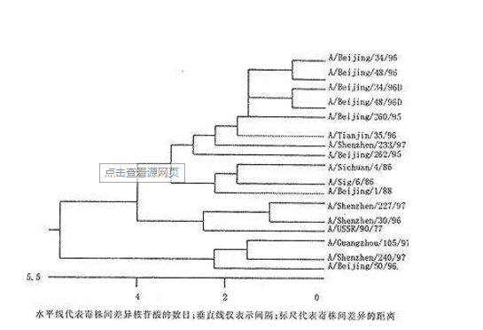
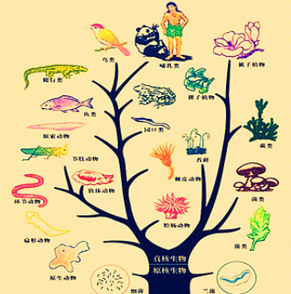
Why build a haplotype network
Notes:
We know that gene trees and species trees are trees established by different methods, which reflect the relationship between genes or species.我们知道基因树和物种树都是通过不同的方法建立的树，反映的是基因或是物种之间的关系。

Slide 5
Why build a haplotype network
The haplotype network diagram reflects the relationship between different individuals of the same species, so the species tree is unreasonable.
Notes:
单倍型网络图反映的是同一物种不同个体之间的关系，所以物种树是不合理的。

Slide 6
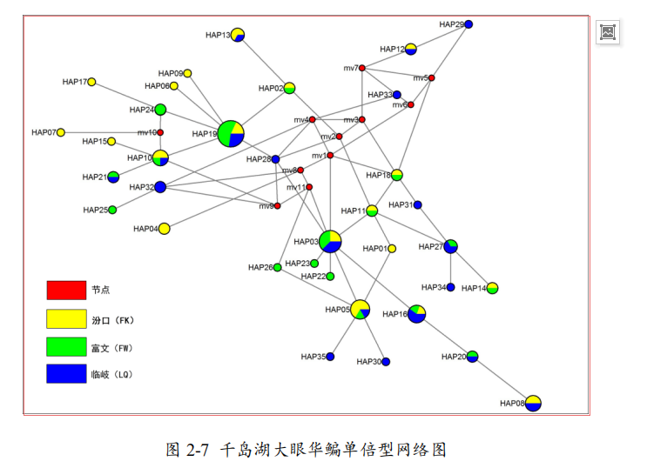
Haplotype network
Notes:
This haplotype network diagram shows the simplest tree, showing sequence information（这种单倍型网络图可以显示最简单的树，可以显示序列的信息）。It can represent the relationship between populations on a two-dimensional graph（它可以将种群之间的关系在二维图形上表示出来）
图中的一个圆圈代表的是一种单体型，两个圆圈之间的连线表示两个单体型是相关的，这个图形是发散的，我们需要找这个发散的中心，比如HAP19是一个中心，我们可以猜想旁边的单倍型可能从HAP19突变而来。而图中红色的节点代表没有收集到或者灭绝的单倍型。一种颜色一般表示一个群体，如按地理划分，品种划分等。图中例子一个单体型只存在于一个群体中，实际情况一个单体型往往在多个群体中出现。此时，一个单体型圆圈中填充多种颜色，以饼图的形式展示。A circle in the figure represents a haplotype. The connection between the two circles indicates that the two haplotypes are related. This graph is divergent. We need to find the center of this divergence. For example, HAP19 is a Center, we can guess that the haplotype next to it may be derived from HAP19 mutation. The red nodes in the figure represent haplotypes that have not been collected or extinct. A color generally represents a group, such as geographical division, variety division, and so on. In the example shown in the figure, a haplotype exists only in one population. In reality, a haplotype often appears in multiple populations. At this point, a single haplotype circle is filled with multiple colors and displayed in the form of a pie chart.

Slide 7
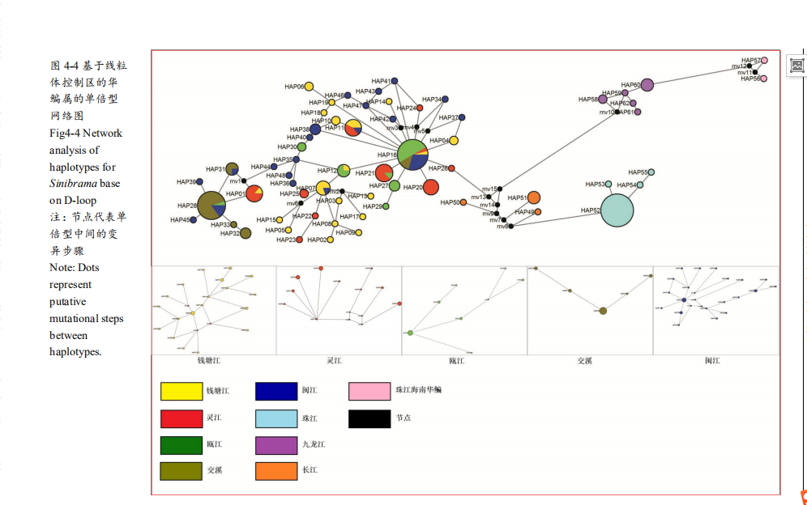

Slide 8
How to build a haplotype network ？
We often use network software to build haplotype network .
Binary data:Generally it is STRs, RFLP, and related DNA sequences. The file format of this data is * tor.
If the sequence is in FASTA format, it can be converted by DNA Alignment software.
Notes:
一般为STRs、RFLP、近缘的DNA序列，这种数据的文件格式为*。tor.
如果序列是FASTA格式则可以通过DNA Alignment软件去转换。

Slide 9
Download link
https://www.fluxus-engineering.com/sharenet.htm

