Slide 1
Phylogenomics
Prediction of gene function (Eisen, 1998)
Establishment of evolutionary relationships using genome or genome-scale data

Slide 2
One gene or more genes?
Single gene or a few genes often result low resolution.
Single gene or a few genes may even reach to the wrong phylogeny.

Slide 3
Systematic error
+
+
+ …
Phylogenetic signal
Gene A
Gene B
Gene C

Slide 5
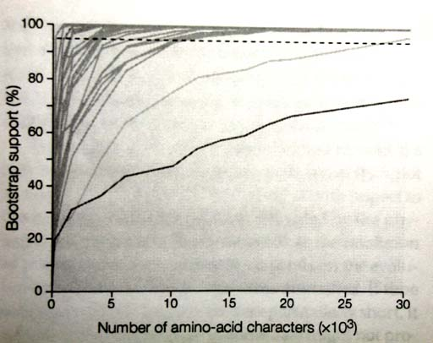
How many gene needed?
The figure shows resolving different node may need different number of genes.
Few nodes can be resolved by single gene or a few genes.
Most node need 5 to 10 thousand amino-acid (15-30 genes) to be resolved.
Few nodes can not be resolved even with many genes.
2,5000 nucleotides are needed for resoultion of avian tree (Edwards et at., 2005).
From Delsuc et al. 2005

Slide 6
How to analyze multilocus data?
Remember i.i.d.?

Slide 7
Partitioned analysis guided by cluster analysis and phylogeny of ray-finned fish

Slide 8
Assumption of i.i.d.
???
Topology and branch length
Substitution matrix
r_{TC} (= r_{CT}), r_{TA} (= r_{AT}), r_{TG} (= r_{GT})
r_{CA} (= r_{AC}), r_{CG} (= r_{GC})
r_{AG} (= r_{GA})
Stationary base frequencies
f_{T}, f_{C}, f_{A}, f_{G},
Taxa 1
Taxa 2
Taxa 3
Taxa 4
Taxa 5

Slide 9
Partitioning by genes and codons
Concatenated sequence
By genes
G1
G2
G3
G4
G5
G6
G7
G8
G9
G10
By codon positions
1st
2nd
3rd

Slide 10
By both genes and codon positions
G1
G2
G3
G4
G5
G6
G7
G8
G9
G10
1st 2nd 3rd
1st 2nd 3rd
1st 2nd 3rd
1st 2nd 3rd
1st 2nd 3rd
1st 2nd 3rd
1st 2nd 3rd
1st 2nd 3rd
1st 2nd 3rd
1st 2nd 3rd
Is partitioned by both genes and codon positions over-parameterized?

Slide 11
Data
Ten nuclear genes: zic1, myh6, RYR3, Ptc, tbr1, ENC1, Glyt, SH3PX3, plagl2 and sreb2.
56 taxa representing 41 of the 44 orders of ray-finned fish and 4 outgroups
8025 nucleotides

Slide 12
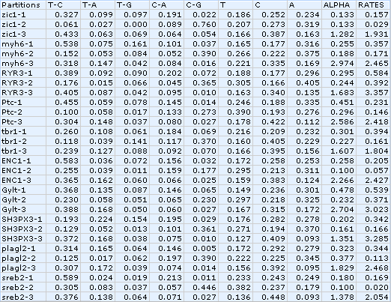
Data

Slide 13
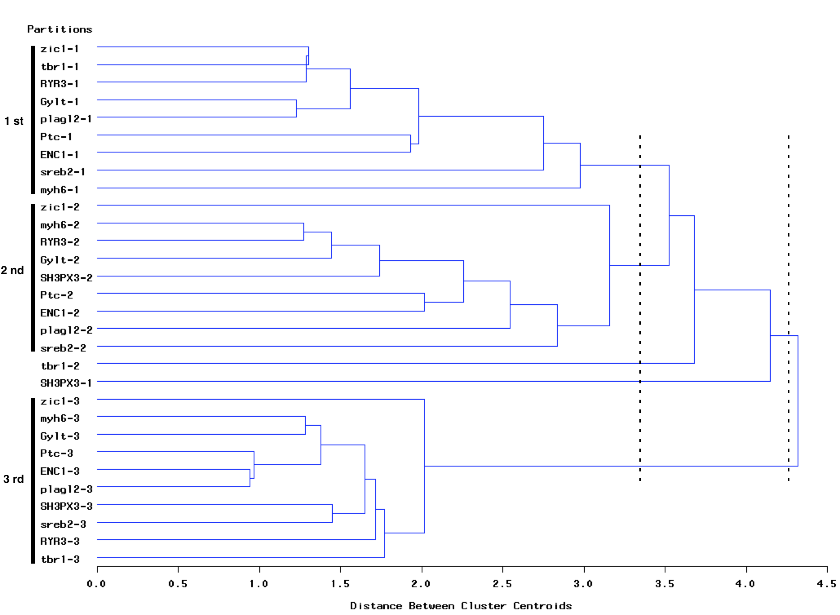
Clustering of blocks based on genes and codons
5 parts
2 parts

Slide 14
∆_{i}(AIC_{i} - AIC_{best}) and Bayes likelihood for partitioning based on grouping blocks
∆_{i}
Bayes likelihood

Slide 15
Conclusion
Partitioning by both genes and codon positions is over-parameterized. Cluster analysis helps in reducing the number of partitions.
Li et al., 2008, Syst. Biol. 57(4): 519-539

Slide 16
Lanfear et al., 2012, MBE, 被引用次数：>7000

Slide 17
Gene tree vs. species tree
A paradigm shift (Scott Edward)

Slide 18
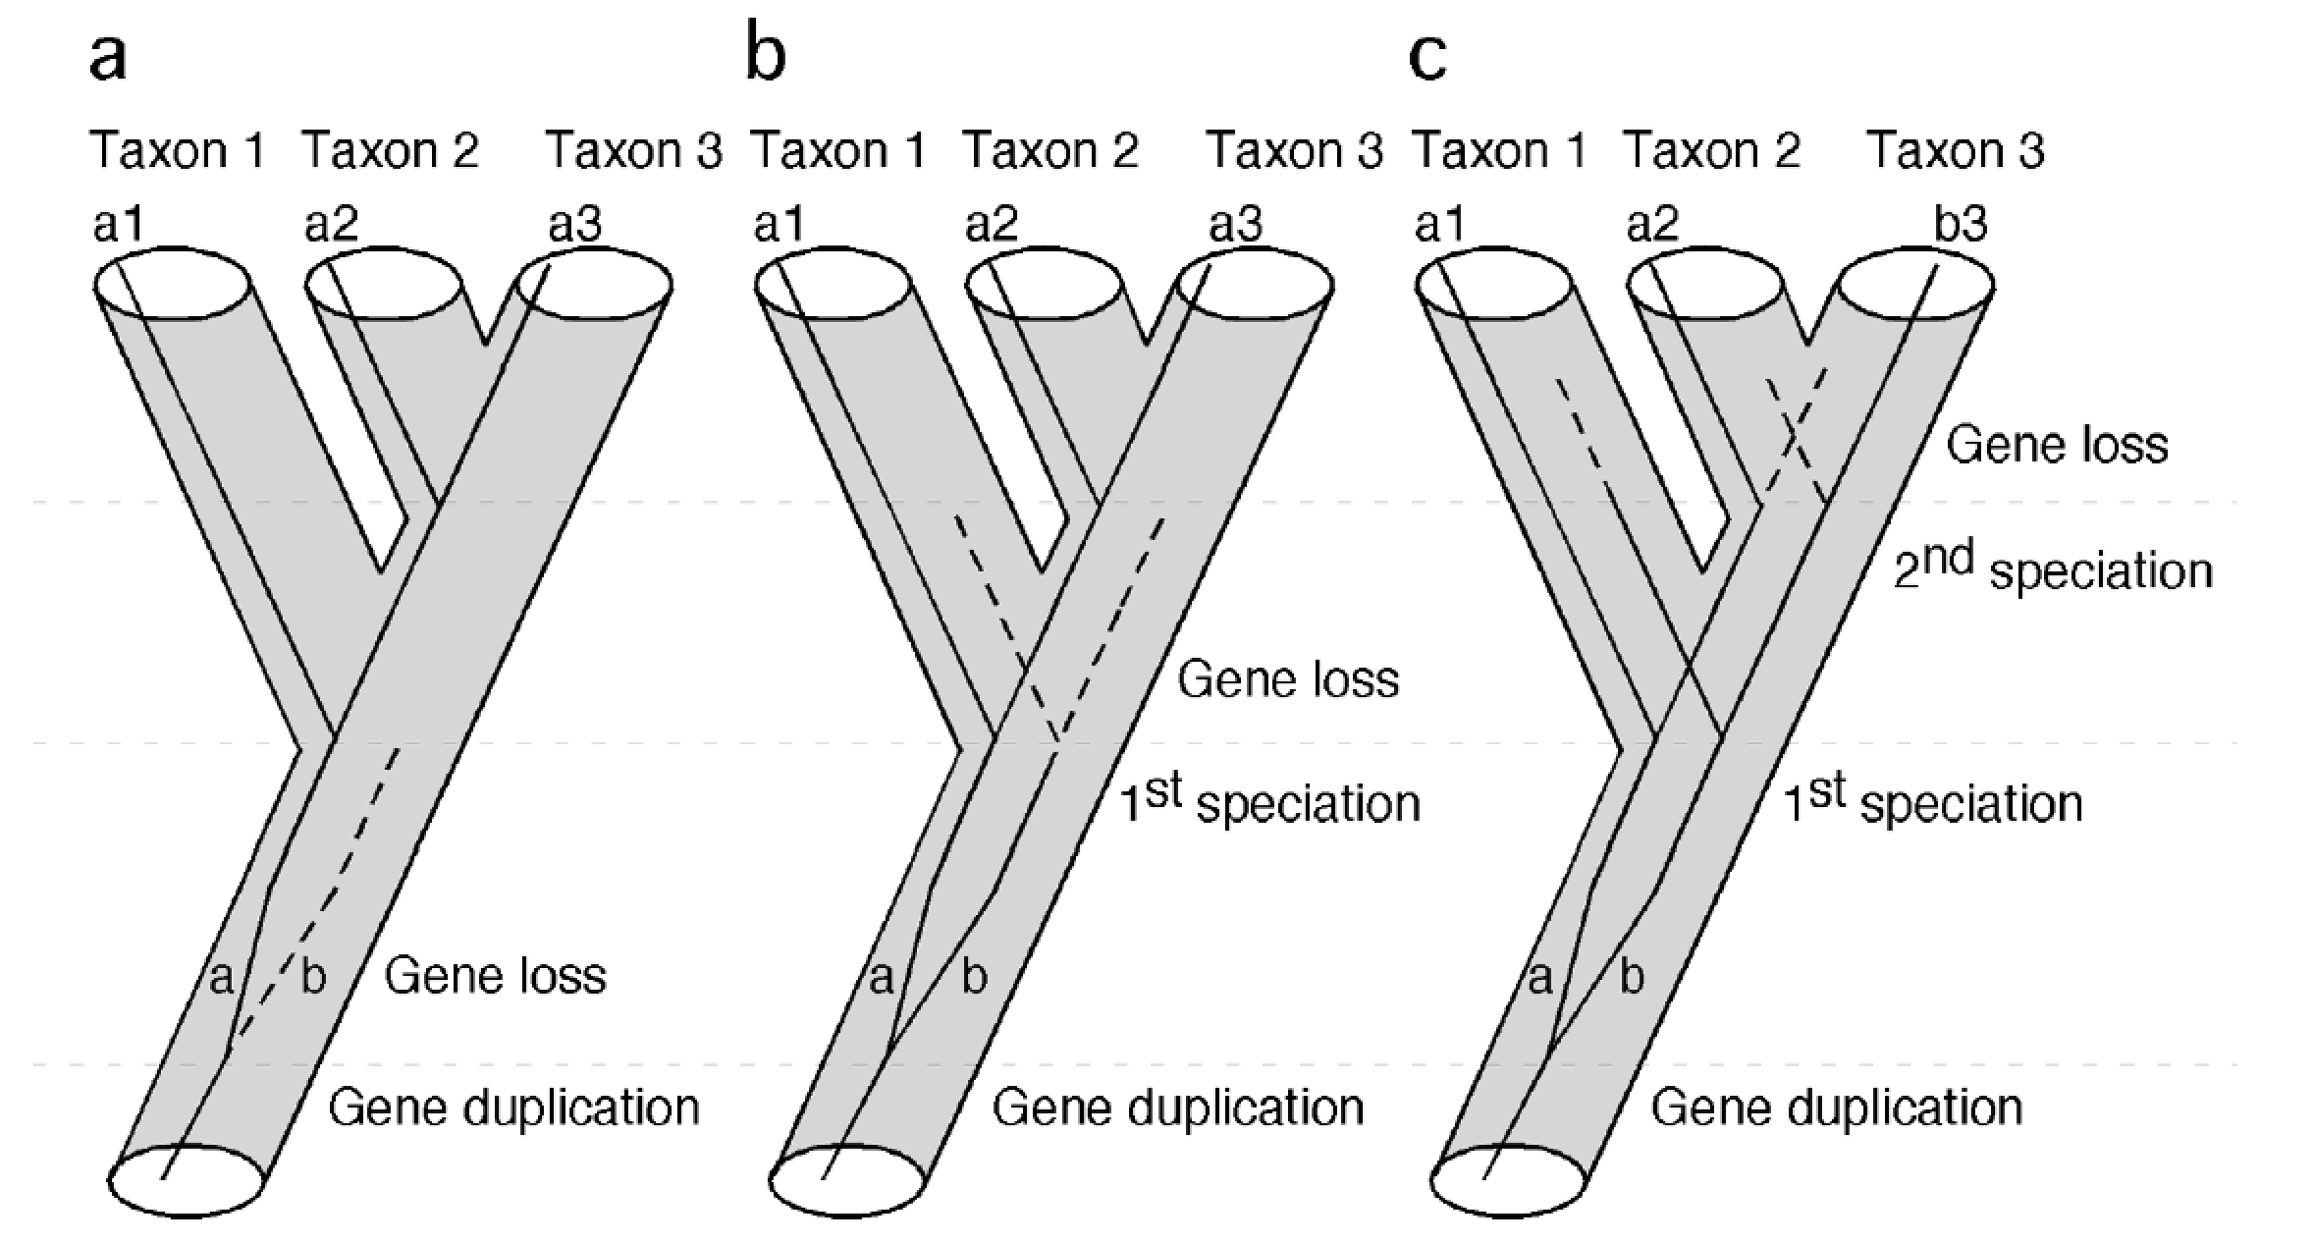
Gene duplication and loss
Li et al., 2007 BMC Evolutionary Biology

Slide 19
Horizontal Gene Transfer
Cordero et al., 2009 PNAS

Slide 20
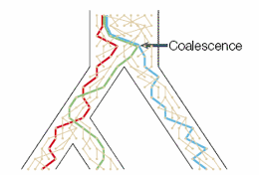
Incomplete lineage sorting (ILD)

Slide 21
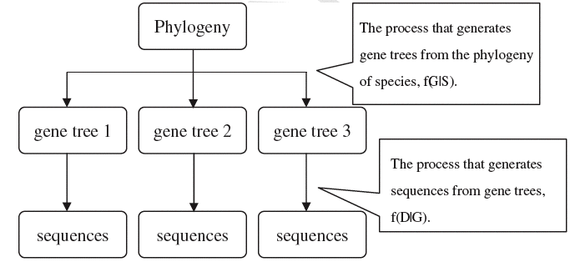
Hierarchical nature of phylogeny
Liu, Yu, Kubatko, Pearl and Edwards 2009. Mol. Phyl. Evol. 53:320-328

Slide 22
http://www.stat.osu.edu/~dkp/BEST/introduction/

Slide 23
http://beast.bio.ed.ac.uk/Main_Page
BEAST is a cross-platform program for Bayesian MCMC analysis of molecular sequences. Can be used to reconstruct species tree.

Slide 24
ASTRAL: genome-scale coalescent-based species tree estimation
ASTRAL is a java program for estimating a species tree given a set of unrooted gene trees.
ASTRAL is statistically consistent under multi-species coalescent model (and thus is useful for handling ILS).
The optimization problem solved by ASTRAL seeks to find the tree that maximizes the number of induced quartet trees in gene trees that are shared by the species tree.
The current repository (master branch) includes the ASTRAL-III algorithm.

