Slide 1
Phylogenetics -- Introduction
phylogenetics (pron.: /faɪlɵdʒɪˈnɛtɪks/) is the study of evolutionary relationships among groups of organisms (e.g. species, populations)

Slide 2
Why phylogeny?
Phylogeny is the evolutionary relationship among taxa, it provides framework for studying
Comparative morphology
Conservation
Agriculture
Biogeography
Disease
Genomics

Slide 3
http://www.phylo.org/atol/

Slide 4
Terminology
Internal nodes
Branches
Root
Terminal nodes
Phylogram or phylogenetic tree

Slide 5
Number of Trees Unrooted bifurcating (2N-5)!!
1
3
2
4
1
2
3
4
1
3
4
2

Slide 6
Number of Trees Rooted bifurcating (2N-3)!!
1
3
1
2
1
3
2
4
3
4
4
2
4
2
3
1
3
1
4
2
3
1
2
4
4
2
3
1
4
2
3
1

Slide 7
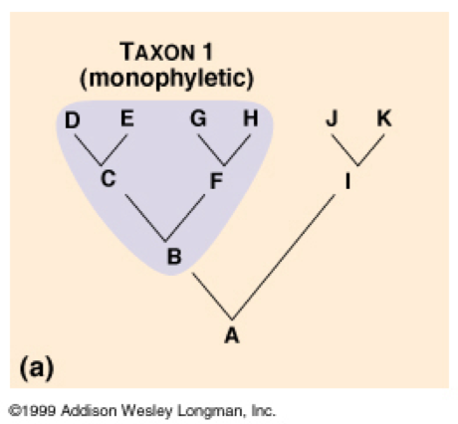
Reading phylogenetic trees
A valid clade is monophyletic consisting of the ancestor taxon and all its descendants
Notes:
(a) Monophyletic. In this tree, grouping 1, consisting of the seven species B–H, is a monophyletic group, or clade. A mono- phyletic group is made up of an ancestral species (species B in this case) and all of its descendant species. Only monophyletic groups qualify as legitimate taxa derived from cladistics.

Slide 8
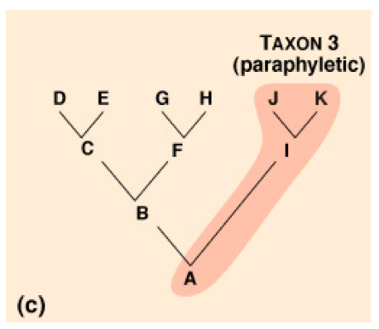
Reading phylogenetic trees
A paraphyletic clade consists of an ancestral taxon and some, but not all, of the descendants
Notes:
(b) Paraphyletic. Grouping 2 does not meet the cladistic criterion: It is paraphyletic, which means that it consists of an ancestor (A in this case) and some, but not all, of that ancestor’s descendants. (Grouping 2 includes the descendants I, J, and K, but excludes B–H, which also descended from A.)

Slide 9
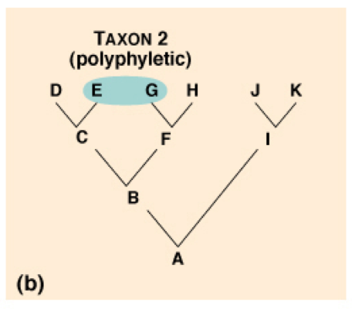
Reading phylogenetic trees
A polyphyletic grouping includes numerous taxa that lack a common ancestor
Notes:
Polyphyletic. Grouping 3 also fails the cladistic test. It is polyphyletic, which means that it lacks the common ancestor of (A) the species in the group. Further- more, a valid taxon that includes the extant species G, H, J, and K would necessarily also contain D and E, which are also descended from A.

Slide 10
Homology vs. Homoplasy
Homology is any similarity between characters that is due to their shared ancestry
Homoplasy occurs when characters are similar, but are not derived from a common ancestor.
Homoplasy often results from convergent evolution.
What type of characters do we use to determine evolutionary relationships?

Slide 11
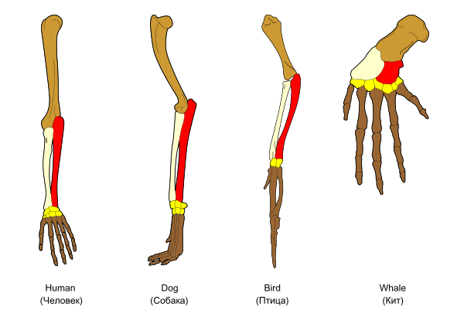
Vertebrate limbs are homologous.

Slide 12
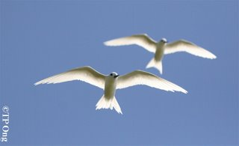
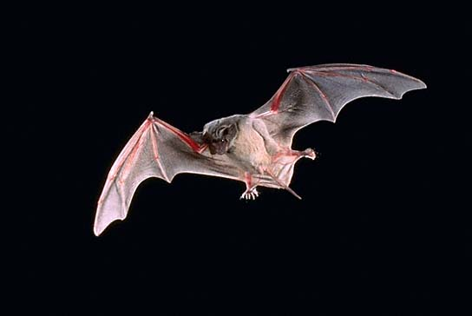
Are bird and bat WINGS homologous?
lazybirder.blogspot.com
http://www.fs.fed.us
No, they are homoplasious.

Slide 13
Sequence homolog
Ortholog
Speciation
Paralog
Gene duplication
xenolog
Gene duplication
Horizontal gene transfer

Slide 14
Sequence homolog

Slide 15
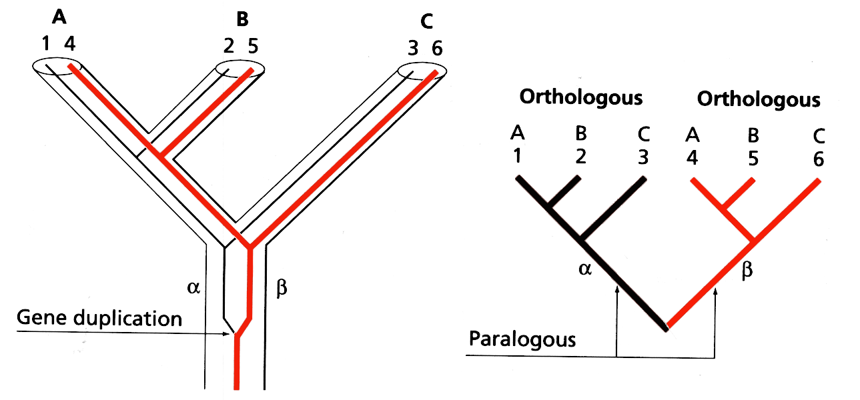
Gene Duplication
If we unwittingly sequenced genes 1, 3 and 5 we would incorrectly infer that ((A,C) B) was the organismal tree. This would be a paralogous comparison. Only orthologous comparisons reflect the organismal tree

