Slide 1
Bioenergetics model
Ichthyology
reporter:陈秀娟

Slide 2
01
What is bioenergetics model?
bioenergetics model
CONTENTS
02
The significience of studies on bioenergetics model
03
An example of studies on bioenergetics model in fish
Notes:
It may seem unfamiliar to us at first to see this term, but in fact, we have a basic understanding of such concepts as early as high school biology courses, when textbooks called it the energy flow of ecosystems

Slide 3
PART 01
What is bioenergetics model?

Slide 4
Definition of bioenergetics model
the model that describe the biology of energy transformations and energy exchanges within and between living things and their environments
Application
It is mainly used in three areas.
1.Energy conversion during biochemical processes and cellular activity
2.Energy conversion between different trophic levels in ecosystems
3.Energy conversion at the individual animal level
Notes:
It may seem unfamiliar to us at first to see this term, but in fact, we have a basic understanding of such concepts as early as high school biology courses, when textbooks called it the energy flow of ecosystems

Slide 5
Phylogeny
Foreign research on fish bioenergetics is relatively early
1914 Ege & Krough apply the principles of bioenergetics to fish
1939 Ivlev study the bioenergetics of Cyprinus carpio
1956 Winberg put forward the bioenergetics equation C=E+R+P
1967 Warren & Davis improve the equation on the basis of the former C=F+U+SDA+RS+RA+G
1980+ Domestic research on fish bioenergetics is carried out.
Notes:
It may seem unfamiliar to us at first to see this term, but in fact, we have a basic understanding of such concepts as early as high school biology courses, when textbooks called it the energy flow of ecosystems

Slide 6
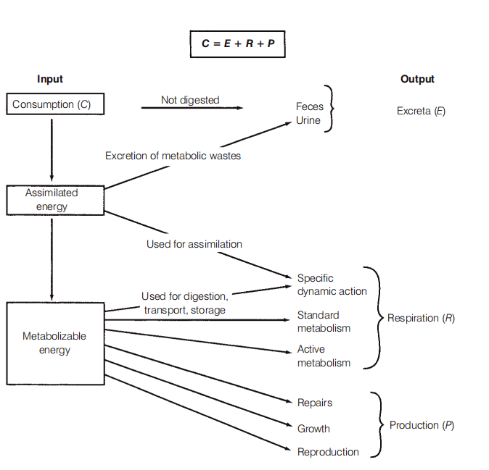
C is the energy consumed, E is the energy excreted,
R is the energy used in respiration, and P is the energy
remaining for production.
C = E + R + P
C is the energy consumed
E is the energy excreted
R is the energy used in respiration
P is the energy remaining for production.
This equation was first proposed by scientists Winberg based on ichthyology.
Notes:
It may seem unfamiliar to us at first to see this term, but in fact, we have a basic understanding of such concepts as early as high school biology courses, when textbooks called it the energy flow of ecosystems

Slide 7
C is the energy consumed, E is the energy excreted,
R is the energy used in respiration, and P is the energy
remaining for production.
Several methods can be used to determine the energetic content of food items, waste products, or components of fish growth such as tissue or gametes
The energetic costs of different activities can be estimated
by direct calorimetry
(measuring the heat produced by an organism)
by some form of indirect calorimetry
(such as measuring oxygen consumption)
Notes:
It may seem unfamiliar to us at first to see this term, but in fact, we have a basic understanding of such concepts as early as high school biology courses, when textbooks called it the energy flow of ecosystems

Slide 8
C is the energy consumed, E is the energy excreted,
R is the energy used in respiration, and P is the energy
remaining for production.
Influencing factors
1.temperature
2. absorption efficiency (or digestibility)
3.salinity
4.weight
5.gender
6.environment
Notes:
It may seem unfamiliar to us at first to see this term, but in fact, we have a basic understanding of such concepts as early as high school biology courses, when textbooks called it the energy flow of ecosystems

Slide 9
PART 02
The significience of studies on bioenergetics model

Slide 10
The significience of studies on bioenergetics model
1.Bioenergetics models can aid in understanding energy intake and utilization.
2.Bioenergetics models be useful in understanding how energy is allocated, and may be used to estimate the impacts of environmental alterations on rare species
3. Bioenergetics models of individual species can be used to construct community bioenergetic models,
Notes:
It may seem unfamiliar to us at first to see this term, but in fact, we have a basic understanding of such concepts as early as high school biology courses, when textbooks called it the energy flow of ecosystems

Slide 11
PART 03
An example of studies on bioenergetics model in fish

Slide 12
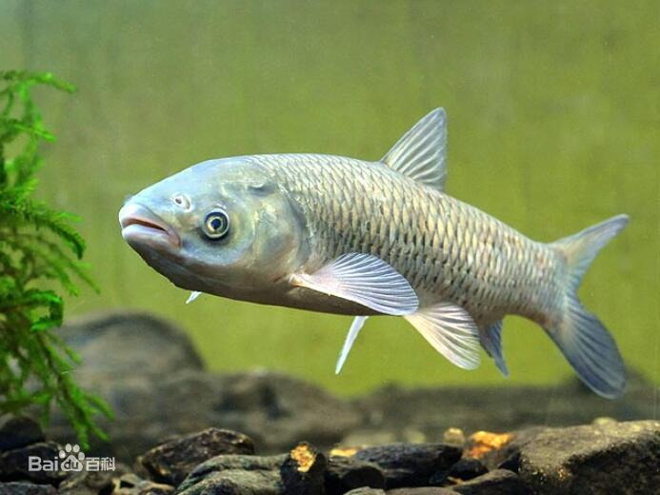
The study of bioenergetics of the Grass Carp
Characteristics
1.a high consumption
2.high metabolic expenditure
3.low growth efficiency
Four aspects
1.Is grass carp herbivorous or omnivorous?
2.Effects of feeding level on growth and energy budget of juvenile grass carp
3.Effects of temperature on growth and energy budget of grass carp juveniles
4.Effects of body weight on growth and energy budget of juvenile grass carp

Slide 13
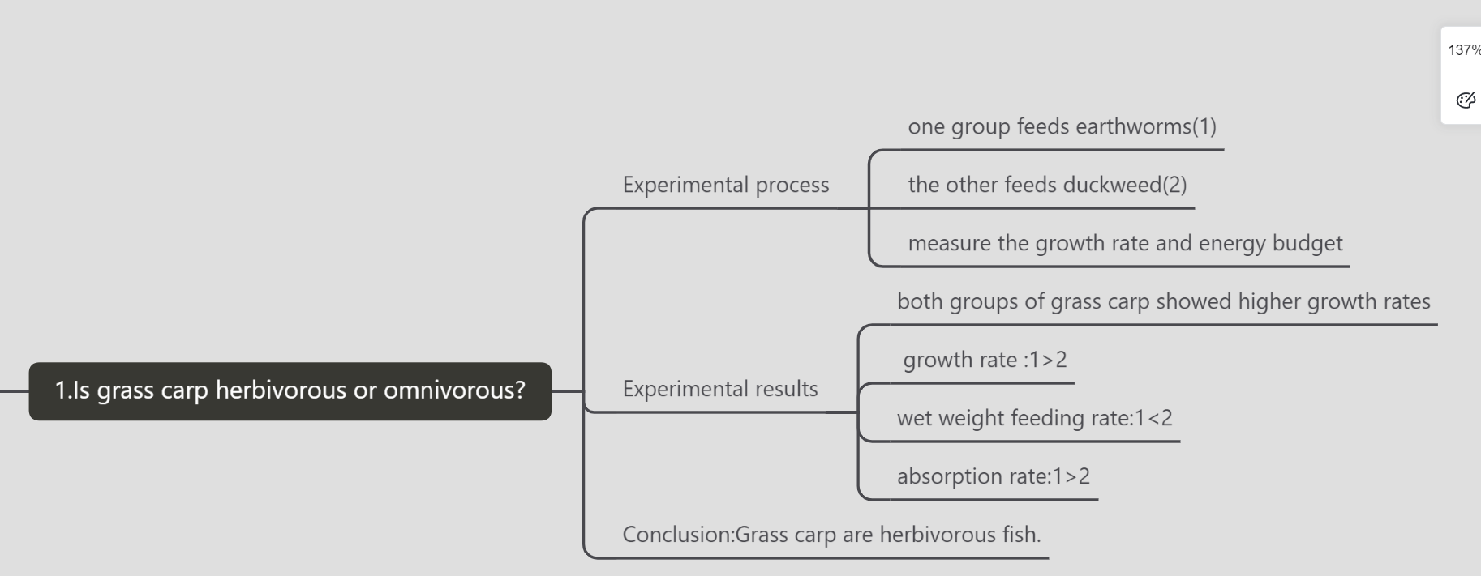
Is grass carp herbivorous or omnivorous?

Slide 14
Effects of feeding level on growth and energy budget of juvenile grass carp

Slide 15
Effects of temperature on growth and energy budget of grass carp juveniles

Slide 16
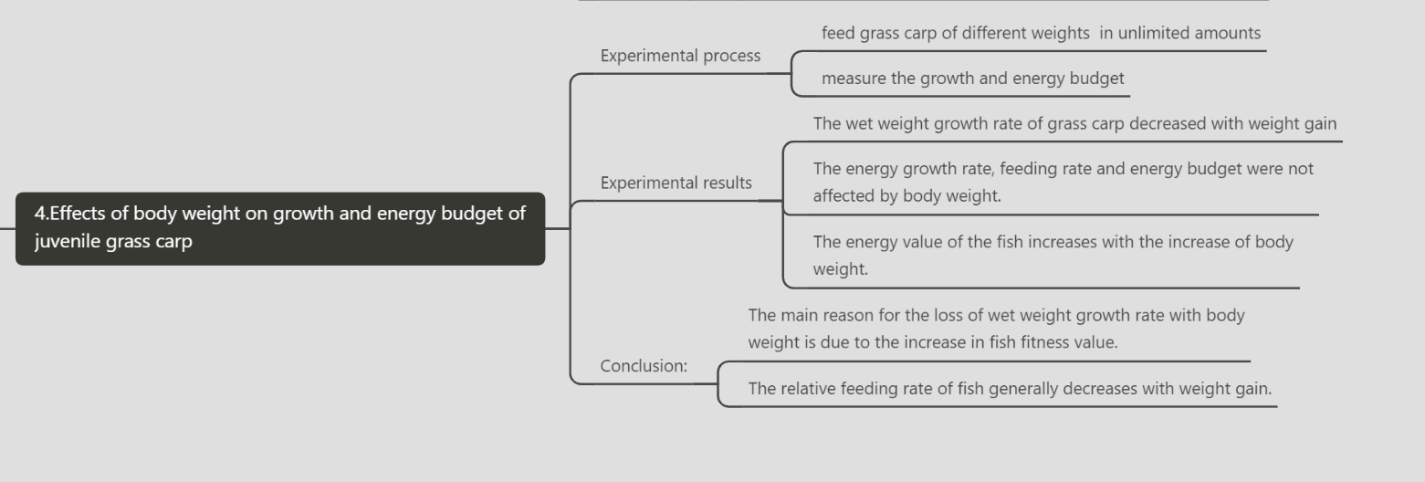
Effects of body weight on growth and energy budget of juvenile grass carp

Slide 17
Thanks for your listening
Ichthyology

