Slide 1
The three types of
air breathing
in fishes.
——2111211黄源英

Slide 2
CONTENTS
01
Introduction
02
Three types
• Derived from the gut
• Structures of the head and pharynx
• Skin

Slide 3
Introduction
Air breathing evolved among fishes over 400 milion years ago, and at least some members of extinct groups suchas the placoderms and acanthodians may have been air breathers (Graham 1997a).

Slide 4
Introduction
Most air-breathing fishes remain in water all of the time (aquatic airbreathers).
Among these some only supplement gill respiration when necessary (facultative air breathing), whereas others must have access to air or they will drown (obligate air breathing).

Slide 5
Three types
02
01
03
Structures of the head and pharynx
Derived from the gut
Skin

Slide 6
◆A. Derived from the gut
Those that are derived from the gut,such as the lungs, gas bladder, stomach, or intestine.

Slide 7
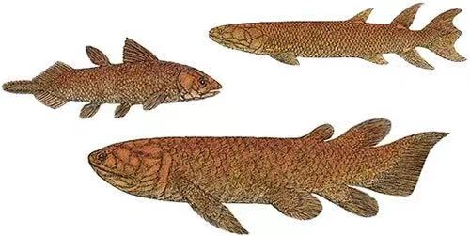
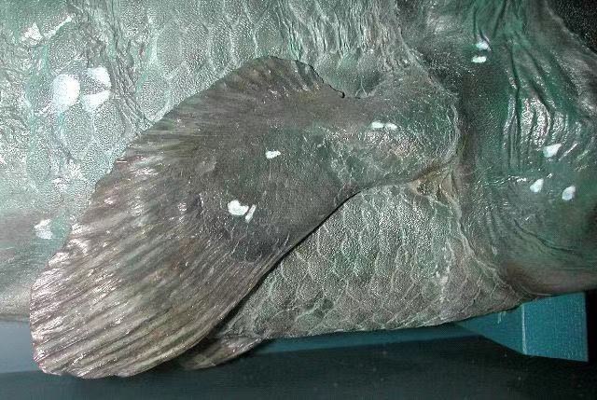
◆A. Derived from the gut：lungs
Lungs were present in many primitive fishes, and became more specialized and efficient among the sarcopterygiansas they evolved and one lineage became the modern tetrapod's.

Slide 8
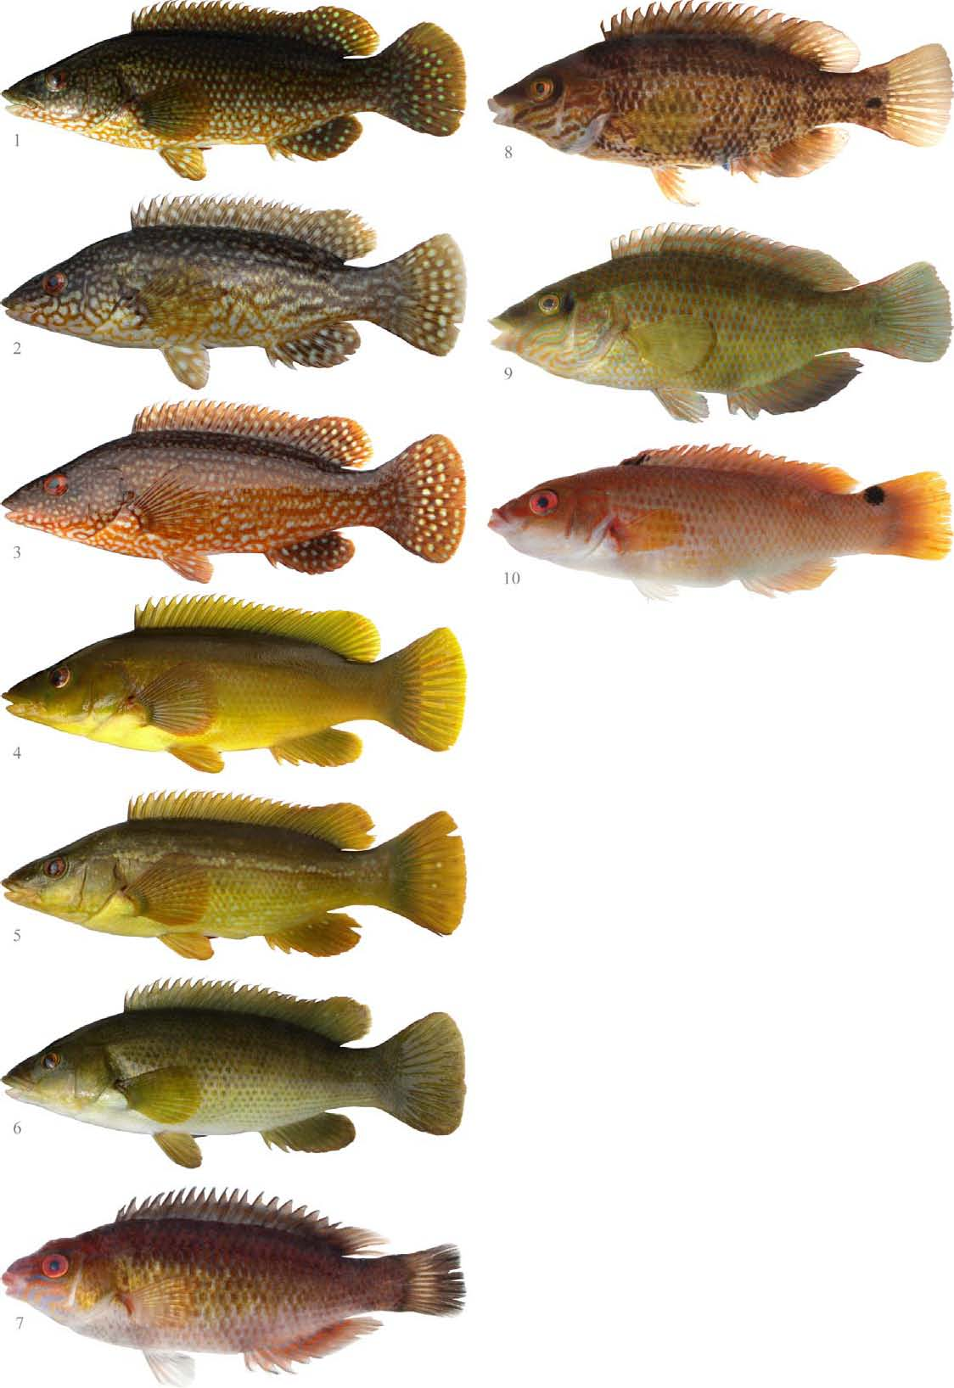
As the actinopterygians evolved and became more advanced, the lung lost its respiratory function and became the gas bladder, which functions for buoyancy control and, in some fishes, enhances hearing (see Hearing).
◆A. Derived from the gut：lungs

Slide 9
Subsequently, some of the more advanced fishes developedalternative mechanisms to once again take advantage of the oxygen available in air.
◆A. Derived from the gut：lungs

Slide 10
◆A. Derived from the gut：lungs
The lungfishes (Dipnoi)have true lungs. The Australian Lungfish (Ceratodontidae) is a facultative air breather with a single lung, whereas the African and South American lungfishes (Protopteridae and Lepidosirenidae,respectively)are both obligate air breathers with bilobed lungs (see Subclass Dipnoi, Order Ceratodo ntiformes: the lungfishes ).

Slide 11
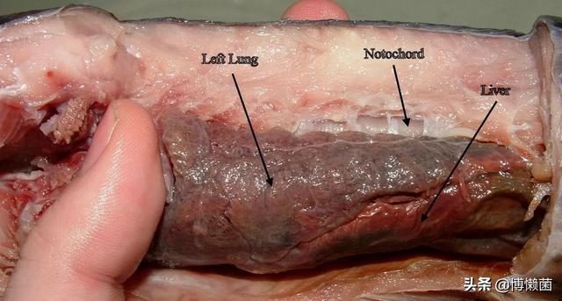
◆A. Derived from the gut：lungs
The gills of the South American Lungfish(Lepidosiren paradoxa) are of so little value for gas or ion exchange that the respiratory physiology of this species is more similar to that of an amphibian than to most otherfishes (de Moraes et al. 2005).

Slide 12
◆A. Derived from the gut：gas bladder
Gas bladders of most fishes are not well vascularized except in the regions designed for gas deposition or removal, but several air breathers have highly vascularized and subdivided gas bladders designed for gas exchange.

Slide 13
◆A. Derived from the gut：gas bladder
These include the very large South American osteoglossiform Arapaima (Osteoglossidae), as well as the North American Bowfin (Amiidae) and gars (Lepisosteidae). the Pacific Tarpon uses its gas bladder to augment respiration when Oxygen levels in the water are low.

Slide 14
◆A. Derived from the gut：intestine
The intestinal wall is thin and the blood vessels are abundant.

Slide 15
◆A. Derived from the gut：intestine
For example, if the loach does not eat in summer, the intestinal epithelium becomes squamous epithelium.

Slide 16
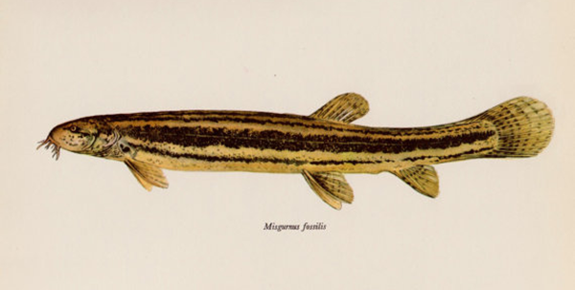
◆A. Derived from the gut：intestine
Vascular lymphatics appear between the cells.Oxygen is swallowed to complete the gas exchange in the intestine.The remaining oxygen and carbon dioxide are discharged from the anus.

Slide 17
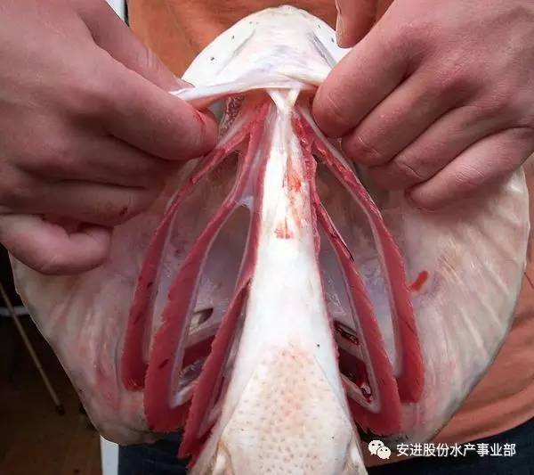
◆B. structures of the head and pharynx
such as modifications of the gills, mouth, pharynx,or opercles
Freshwater air-breathing fishes show a wide array of adaptations for aerial gas exchange. Gills are not well suitedfor aerial respiration because they collapse and stick together when not supported by the buoyancy of water.

Slide 18
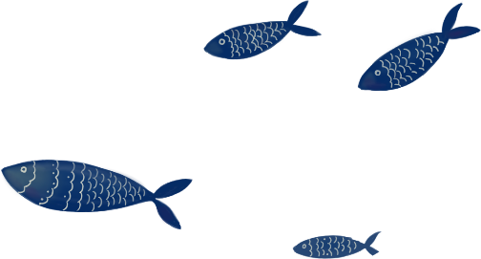
There are, however, a few fishes that have modified gill structures that assist with aerial respiration, such as the modified treelike branches found above gill arches two and four of the Walking Catfish (Clariidae)or the complex plate likeoutgrowths of the gill arches of anabantoids such as the Giant Gourami (Osphronemidae) and several other Asian perciforms(Fig. 5.4).

Slide 19
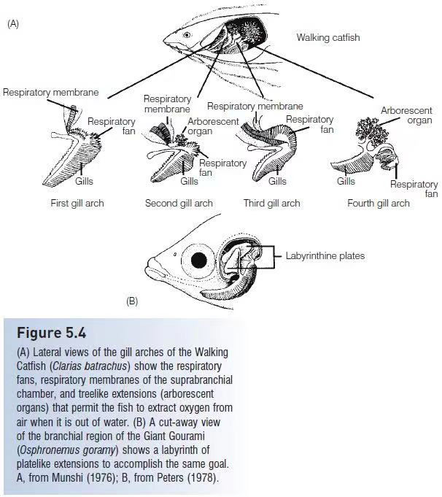

Slide 20
◆C. skin
which can be very effective for gas exchange if it is well vascularized and kept moist.
◆ The skin often is well vascularized, has few scales, and is kept moist.mudskippers (Periopthalmidae) rely on cutaneous respiration to support their amphibious lifestyle.
◆Most marine air-breathing fishes are emergent or amphibious and rely on thei skin for respiration while in air.

Slide 21
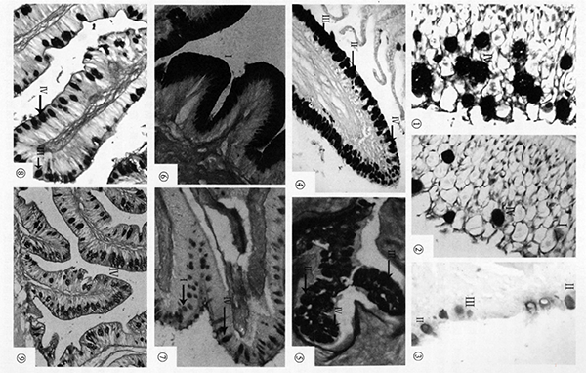
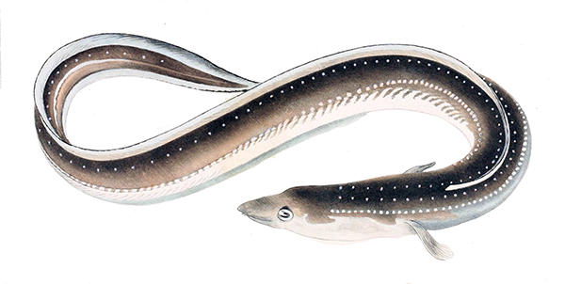
Anguilla japonica also uses skin to help breathe.
◆C. skin

Slide 22
for
your
Thanks
listening
——2111211黄源英

