Slide 1
Describe the three types of photoreceptive glycoprotein(opsin) and their difference
2111418 陈子涵

Slide 2
the three types of photoreceptive glycoprotein (opsin)
There are several types of cones, each with a different photoreceptive glycoprotein (opsin) that responds to different wavelengths of light.
Fishes may have only two or three of these types of cones, depending on the light quality in the ﬁsh’s habitat.

Slide 3
Porphyropsin
Porphyropsins are sensitive to yellow-red light, which has longer wavelengths and attenuates relatively quickly in water.
Therefore, porphyropsins tend to be more common in ﬁshes living in shallow areas or closer to the surface.

Slide 4
Rhodopsins
Rhodopsins are more sensitive to shorter wavelength, blue-green light which penetrates further into the water, and are therefore common in ﬁshes inhabiting somewhat deeper areas.
Most elasmobranchs, for example, have rhodopsins, but porphyropsins are rare in this group.

Slide 5
Chrysopsin
Chrysopsins are most sensitive to deep blue light, which penetrates furthest into the water due to its short wavelength, and these are found in deepsea ﬁshes.

Slide 6
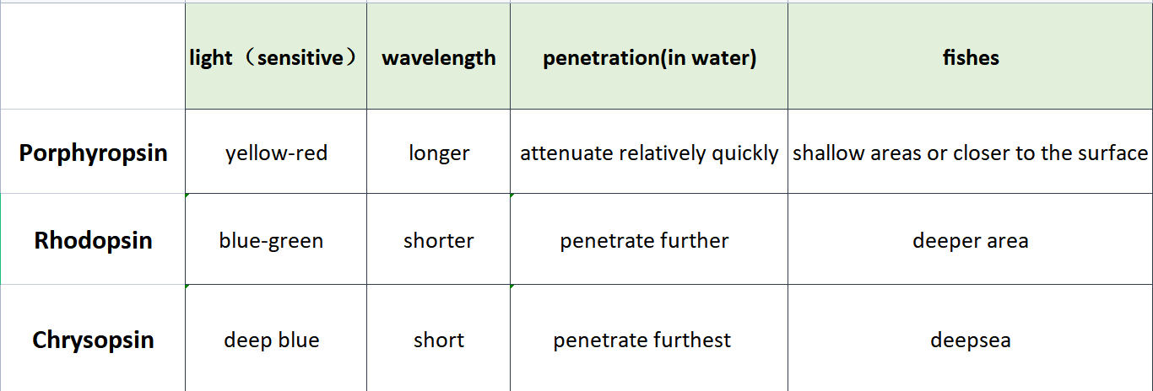
difference
Porphyropsin
Rhodopsins
Chrysopsins

Slide 7
fishes
dominating opsin
freshwater fish
porphyropsin
sea fish
rhodopsin
Most of fishes have both two opsins.

Slide 8
porphyropsin–rhodopsin shift
Juvenile Lemon Sharks have porphyropsins, which are beneficial in shallow, turbid, inshore habitats, but as the fish get older the pigments change to rhodopsins, which are more useful as the fish move to the deeper, clearer open ocean

Slide 9
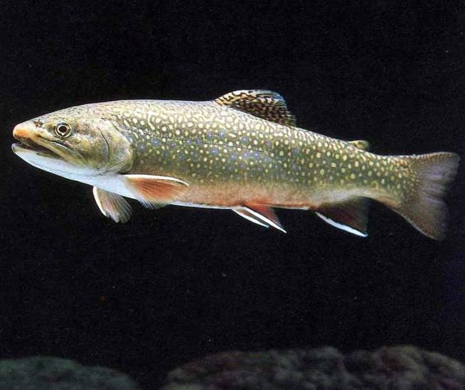
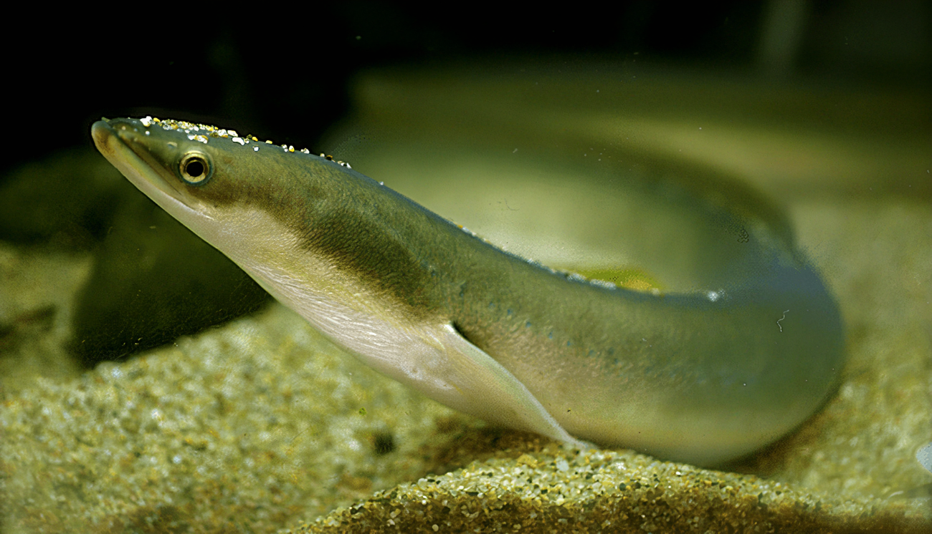
some cyprinidae
only rhodopsins
Salmo
（anadromous）
Anguilla（catadromous）
sea
river
freshwater
sea
rhodopsin
porphyropsin
porphyropsin
rhodopsin

