Slide 1
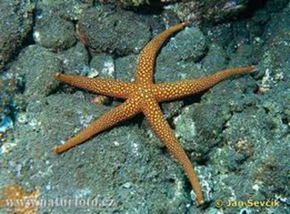
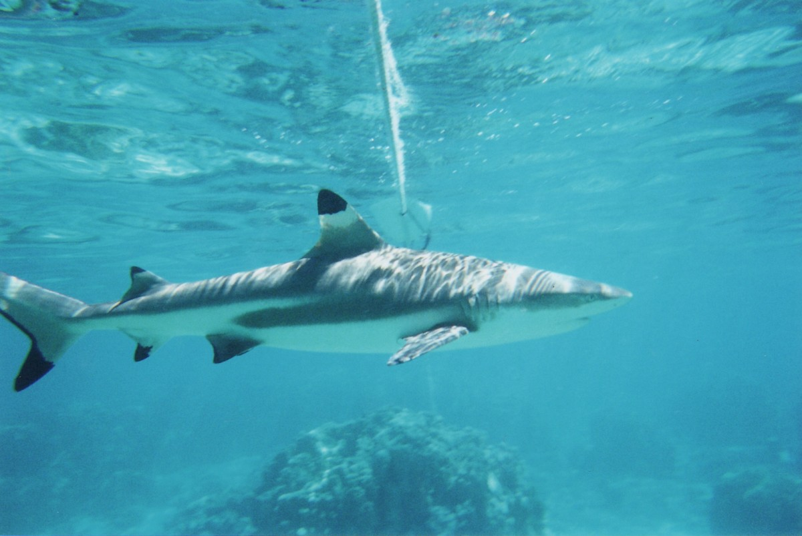
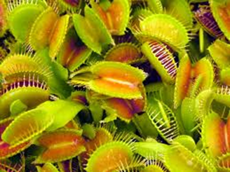
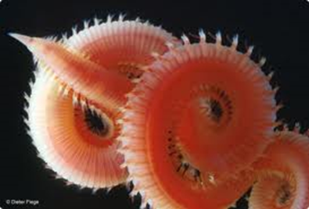
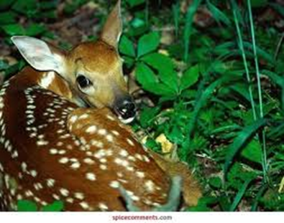
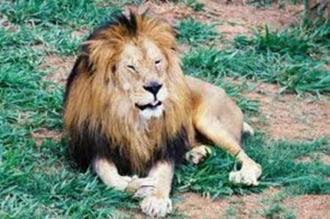
Trophic CASCADES

Slide 2
Trophic Cascades? What?
Trophic cascades are powerful indirect interactions that can control entire ecosystems, occurring when predators in a food web suppress the abundance or alter the behavior of their prey, thereby releasing the next lower trophic level from predation (or herbivory if the intermediate trophic level is a herbivore).

Slide 3
Trophic Cascades? What?
A trophic cascade is an ecological phenomenon triggered by the addition or removal of top predators and involving reciprocal changes in the relative populations of predator and prey through a food chain, which often results in dramatic changes in ecosystem structure and nutrient cycling.

Slide 4
How it works?
Carnivores keep the herbivore population in check which allows producers to keep producing.
…

Slide 5
Carnivores
No predators
Limited only by food
Herbivores
Limited by predation
Limited by competition and resources
Producers

Slide 6
Trophic cascade – influence of producers or consumers on species that are two or more trophic levels away Top-down Control – influence of predators on the relative abundance of lower trophic levels Bottom-up Control – influence of producers on the relative abundance of higher trophic levels

Slide 7
The number of second trophic levels will increase when the third trophic level disappears.

Slide 8
Fourth trophic level Third trophic level Second trophic level First trophic level

Slide 9
Classic examples
The producer is the first trophic level, and for an animal, its trophic level is not fixed, the starting point of each food chain is the producer, and the end point is an animal that is not eaten by other animals..

Slide 10
References
^Leopold, A. (1949) "Thinking like a mountain" in "Sand county almanac"Jump up
^ Hairston, NG; Smith, FE; Slobodkin, LB (1960). "Community structure, population control and competition". American Naturalist. 94: 421–425. doi:10.1086/282146.

Slide 11
