Slide 1
Avoiding detection
Fish as prey
Made by ：陈蕊

Slide 2
Contents
First
Camouflage
Second
Invisible fishes
Third
Early detection
Fouth
Shoaling and search

Slide 3
Camouflage
First

Slide 4
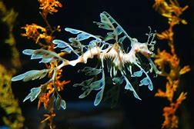
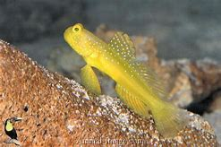
Camouflage
Fishes avoid detection by visually hunting predators in two chief ways , either by appearing like something unfishlike and therefore unrecognizable , or by disappearing entirely . In both categories , detection is accomplished through either reduction of photocontrast with the background or disruption of the outline of the fish.A common form of the first tactic , appearing unfishlike through photocontrast reduction , is called protective resemblance . Here a fish matches its background so accurately that it appears to blend in with it.Resemblance is achieved through constant or variable coloration and epidermal body growths that match surrounding objects . As most predatory animals are highly sensitive to movement , protective resemblance is usually enhanced by immobility.
Leafy Seadragons
Cardinalfishes
Yellow-spotted Gobies

Slide 5
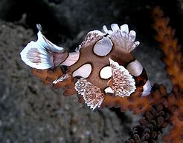
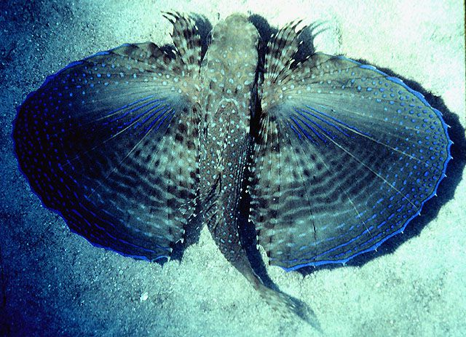
Camouflage
Juvenile
sweetlips
batfish
An alternative tactic is to be obvious but to appear as an inedible object . This is achieved by mimicking distasteful or otherwise inedible organisms and objects.
Several small fishes mimic small floating sticks , blades of grass , or dead leaves , for example juvenile sweetlips and batfishes ,

Slide 6
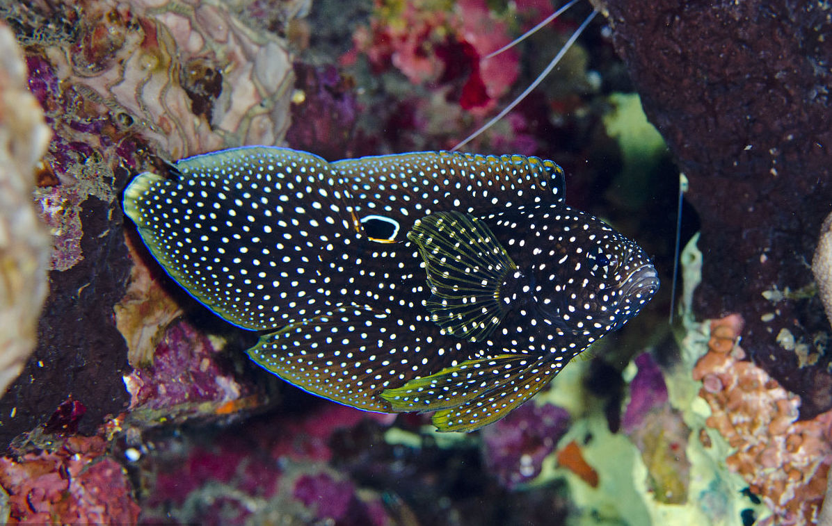
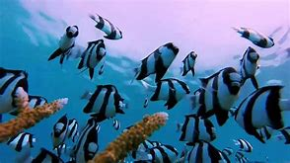
Camouflage
Some special cases involve mimicry of dangerous fishes by otherwise harmless species.
Another means of appearing unfishlike is to be disruptively colored.

Slide 7
Invisible fishes
Second

Slide 8
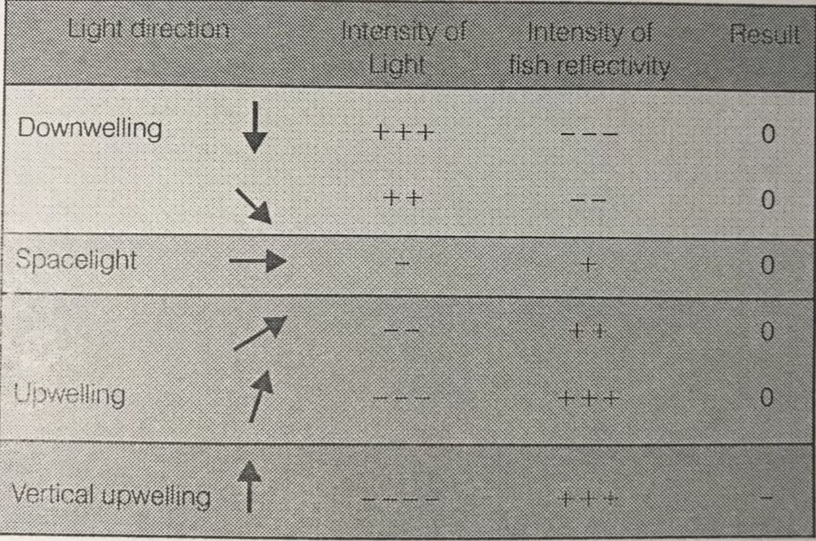
Invisible fishes
In water ,light has a much more predictable distribution , particularly in open water situations where the bottom is not visible . Sunlight is refracted at the water’s surface , being bent downward even at relatively low sun angles . Hence the brightest light is consistently directly overhead or downwelling .

Slide 9
Invisible fishes
Invisibility can be accomplished via three mechanisms:
^ countershading
^ slivery sides
^ transparency

Slide 10
Invisible fishes
The strength of the light that the fish reflects , which differs at different angles from the horizontal.
The actual color or shade of the fish is less important than:
The background light against which the fish will be compared.
The viewing angle of the observer.

Slide 11
Early detection
Third

Slide 12
Early detection
Sensitivity of the eye to light is determined by the brightest features of the environment : the eye becomes relatively in capable of seeing dimly lit objects against a bright background . In water this effect is heightened by turbidity . As light enters water , it reflects off particles such as phytoplankton and silt . When looking horizontally underwater on a sunny day , particles are particularly obvious as bright blotches . Particles closest to the observer’s eyes are the brightest because the light reflected off them travels the shortest distance . Turbidity therefore creates a bright region adjacent to the observer , a veil of brightness that intervenes between the eye and more distant targets . The eye quickly adapts to this bright region , and objects farther away in the darker background of space light become more difficult to detect.
PPT模板下载：www.1ppt.com/moban/ 行业PPT模板：www.1ppt.com/hangye/
节日PPT模板：www.1ppt.com/jieri/ PPT素材下载：www.1ppt.com/sucai/
PPT背景图片：www.1ppt.com/beijing/ PPT图表下载：www.1ppt.com/tubiao/
优秀PPT下载：www.1ppt.com/xiazai/ PPT教程： www.1ppt.com/powerpoint/
Word教程： www.1ppt.com/word/ Excel教程：www.1ppt.com/excel/
资料下载：www.1ppt.com/ziliao/ PPT课件下载：www.1ppt.com/kejian/
范文下载：www.1ppt.com/fanwen/ 试卷下载：www.1ppt.com/shiti/
教案下载：www.1ppt.com/jiaoan/
字体下载：www.1ppt.com/ziti/

Slide 13
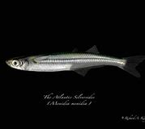
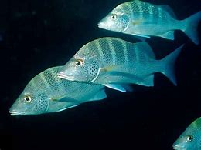
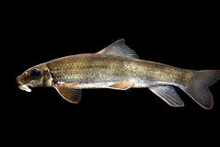
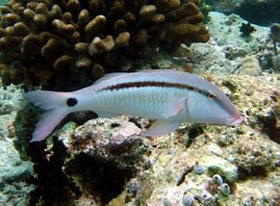
Early detection
Hovering in shade is a tactic commonly employed by resting fishes.
silversides
snappers
suckers
goatfishes
Many nocturnally active fishes form daytime resting schools in shaded regions by day .
Diurnally active fishes also hover in shade when resting.

Slide 14
Shoaling and search
Fouth

Slide 15
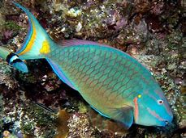
Shoaling and search
Fish in a shoal have a lower probability of being found by a predator than the same fish distributed solitarily . among herbivorous and planktivorous fishes . Highly evolved protective resemblance is not an option for such fishes ; hence group formation is an alternative.
Upon detection of a predator , fish in shoals typically shift to polarized , schooling tactics . Behaviors are emphasized that preserve the integrity of the threatened group . Subgroups stream toward the main group , interindividual distances decrease , and movements become synchronized among school member .
If few conspecifics exist , members of the minority species may seek shelter rather than wing up as the odd members of a school .
Parrotfish

Slide 16
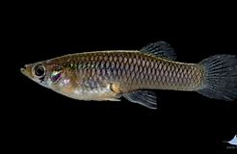
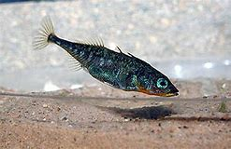
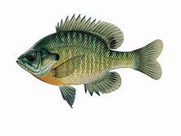
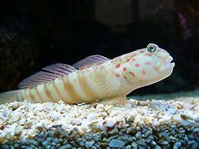
Shoaling and search
In some situation , members of the prey group will actually move away from the shoal , approach the predator , and then return to the shoal . The behavior may:
one
two
* Allow prey fish to assess the identity , motivational state , or other traits of the predator
* Inform the predator that it has lost the element of the surprise and that an attack is unlikely to be successful.

Slide 17
Summary
Protective resemblance , mimicry ,
disruptive , coloration ;
Blend into its background ,
or just disappear.
Countershading , mirror ,
and transparency .
Various types of camouflage
that make a prey appear
unfishlike or inedible.
Shoaling may increase the ability
of prey to detect and assess
Approaching predators , as does
hovering under shade-producing
objects.

Slide 18
THANK
YOU
Made by ：陈蕊

