Slide 1
Superorder of Acanthopterygii
辐鳍鱼纲共同特征
主讲人：柏皓天

Slide 2
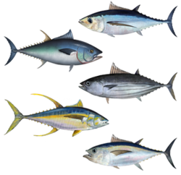
General informations
Acanthopterygii is a superorder within the class teleostei.
This superorder contains a remarkably diversity of the higher spiny-rayed fishes with 14,800 species in 267 families

Slide 3
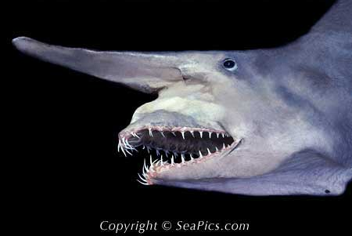
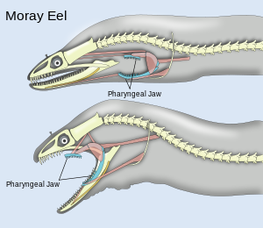
The Acanthoperygii are being distinguished by:
Upper jaw is mobility and protrusibilty in this group.
Pharyngeal dentition and action reach their
highest level of development.

Slide 4
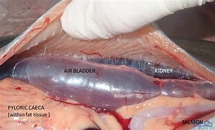
Other features Acanthopterygians typically charactarize:
Ctenoid scales;
A physoclistous gas bladder;
Two distinct dorsal fins, which of one is spiny and the other is soft-rayed;
Pelvic and anal fins with spines;
And a number of trends in feeding, locomotion, and predator protection.

Slide 5
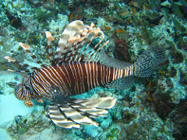
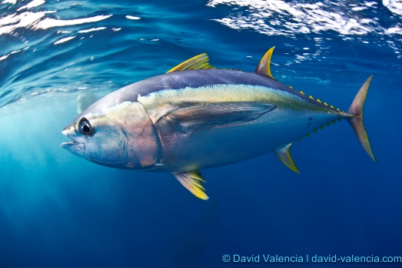
Acanthopterygian species
Lionfish (Scorpaeniformes)
Tuna (Scombridae)
Anglerfish (Lophiiformes)

Slide 6
