Slide 1
The Cardiovascular system of the fish
2111309周兴泓

Slide 2
Introduction
The cardiovascular system serves all bodily functions but is most closely associated with respiration, excretion, osmoregulation, and digestion. The cardiovascular system is the system of arteries, veins, and capillaries that carry respiratory gases, wastes, excretory metabolites, minerals, and nutrients.

Slide 3
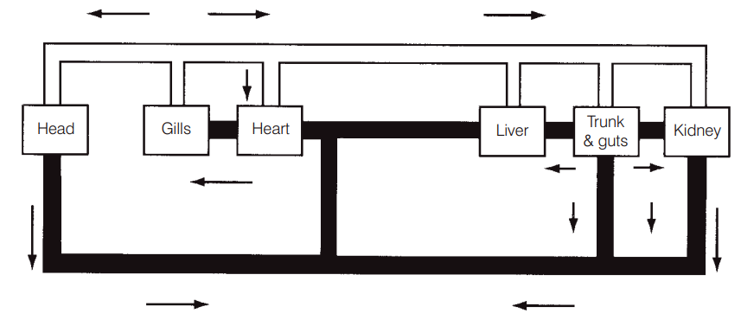
Anatomy
The basic pattern of blood flow in fishes involves a single-pump, single-circuit system – from the heart to the gills to the body and back to the heart.
Block diagram showing the simplest type of fish circulatory system.
Solid black vessels contain blood of lower oxygen content; white vessels contain blood with higher oxygen content. Arrows indicate direction of blood flow. From Mott(1957).

Slide 4
Anatomy
The heart is located posterior and ventral to the gills in all fishes, although it is located farther anterior in teleosts than in chondrichthyans. It lies in a membranous pericardial cavity that is lined with parietal pericardium.
The basic fish heart consists of four chambers in series: venous blood enters (i) the sinus venosus (a thin-walled sac) from the ducts of Cuvier and the hepatic veins; it next flows into (ii) the atrium; then into (iii) the ventricle; and finally blood flows out of the heart into (iv) the conus or bulbus arteriosus .

Slide 5
Anatomy
Heart valves prevent backflow of blood and maintain pressure in the circulatory system.
Sinoauricular valves separate the sinus venosus and atrium.
Atrioventricular valves vary in number depending on the group.
The number of ventriculobulbar valves is related to the length of the conus.
Valves outside the heart region can occur in various parts of the circulatory system of fishes, such as segmental arteries and veins in the caudal regions of the Port Jackson Shark and teleost veins.
Heart size as a proportion of body weight is lower in fishes than in other vertebrates. Inactive fishes have very small hearts.

Slide 6
Blood vessels of the gills and head
Afferent branchial arteries bringing oxygen-deficient blood to the gills from the ventral aorta.
Efferent branchial arteries bring oxygenated blood from the gills to the rest of the body. These arteries merge to form the dorsal aorta, the largest and longest artery in a fish’s body.
Many fishes have a pseudobranch, a small structure under the operculum composed of gill-like filaments that may provide oxygenated blood to the visual system.

Slide 7
Blood vessels of the body
The dorsal aorta is the main route of transport of oxygenated blood from the gills to the rest of the body.
The subclavian artery goes to the pectoral girdle, the coeliaco-mesenteric artery supplies the viscera, and the iliac or renal artery supplies the kidneys.
The dorsal aorta becomes known as the caudal artery upon entering the closed haemal canal of the caudal vertebrae.

Slide 8
Blood vessels of the body
The major return route of blood from most of the body is the postcardinal vein. It is best developed on the right side and empties into the common cardinal or ducts of Cuvier, then into the sinus venosus, and finally into the heart proper.

Slide 9
Gills and blood vessels of the head of a cod (Gadus). From Lagler et al. (1977).

Slide 10
Lymphatic system
The lymphatic system is derived from the venous part of the blood vascular system and is similar to that of other vertebrates. Lymph is collected by paired and unpaired ducts and sinuses that empty into the main blood system.
Hagfishes and lampreys have more connections to the venous system; they essentially have a hemolymph system. At least some species of lampreys and bony fishes have contractile lymph “hearts”.
Chondrichthyes have lymph vessels but do not have sinuses or lymph “hearts”.

Slide 11
Blood
Blood itself is composed of plasma and blood cells.
Solutes in the blood function to lower its freezing point. Freezing point depression of blood plasma is −2.2°C in marine Chondrichthyes versus a freezing point of −2.1°C for sea water. Antarctic notothenioids (see Chapter 18) have additional blood antifreeze glycoproteins that reduce the freezing point of their blood to −0.9 to −1.5°C.
Red blood cells (RBCs) account for nearly 99% of oxygen uptake. RBCs are nucleated, yellowish-red, oval cells in most fishes but are round in lampreys. Fishes have relatively fewer and larger RBCs than do mammals.

Slide 12
Thanks for listening!

