Slide 1
What traits that the ostariophysans have, which made this group so successful?
2111714 倪婧方

Slide 2
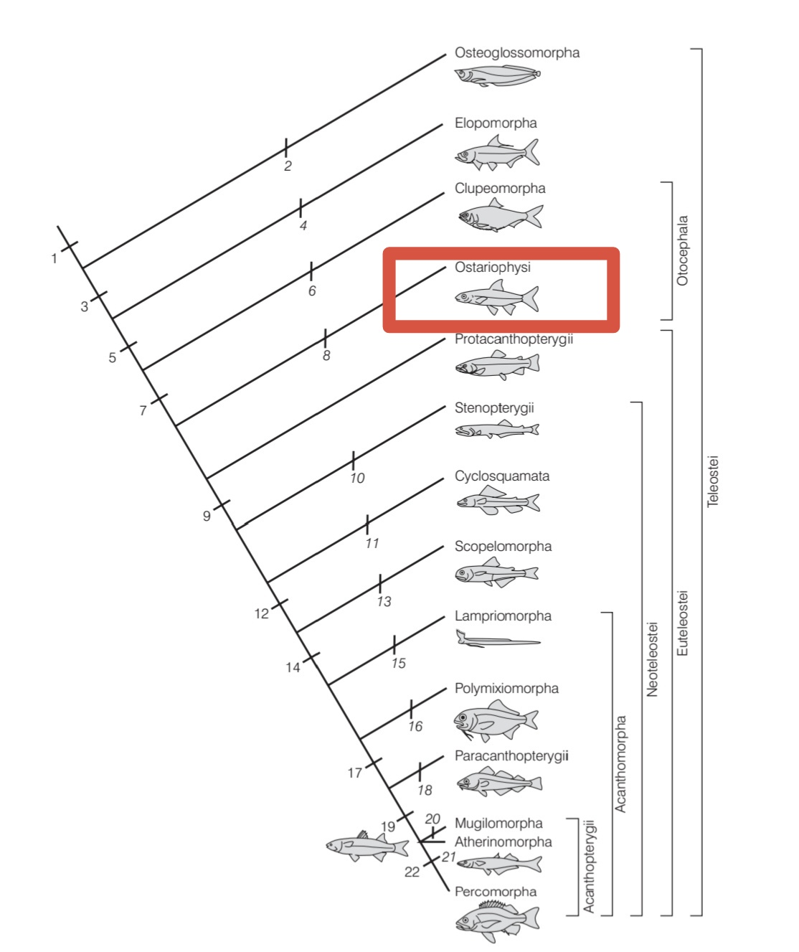
Teleostei
Subdivision
Otocephala
Superorder
Ostariophysi

Slide 3
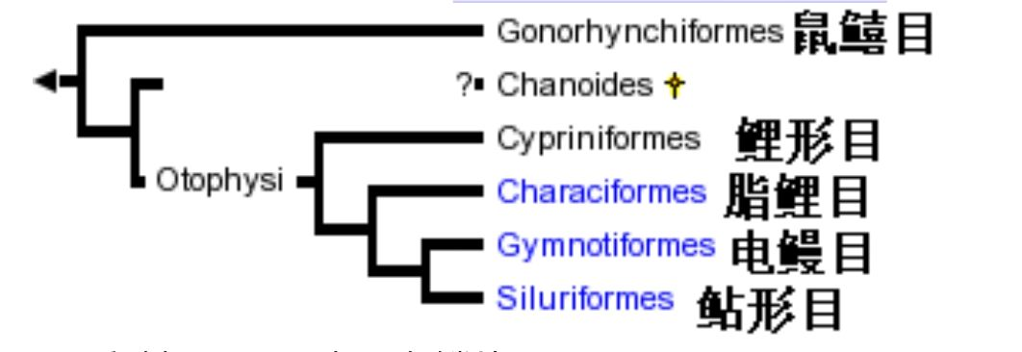
Freshwater habitats worldwide are dominated in terms of numbers of both species and individuals by ostariophysans, which account for about 68% of all freshwater species. Ostariophysans include such disparate taxa as milkfish, minnows, carps, barbs, suckers, loaches, piranhas, tetras, catfishes, and electriceels, but two unique traits characterize most members of this massive taxon.
1
Weberian apparatus
2
alarm response

Slide 4
Weberian apparatus
Ostariophysans possess a unique series of bones that connect the gas bladder with the inner ear, an otophysic condition.
The superorder gets its name from this complex structure (ostar = small bone, physa = a bladder; “otophysic” basically means “ear” and “bladder”)
When sound waves contact the fish, the gas bladder vibrates, and this vibration is passed anteriorly to the inner ear, being amplified by the intervening Weberian ossicles. Unrelated taxa have convergently evolved connections between the gas bladder and the inner ear, either by an otophysic extension of the gas bladder anteriorly; by a bony connection involving the pectoral girdle or skull; or, in chaetodontid butterflyfishes, by connections between anterior extensions of the bladder and the lateral line canal system.

Slide 5
The alarm response
The alarm response, which involves:
(i) the production of an alarm substance (Schreckstoff)
(ii) a behavioral alarm reaction to the presence of the substance
in the water. (Schreckreaktion)
The alarm substance is given off when specialized dermal club cells are ruptured, as when a predator bites down on a prey fish. Nearby individuals, most likely schoolmates, sense the chemical in the water and take a variety of coordinated escape actions, depending on the species. Possession of the alarm response was a factor contributing to the inclusion of the gonorhynchiforms within the Ostariophysi.

Slide 6
Examples for adaptive reasons
Some ostariophysans lack one or both parts of the response for apparently adaptive reasons. Piranhas lack the alarm reaction, which makes sense as many of their prey are also ostariophysans and it would be counterproductive for a predator to flee each time it bit into prey.
An interesting seasonal loss of the production end of the response occurs in several North American minnows. It would be less than helpful to the male if he produced a substance that frightened females away during nest building and courtship. Males resume the production of alarm substance in the fall, after the breeding season.

Slide 7
Interesting conditions
Some cyprinids have chromosomes in the polyploid condition, an unusual occurrence among fishes. The normal diploid 2N condition of most cyprinids is 48 or 50, although tetraploid (2N = 100), hexaploid, and even octaploid species occur, as is the case for the goldfish. Polyploidy is linked with large size in minnows.
Gyrinocheilid algae eaters are interesting because of modifications to the mouth and gill apparatus that allow them to scrape algae from rocks in areas of strong current. The mouth is modified into a sucking organ that helps them cling to rocks while scraping off algae. The fish breathes by inhaling water dorsally and exhaling it ventrally through small apertures in the gill opening.

Slide 8
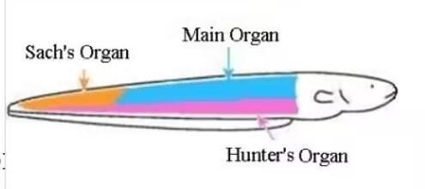
It is in the cyprinids that we see the first real development of pharyngeal dentition, a second set of jaws in the throat region that are derived from modified, tooth-bearing pharyngeal arches. Specifically, the fifth ceratobranchial bone occludes against an enlarged posterior process of the basiocciptal bone to form the pharyngeal bite. Cyprinids are also the first teleosts to develop a highly protrusible upper jaw and to eliminate the maxillary bones from the biting bones and gape of the mouth, both trends that are increasingly developed in more advanced teleostean taxa.
The most advanced ostariophysans are the gymnotiforms, which are distinct from catfishes and all other ostariophysans. They can produce and receive weak electric impulses. Their eyes and electrogenic tissue combined with modified lateral line organs for detecting weak electric fields. The electrogenic tissue is derived from modified muscle cells.The electrical output is very weak, on the order of fractions of a volt, except in the Electric Eel, which puts out a weak field for electrolocation purposes and strong
pulses upwards of 600 volts for stunning prey or
deterring predators.

Slide 9
Thanks!

