Slide 1
Thyroxin
2111612 刘方幸妍

Slide 2
Contents
Organs
Functions
Reference

Slide 3
organs
hypothalamus
posterior pituitary
pituitary
anterior pituitary
thyroid

Slide 4
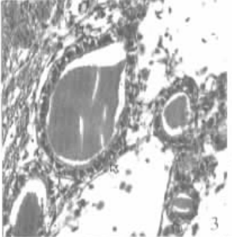
Fuctions
The thyroxin tissue of most of fishes is scattered as small clusters of cells in the connective tissue of the throat regions, as opposed to the rather discrete gland found in tetrapods.
Thyroid follicles in young mullet, more cuboidal cells were found than squamous cells.

Slide 5
Fuctions
growth, development, and metabolism
seaward migratory behavior
morphological and physiological

Slide 6
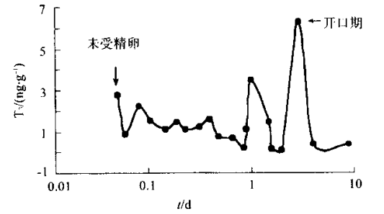
Example
Detect the content of T3 in embryos which are in the different stage of development and issues of fry.
The unfertilized eggs : high content of T3, 2.75ng,
Fertilized eggs or embryos : decrease gradually.
Hatched larvae: increased to 3.05ng.
Until 50d: the content is the highest and it had remained at the high level.

Slide 7
Example
Thyroxin not only plays a important role in adult, but also it does express in the unfertilized egg when it adjusts fish’s development after adenophypophysis or anterior pituitary appears functional polarization.
The first peak of the data ——
the mother-sourced thyroxin in yelk had be digested,the most of thyroxin are endogenous
The third bottom ——
after 15d, the content of T3 retained at the relatively lower level while the content of T4 increased obviously. It indicated that fry has the ability to control the excretion of T3 via the activity of enzymes

Slide 8
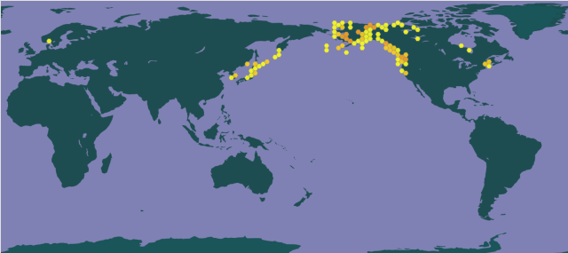
Example
——salmonids
“It also initiates seaward migratory behavior and the accompany osmoregulatory adaptations of juvenile salmonids during their seaward spawning migration.”

Slide 9
Example
——salmonids
The migratory behavior of several species of salmonids raised in hatcheries or artificial streams together with its hormonal control.
Thyroxine (T4)-treated pre-smolts showed less aggressive behavior. Before the migratory period, chum salmon fry and coho salmon yearlings preferred shaded areas more than open areas.
Triiodothyronine (T3) or T4 treatment induced a preference for open areas.

Slide 10
Example
——salmonids
During the premigratory season, chum salmon fry swam against the flow of current. T3 treatment changed their swimming direction to downstream . Underyearling sockeye salmon showed a natural surge of T4, 2 weeks before downstream migration occurred.
Underyearling coho salmon showed greater preferences for seawater or undirected searching behavior after treatment with growth hormone, T4 and cortisol.

Slide 11
[1] Munehico Iwata,Downstream migratory behavior of salmonids and its relationship with cortisol and thyroid hormones: A review,Aquaculture,Volume 135, Issues 1–3,1995,Pages131-139,ISSN0044-8486,https://doi.org/10.1016/0044-8486(95)01000-9.s
[2] 冉雪琴,李文笙,林浩然. 甲状腺素和生长激素与斜带石斑鱼早期个体发育的关系[J]. 中山大学学报（自然科学版）,2003,42(4):74-78. DOI:10.3321/j.issn:0529-6579.2003.04.020.

Slide 12
Thank for listening

