Slide 1
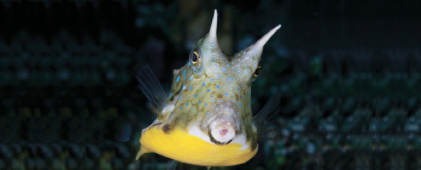
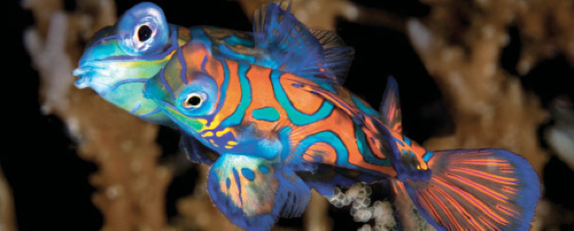
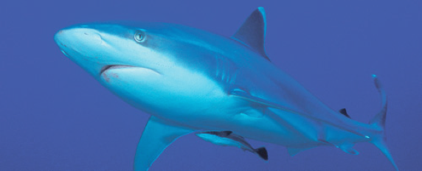
Lesson 2 Skeleton, skin and scales
Ichthyology
Shanghai Ocean University
Mar 8, 14, 2017

Slide 2
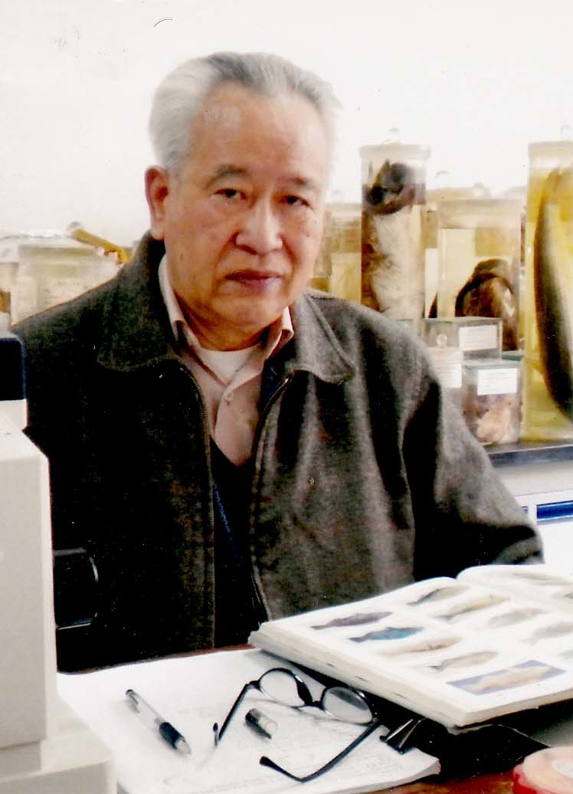
元鼎论坛
20号下午1:00，A101
伍汉霖
上海水产大学
Hanlin Wu
SOU

Slide 3
Skull (or cranium)
Actinopterygians have more skull bones than do sarcopterygians.
The skull encloses and protects the brain and is composed of the neurocranium and the branchiocranium.

Slide 4
Skull (or cranium)

Slide 5
Neurocranium
The neurocranium is derived from the chondrocranium (the original cartilaginous braincase) and the dermatocranium (dermal bones derived from scales).
Actinopterygian skull bones can be divided into four regions: ethmoid, orbital, otic, and basicranial.

Slide 6
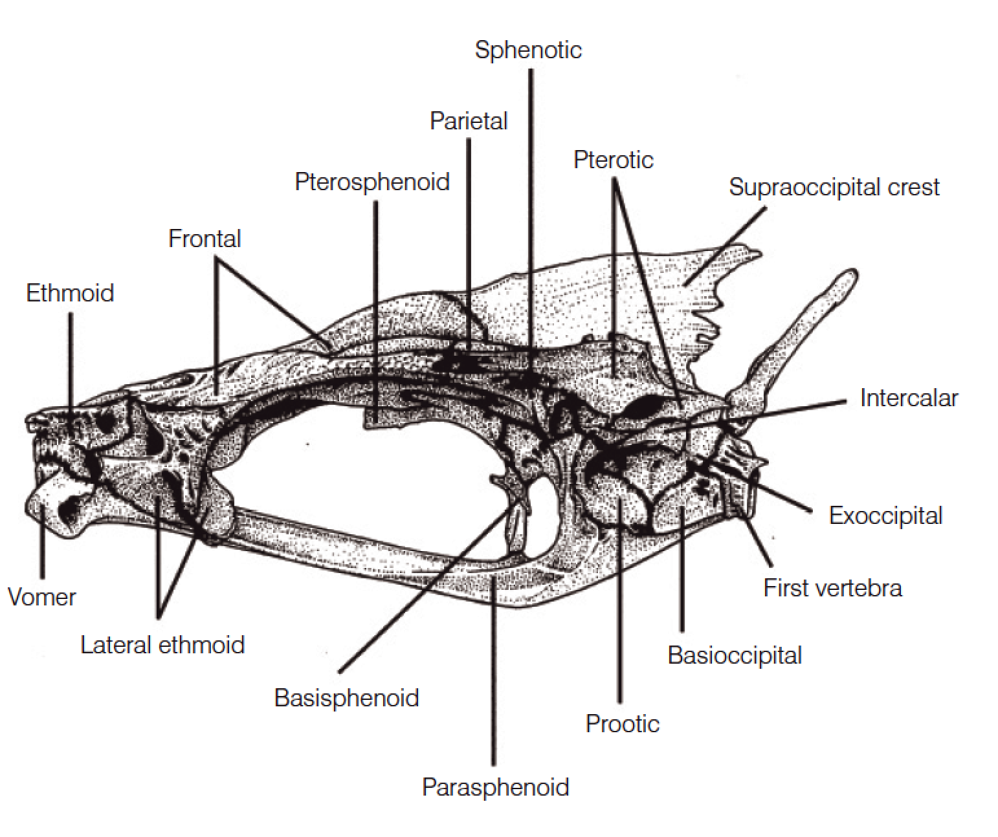
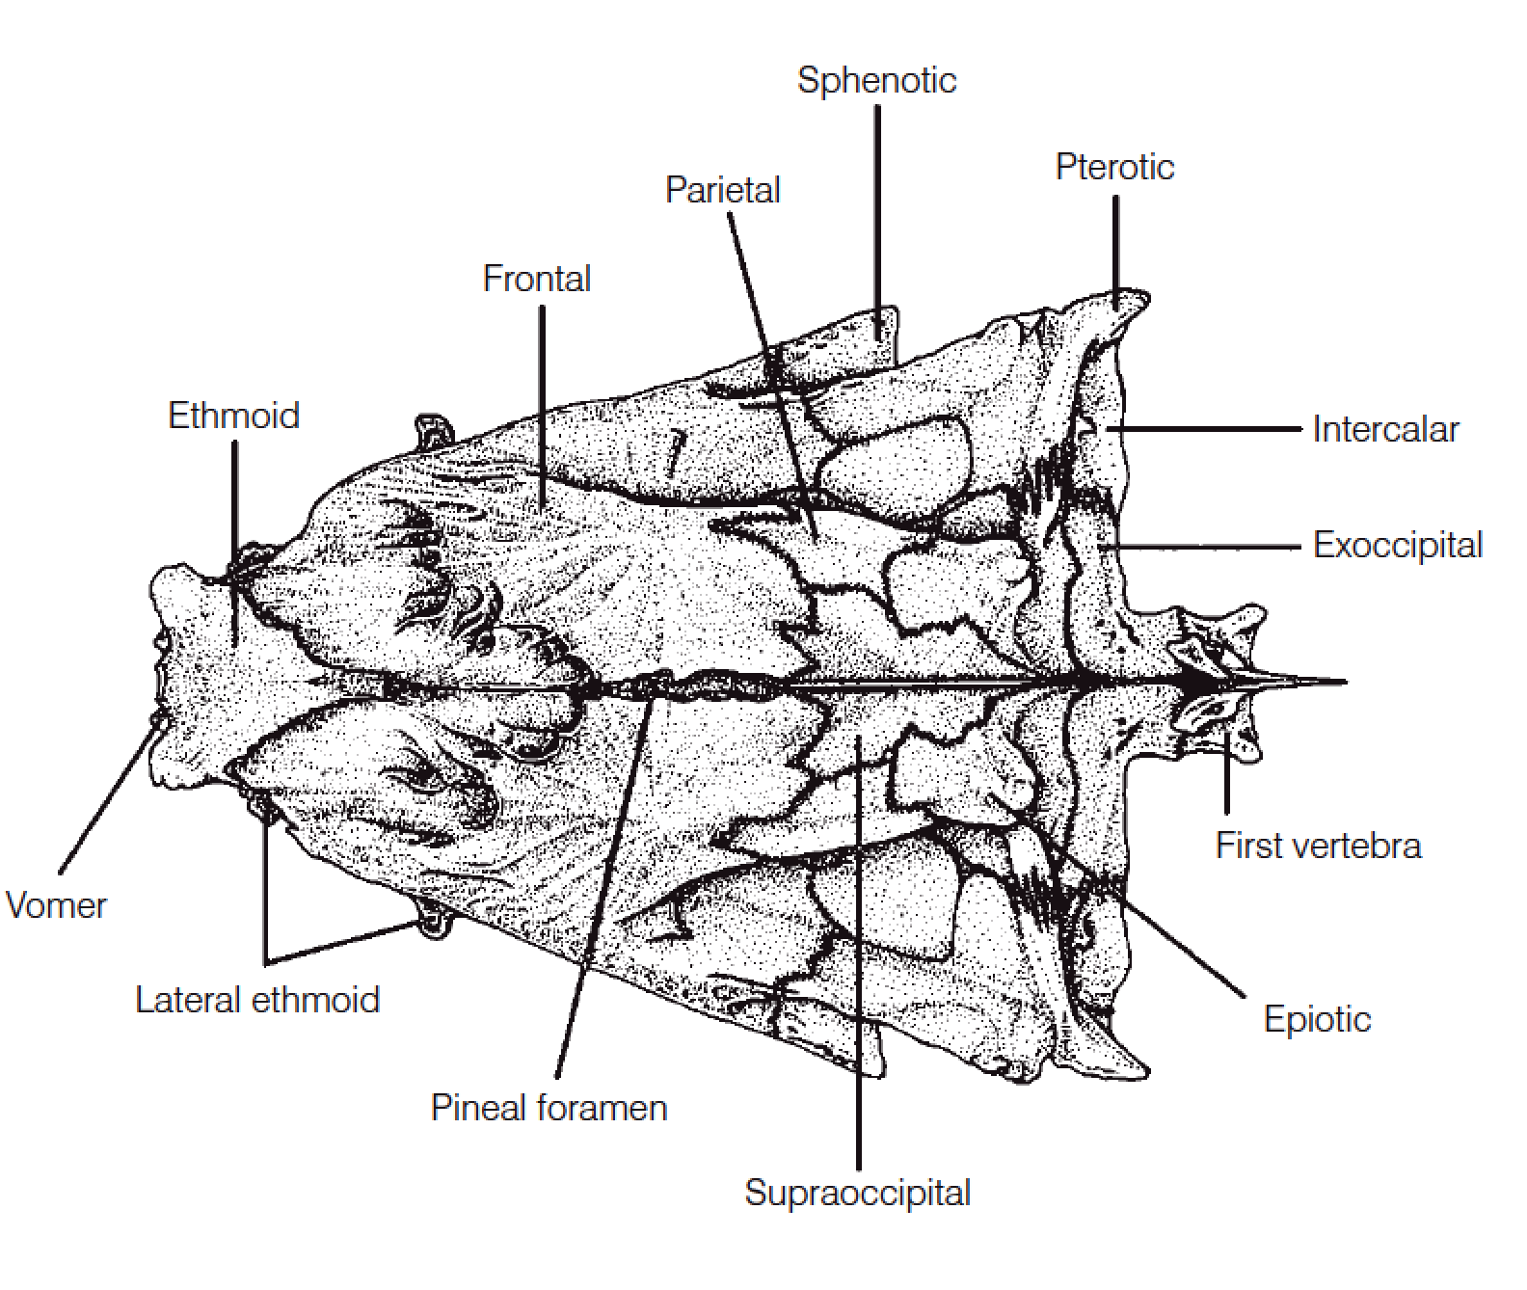
Ethmoid region
Two sets of dermal bones in this region:
vomer
mesethmoid
Two main sets of cartilage bones:
lateral ethmoids
ethmoid

Slide 7
Orbital region
Two sets of dermal bones in this region:
the paired frontals
the circumorbitals.
Three sets of cartilage bones:
Pterosphenoids
Basisphenoid
Parasphenoid
Sclerotic cartilages

Slide 8
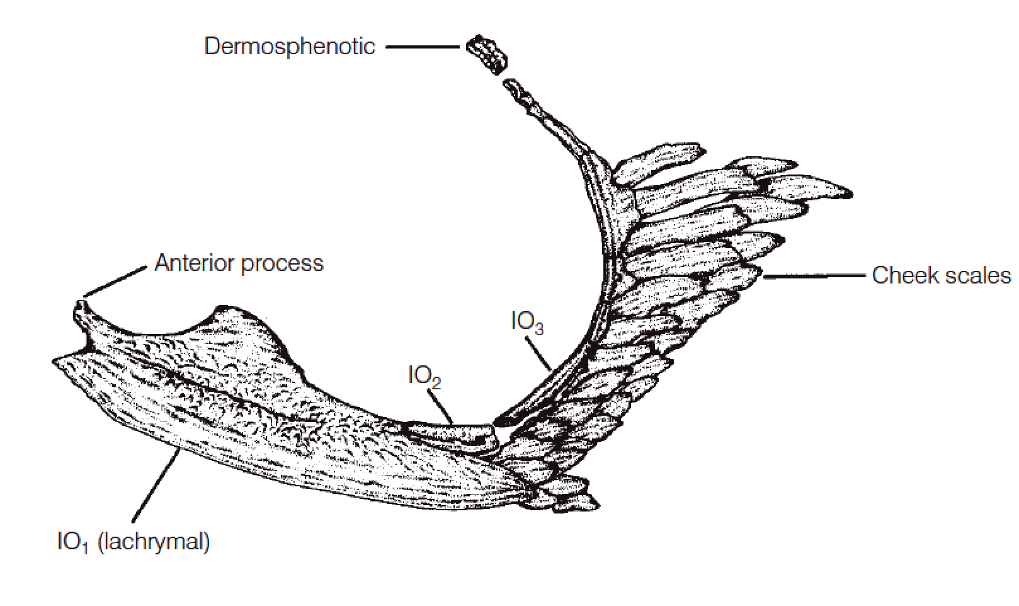
Orbital region
Two sets of dermal bones in this region:
the paired frontals
the circumorbitals.

Slide 9
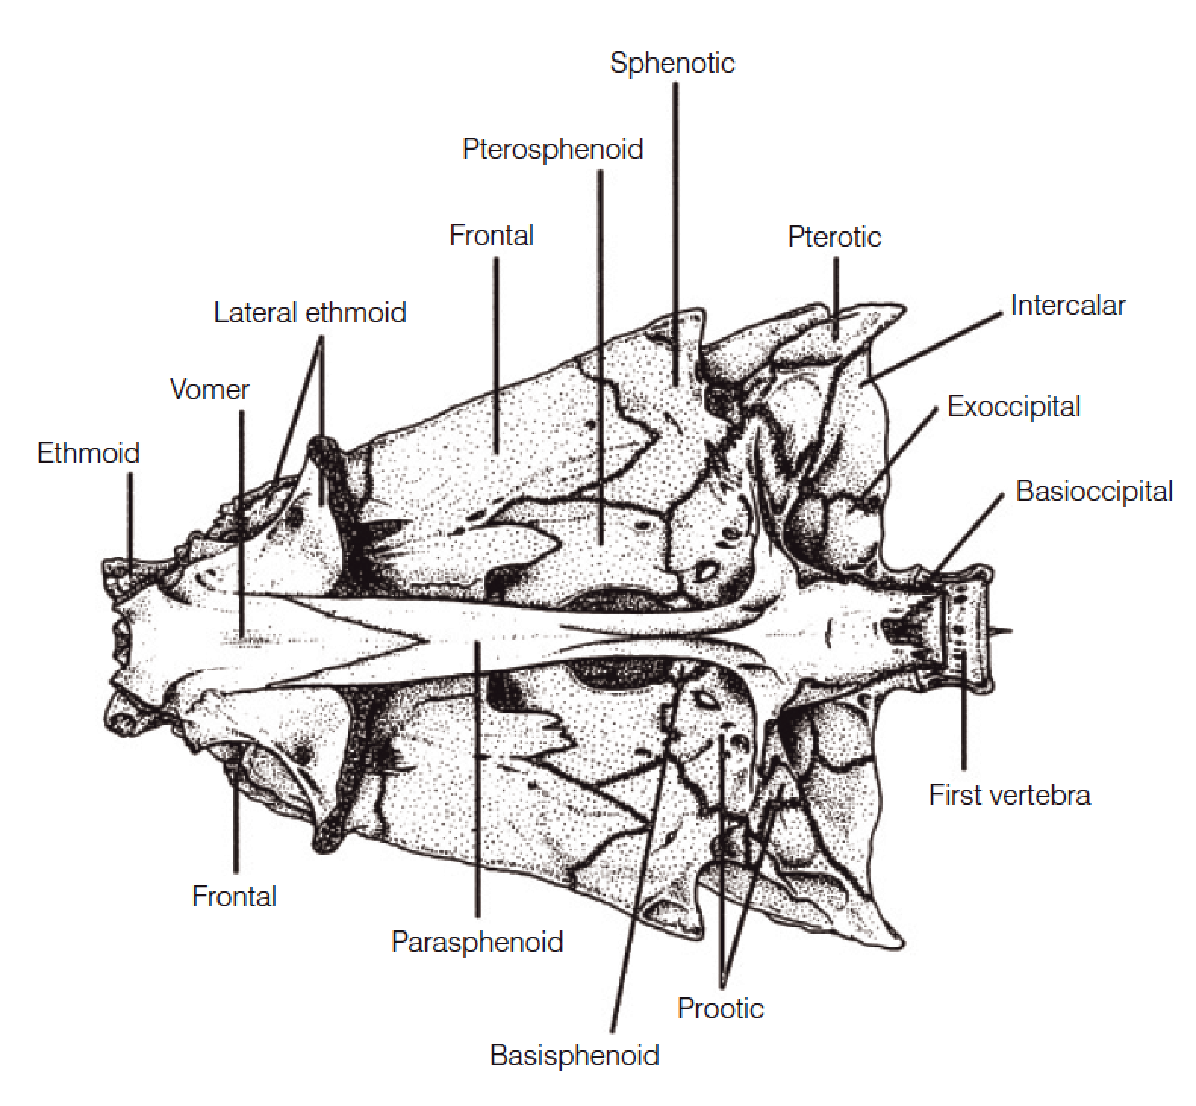
Otic region
Five cartilage bones enclose each bilateral otic (ear) chamber inside the skull:
Sphenotics
Pterotics
Prootics
Epiotics
Intercalars
Dermal bones
Parietals

Slide 10
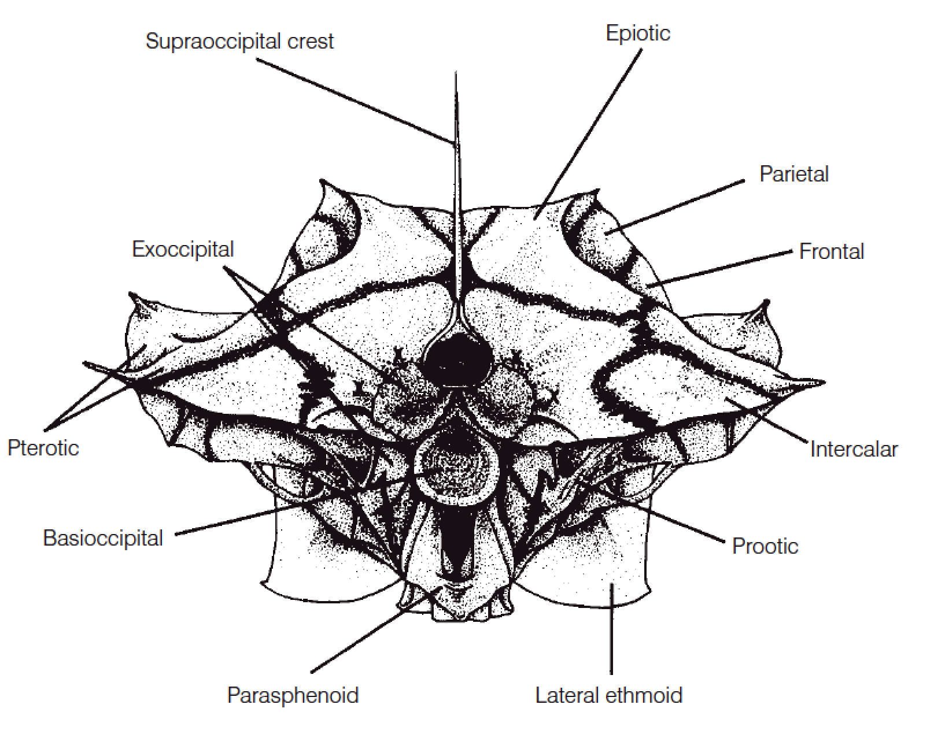
Basicranial region
Three sets of cartilage bones,:
Exoccipitals
Basioccipital
Supraoccipital
Dermal bones
parasphenoid

Slide 11
Branchiocranium
The branchiocranium is divisible into five parts:
Mandibular,
Palatine
Hyoid
Opercular
Branchial.

Slide 12
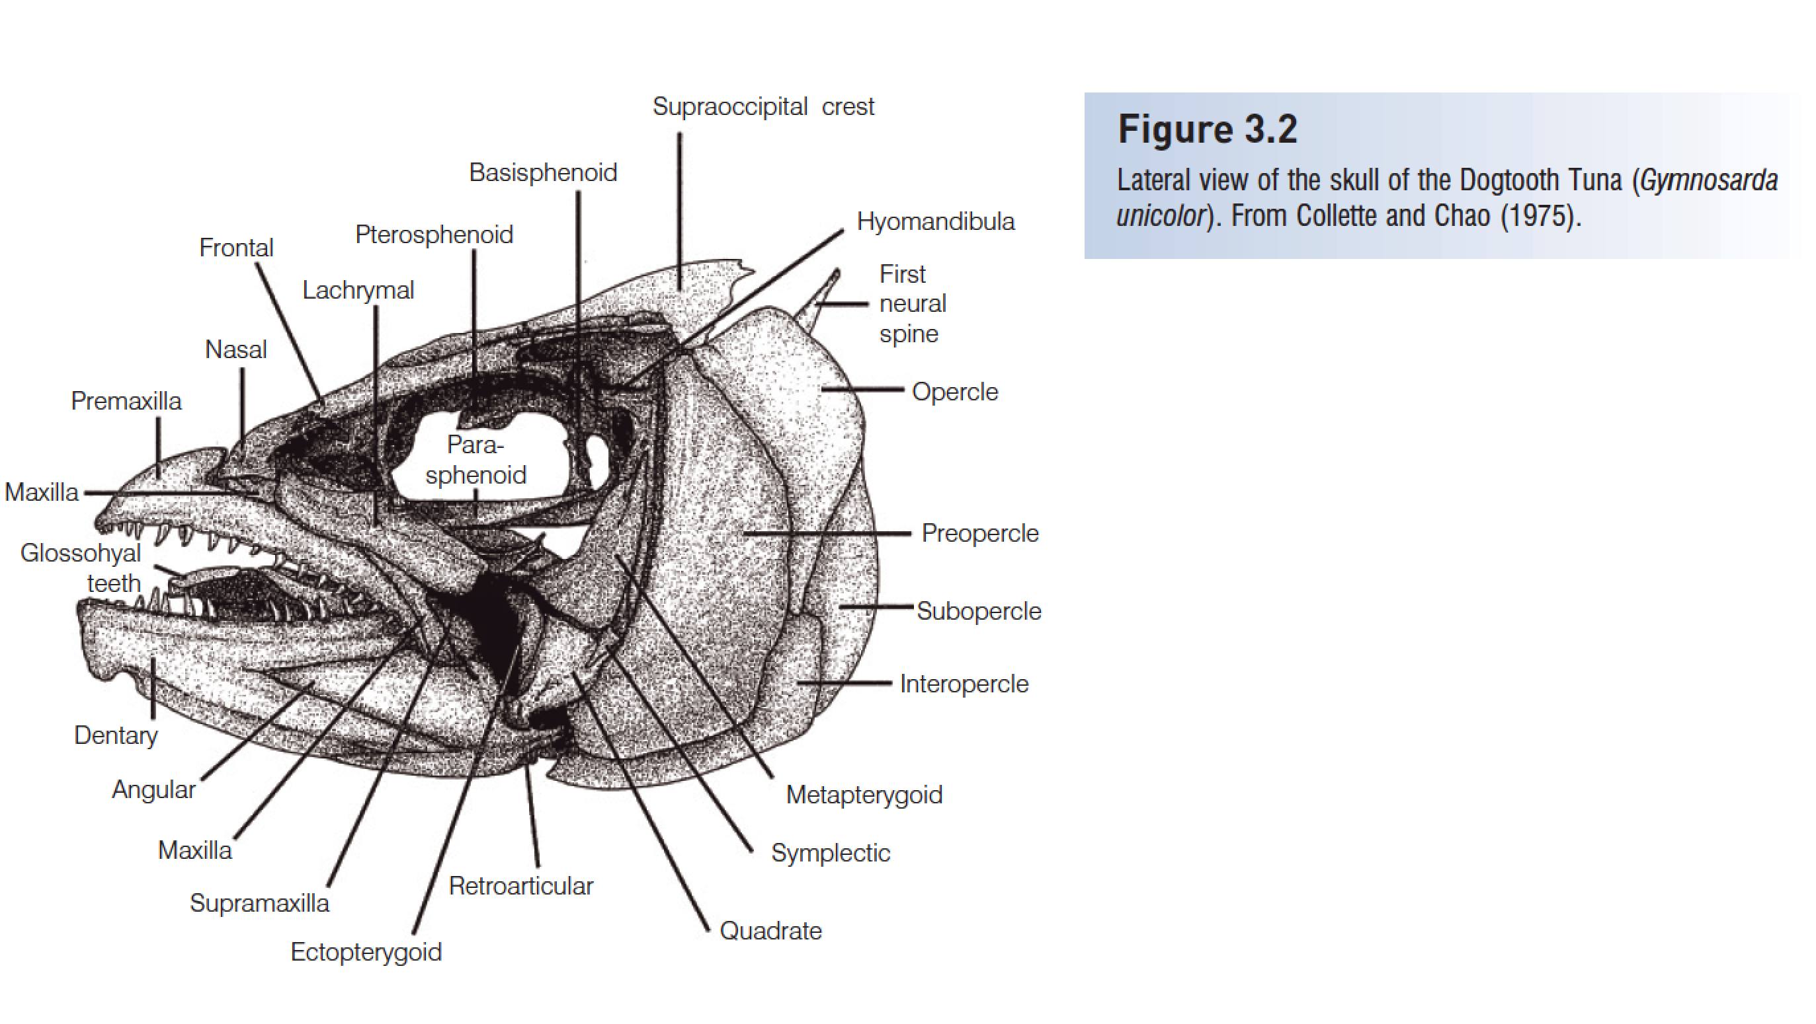
Mandibular arch
Upper jaw known as the palatoquadrate cartilage in Chondrichthyes
in bony fishes. may have three sets of bones.
Premaxillae
Maxillae
Supramaxilla

Slide 13
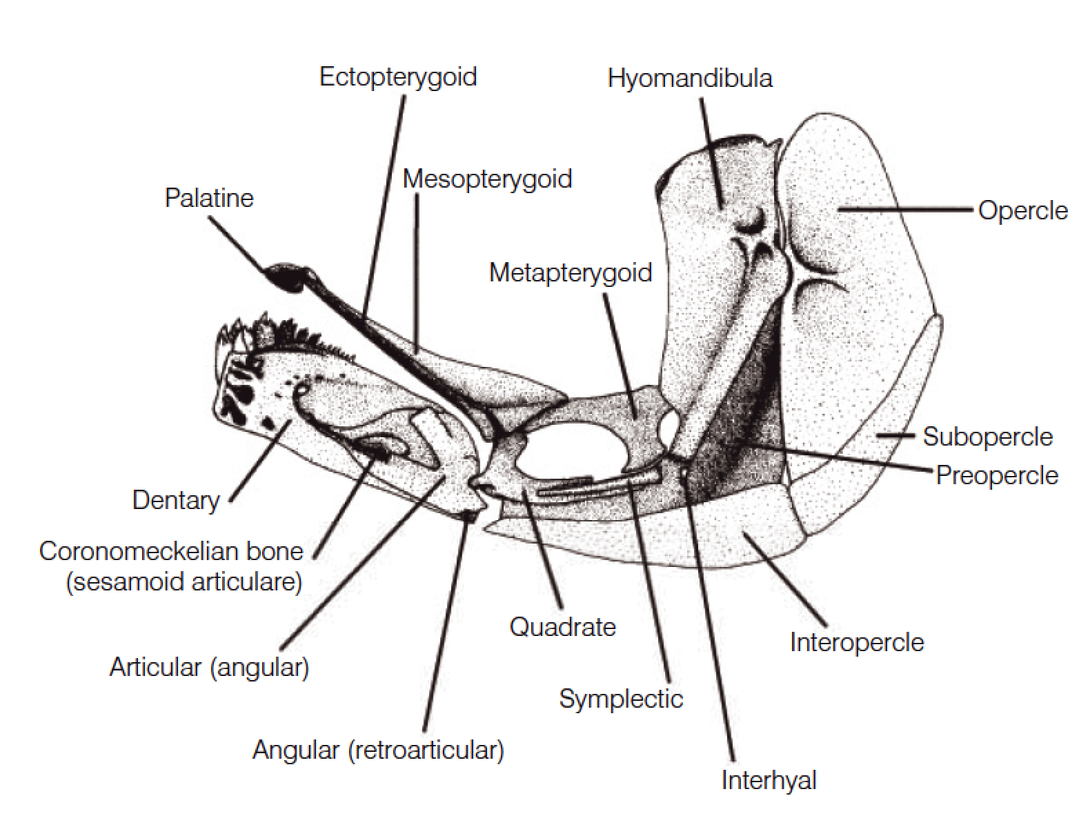
Mandibular arch
The lower jaw consists of Meckel’s cartilage in Chondrichthyes.
In bony fishes:
dentary
articular
angular

Slide 14
Presentation for next week
徐文迪
Compare different types of pharyngeal teeth, give some example fishes
赵凡
Explain different type of caudal fin, give examples
彭渝
Explain the difference between placoid, cycloid and ctenoid scales

Slide 15
HWK
Homework 1
Name of your species
List two species (scientific name)
Send me through email or QQ by Mar 14

Slide 21
H Li, Y. He, J. Jiang, Z. Liu, C. Li, 2018. Molecular systematics and phylogenetic analysis of the Asian endemic freshwater sleepers (Gobiiformes: Odontobutidae). Molecular Phylogenetics and Evolution, 121, 1–11.

Slide 23
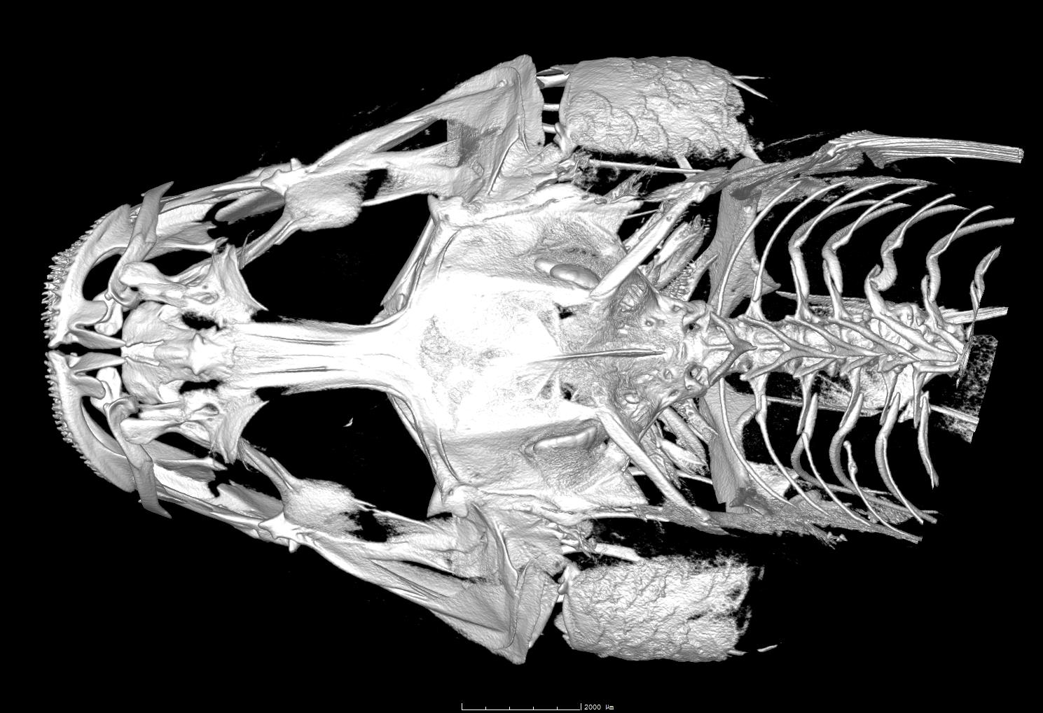
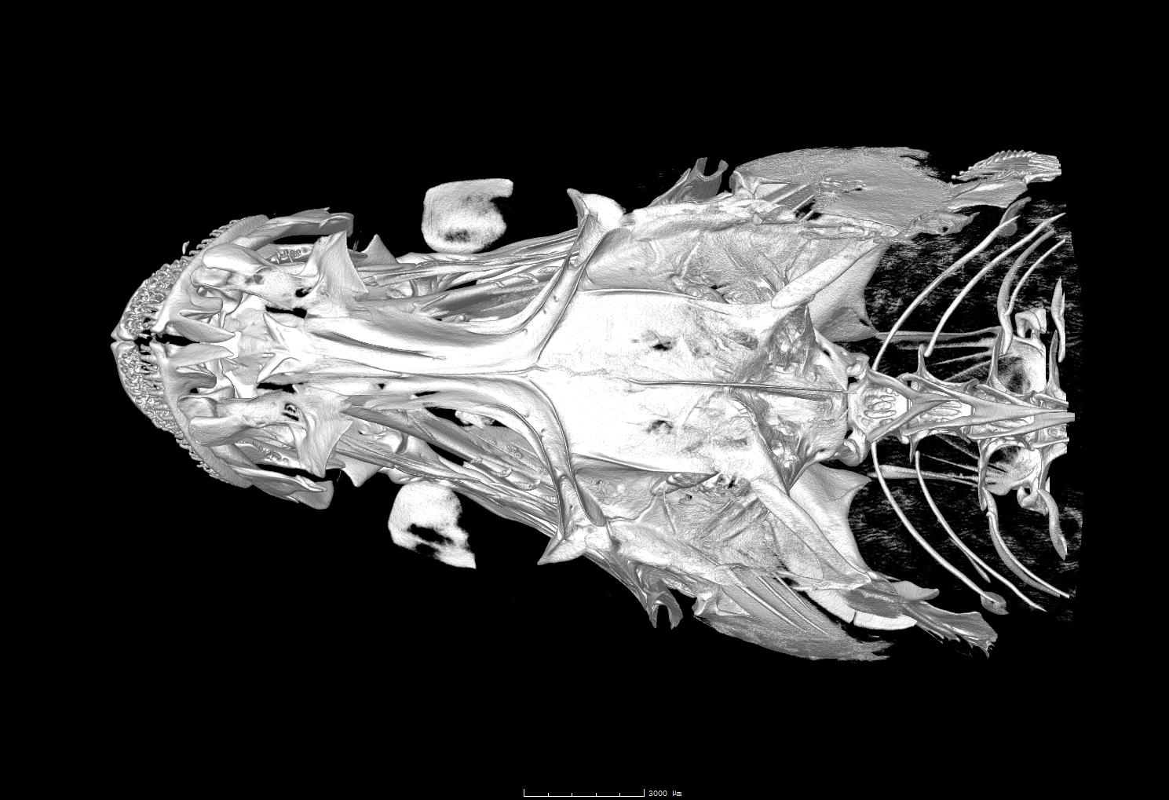

Slide 24
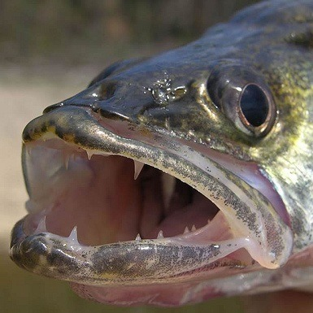
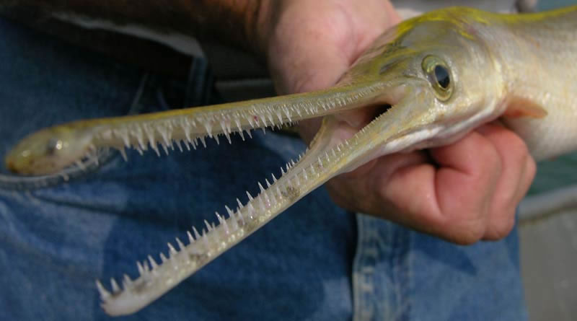
Teeth
The oral jaws and many pharyngeal bones may bear teeth.
Many different terms have been applied to the different sizes and shapes of teeth
Canine
Villiform
Molariform
Incisor

Slide 25
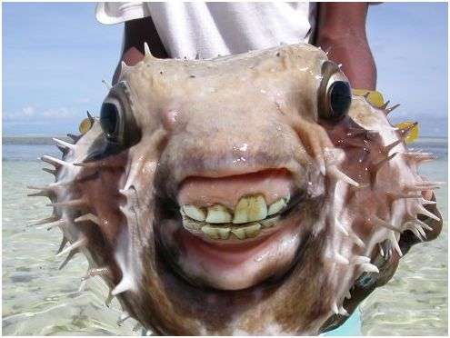
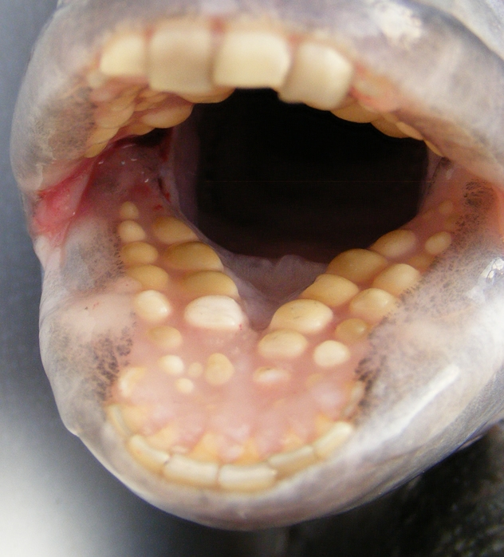
Teeth
The oral jaws and many pharyngeal bones may bear teeth.
Many different terms have been applied to the different sizes and shapes of teeth
Canine
Villiform
Molariform
Incisor

Slide 26
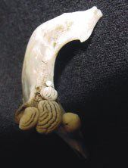
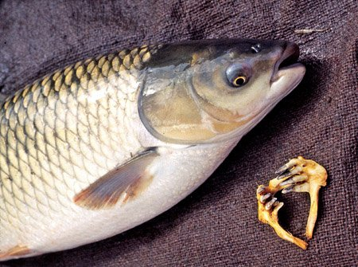
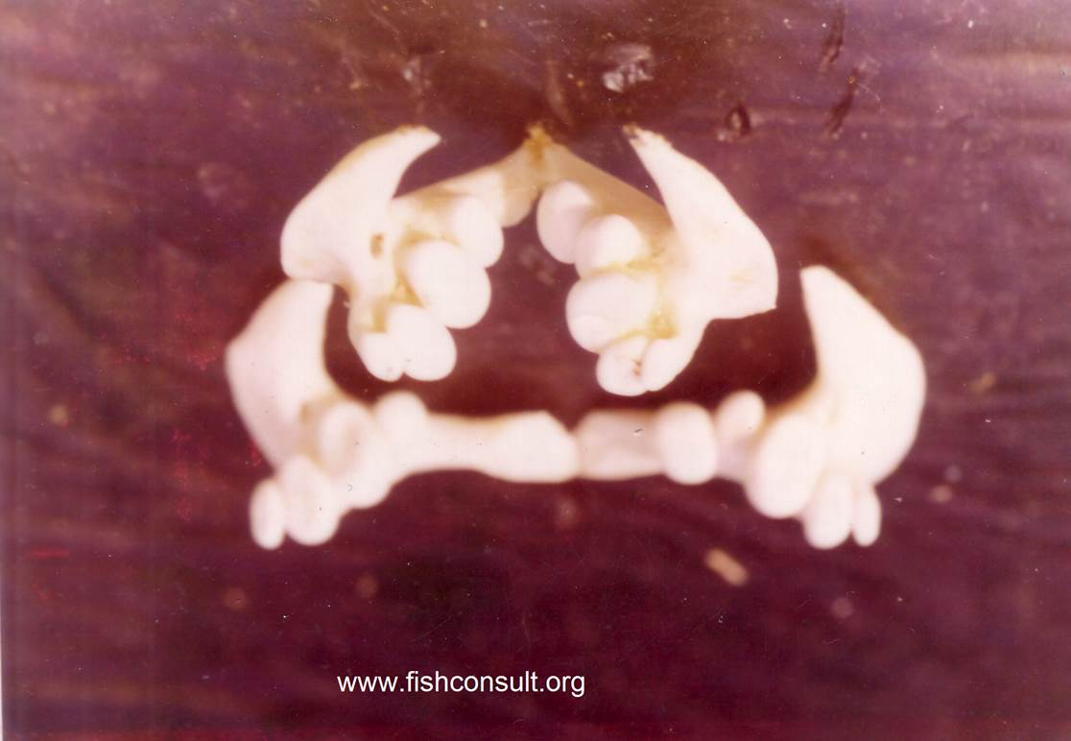
Pharyngeal teeth

Slide 27
Pharyngeal teeth
徐文迪
Compare different types of pharyngeal teeth, give some example fishes

Slide 28
Palatine and hyoid arches
The palatine arch consists of four pairs of bones in the roof of the mouth:
palatines
ectopterygoids
entopterygoids
metapterygoids
The suspensorium consists of a chain of primarily cartilage
bones that attach the lower jaw and opercular apparatus to the skull
hyomandibula
quadrate

Slide 29
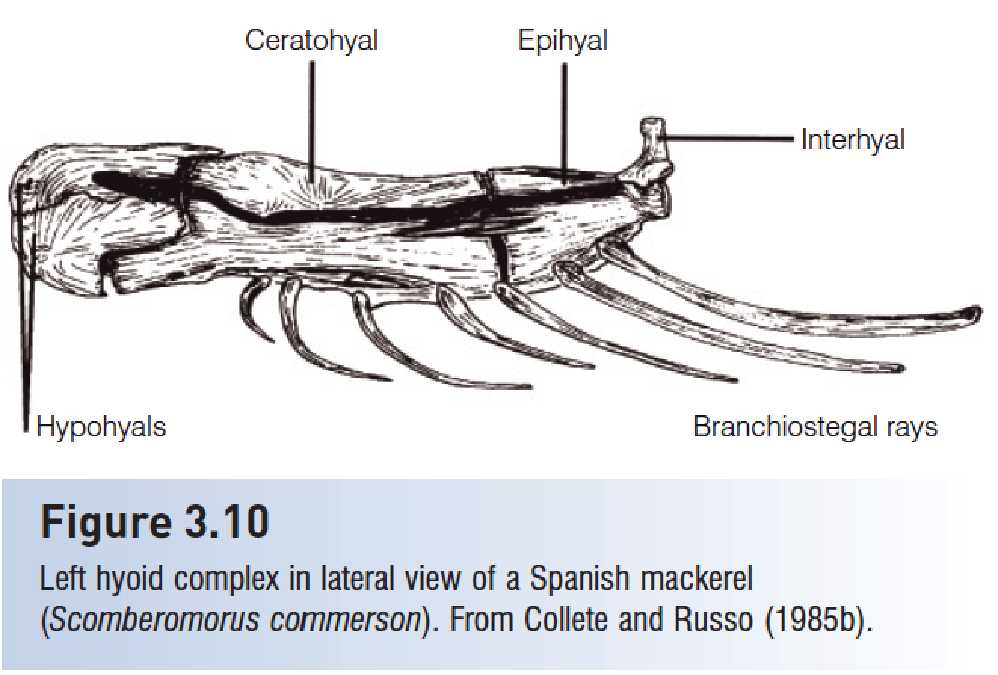
Palatine and hyoid arches
The hyoid complex is a series of five pairs of bones that lie medial to the lower jaw and opercular bones and lateral to the branchiostegal rays that attach to them.
The dermal bones of the hyoid arch are the branchiostegal rays, elongate, flattened, riblike structures

Slide 30
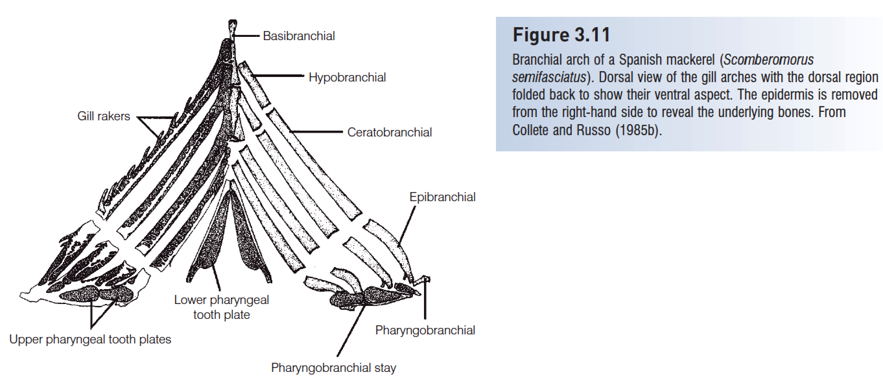

Slide 31
Postcranial skeleton
The notochord of primitive chordates is replaced by the vertebral column in lampreys, Chondrichthyes, and osteichthyans.
Posterior vertebrae support the caudal fin in most fishes.
In teleosts, hypurals (enlarged haemal spines) support the branched principal caudal fin rays.

Slide 32
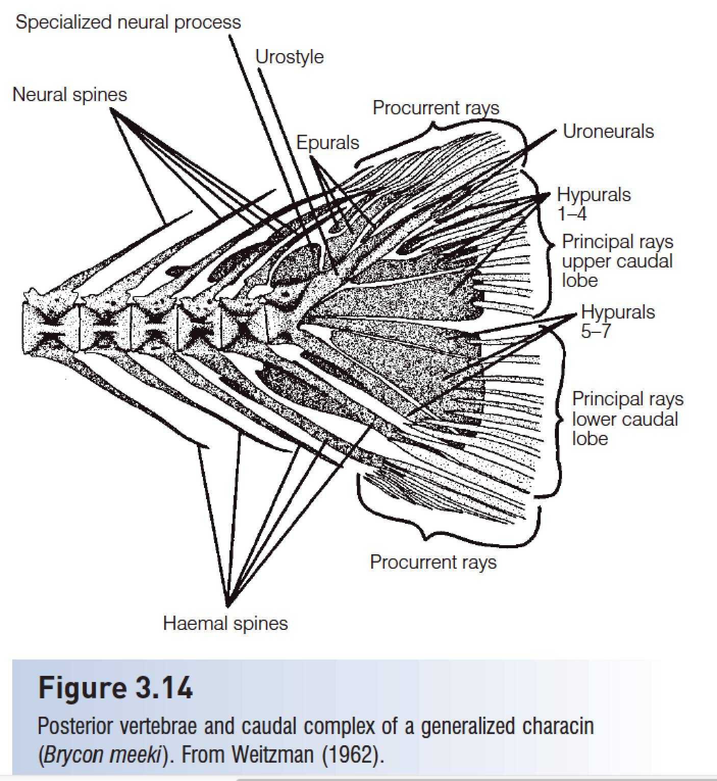
Caudal complex

Slide 33
Caudal fin
赵凡
Explain different type of caudal fin, give examples

Slide 34
Three basic types of caudal fins are:
(i) protocercal, the primitive undifferentiated caudal fin of adult lancelets, hagfishes, lampreys, and larvae of more advanced fishes
(ii) heterocercal, or unequal-lobed tail, in Chondrichthyes and primitive osteichthyans; and
(iii) homocercal, or equal-lobed tail, found in most teleosts.

Slide 35
Ribs (pleural ribs) attach to the vertebrae and protect the viscera.
Intermuscular bones are segmental, serially homologous ossifications in the myosepta of teleosts.

Slide 36
The dorsal, anal, and adipose fins form the median or unpaired fins.
Primitive teleosts have a single dorsal fin composed of soft rays.
Advanced teleosts usually have two dorsal fins: the anterior fin composed of spines and the posterior fin composed of soft rays.

Slide 37
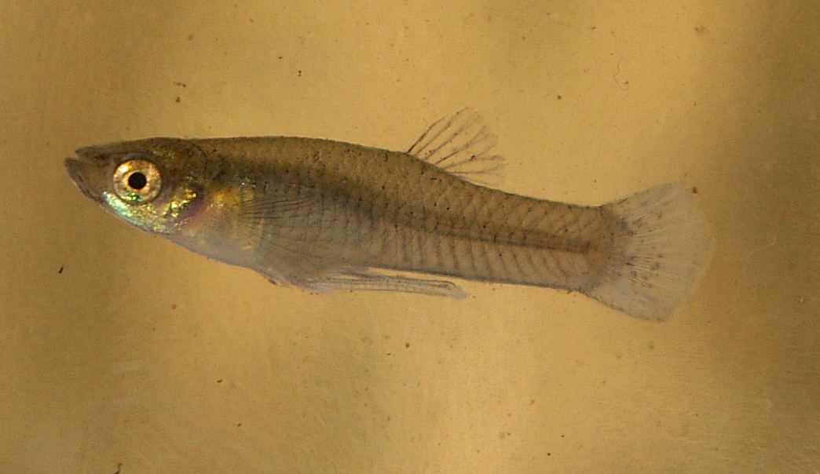
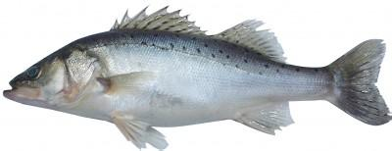
Primitive teleosts have a single dorsal fin composed of soft rays.
Advanced teleosts usually have two dorsal fins: the anterior fin composed of spines and the posterior fin composed of soft rays.

Slide 38
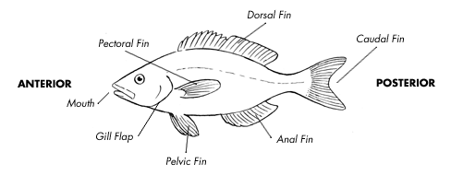
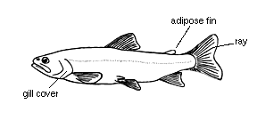
Six fin types
Fin Name | Paired or Single | Typical Function
Dorsal | single | Keel (stabilizer); may be divided
Caudal | single | Propulsion!!!
Anal | paired | Stabilizers
Pelvic | paired | Stabilizers; braking
Pectoral | Paired | Steering
Adipose | single | Unknown
http://www.pbs.org/wgbh/nova/teachers/activities/3003_fish_01.html
Heterocercal tail
Homocercal tail

Slide 39
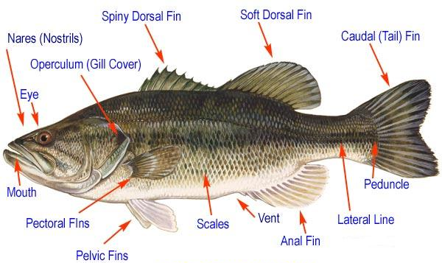
External features – bony fish
Premaxilla
Dentary
Maxilla

Slide 40
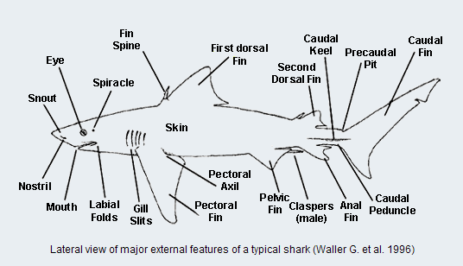
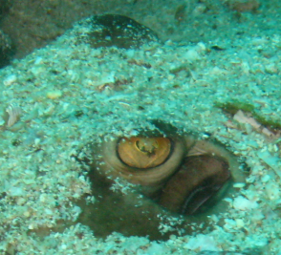
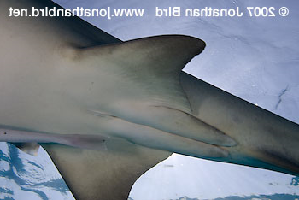
External features – cartilagenous fish

Slide 41
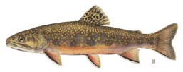
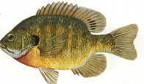
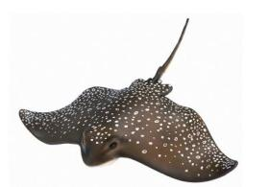
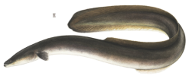
Body shapes
Fusiform (torpedo-like)
Sagittiform (arrow-like)
http://pond.dnr.cornell.edu/nyfish/Esocidae/northern_pike.html
Compressiform
(horizontally flattened)
Depressiform
(vertically flattened)
Anguilliform
(circular; eel-like)

Slide 42
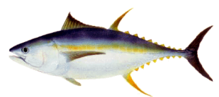
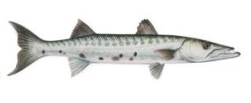
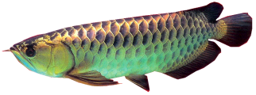
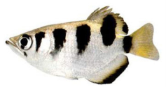
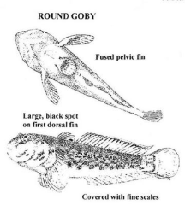
Body types by function
Rover predators
Lie-in-wait predators
Surface-oriented
Bottom rover
Bottom clinger

Slide 43
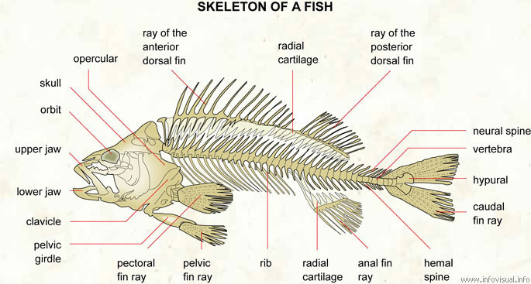
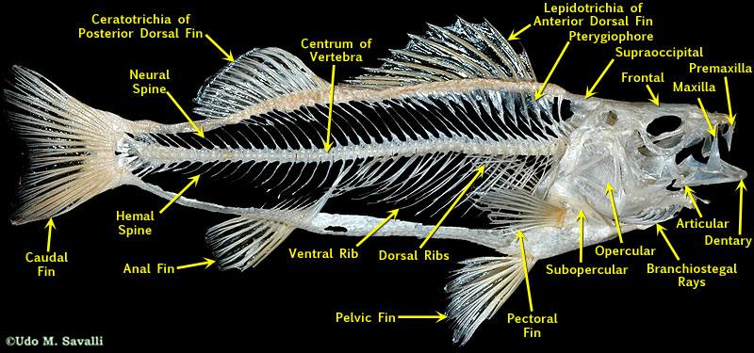
Skeletal Structures

Slide 44
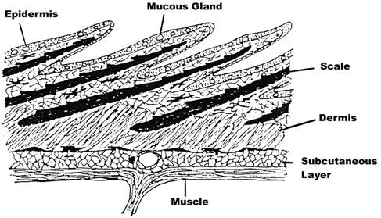
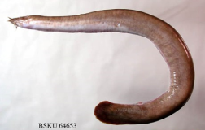
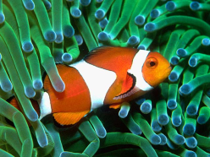
Skin and Scales
1. Epidermis
10-30 of cells
Mostly flat / compressed epithelial cells
Mucus glands
Protective barrier
2. Dermis
Matrix of connective tissue – connected to muscles
Pigment cells, blood vessels, dermal skeleton
http://www.icanteachmyself.com/edu_694_assignments/1_2/clownfish.jpg

Slide 45
Scales
彭渝
Explain the difference between placoid, cycloid and ctenoid scales

Slide 46
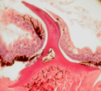
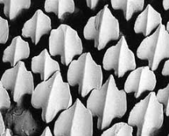
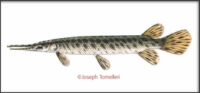
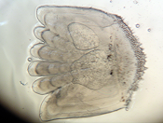
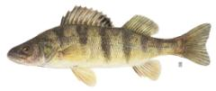
Skin and Scales
Scales – 3 main types in living fishes
Housed within pocket of dermal cells
1. Placoid (denticles)
Tooth-like projections on sharks
VERY different from scales in other fish
Pulp cavity just like teeth!
2. Ganoid – diamond-shaped
Hard protein covering (ganoine)
Not flexible
Non-overlapping
3. Bony-ridge scales – overlapping, flexible bony ridges
Ctenoid – comb-like rim
Cycloid – smooth rim

Slide 47
HWK
Homework 2

Slide 48
Presentation for next week
刘璟昊
Describe the cardiovascular system of fish.
喻一峰
How does fish manage gas exchange in swim bladder?
程起超
Describe five parts of fish brain.

