Slide 1
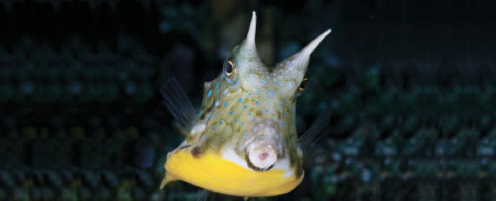
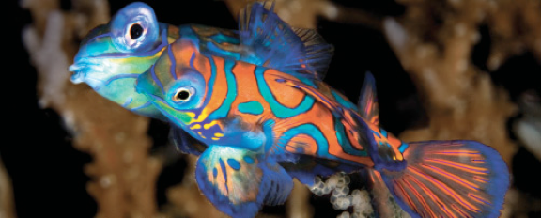
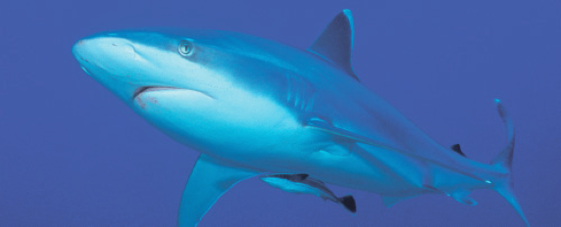
Lesson 1
Introduction to fishes, history of ichthyology and systematics
Ichthyology
Shanghai Ocean University
Fall, 2026

Slide 2
1.3 Superlative Fishes

Slide 3

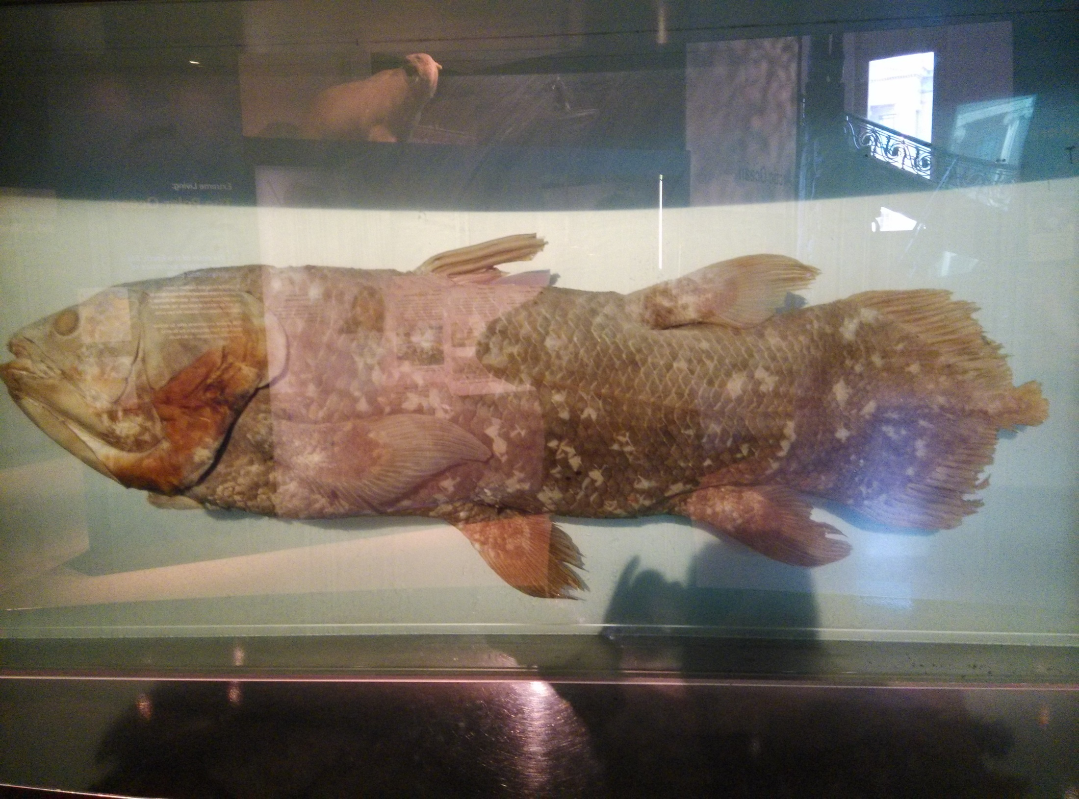
Fish or tetrapods?
Coelacanths were thought to have died out at the end of the Cretaceous, 65 million years ago. However, in 1938, fishermen in South Africa trawled up a very live Coelacanth.

Slide 4
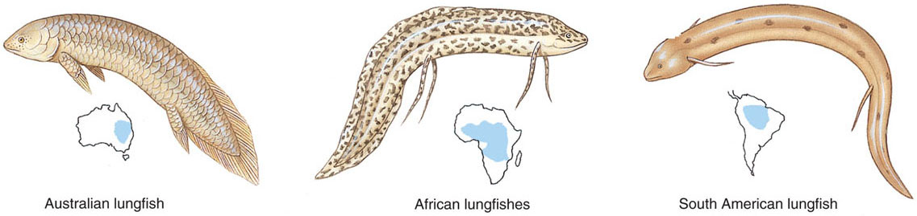
Lungfishes can live in a state of dry “suspended animation” for up to 4 years,
becoming dormant when their ponds dry up and reviving quickly when immersed in water (see Chapters 5, 13).
4 sp.
Notes:
Lungfi shes can live in a state of dry “suspended
animation” for up to 4 years, becoming dormant when
their ponds dry up and reviving quickly when
immersed in water (see Chapters 5, 13).

Slide 5

Fooled by nature

Slide 6
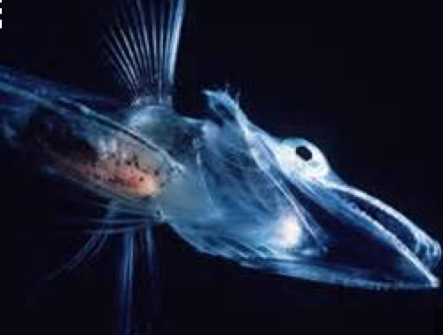
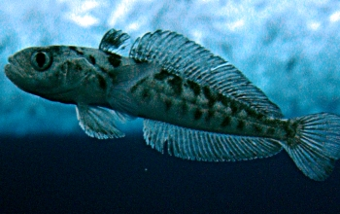
Antarctic fishes live in water that is colder than the freezing point of their blood. The fishes keep from freezing by avoiding free ice and because their blood contains antifreeze proteins that depress their blood’s freezing point to −2°C.
Some Antarctic fishes have no hemoglobin (see Chapter 18).
Pagothenia borchgrevinki, the bald rockcod
Channichyidae
Notothenioidei
Notes:
Antarctic fi shes live in water that is colder than the
freezing point of their blood. The fi shes keep from
freezing by avoiding free ice and because their blood
contains antifreeze proteins that depress their blood’s
freezing point to −2°C. Some Antarctic fi shes have no
hemoglobin (see Chapter 18).

Slide 7
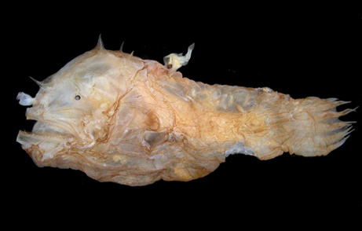
Deepsea fishes include many forms that can swallow prey larger than themselves.
Some deepsea anglerfishes are characterized by females that are 10 times larger than males, the males existing as small parasites permanently fused to the side of the female, living off her blood stream (see Chapter 18).
Anglerfish (Lophiiformes)
Notes:
Deepsea fi shes include many forms that can swallow
prey larger than themselves. Some deepsea anglerfi shes
are characterized by females that are 10 times larger
than males, the males existing as small parasites
permanently fused to the side of the female, living off
her blood stream (see Chapter 18).

Slide 8
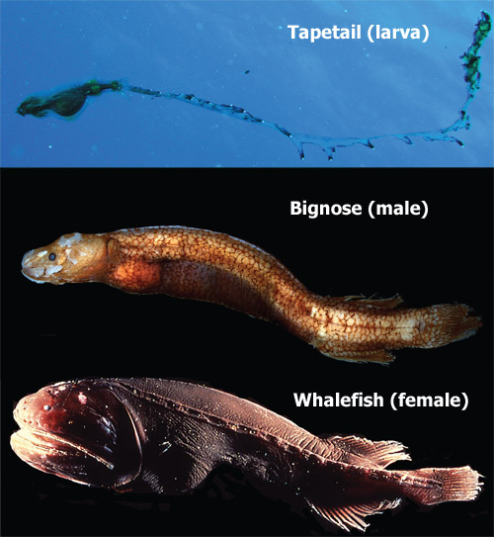
Fishes grow throughout their lives, changing their ecological role several times. In some fishes, differences between larvae and adults are so pronounced that many larvae were originally described as entirely different taxa (see Chapter 9).
Then, a Japanese group led by Masaki Miya found that a whalefish and a tapetail had almost identical genomes in their mitochondria.
Notes:
Fishes grow throughout their lives, changing their
ecological role several times. In some fi shes,
differences between larvae and adults are so
pronounced that many larvae were originally described
as entirely different taxa (see Chapter 9).

Slide 9
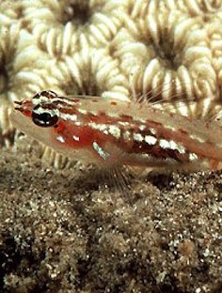
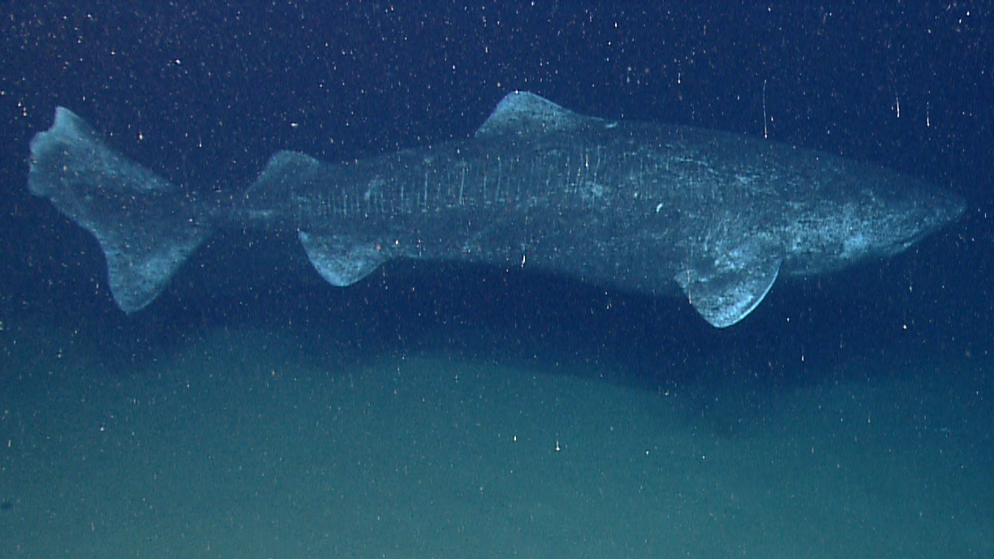
Fishes have maximum life spans of as little as 10 weeks (African killifishes and Great Barrier Reef pygmy gobies)
and as long as 150 years (sturgeons and scorpaenid rockfishes), but the fish with longest life probably is the Greenland sleeper shark (Somniosus microcephalus)
Notes:
Fishes have maximum life spans of as little as 10
weeks (African killifi shes and Great Barrier Reef
pygmy gobies) and as long as 150 years (sturgeons and
scorpaenid rockfi shes). Some short-lived species are
annuals, surviving drought as eggs which hatch with
the advent of rains. Longer lived species may not
begin reproducing until they are 20 years old, and
then only at 5+ year intervals (see Chapter 10).

Slide 10
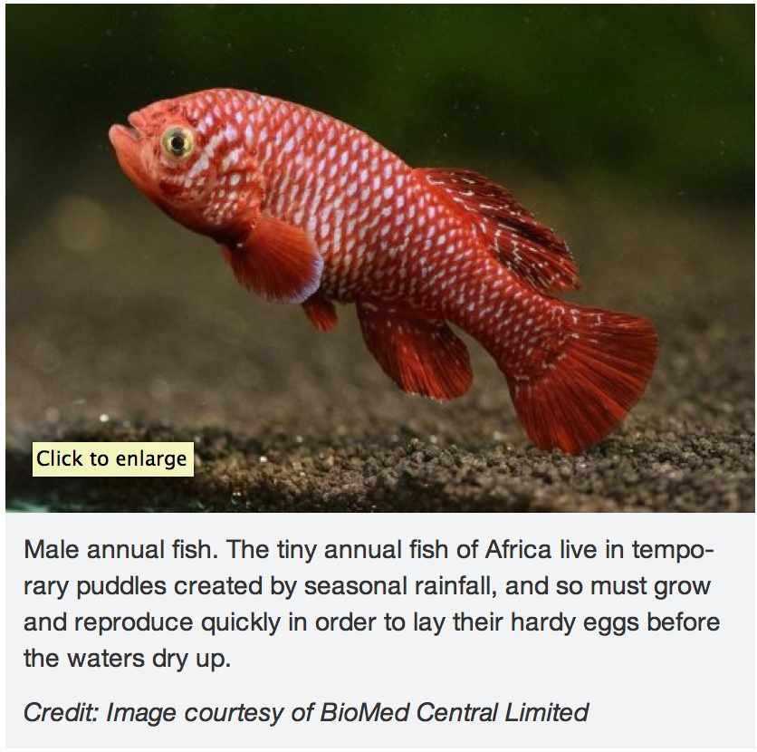
Some short-lived species are annuals, surviving drought as eggs which hatch with the advent of rains. Longer lived species may not begin reproducing until they are 20 years old, and then only at 5+ year intervals (see Chapter 10).
Notes:
Fishes have maximum life spans of as little as 10
weeks (African killifi shes and Great Barrier Reef
pygmy gobies) and as long as 150 years (sturgeons and
scorpaenid rockfi shes). Some short-lived species are
annuals, surviving drought as eggs which hatch with
the advent of rains. Longer lived species may not
begin reproducing until they are 20 years old, and
then only at 5+ year intervals (see Chapter 10).

Slide 11
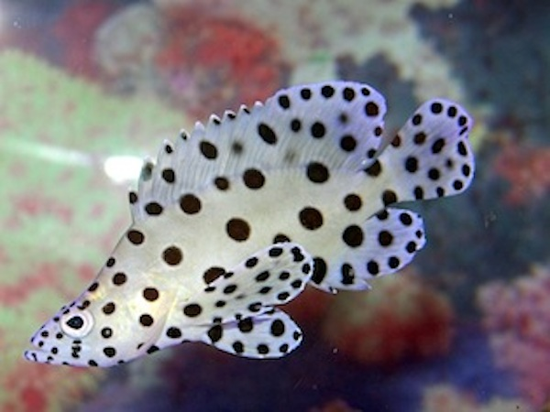
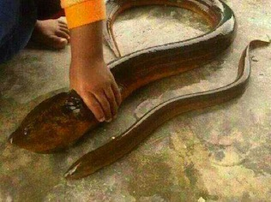
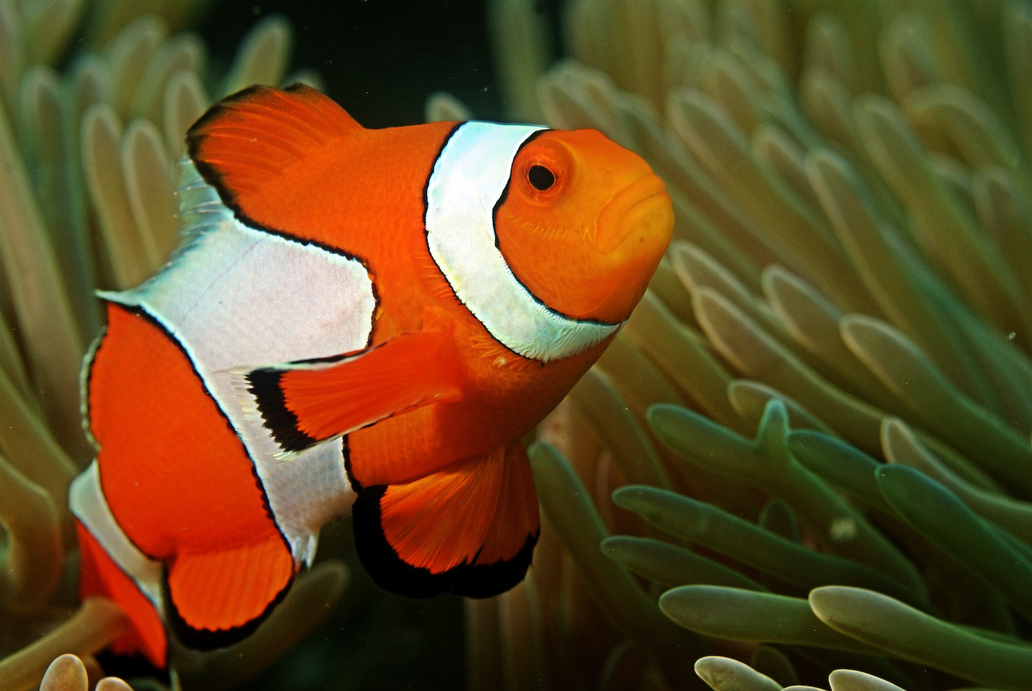
Gender change is common among fishes. Some species are simultaneously male and female, whereas others change from male to female, or from female to male (see Chapters 10, 21).
Panther grouper
Cromileptes altivelis
Swamp eel
Monopterus albus
Clownfish, Amphiprion ocellaris
Notes:
Gender change is common among fi shes. Some species
are simultaneously male and female, whereas others
change from male to female, or from female to male
(see Chapters 10, 21).

Slide 12
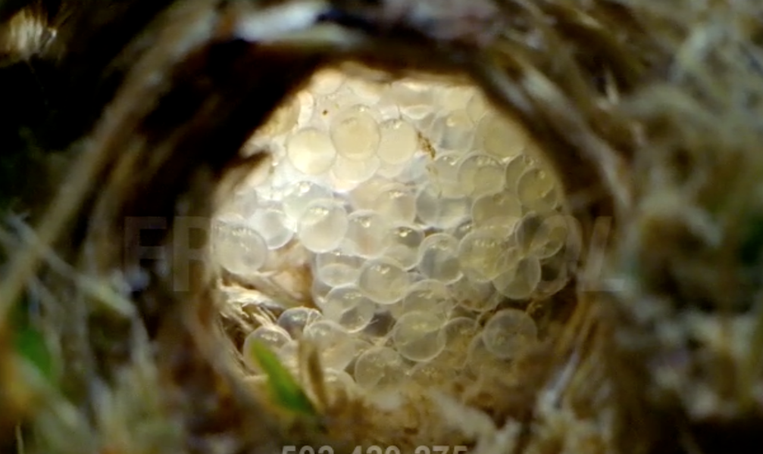
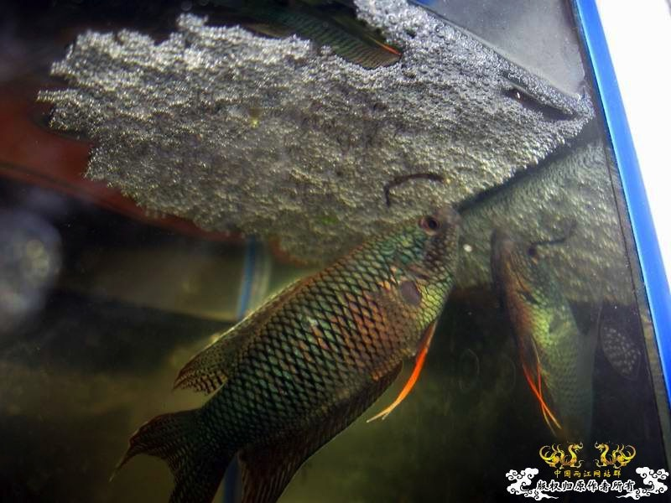
Fishes engage in parental care that ranges from simple nest guarding to mouth brooding to the production of external or internal body substances upon which young feed.
Many sharks have a placental structure as complex as any found in mammals.
Egg-laying fishes may construct nests by themselves, whereas some species deposit eggs in the siphon of living clams, on the undersides of leaves of terrestrial plants, or in the nests of other fishes (see Chapters 12, 21).
Notes:
Fishes engage in parental care that ranges from simple
nest guarding to mouth brooding to the production of
external or internal body substances upon which
young feed. Many sharks have a placental structure as
complex as any found in mammals. Egg-laying fi shes
may construct nests by themselves, whereas some
species deposit eggs in the siphon of living clams, on
the undersides of leaves of terrestrial plants, or in the
nests of other fi shes (see Chapters 12, 21).

Slide 13
Fishes are unique among organisms with respect to the use of bioelectricity. Many fishes can detect biologically meaningful, minute quantities of electricity, which they use to find prey, competitors, or predators and for navigation.
Some groups have converged on the ability to produce an electrical field and obtain information about their surroundings from disturbances to the field, whereas others produce large amounts of high-voltage electricity to deter predators or stun prey (see Chapters 6, 19, 20).
Notes:
Fishes are unique among organisms with respect to
the use of bioelectricity. Many fi shes can detect
biologically meaningful, minute quantities of
electricity, which they use to fi nd prey, competitors, or
predators and for navigation. Some groups have
converged on the ability to produce an electrical fi eld
and obtain information about their surroundings from
disturbances to the fi eld, whereas others produce large
amounts of high-voltage electricity to deter predators
or stun prey (see Chapters 6, 19, 20).

Slide 14


Slide 15
Fishes are unique among vertebrates in their ability to produce light; this ability has evolved independently in different lineages and can be either autogenic (produced by the fish itself) or symbiotic (produced by bacteria living on or in the fish) (see Chapter 18).
Notes:
Fishes are unique among vertebrates in their ability to
produce light; this ability has evolved independently in
different lineages and can be either autogenic
(produced by the fi sh itself) or symbiotic (produced by
bacteria living on or in the fi sh) (see Chapter 18).

Slide 16


Slide 17
Although classically thought of as cold-blooded, some
pelagic sharks and tunas maintain body temperatures warmer than their surroundings and have circulatory systems specifically designed for such temperature maintenance (see Chapter 7).
Notes:
Although classically thought of as cold-blooded, some
pelagic sharks and tunas maintain body temperatures
warmer than their surroundings and have circulatory systems specifi cally designed for such temperature
maintenance (see Chapter 7).

Slide 18
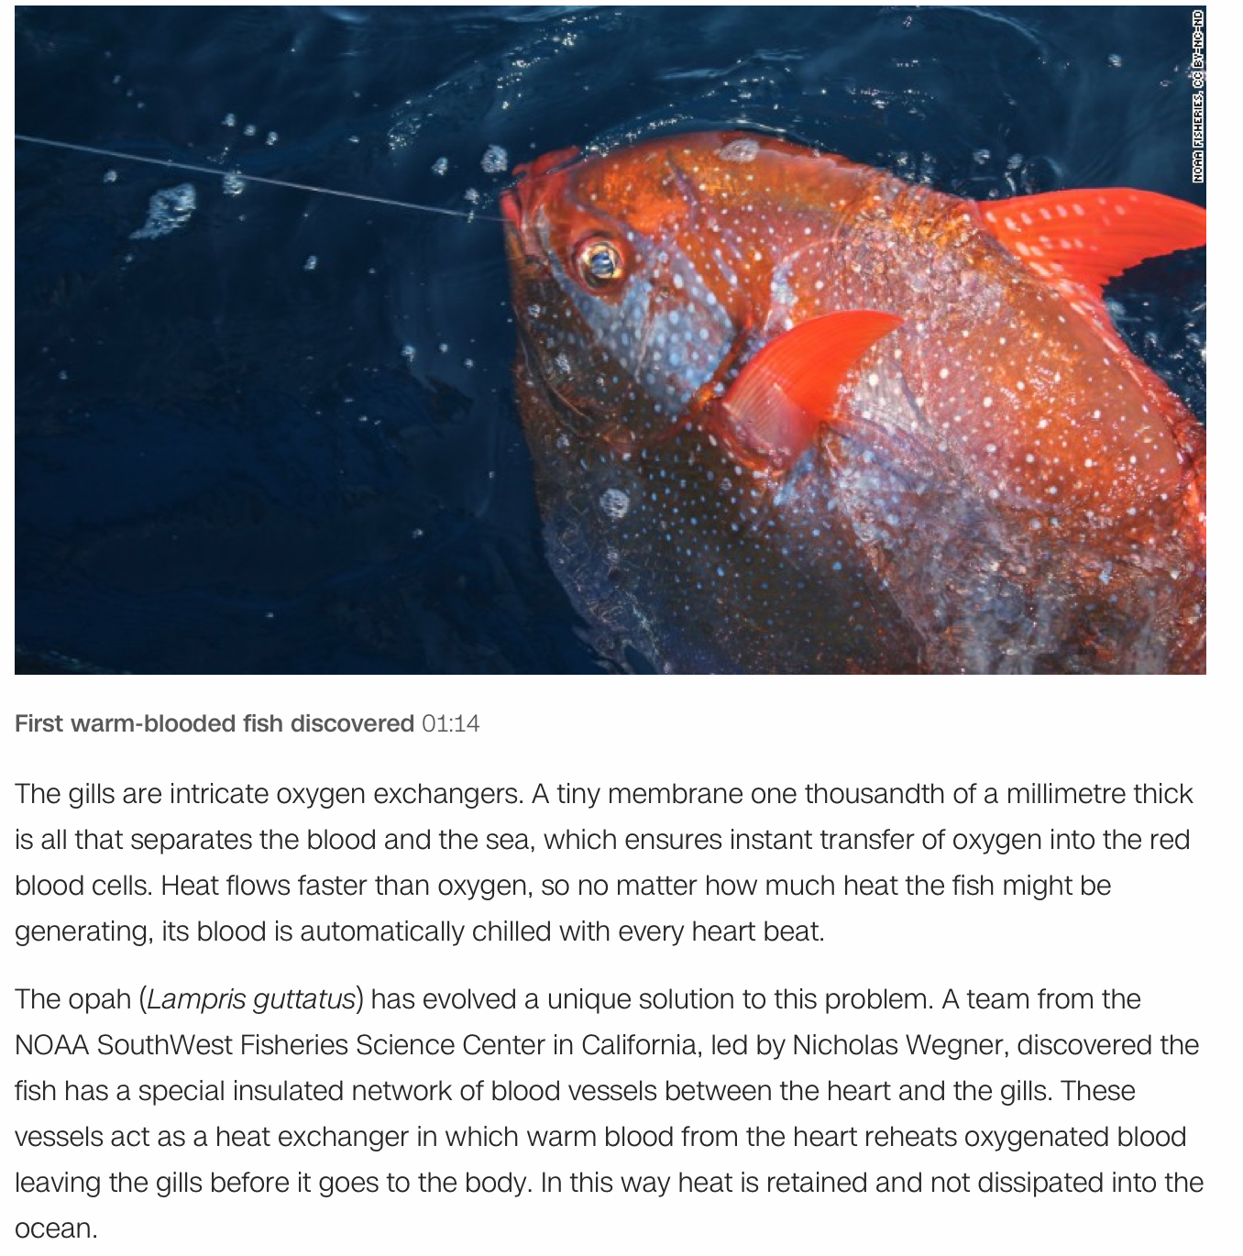

Slide 19
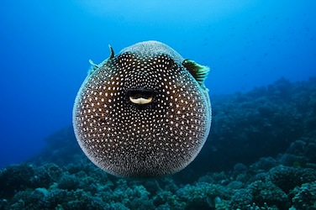
Fishes can significantly change the depth of their bodies by erecting their fins or by filling themselves with water, an effective technique for deterring many predators.
In turn, the ligamentous and levering arrangement of mouth bones in some fishes allows them to increase mouth volume when open by as much as 40-fold (see Chapters 8, 20).
Notes:
Fishes can signifi cantly change the depth of their
bodies by erecting their fi ns or by fi lling themselves
with water, an effective technique for deterring many
predators. In turn, the ligamentous and levering
arrangement of mouth bones in some fi shes allows
them to increase mouth volume when open by as
much as 40-fold (see Chapters 8, 20).

Slide 20

Predatory tactics include attracting prey with modified body parts disguised as lures, or by feigning death. Fishes include specialists that feed on ectoparasites, feces, blood, fins, scales, young, and eyes of other fishes (see Chapters 19, 20).
Frogfishes & Anglerfishes (Antennaridae)
Notes:
Predatory tactics include attracting prey with modifi ed
body parts disguised as lures, or by feigning death.
Fishes include specialists that feed on ectoparasites,
feces, blood, fi ns, scales, young, and eyes of other
fi shes (see Chapters 19, 20).

