Slide 1
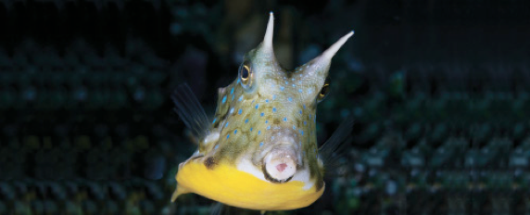
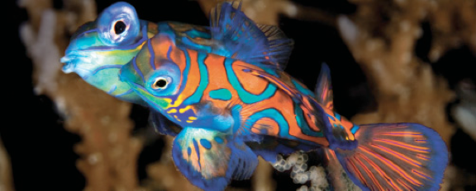
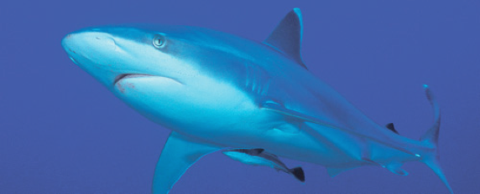
Lesson 5
Oxygen, Metabolism and Energetics
Ichthyology
Shanghai Ocean University
Fall, 2025

Slide 2
Metabolic rate
Metabolic rates can be influenced by a variety of factors, including
  Age
  Sex
  Reproductive status
  Food in the gut
  Physiological stress
  Activity
  Season
  Temperature

Slide 3
Metabolic rate
Standard metabolic rate is often defined as the metabolic rate of a fish while it is at rest and has no food in its gut
routine metabolic rate is often used to indicate that the rate was measured during routine activity levels
The difference between the standard metabolic rate and the maximum metabolic rate at any given temperature is known as the metabolic scope

Slide 4
Measure metabolic rate
Oxygen consumption
Why is it useful to measure metabolic rate?

Slide 5
Energetics
Swimming
Buoyancy regulation
Energy intake
Bioenergetics models

Slide 6
Minimize the cost of swimming
regulate buoyancy by regulating the size of the gas bladder
  Physostomous
  Physoclistous
  cartilaginous skeleton in elasmobranchs, squalene, wax esters,

Slide 7
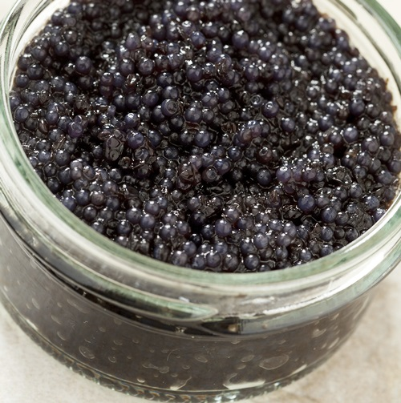
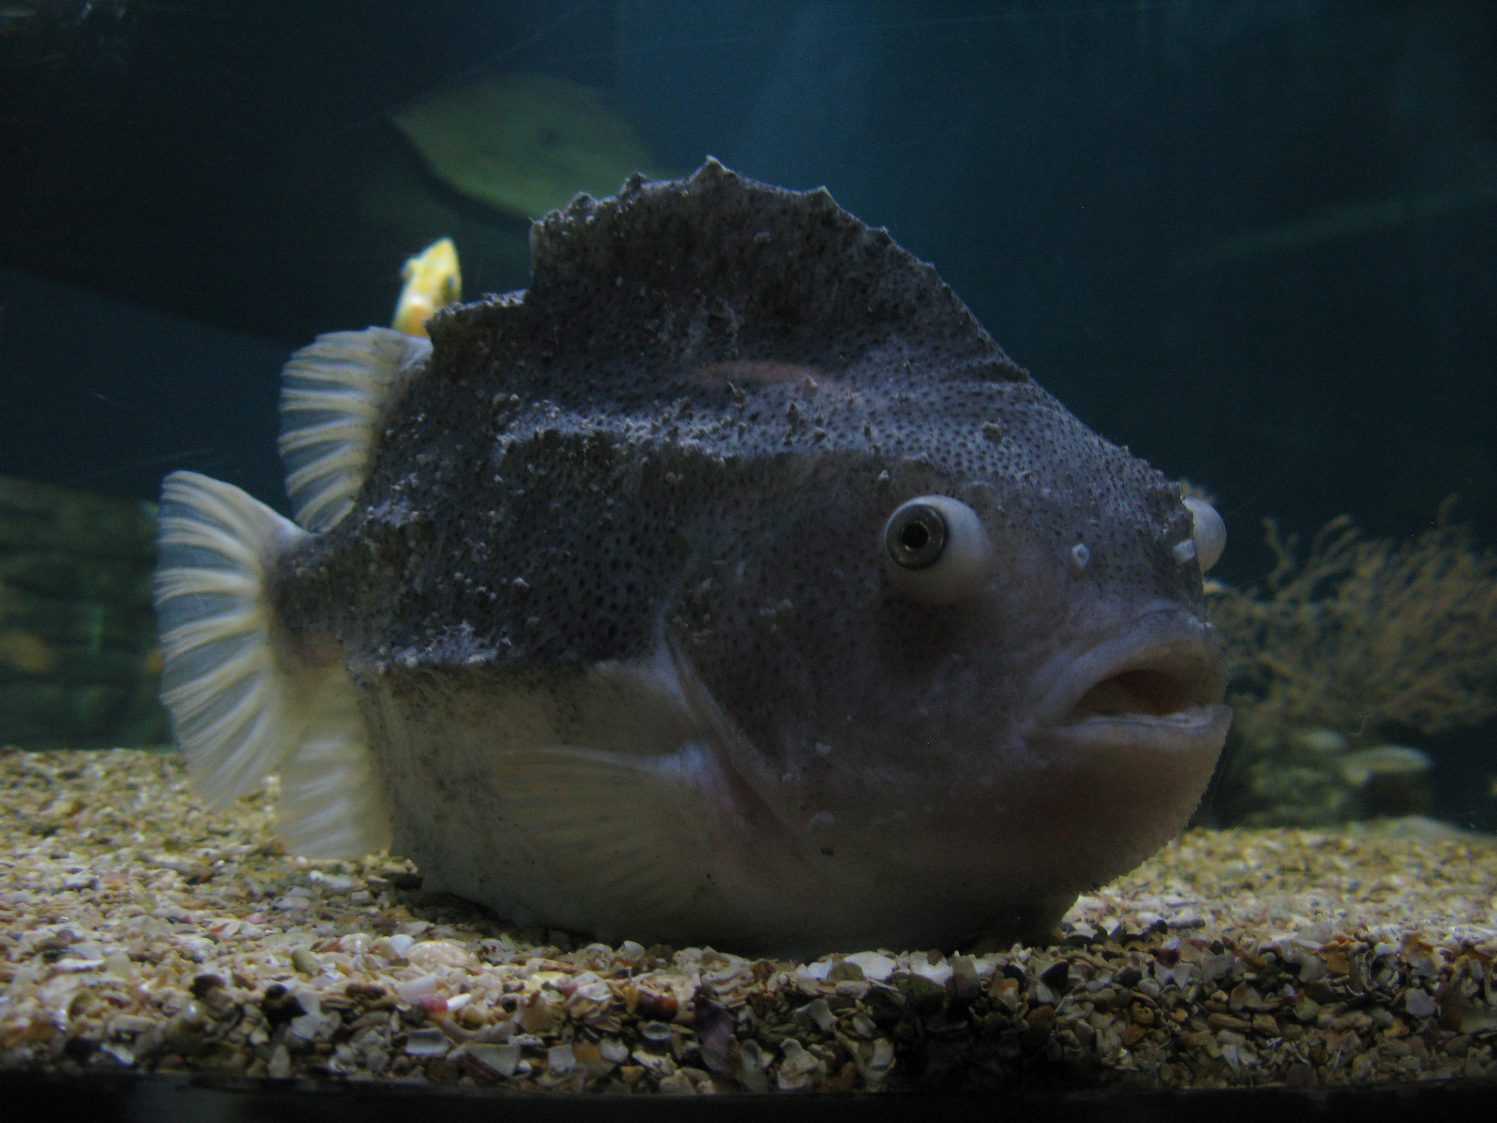
The lumpfish (Cyclopterus lumpus)

Slide 8
Energy intake
Food is taken into the mouth and passed down the esophagus into the stomach
Most fishes lack a mechanism for chewing food in the mouth, much of the physical breakdown takes place in the stomach
pharyngeal teeth grind up food
Acidic secretions of the stomach help to further break down foods; proteolytic enzymes also function more efficiently at lower pH

Slide 9
Energy intake
Bile from the liver helps emulsify lipids
Pancreatic juice contains bicarbonate to neutralize the acid from the stomach and a wide variety of enzymes to complete the process of chemical digestion
The small intestine is also the primary site of absorption
  Elasmobranchs have spiral valve
  Some teleosts have pyloric caecae
large intestine, this last major portion of the gut functions primarily in water absorption.

Slide 10
顾敖
  What is bioenergetics model? Please give an example of studies on bioenergetics model in fish.

Slide 11
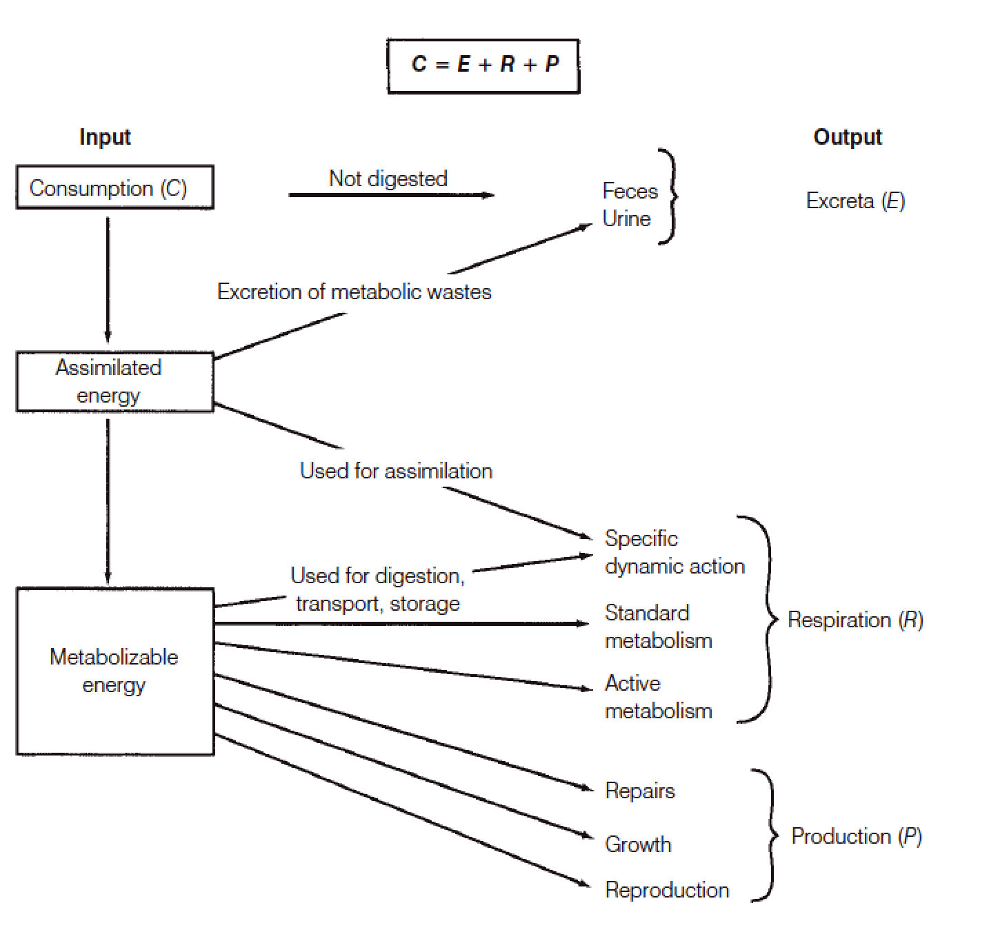
Bioenergetics models

Slide 12
Summary
Fishes need oxygen to provide energy for physiological function. In the presence of oxygen, far more energy can be derived from the metabolism of glucose than is possible in the absence of oxygen. Although anaerobi metabolism can provide some energy, it also results in the build up of lactate, which can inhibit further metabolism.
Water’s high density and viscosity, as compared to air, make it a difficult medium to move across respiratory surfaces. Water also contains considerably less oxygen than air, especially at elevated temperatures. Fish gills provide a large surface area for gas exchange, and the countercurrent flow of blood and water across the lamellae maximizes the efficiency of gas exchange by diffusion. Some fishes have special adaptations to allow them to breathe air.

Slide 13
Summary
Blood transport of carbon dioxide and oxygen is closely linked because of hemoglobin’s sensitivity to pH. At metabolically active tissues, high levels of carbon dioxide result in lower pH, which enhances the release of oxygen by hemoglobin. The loss of carbon dioxide to the surrounding water at the gills results in an increase in pH, enhancing hemoglobin’s ability to bind oxygen
Metabolism is influenced by a wide variety of factors, including the presence of food in the gut, activity, age, sex, reproductive status, temperature, and season. Because of the impacts of these numerous factors, metabolic studies of fishes acclimated to controlled laboratory conditions may not accurately represent the metabolic rates of fishes in nature.

Slide 14
Summary
Many fishes that live in the water column use buoyancy control mechanisms, such as the addition or release of gases from the gas bladder, to save energy.
Energy in food is made available by digestion. Although some mechanical breaking down of food is accomplished in the mouth or pharynx of some fishes, most digestion takes place in the stomach and intestine. The intestines also function in nutrient uptake. Some fishes that feed on plants rely on symbiotic microorganisms in the gut to help break down their food.

Slide 15
Summary
Energy budgets indicate how the energy that is consumed is allocated. Some of the energy in food is not digestible and is subsequently excreted. Of the energy that is digested and absorbed, some must be used for basic metabolism and maintenance. Energy remaining after basic needs have been met can be used for growth and reproduction.

Slide 16
The term paper
Note that introduction, general description and a preliminary list of references are due on Nov 5
You must have at least ten – and at least five of those must be from SCI journals
  百度学术、sciencedirect、webofscience…
Sent to me by email, chli@shou.edu.cn

Slide 17
The Science Citation Index (SCI)
A citation index originally produced by the Institute for Scientific Information (ISI) and created by Eugene Garfield.
The journal impact factor (IF) in a given year is the ratio of the number of times the paper is cited in the preceding two years divided by paper published.
In recent years, research publication in Science Citation Index (SCI) journals with impact factor (IF) has become a prerequisite for a researcher or a professional seeking placement in reputed academia or research organizations.

Slide 18
References
Citation in text - Please ensure that every reference cited in the text is also present in the reference list (and vice versa).
Web references - As a minimum, the full URL should be given and the date when the reference was last accessed.

Slide 19
References
Reference to a journal publication: Van der Geer, J., Hanraads, J.A.J., Lupton, R.A., 2010. The art of writing a scientific article. J. Sci. Commun. 163, 51–59.
Reference to a book: Strunk Jr., W., White, E.B., 2000. The Elements of Style, fourth ed. Longman, New York.
Reference to a chapter in an edited book: Mettam, G.R., Adams, L.B., 2009. How to prepare an electronic version of your article, in: Jones, B.S., Smith , R.Z. (Eds.), Introduction to the Electronic Age. E-Publishing Inc., New York, pp. 281–304.
Reference to a website:Cancer Research UK, 1975. Cancer statistics reports for the UK. http://www.cancerresearchuk.org/aboutcancer/statistics/cancerstatsreport/ (accessed 13.03.03).

Slide 20
Presentation for next week
(Nov 14)
张鑫喨
  Describe what does thyroxin do and give two examples in different species
刘语涵
  Explain osmoregulation in elasmobranchs, freshwater and marine teleosts.
施瀚阳
  What are the innate and adaptive immune systems?

Slide 21
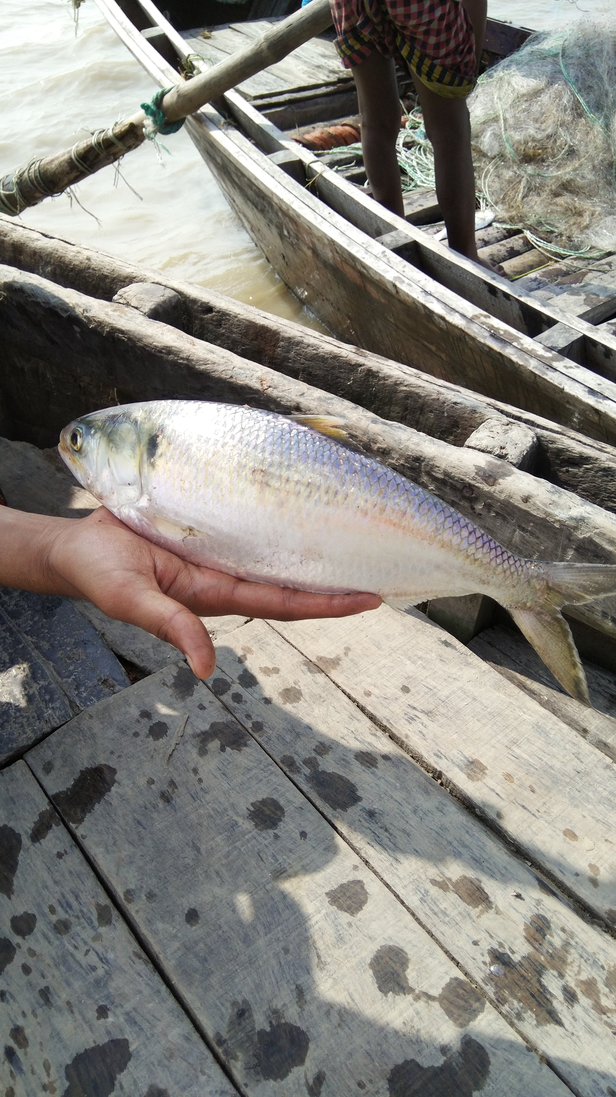
Have a nice week!
Hilsa shad (Tenualosa ilisha), Bangladesh

Slide 22
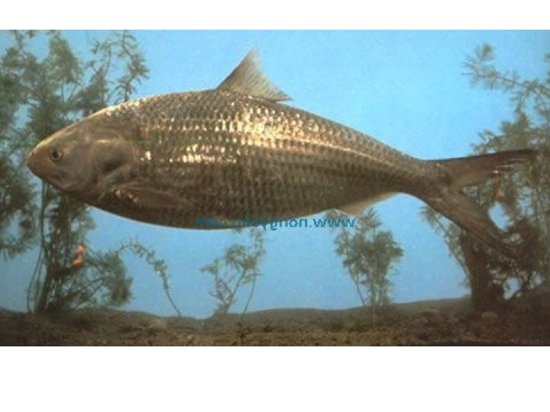
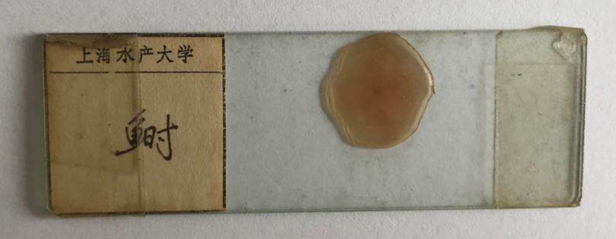
Tenualosa reevesii

