Slide 1
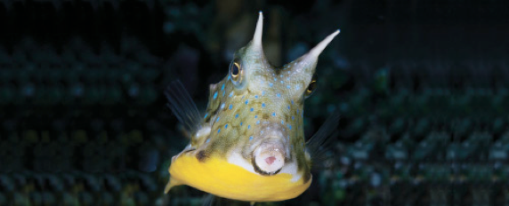
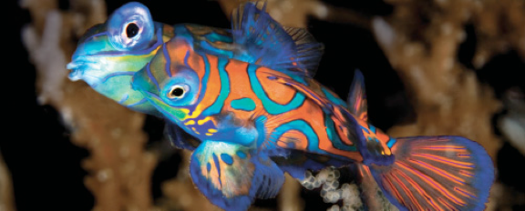

Lesson 1
Introduction to fishes, history of ichthyology and systematics
Ichthyology
Shanghai Ocean University
Fall, 2025

Slide 2
1.4 History and Taxonomy

Slide 3
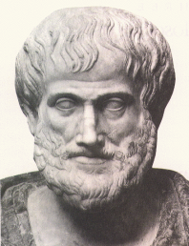
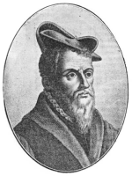
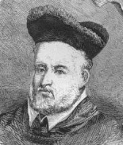
History of Ichthyology
Aristotle (384-322 B.C.)
Made many astute observations on fish biology
Recognized >100 species of fish
No major advances for ≈ 1900 years!
Pierre Belon
French natural
historian
1551
First publication
On fish systematics
Hippolyto Salviani
1554-1557
First publications on regional fishes (Italy)
Guillome Rondelet
1555
Libri de Piscibus Marinis
First ichthyology ‘text’
http://www.septentrion.qc.ca/banque-images/resultats-images.asp?id=2513

Slide 4

History of Ichthyology
Many reports from expeditions followed…
Natural History of Fishes of Brazil; Marcgrave, 1648
Historia Piscium (European fishes); Ray & Willughby, 1686 – described 420 species, 178 new!
Peter Artedi (1704-1734, Swedish naturalist)
> “Father of Ichthyology” – came up with the first
classification system for fishes, published as part of
Systema Naturae in 1739 by…
Kingdom
Phylum
Class
Order
Family
Genus
Species
Carolus Linnaeus (1707-1778, Swedish zoologist)
Classification system for all major life forms
Introduced binomial system for naming species
“Father of modern taxonomy”

Slide 5
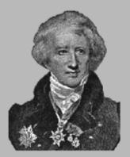

History of Ichthyology
Others of note…
Georges Cuvier (1769-1822); Histoire Naturelle
des Poissons, 1828
Professor at French Museum of Natural History;
Detailed studies of anatomy paved way for better understanding of relationships between fishes (cladistics)
As knowledge continued to expand, regional studies followed…
Louis Aggasiz (1807-1873); Professor of Natural History at Harvard; described numerous extant and fossil fish species
Heterandria formosa Agassiz
Genus
species
Taxonomist
(who described)

Slide 6
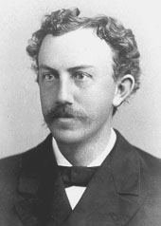

History of Ichthyology
Others of note…
David Starr Jordan (1851-1931); Founding President of Stanford University ; most influential of all North American ichthyologists;
Collected & described fishes throughout North America and down into Central America
Carl Hubbs (1894-1979); studied at Stanford, refined Jordan’s work; Taught at Scripps Institute in CA; authored 712 publications!!! (focus on NA fish)
Clark Hubbs (1921-2008); also studied at Stanford, spend most of career at University of Texas; influential studies of SW fishes; examined geographic variation in life history traits

Slide 7
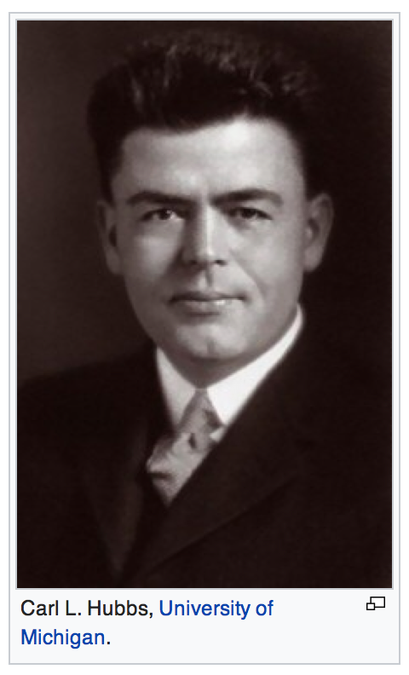
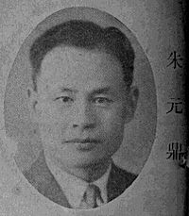
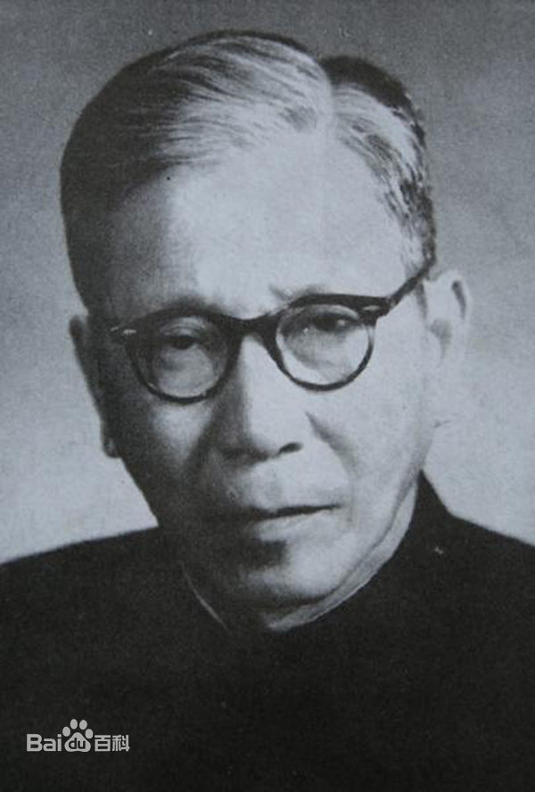
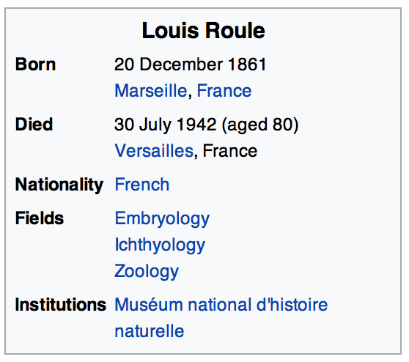
Key of Chinese Fishes
Zhu Yuanding
Shanghai Ocean University
Chinese Cypriniformes
Wu Xianwen
Institute of Hydrobiology, CAS

Slide 8
Siniperca roulei Wu 1930 in honor of Louis Roule (1861-1942), chair of the ichthyology and herpetology departments, Muséum national d’histoire naturelle (Paris), in whose laboratory Wu conducted his studies

Slide 9

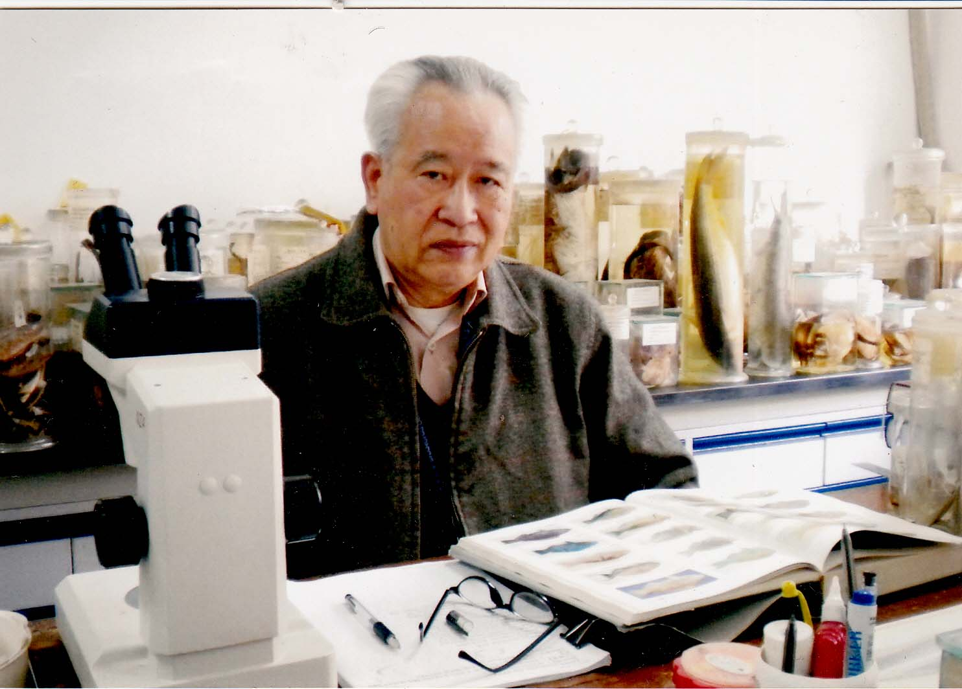


History of Ichthyology
A few that I have worked with…
Wu, Hanlin; SOU
Systematics of Chinese gobies
Frank Pezold; Texas A&M – CC
Systematics and Phylogeography
of gobies
Guillermo Orti; George Washington University
Molecular Systematics of Ray-finned Fishes

Slide 10

Orti Lab

Slide 11

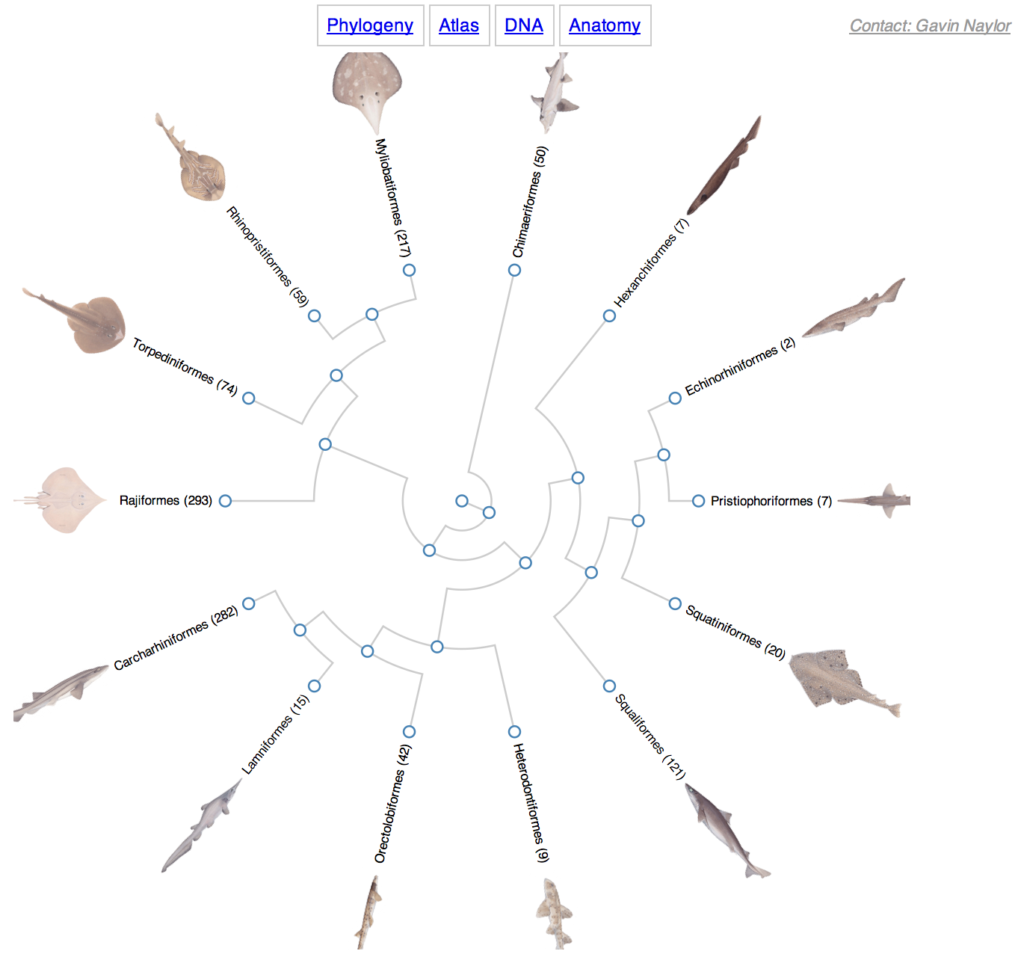
History of Ichthyology
Gavin Naylor; College of Charleston
Shark tree of life, https://sharksrays.org

Slide 12
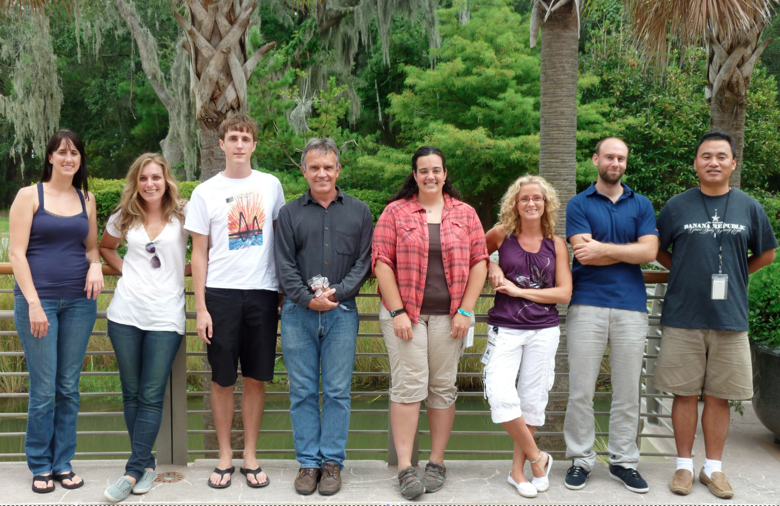
Naylor Lab

Slide 13
Fish Systematics and Classification
Hmm…what does that mean?
Lets start with taxonomy
= the science of describing and naming organisms
taxonomy
classification = placing organisms into ‘logical groups’
systematics = the study of evolutionary relationships between organisms
Linnaean system of classification – based on broad physical similarities
Ok some of the time, but doesn’t always accurately reflect relationships. For instance…

Slide 14

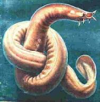

Fish Systematics and Classification
Phylogenetic systematics = systematic use of actual physical data to estimate relationships
Agnatha = ‘jawless fish’
hagfishes
lampreys
jawed fishes
Cladogram = branching diagram to indicate relationships between organisms

Slide 15
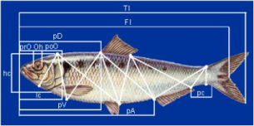
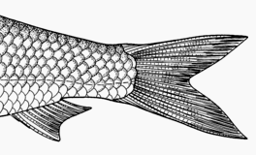
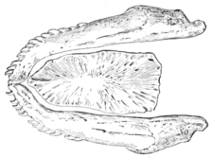
Fish Systematics and Classification
What characters do we use to determine these relationships and to classify fishes (describe species?
Historically, only physical characters (i.e., morphology)…
Morphometrics
(body measurements)
Meristics
(traits that can be counted; e.g., scales)
Others
Color patterns, anatomical characteristics, etc.

Slide 16
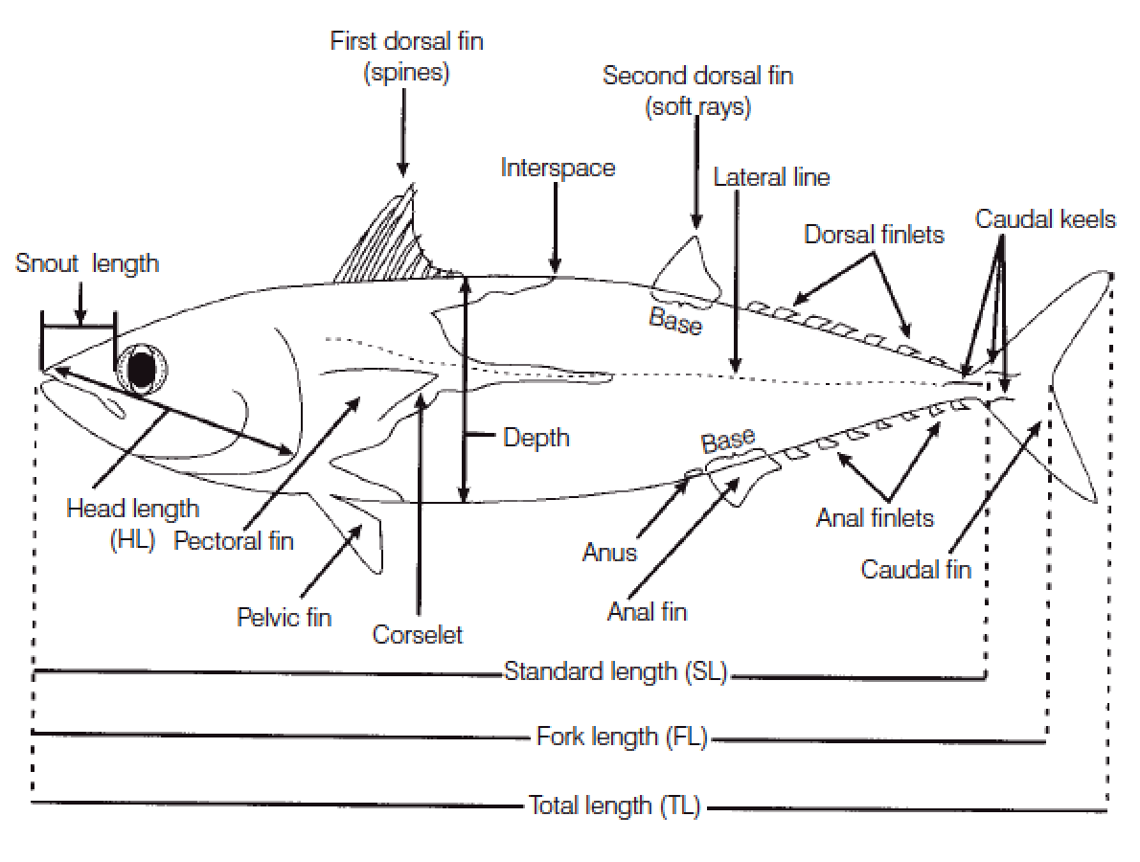

Slide 17
Fish Systematics and Classification
So… how do we “do” systematics with these characters?
In simple terms, traits are scored as (may be presence/absence, variation in length or number) and placed in a table, then relationships calculated:
lamprey
Species | Trait 1 | Trait 2 | Trait 3 | Trait 4 | Trait 5
A | X | X
B | X | X | X | X
C | X | X | X | X | X
jawed fishes
hagfish

Slide 18
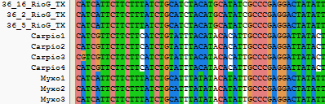
Fish Systematics and Classification
What characters/characteristics do we use to determine these relationships?
Now we use those same classical characters, but we also depend heavily on DNA.
DNA is the genetic material for living things
Only 4 different building blocks: A T C G

Slide 19
Quick review
Hmm…what does that mean?
taxonomy
= the science of describing / naming organisms
classification = placing organisms into ‘logical groups’
systematics = the study of evolutionary relationships between organisms
Linnaean system of classification – based on broad physical similarities
Ok some of the time, but doesn’t always accurately reflect relationships. For instance…

Slide 20
HWK
Homework 1.docx
  due on the day before next class
  No late hand-in will be graded
Read Chapter 3

Slide 21
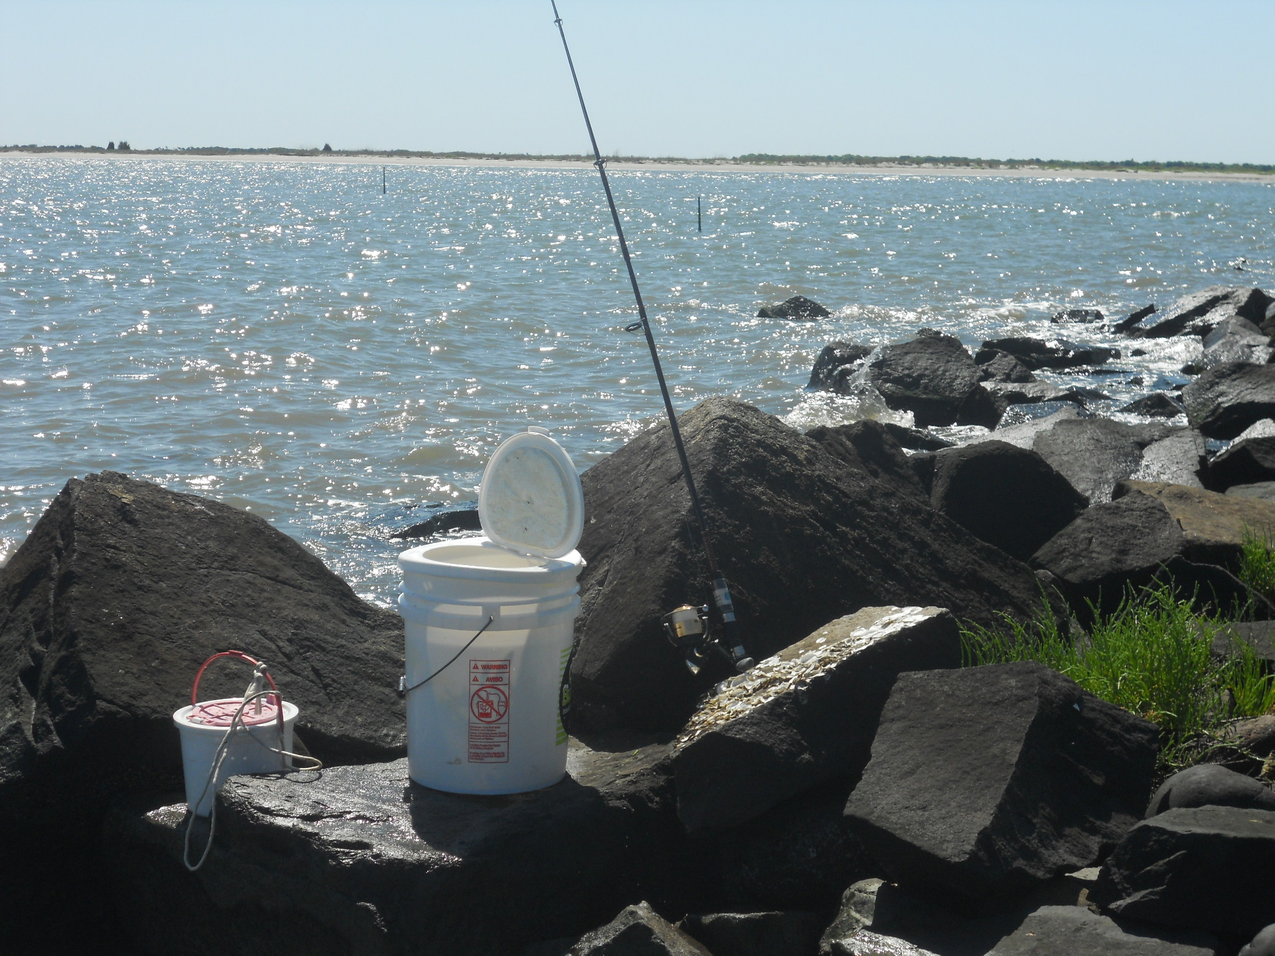
Have a nice week!
Charleston, SC, USA

