Slide 1
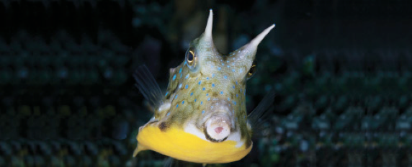
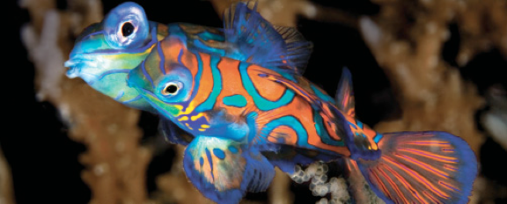
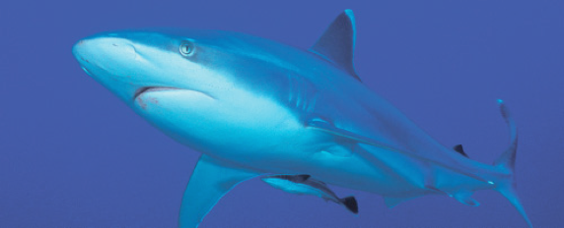
Lesson 1
Introduction to fishes, history of ichthyology and systematics
Ichthyology
Shanghai Ocean University
Fall, 2025

Slide 2
Course Overview / Objectives
Demonstrate a familiarity with the major families of fishes.
Demonstrate knowledge of the anatomy, physiology, and behavior of fishes.
Diagram the most widely accepted hypotheses of relationships among major groups of fishes.

Slide 3
Course Overview / Objectives
Describe fundamental themes in behavior and ecology of fishes.
Explain how the fisheries industry has impacted the stocks of fish species, and how management efforts have attempted to correct this problem.
Have a lot of fun learning a WHOLE lot more about the fishes around you!

Slide 4
1.2 Introduction of Fishes

Slide 5
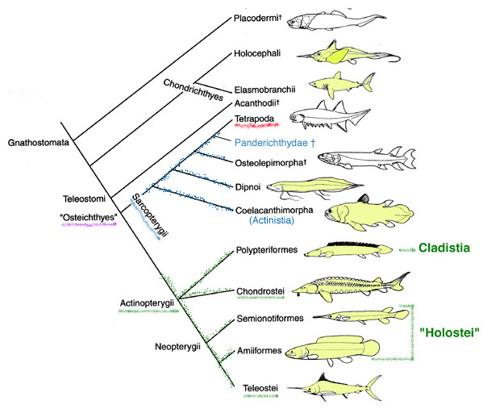
Gnathostome Phylogeny
In terms of phylogeny, some fishes are more closely related to tetrapods than they are to (some) other fishes.

Slide 6
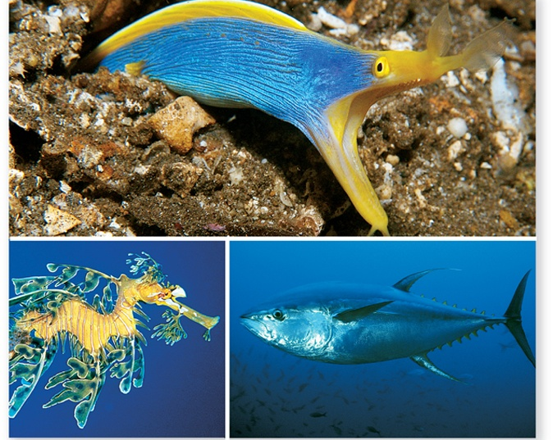
Fishes
Fishes are the most diverse vertebrate group
-Over half of all vertebrates
-Vary greatly in size, shape, color and appearance

Slide 7
Why study fishes?
Fascination
Food source
Ecological Function
Medicine
Tremendous diversity!
Others?

Slide 8
DIVERSITY
Easily the most diverse group of vertebrate
> 30,000 species!
Birds ≈ 10,000
Reptiles ≈ 8,000
Amphibians ≈ 6,000
Mammals ≈ 5,000

Slide 9


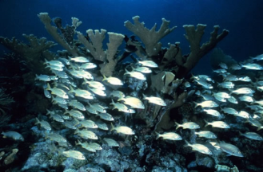
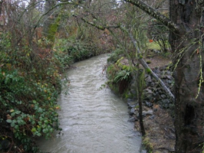

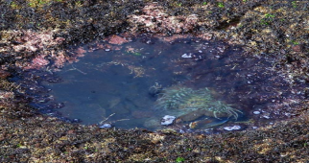
DIVERSITY

Slide 10
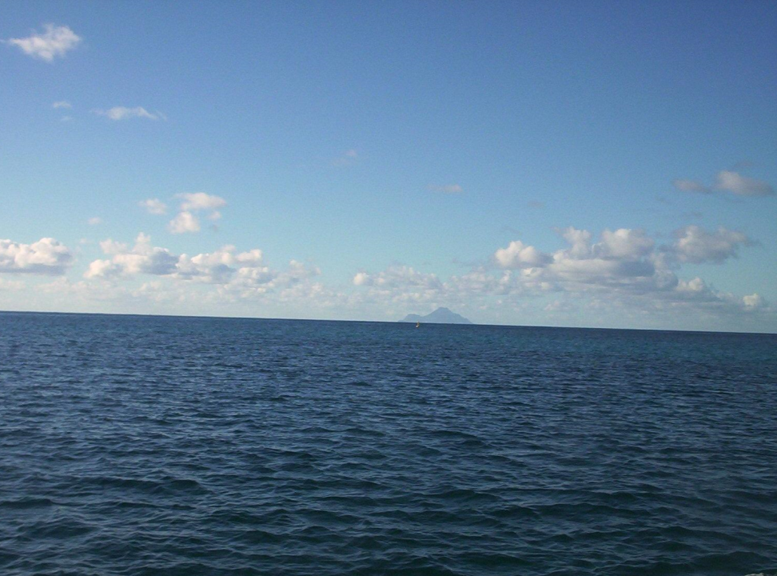
DIVERSITY contd.
Water
97% in oceans, only ,
<1% in lakes and streams, but…
≈ 41% of all fish species occur in fresh water
≈ 1% catadromous or anadromous (go between)
≈ 58% of all fish species occur in oceans
1. Open ocean resource depauperate
Why?
2. FW systems discontinuous

Slide 11
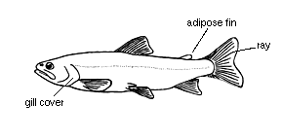
DIVERSITY contd.
Although such great diversity, most fish have recognizable form…
Physical constraints of aquatic environment
Why?
Water is really dense; also, barely compressible!

Slide 12
Other ‘challenges’…
Low penetrability to light.
Water is universal solvent, but carries relatively little oxygen compared to air
There are also advantages!
Because of slight compressibility, sound & lower frequency vibrations carry well.
> Fish have great hearing!
> Also, have an extra sense via the lateral line (= ‘distant touch’)

Slide 13
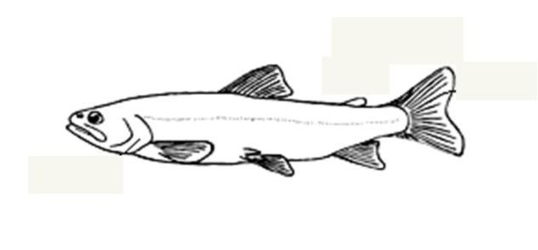
Lateral line

Slide 14
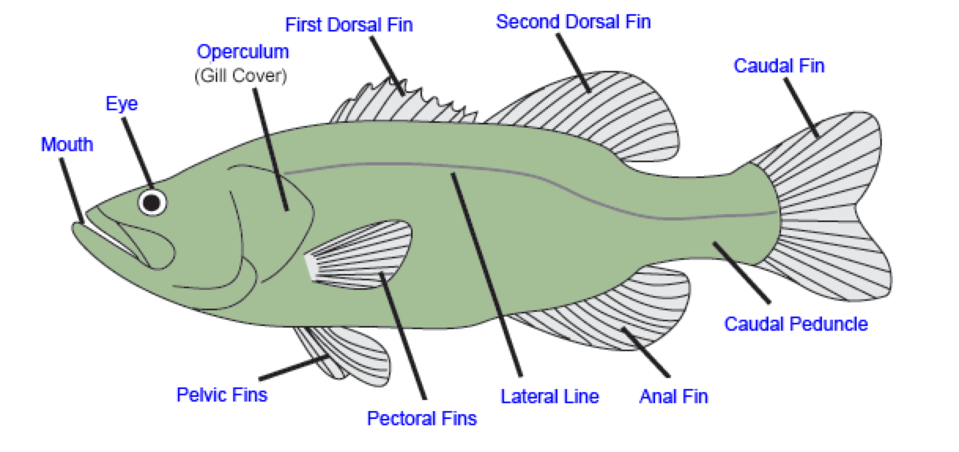
External structure

Slide 15
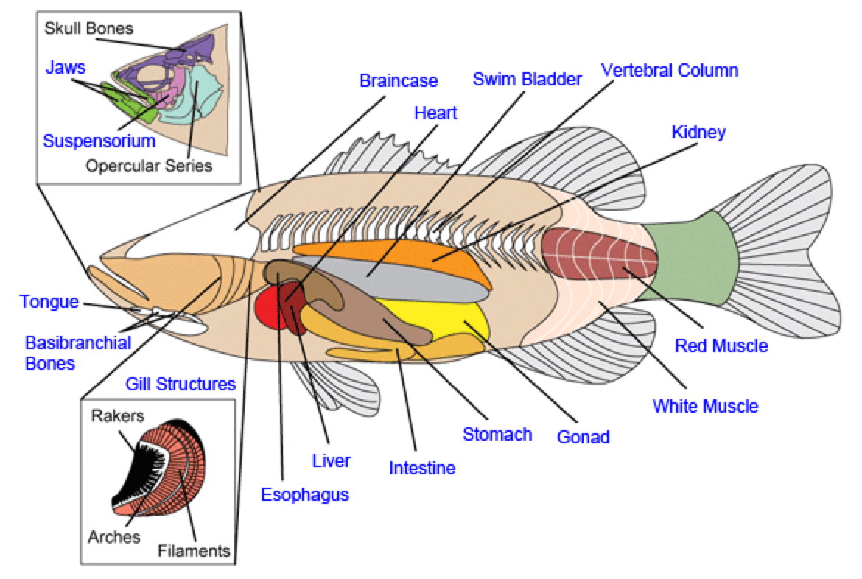
Inner structure

