Slide 1
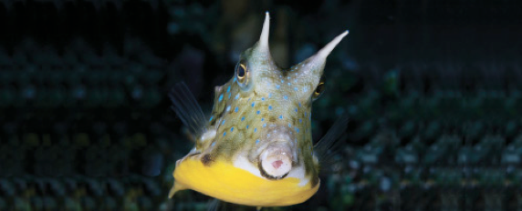
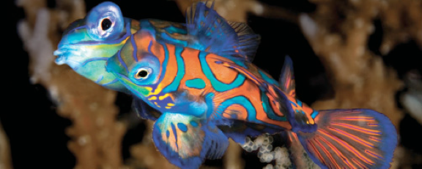
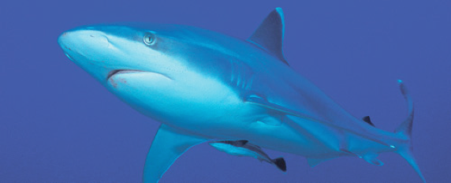
Lesson 1 Introduction to fishes, history of ichthyology and systematics
Ichthyology
Shanghai Ocean University
Fall, 2025

Slide 2
1.1 Course Introduction

Slide 3
李晨虹
主讲课程：《鱼类学》《生物信息》《分子系统和生态》
研究方向：鱼类的系统演化、分子生态
办公地点：生命学院A楼209
联系方式：chli@shou.edu.cn 15692161233
答疑时间与地点：邮件或电话预约
1993，上海水产大学，水生生物，理学士
1996，上海水产大学，水产养殖，硕士
2007，University of Nebraska – Lincoln, Biology, PhD
2012，上海海洋大学，教授

Slide 4
Kishor Kumar Sarker
主讲课程：《鱼类学》
研究方向：比较基因组学、鲱形目进化
办公地点：生命学院A楼210
联系方式：kishorssf91@gmail.com 18621974360
答疑时间与地点：邮件或电话预约
2014 孟加拉国贾格纳特大学 学士 动物学
2016 孟加拉国贾格纳特大学 硕士 动物学
2022 上海海洋大学 博士 生物学
2022- 上海海洋大学 博士后 生物学

Slide 5
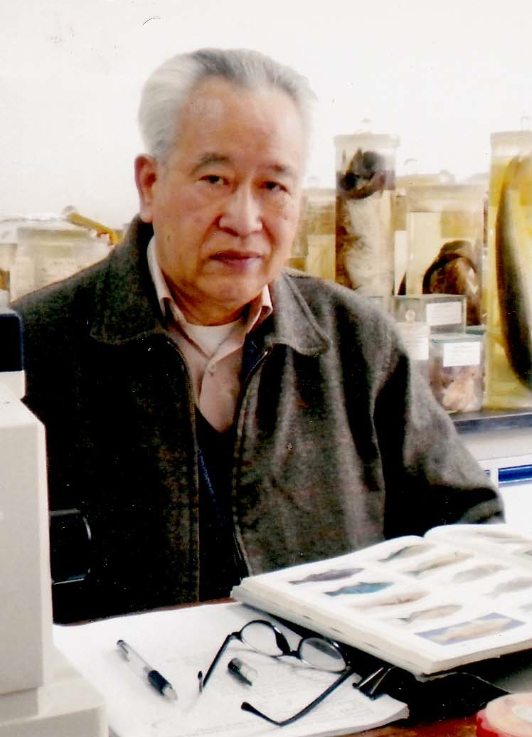
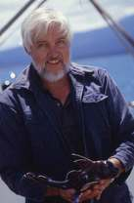
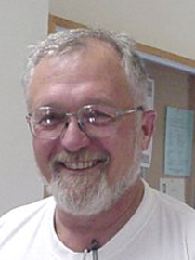
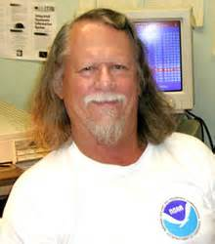
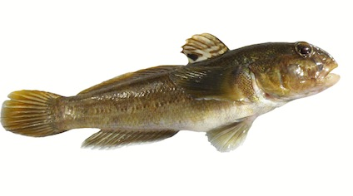
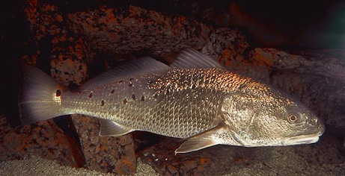
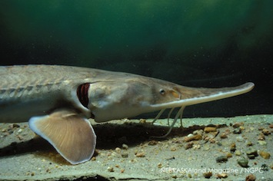
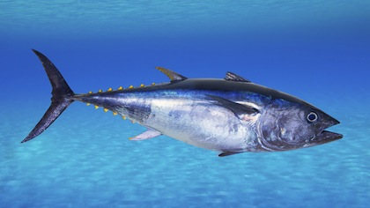
伍汉霖
上海水产大学
Hanlin Wu
SOU
Grant Gilmore
Florida Tech, NASA
Ed Peters
Univ. Nebraska
Bruce Colette
NOAA
Gobies
Red drum
Pallid sturgeon
Scomberids

Slide 6
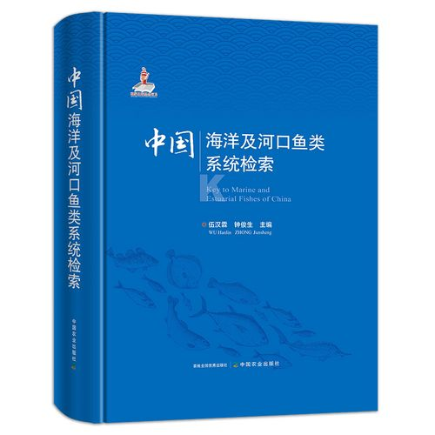

Slide 7
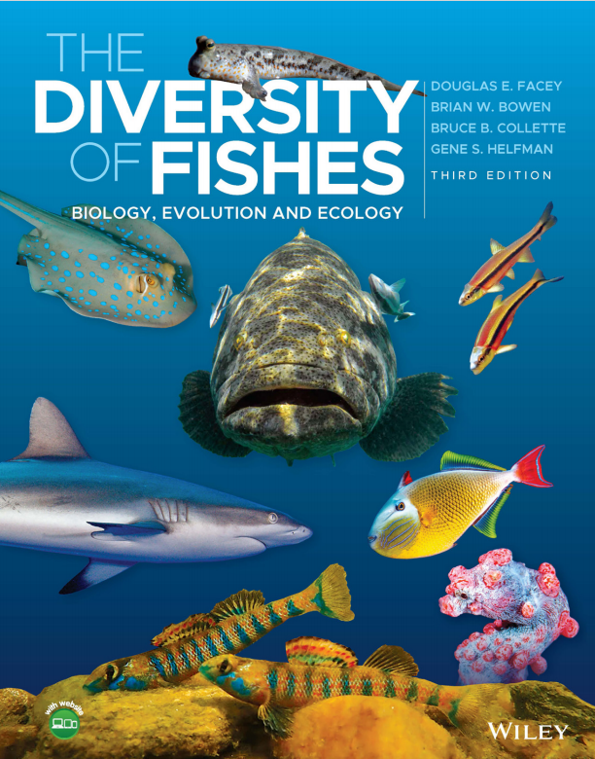
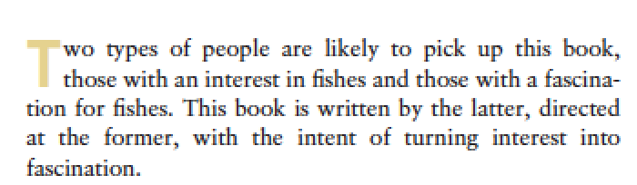
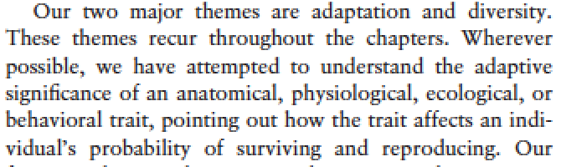

Slide 8
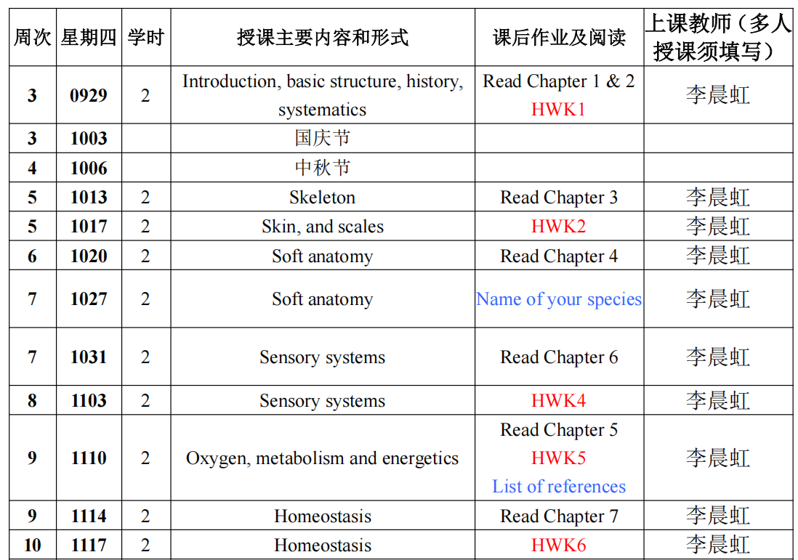

Slide 9
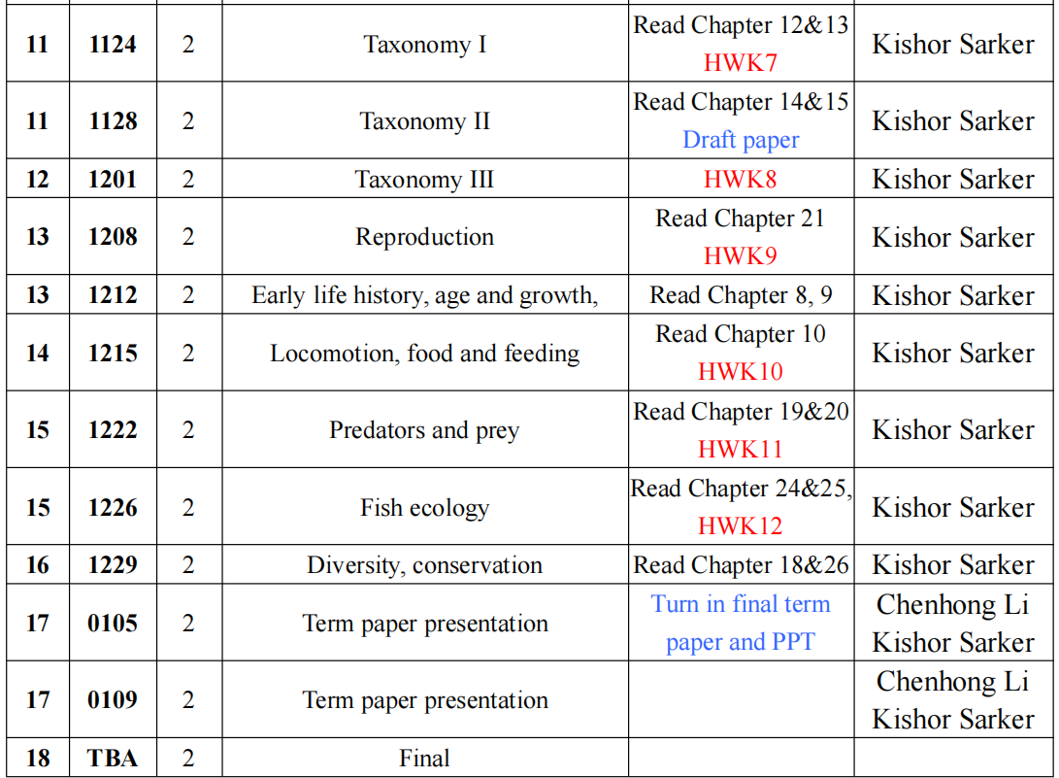

Slide 10

Resource you could use for this course
ppt slides from lectures
Lesson1_Intro…
…
the book
For further reading and as a reference
homework
homework1…
…
www.blyun.com
for journals
or other resources

Slide 11
Grading
Homework, 15%
Short lecture，5%
Term paper，30% (15% paper + 15% talk)
Final，50%

Slide 12
Short lecture
Each of you will give a chance to prepare a short lecture on a topic (~10 min)
I will announce the topics one weeks before the class.

Slide 13
Term paper
Life History Paper Instructions – 2025.pdf
Life History Paper example.pdf
example description and reference.pdf
example final paper.pdf
example presentation.ppt

Slide 14
Where to find credible information?
online:baidu.com, Google, www.bing.com
Journal paper
Electrical resources from library
DeepSeek?

Slide 15
Journals
Copeia
Transactions of the American Fisheries Society
Journal of Fish Biology
Ichthyologic Research
Zootaxa
Zookeys
Molecular Phylogenetics and Evolution
…

Slide 16
Learning in English
Why?
-access to broader information
-exchange ideas
-get prepared
How?
-spend more time
-learning English in English
http://dictionary.cambridge.org
https://ahdictionary.com
you can do it

Slide 17
Ichthyology [ˌɪkθɪ'ɒlədʒɪ]

Slide 18
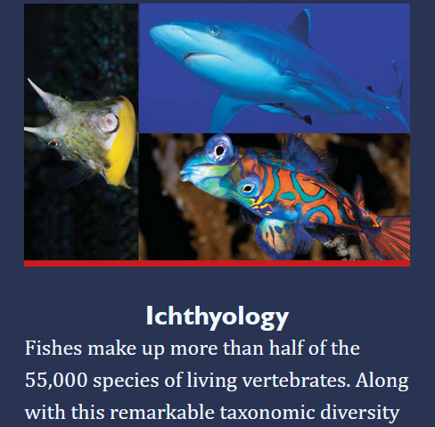
Website for lecture PPT http://lmse.org/learning/Ichthyology.html

Slide 19


